Slide 1
“In the Wild” Video Content as a Special Case of User Generated Content and a System for its Recognition
Mikołaj Leszczuk, Marek Kobosko, Jakub Nawała, Filip Korus, Michał Grega
Akademia Górniczo-Hutnicza im. Stanisława Staszica w Krakowie
AGH University of Krakow
23.06.2023

Slide 2
Large Volume & Demand
According to Cisco:
3-fold increase in IP traffic over the 5 years (from 2017)
82% of all IP traffic was IP video traffic (in 2022)

Slide 3
Upload Increase
According to Cisco:
the average internet user generated 84.6 GB of traffic per month (by 2022)
up 194% from 28.8 GB in 2017

Slide 4
Research on UGC Quality
UGC quality evaluation – very popular research topic nowadays
Clearly distinctive from general quality evaluation
But how to decide in advance if content is really UGC?

Slide 5
Content Type (Formerly)
Professionally-Generated Content (PGC)
User-Generated Content (UGC)

Slide 6
Professional Camera in Your Pocket

Slide 7
Content Type (Currently)
Content
Professionally-Generated Content (PGC)
In-The-Wild Distortions
User-Generated Content (UGC)
Synthetical Distortions

Slide 8
Characteristics of the In-The-Wild Content
Not professionally curated
Captured and processed by amateurs
Unstable camera motion
Captured with hand-held device
May contain other annoying distortions due to:
Out of focus,
Object motion, or
Under-/overexposure

Slide 9
Professional Content vs. “In the Wild“ Content

Slide 10
Database
Created based on content from video sequences (clips) posted on YouTube, by the various TV stations, including Euronews, France24 and BBC
Both professional and amateur shots (“in the wild”) extracted from these sources
Each video divided (cut) into shots and the shots manually labeled into individual categories
12067 resulting shots, of which 3535 belonging to the amateur category (”in the wild”)
Content of various resolutions is used: 144p, 360p, 720p and 1080p
Database available to download from: https://qoe.agh.edu.pl/user-generated-content-database/

Slide 11
Video Indicators Used in the Experiment
The frames belonging to one shot quite like each other
Having similar values of the video indicators
From each shot, the average of the video indicators is determined
Operating on 10-element vectors of indicators (single per shot)
Indicators available to download from: https://qoe.agh.edu.pl/
# | Name
1 | Blockiness
2 | Spatial Activity (SA)
3 | Block Loss
4 | Blur
5 | Temporal Activity (TA)
6 | Exposure (Brightness)
7 | Contrast
8 | Noise
9 | Slicing
10 | Flickering

Slide 12
Model Parameters
XGBoost classification performed using the Python XGBClassifier
Samples split in 80/20 ratio for training/testing
Performed binary classification
Early stopping parameter used in training to prevent over-fitting
Metrics used for evaluation:
Precision
Recall
F1-score
Cross validation performed

Slide 13
Model Tuning
Parameter | Value
max_depth | 10
scale_pos_weight | 0.6
learning_rate | 0.12
reg_lambda | 0.7
colsample_bytree | 0.7
gamma | 0.3
Using 6 parameters to tune the model
GridSearch is used to determine the optimal values of the parameters

Slide 14
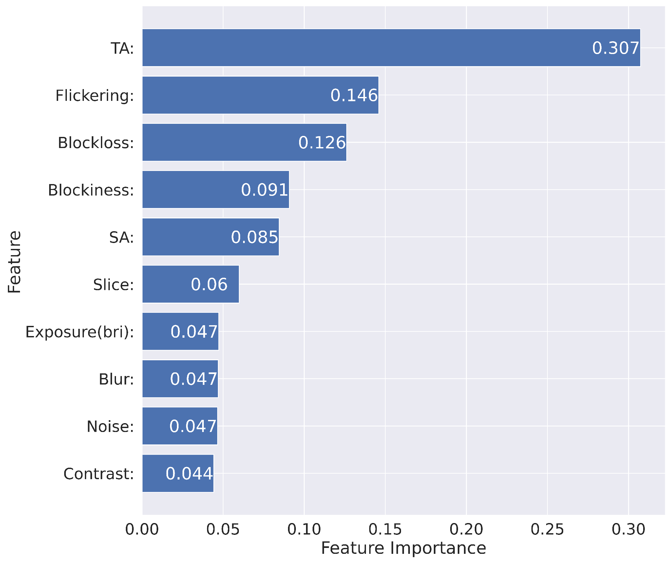
Feature Importance
Using feature importance
Defining which feature had the greatest impact on the prediction

Slide 15
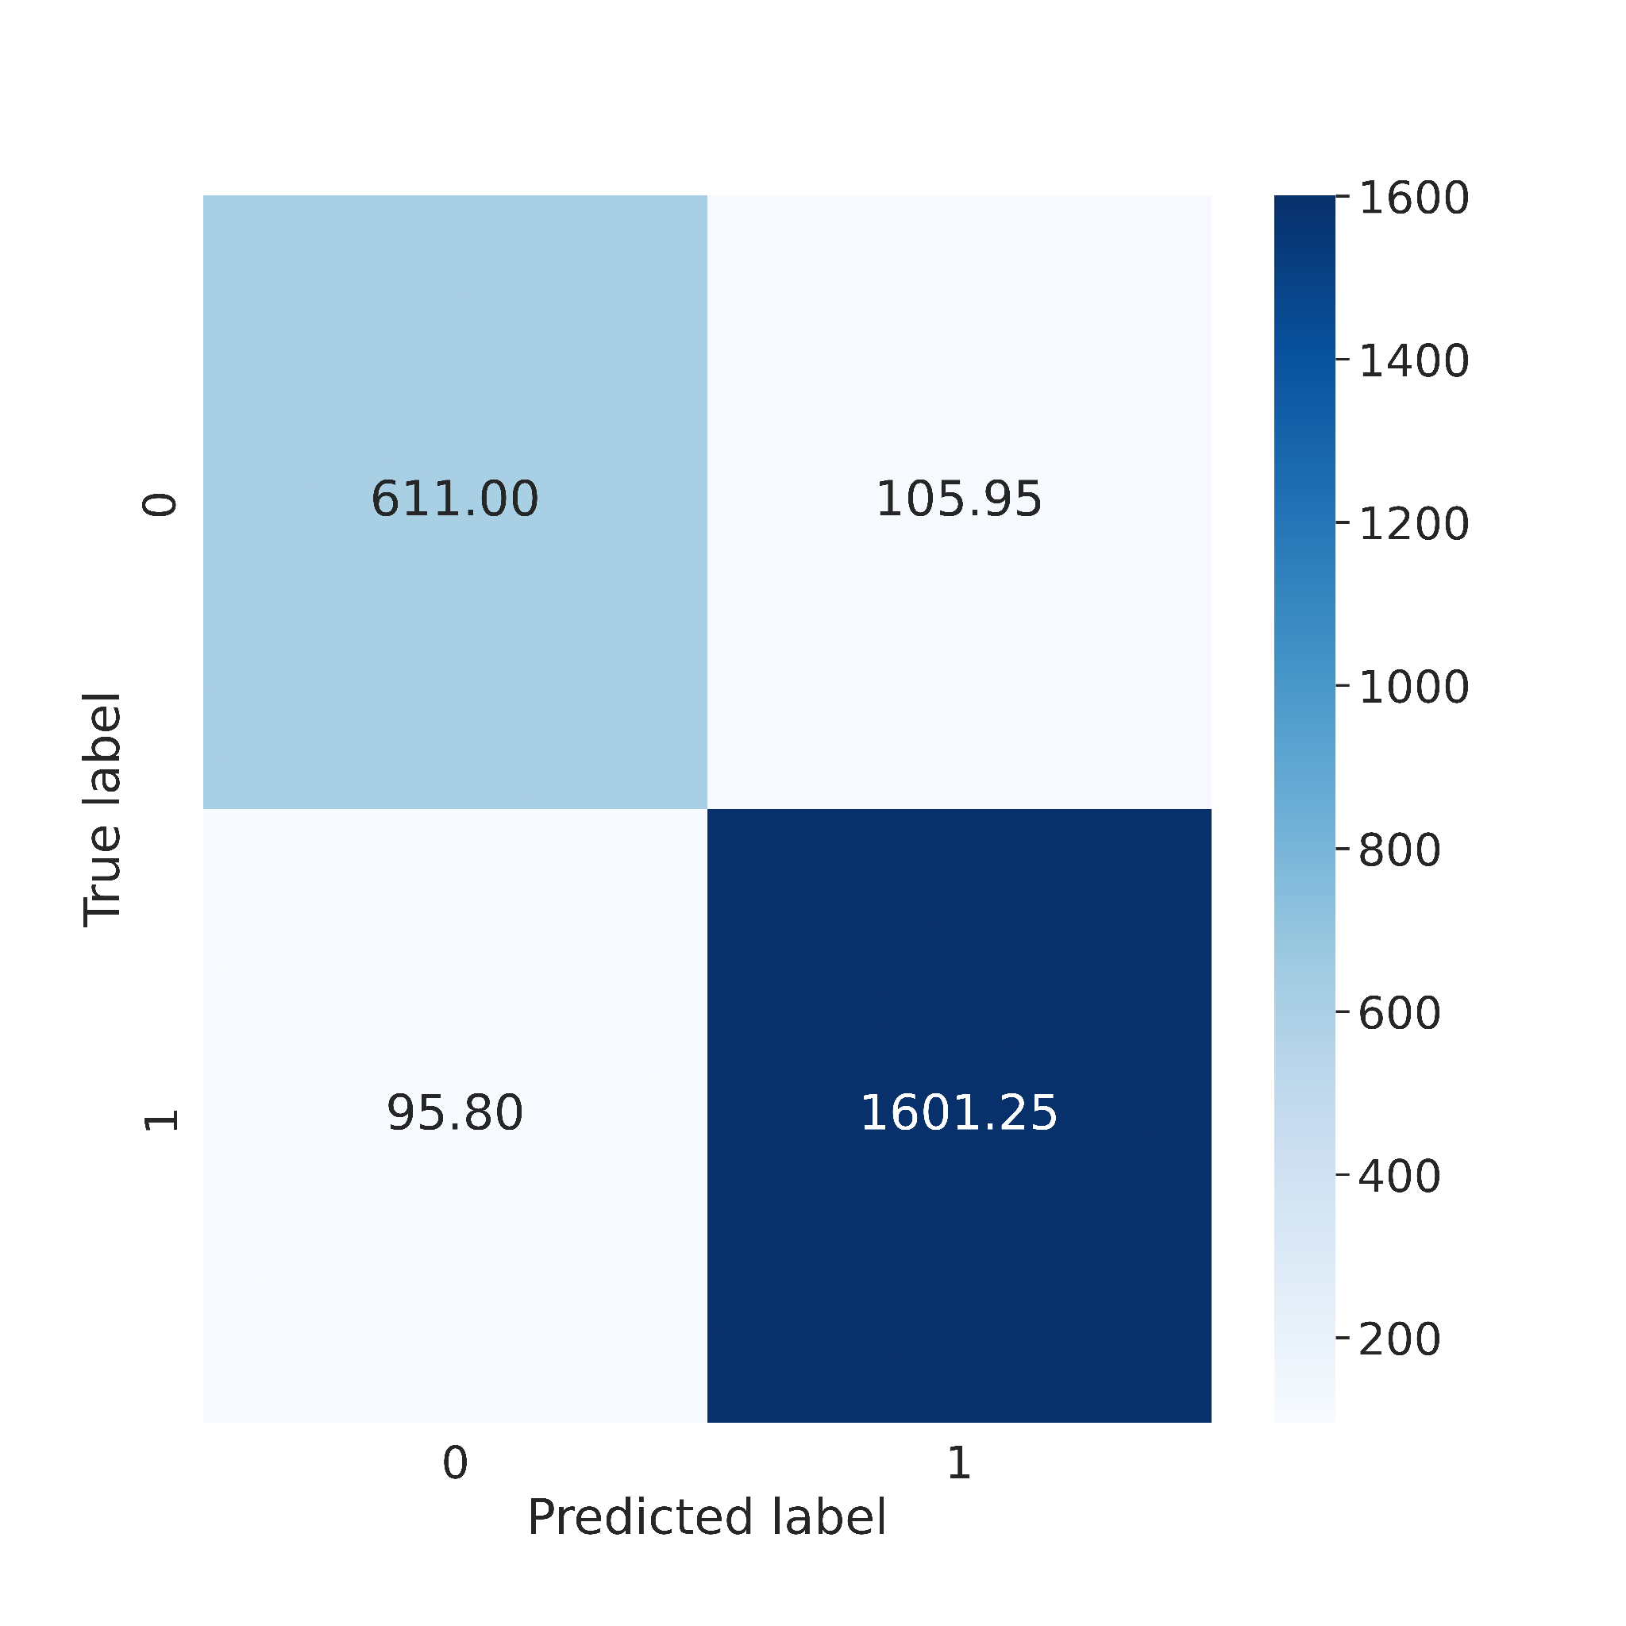
Model Testing
Test set contains 2414 samples
Confusion matrix is used for presenting the results.
Labels classify the content as
1 – professionally generated
0 – amateurly generated (“In the Wild”)

Slide 16
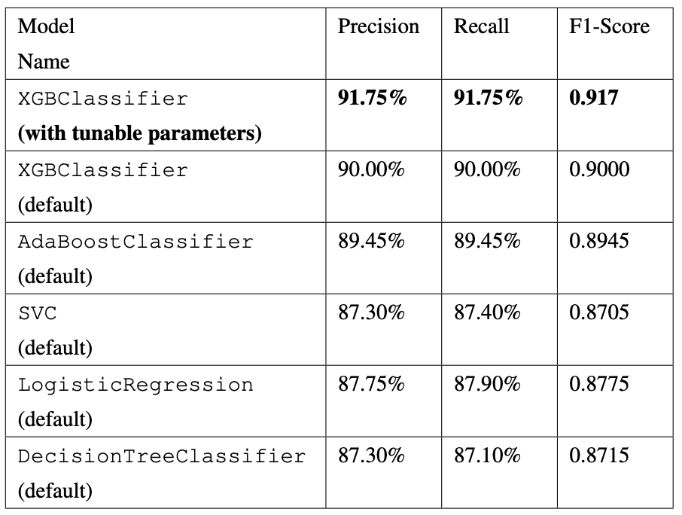
Results
Comparison of the results within the class classification as well as with other classification algorithms

Slide 17
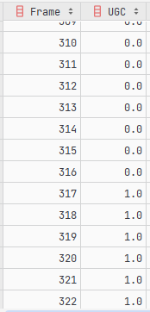
agh_vqis pip Package
Our public pip package now extended with the „In the Wild” (UGC) indicator!
from agh_vqis import process_single_mm_file, VQIs from pathlib import Path process_single_mm_file( Path('video.mp4'), options={ VQIs.ugc: True } )
Fragment of result CSV file with UGC column shown as a table.
1 - user generated content (UGC) – “In the Wild”
0 - professionally generated content (non-UGC)

Slide 18
All Your References, Ideas, Discussion Are Welcome!
https://qoe.agh.edu.pl
qoe@agh.edu.pl
M Leszczuk, M Kobosko, J Nawała, F Korus, M Grega, “’In the Wild’ Video Content as a Special Case of User Generated Content and a System for its Recognition”, Sensors 23 (4), 1769, 2023, https://www.mdpi.com/1424-8220/23/4/1769
https://qoe.agh.edu.pl
qoe@agh.edu.pl

