Slide 1
Advances on the Template on how to Publish DNN-based Video Quality Measures
LOHIC FOTIO TIOTSOP
JEG-HyBRID Group
VQEG Meeting: jun 2023

Slide 2
Aim
Short/mid term goal: writing a journal paper with guidelines about how to publish DNN-based objective measures
In particular, proposing:
A list of typical “mistakes” to avoid
A more effective objective approach to benchmark the trained model
A universal database to test metrics and record their performance
A template to report/publish the results
Long term goal: evolve it into an international recommendation

Slide 3
Motivations
Enhancing research reproducibility
A template to publish the results can strongly help in this aspect
Towards a fair review process
The template will make it easier to compare different manuscripts
An effective comparison of metrics
The correlation coefficients and RMSE are not enough
Avoiding over-generalization and/or misleading claims
e.g., “our metrics is suitable for any context, since it is trained with images impaired by several distortions”
e.g., “Our metrics takes as input an NxM image patch” while it is not clear how create the patch from other image sizes (resize, crop, etc.)

Slide 4
Template Format
The template’s format is still under discussion
Current idea: a single table reporting questions to be answered by authors
Challenge: how to “compress” necessary and sufficient information into single table
A very large table would discourage authors
Not all can fit into a single table
Design a wiki page where authors are invited to report more detailed information
It is expected that the wiki page reports recommendations on suitable datasets for validating the accuracy of specific objective measures
It is expected that the wiki page also reports the performance of many metrics on several datasets
A few advances on the template’s content have already been done

Slide 5
A three-Dimensional Template
Model benchmarking
Model availability for usage
Model reproducibility

Slide 6
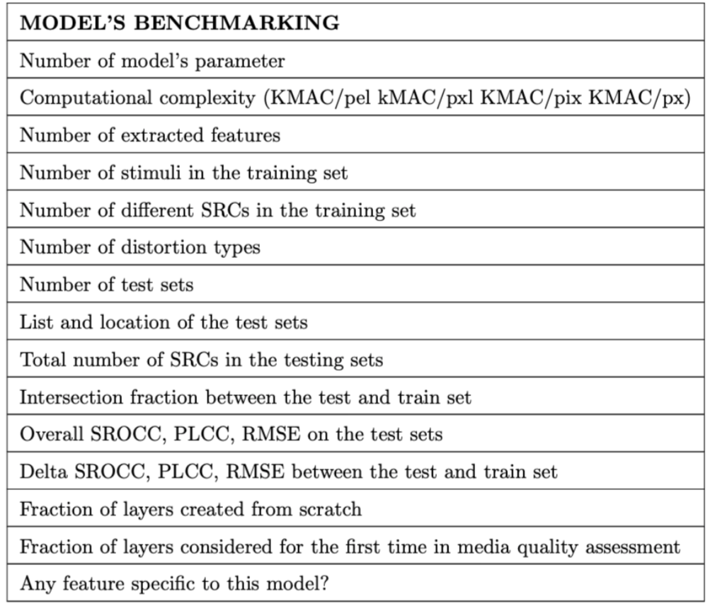
Model Benchmarking: Some Relevant Questions

Slide 7
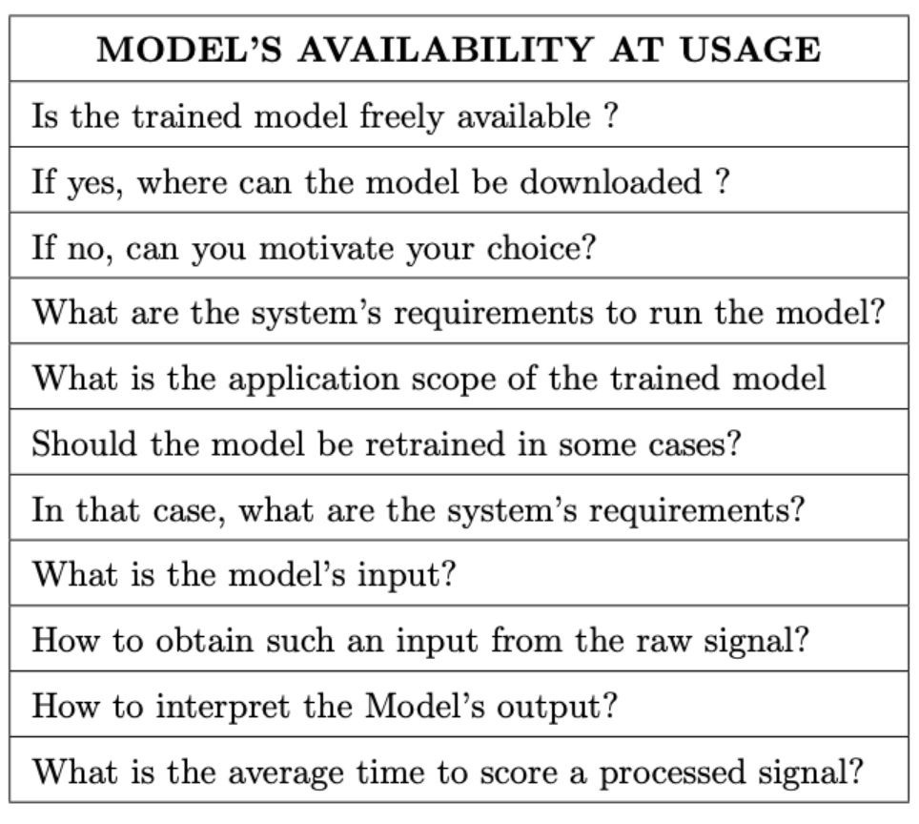
Model Availability for Usage: Some Relevant Questions

Slide 8
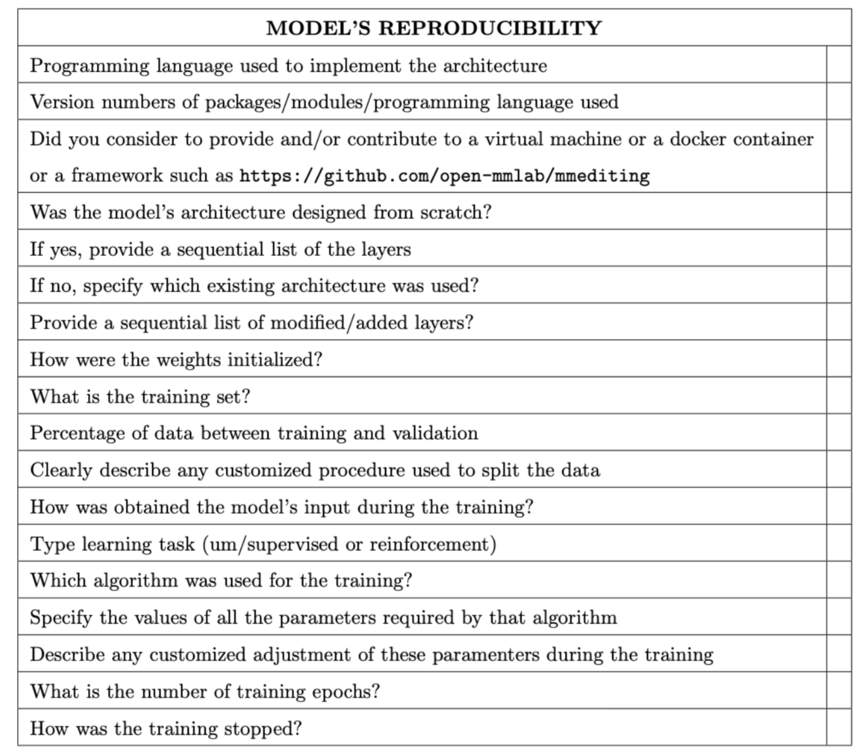
Model Reproducibility: Some Relevant Questions

Slide 9
Ongoing Work
Currently working on different aspects of the template
What to report?
How to report it?
Any person that can contribute is welcome
The updates are discussed during JEG-Hybrid meetings
Meeting schedule: https://vqegjeg.github.io/jeg-hybrid/meetings

