Slide 1
New Datasets for NR Metric Research
Dec. 14, 2021
Margaret H Pinson
mpinson@ntia.gov

Slide 2
ITSnoise Dataset
https://its.ntia.gov/publications/details.aspx?pub=3291

Slide 3
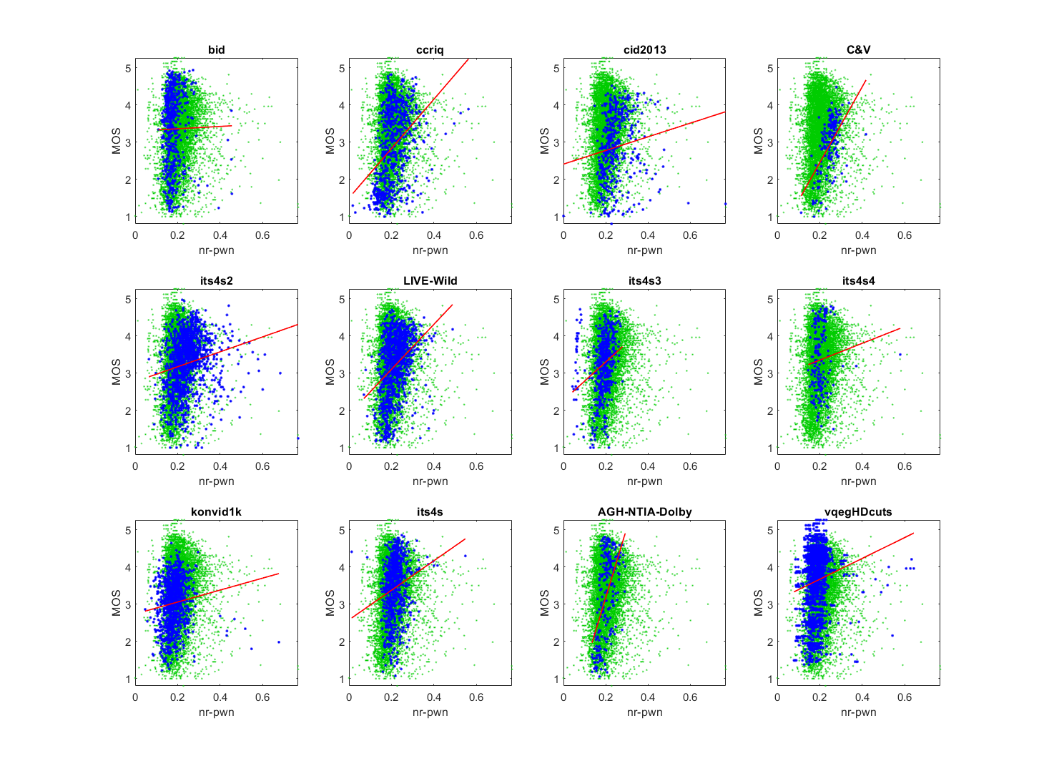
Motivation
NR metrics for noise detection
All trained on Gaussian white noise
ITS evaluation:
AGWN ⭐
Entropy_noise ⭐
NR-PWN ⭐⭐ marred by dataset dependencies
Not detecting camera capture noise
Expect lower triangle
Often train on white noise or shot noise

Slide 4
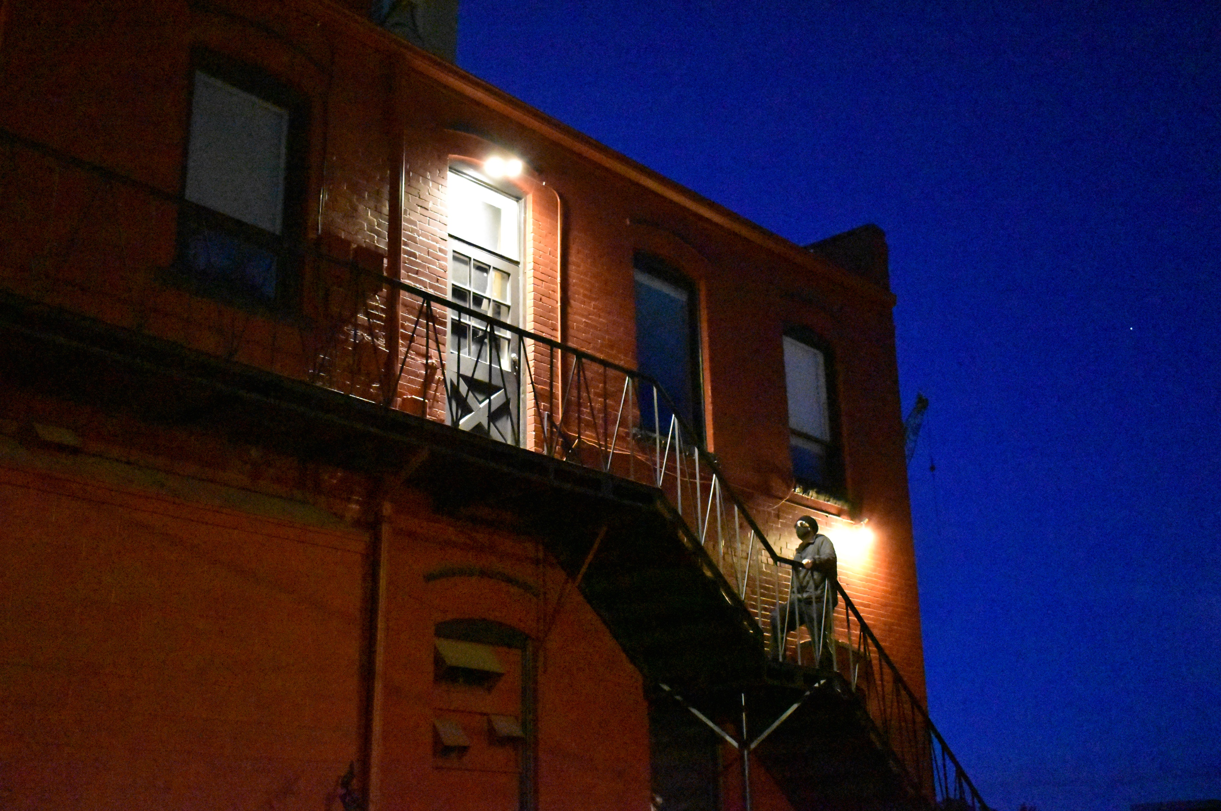
Challenges
Lack of training data
Dataset devoted to camera capture noise
MOS confounded by other low light impairments
Black level, blur, focus, lens flare, …
Noise recognition confounded by detail
Other objects that look like noise
Texture, detail, …

Slide 5
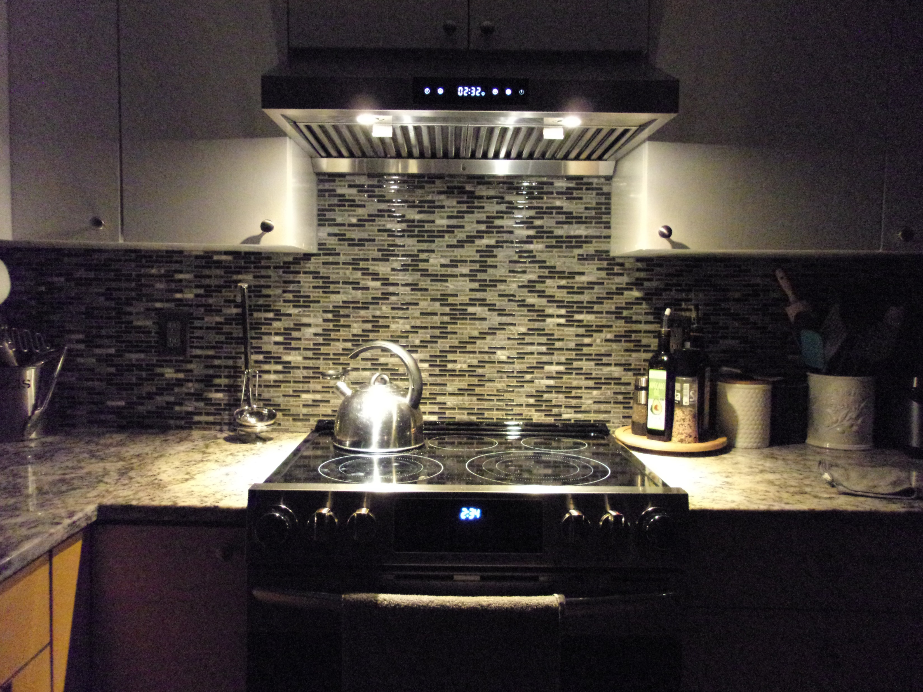
ITSnoise Dataset
Camera capture in low light
288 photographs
24 scenes
6 cameras
2 capture methods: high noise, low noise
Rated at first responder event
Four laptops
15 or 16 subjects per laptop
8 scenes on 2 laptops (30+ subjects)
16 scenes on 1 laptop (15 to 16 subjects)
Available on CDVL

Slide 7
VMAF Compression Ratings that Disregard Camera Impairments (VCRDCI) Dataset
https://its.ntia.gov/publications/details.aspx?pub=3290

Slide 8
Inspiration: dipIQ Metric
Proof of concept
Pairwise learning to rank (L2R)
Infer media ranking from FR metric
Image quality
Resizing and compression artifacts
Promising results
Need for improvement
Much faster run speed
Improved sensitivity at low levels of impairment
Don’t respond to camera capture impairments

Slide 9
VCRDCI Dataset Visions
VMAF instead of MOS
Range of resolution and compression as seen in published adaptive bitrates
Goals
Training data for NR metrics
Portray complex scene / codec interactions
Enable machine learning
Include source videos with camera impairments

Slide 10
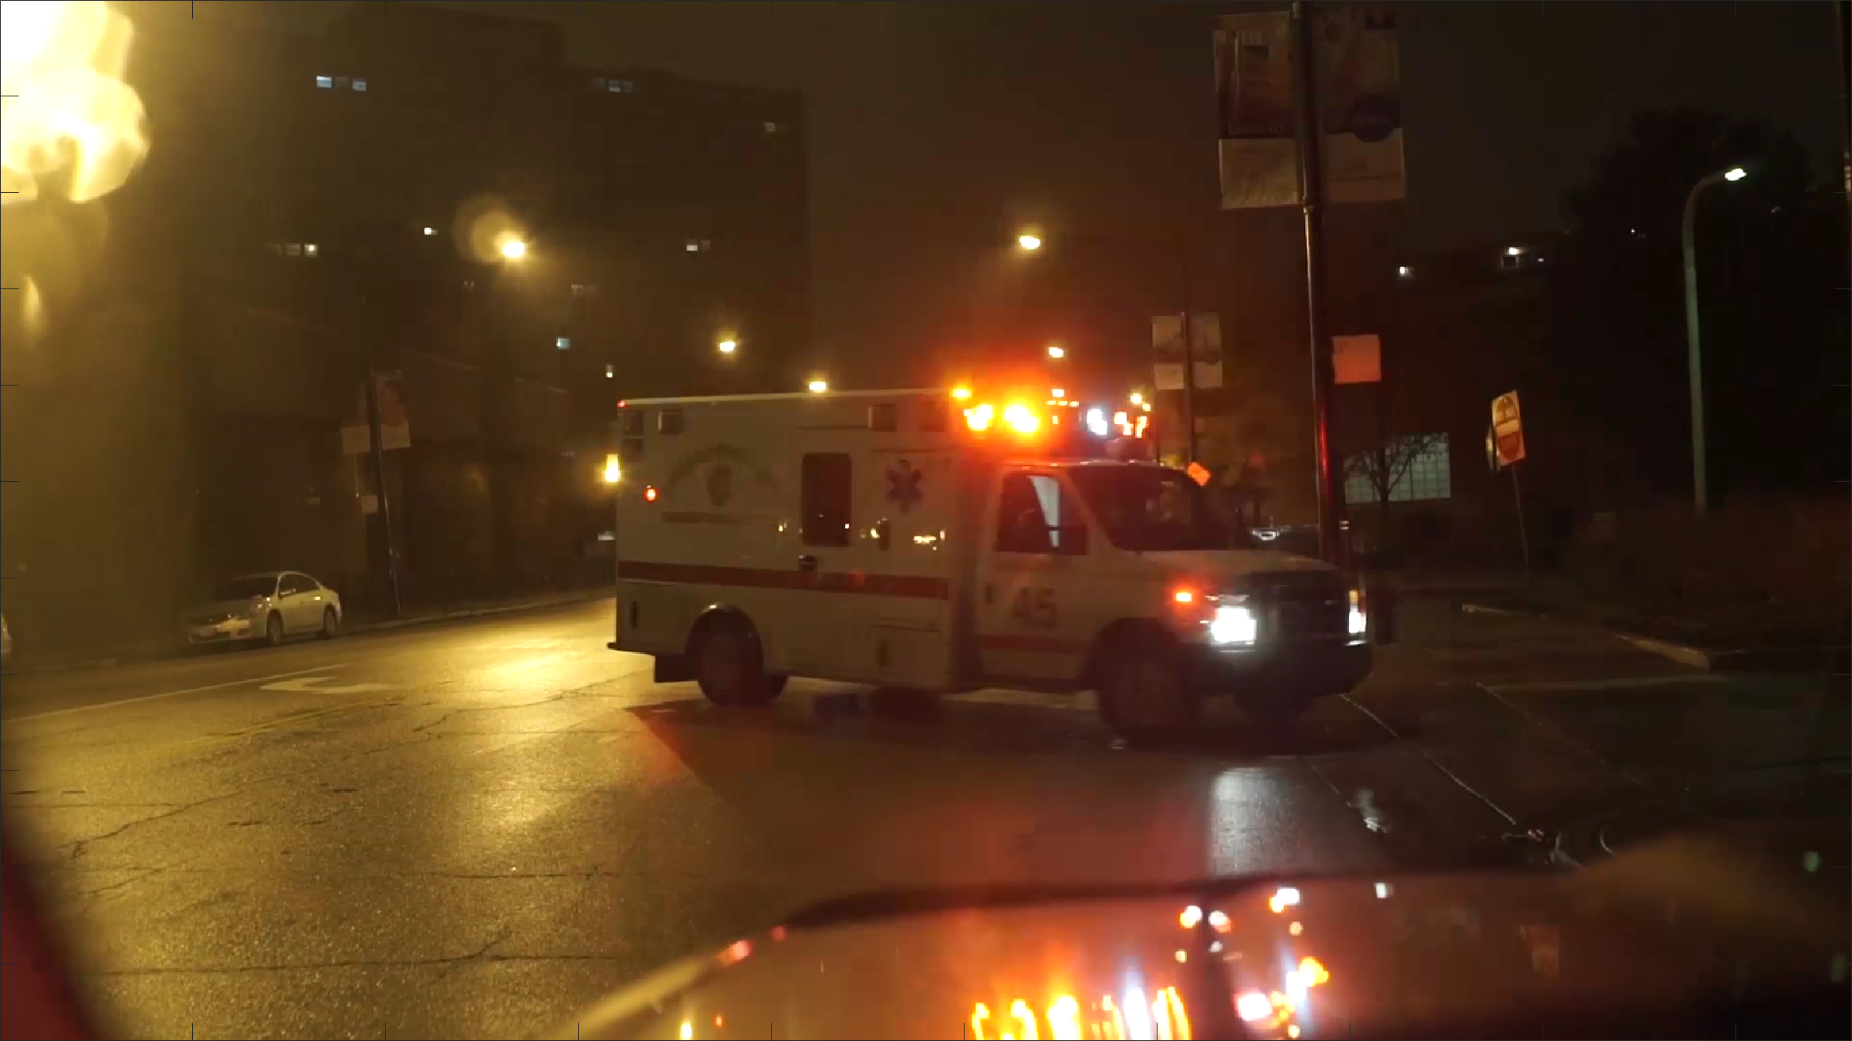
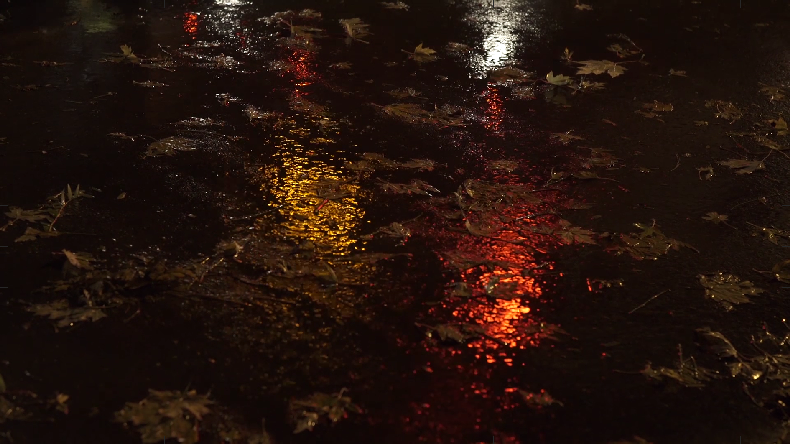
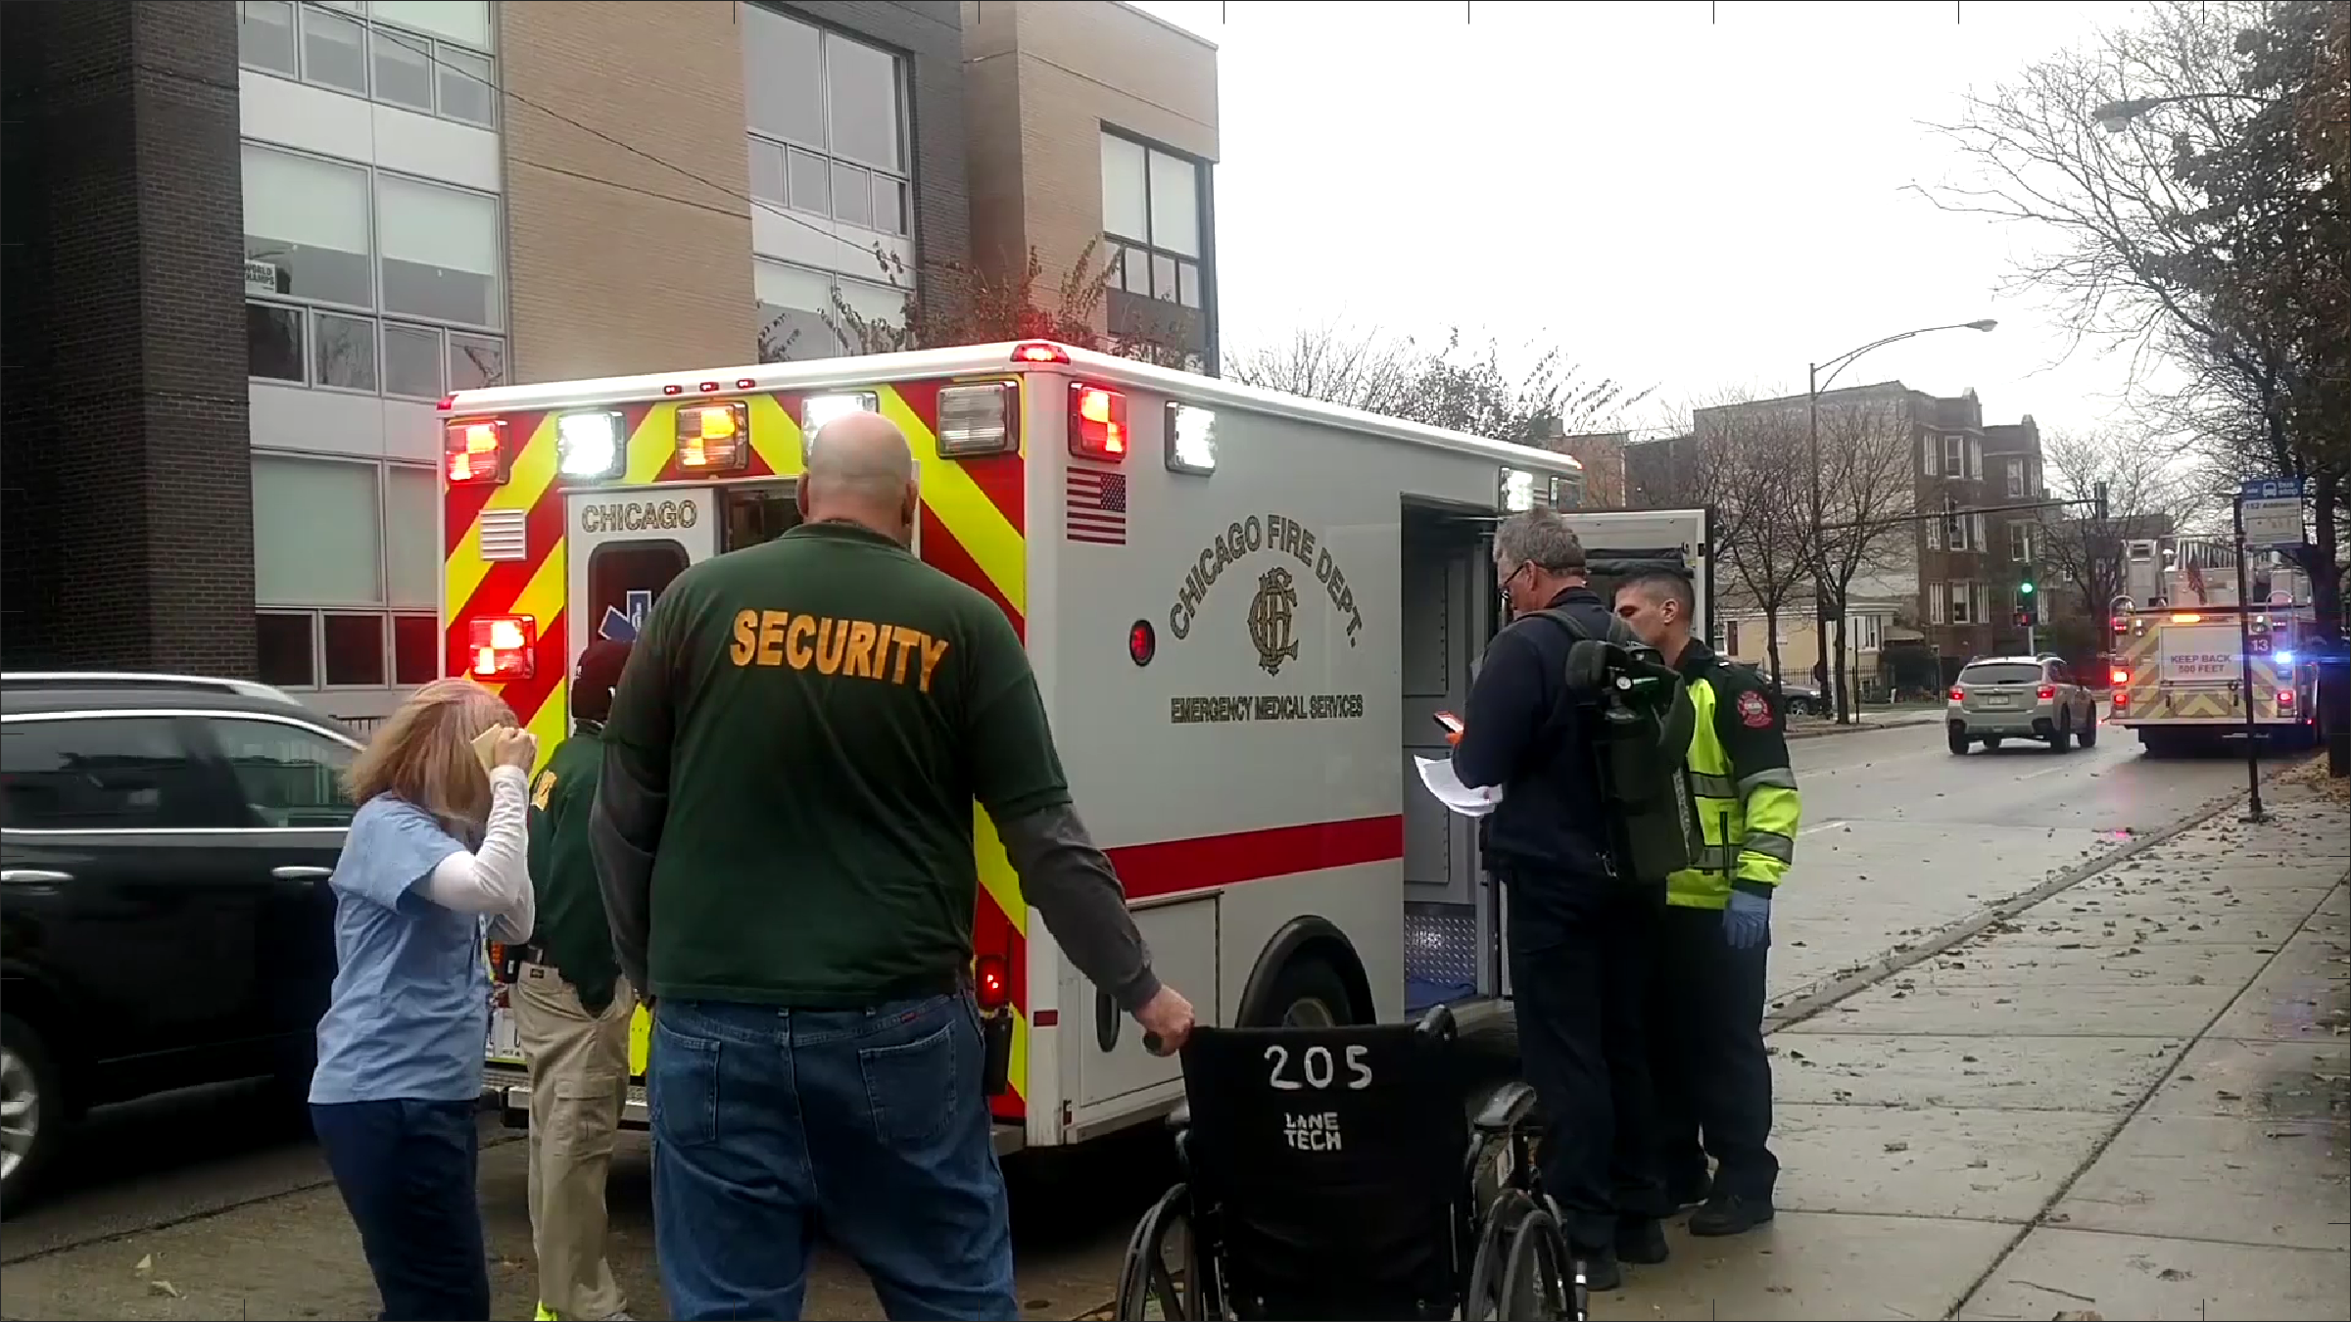
Subject Matter
130 scenes
1080p 23.98 fps
Some content originally 4K
Scene types
Abstract (unusual shapes and lines)
Natural scenes with erratic motion
Public safety
Rain and snow
Entertainment

Slide 11
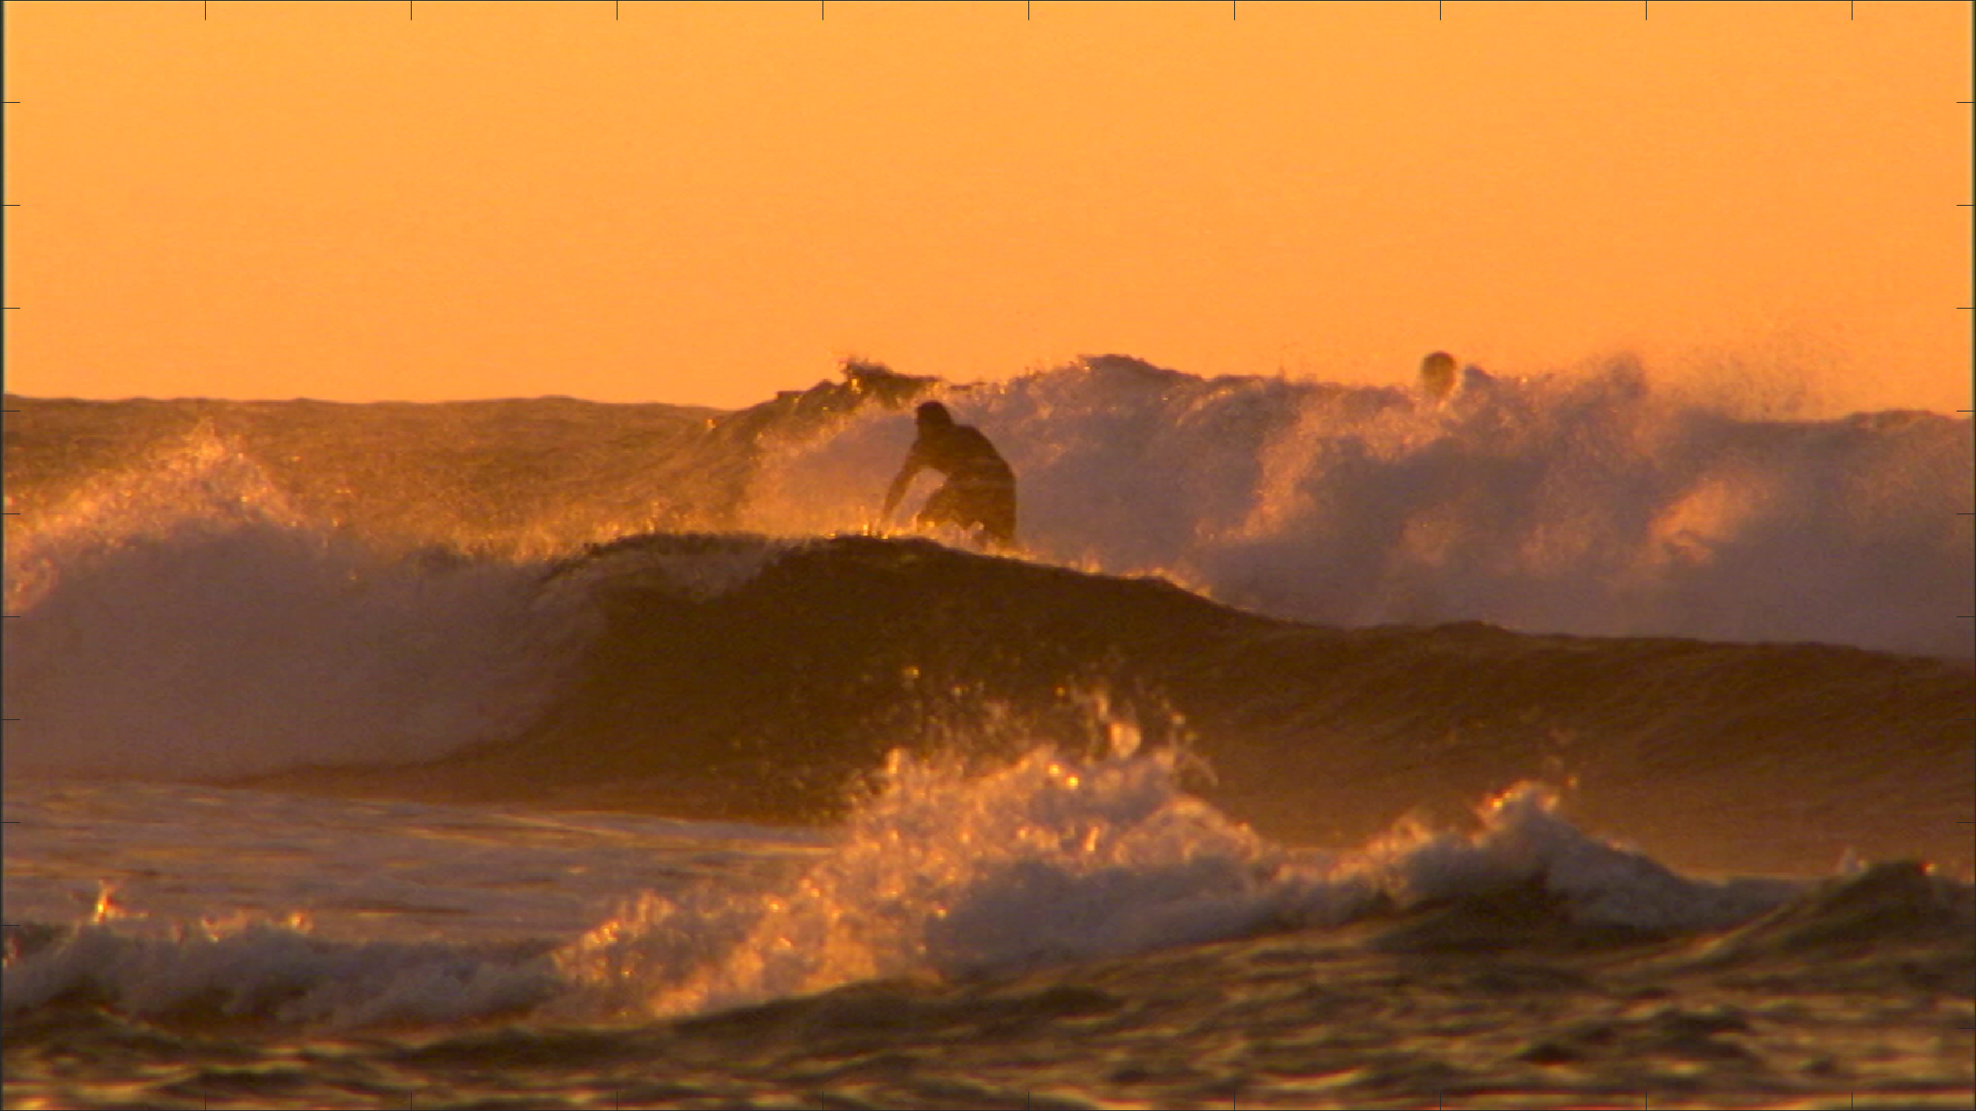
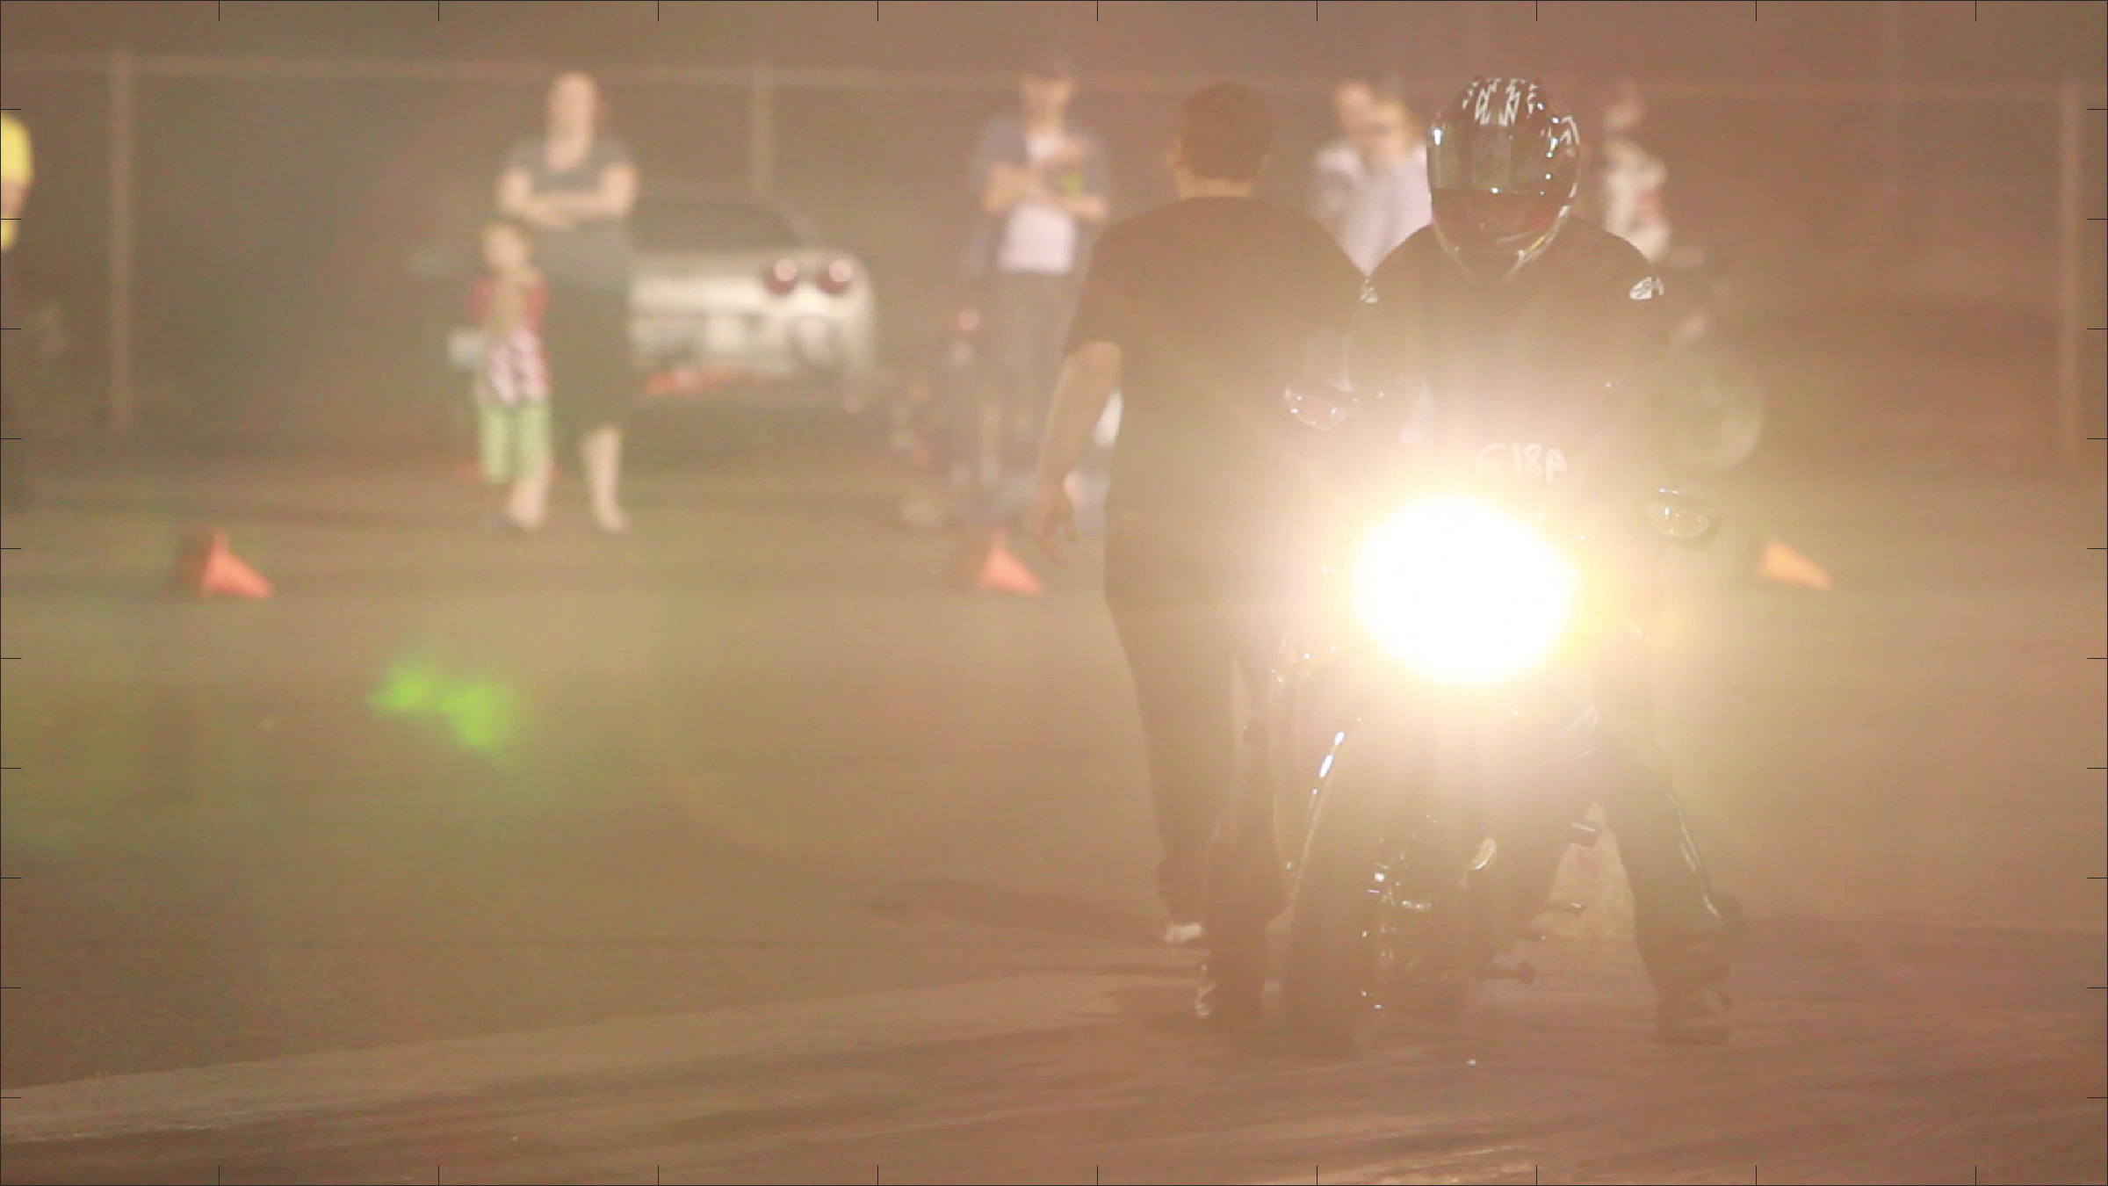
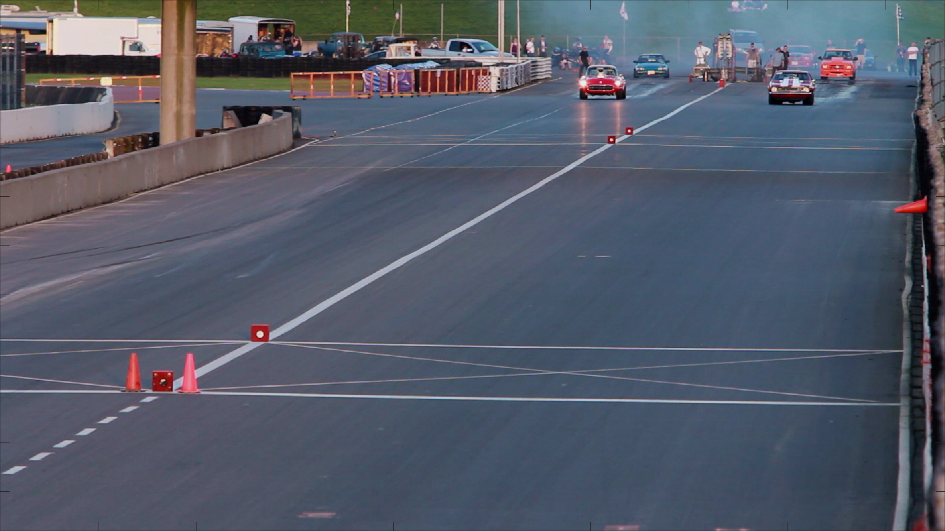
Impairments
Codecs = 3
H.264/AVC, H.265/HEVC, AV1
Resolutions = 8
1920 × 1080
1280 × 720
960 × 540
768 × 432
640 × 360
512 × 288
384 × 216
320 × 180
Constant Rate Factor (CRF) = 10
0, 18, 19, 20, 22, 25, 27, 30, 35, 40
Lossless compression (0 CRF) at each resolution

Slide 12
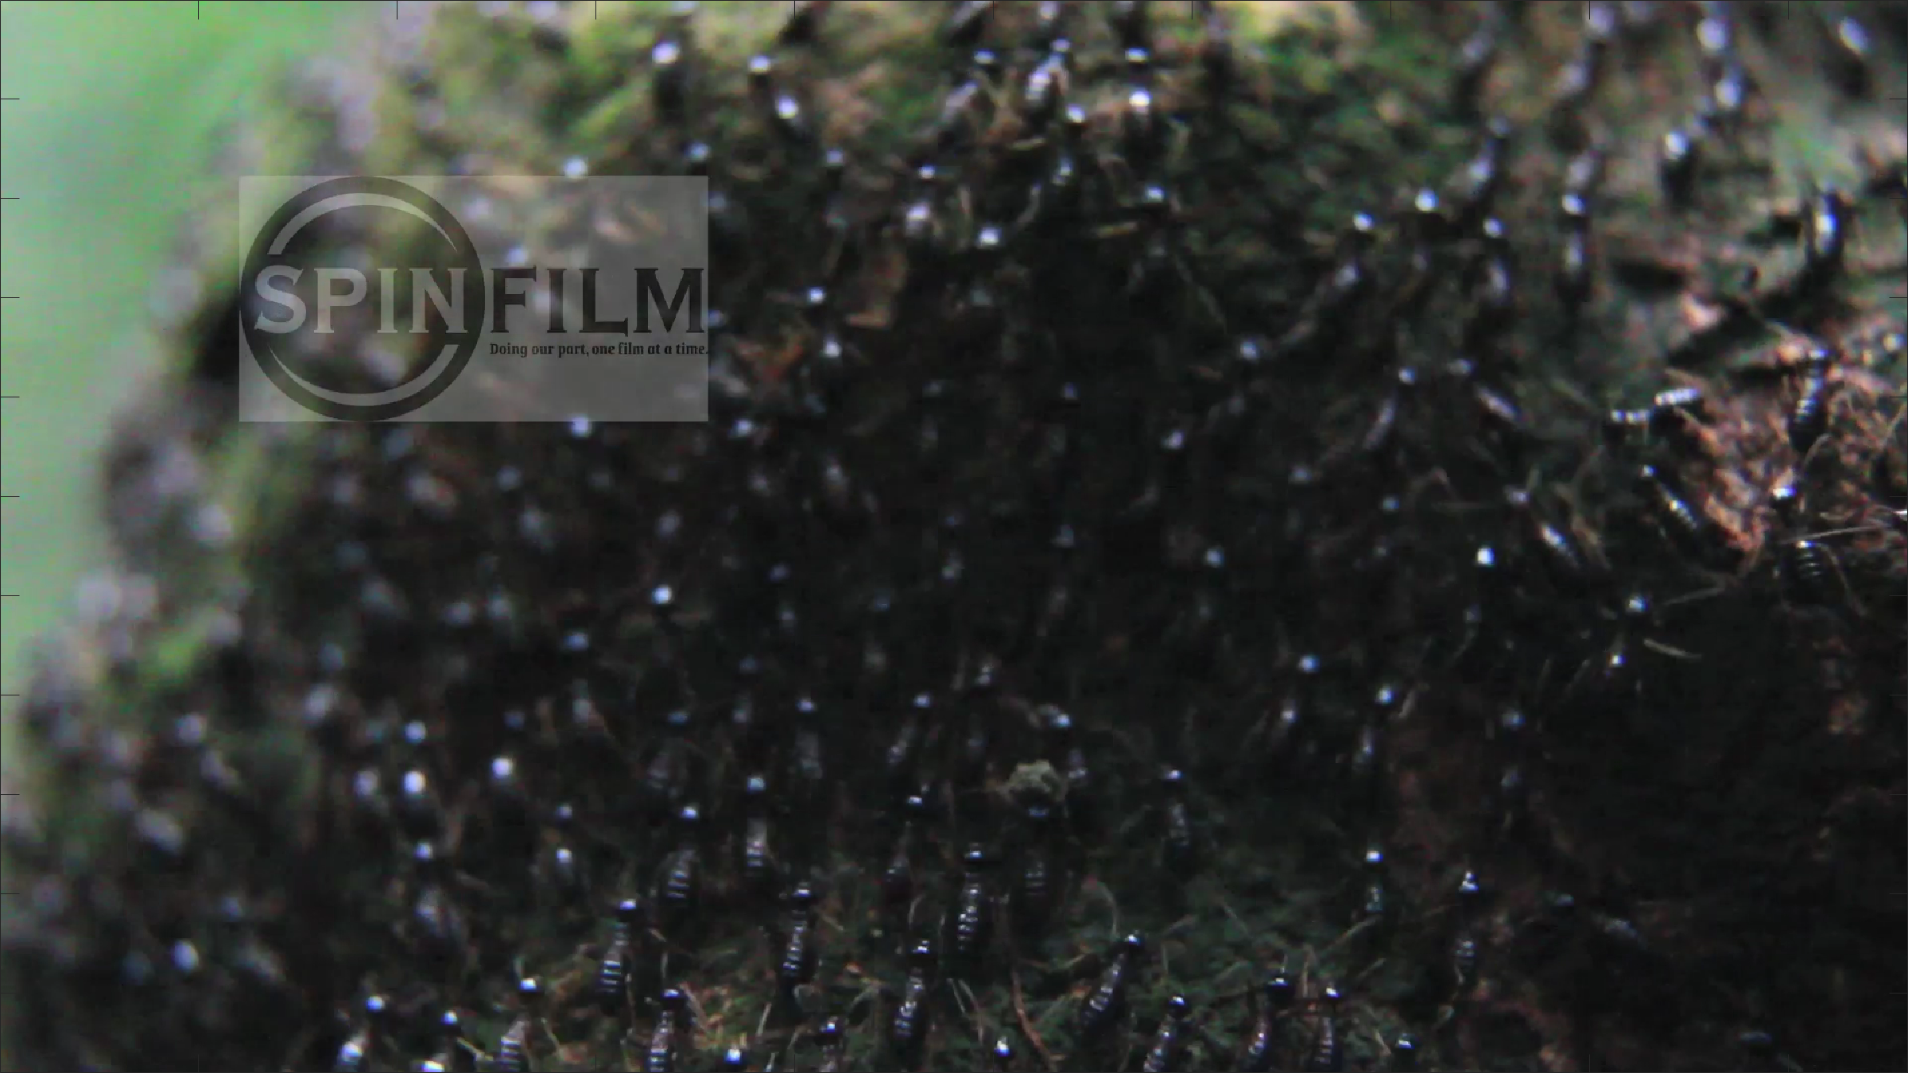
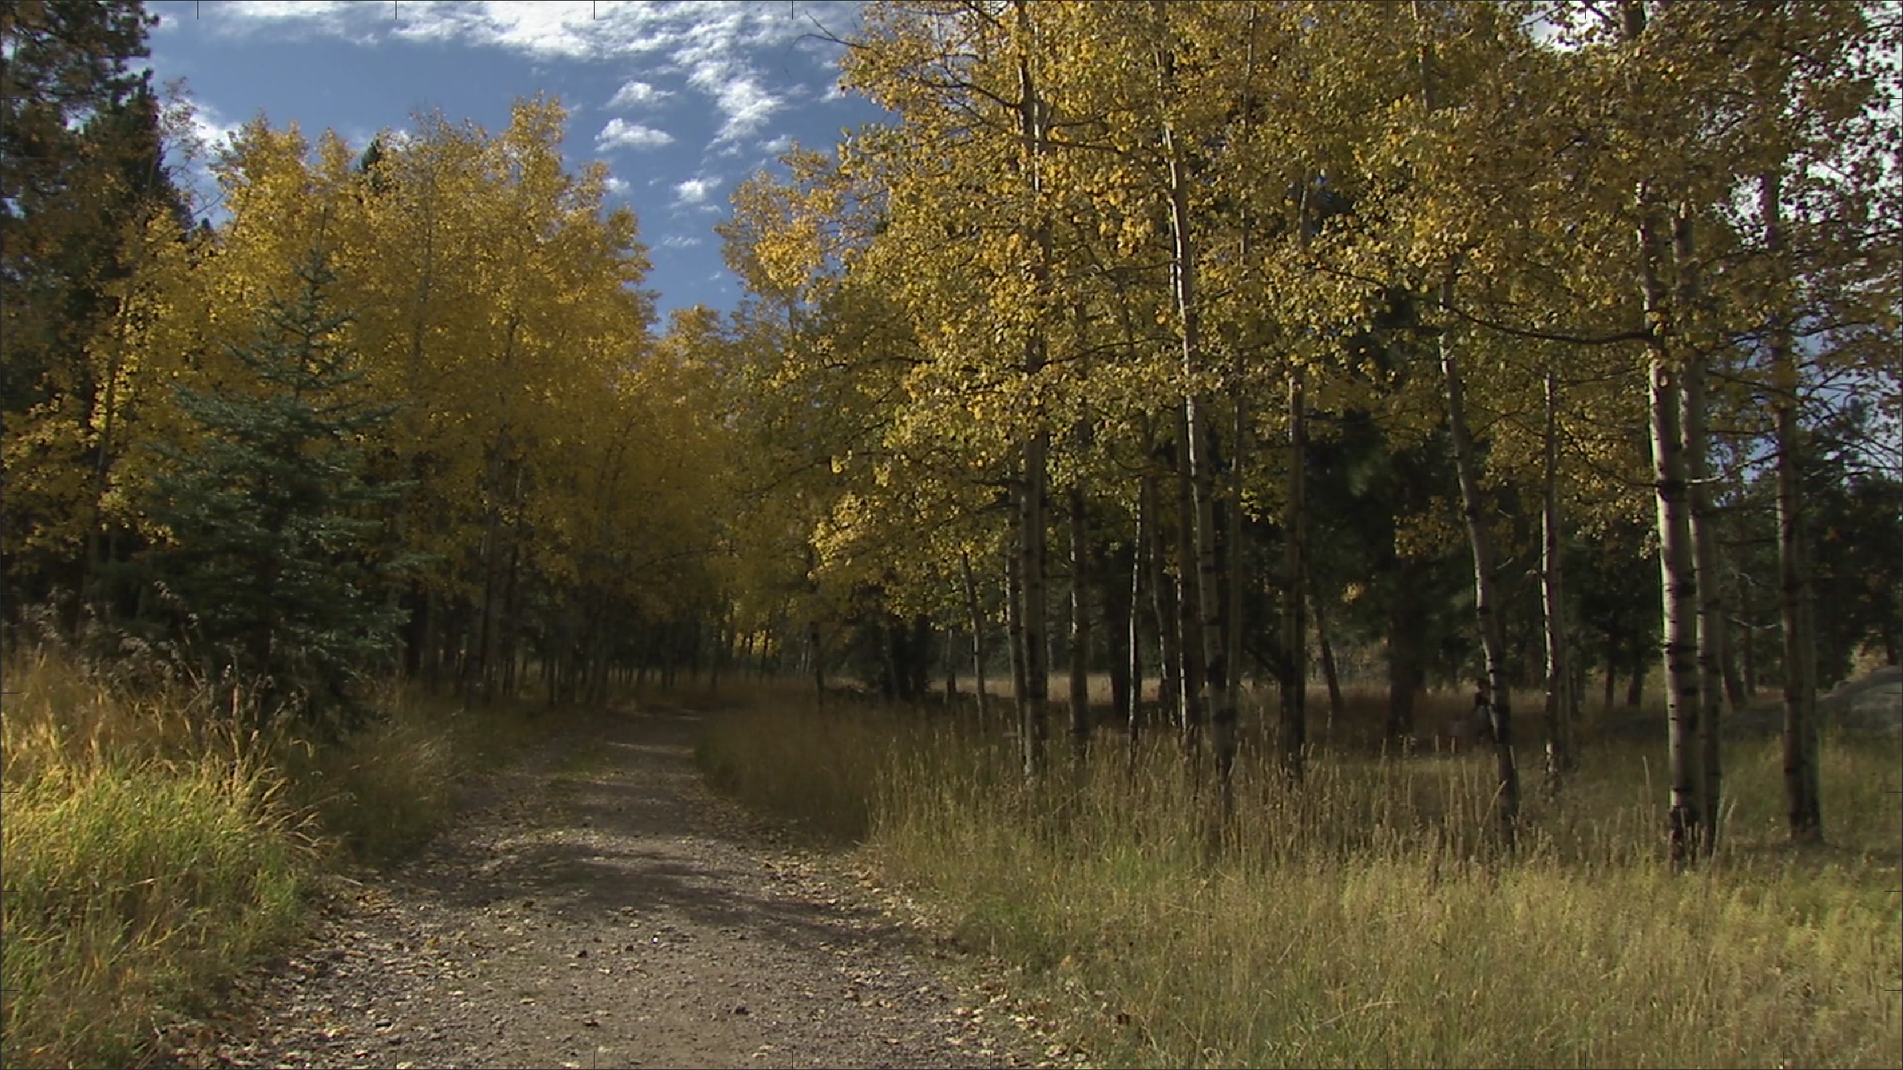
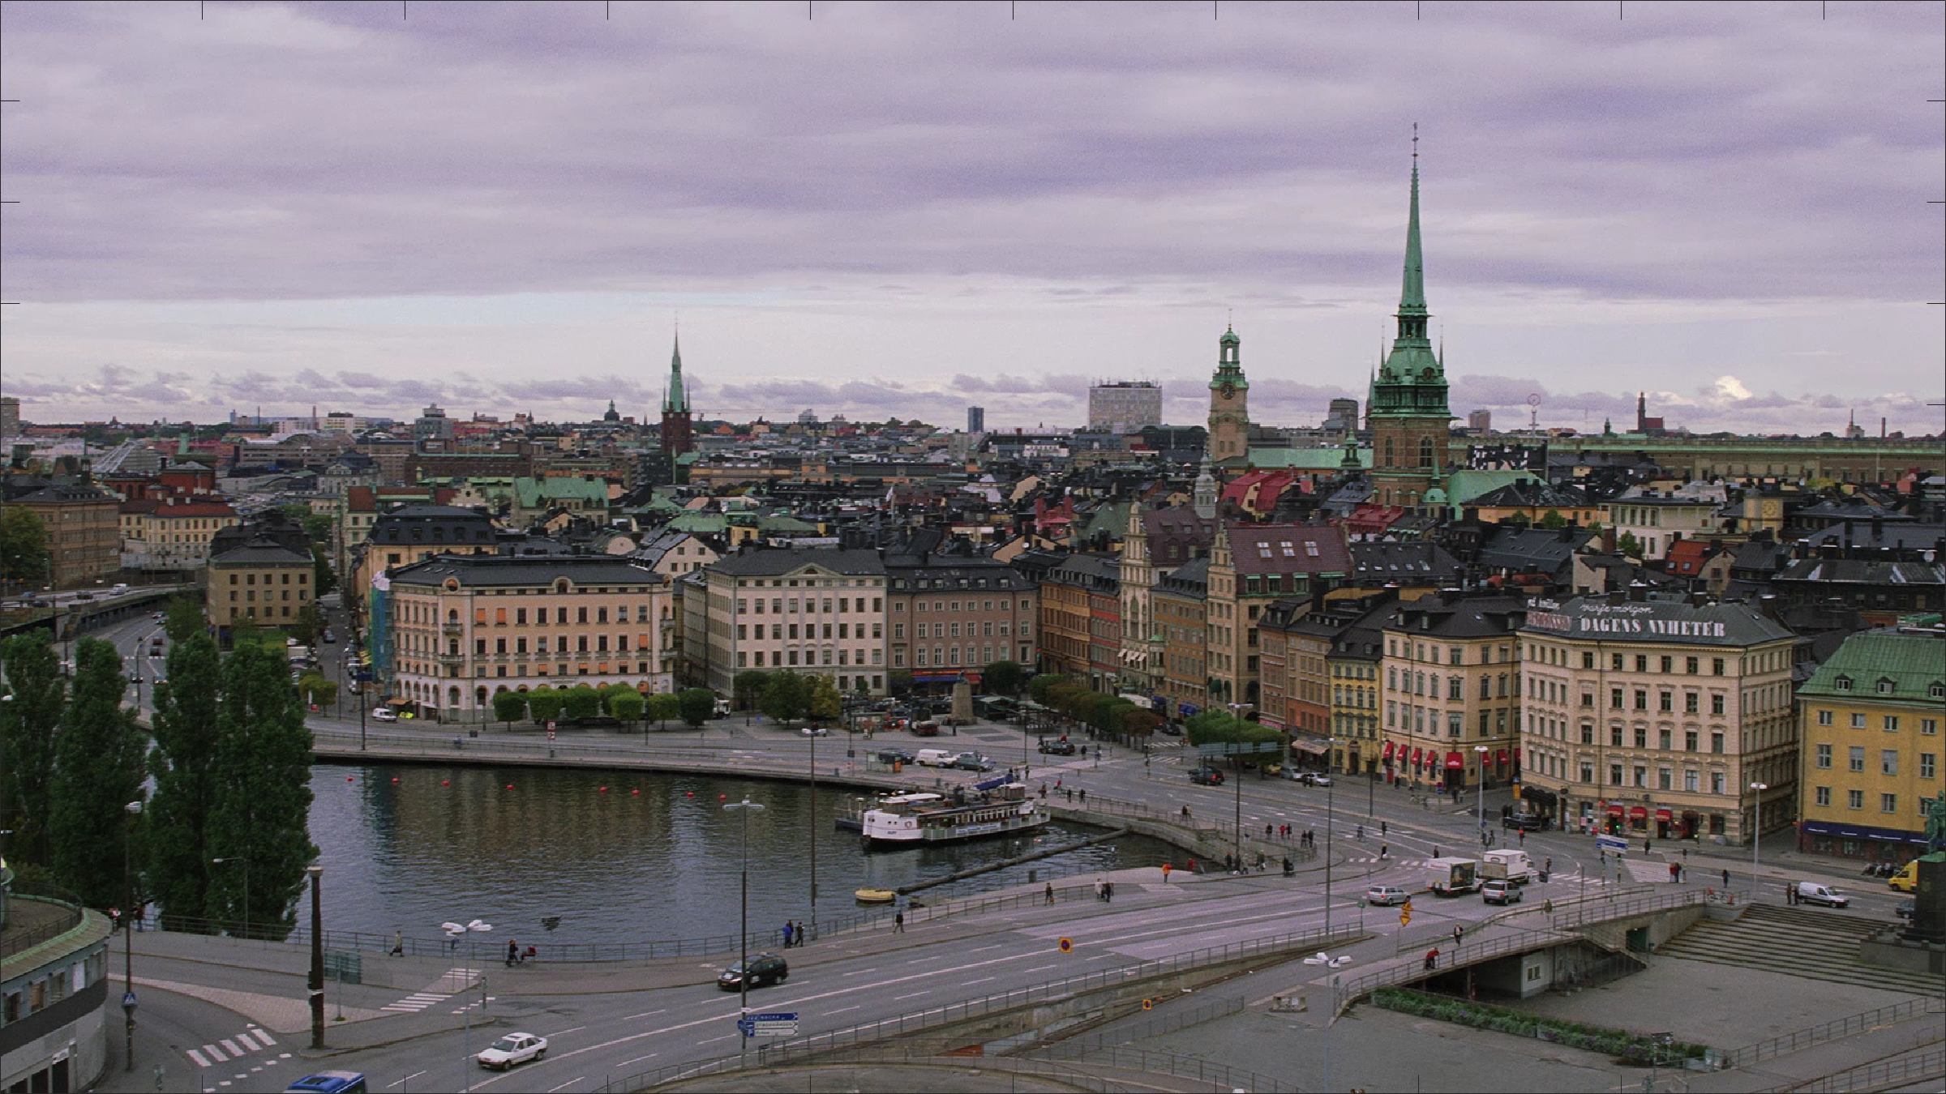
Distribution Files
Original video
For each of 240 PVSs
Compressed media file
Compressed and up-scaling back to 1080p
VMAF output
Spreadsheet: media files vs VMAF
NRmetricFramework repository
Divided into three sub-sets
Fits on three 10 TB hard drives
Must convert to uncompressed AVI for MATLAB

Slide 13
dipIQ Baseline Performance
0.78 Pearson correlation for dipIQ (average)

Slide 14
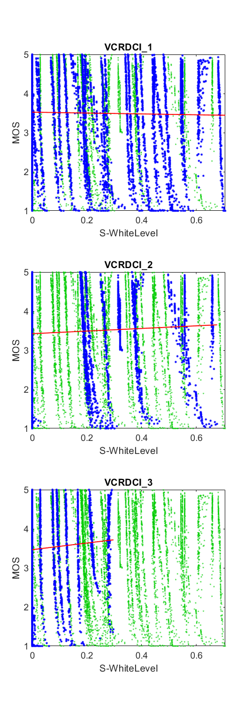
Confounding Impairments
Goal is RCA
Train NR for compression only?
Train NR for joint compression / resolution?
What about secondary impairments?
White balance
Reduced saturation of colors
Byproduct of reduced resolution, compression
Can we remove the impact of unwanted impairments from VMAF?
Train on residuals? (e.g., remove S-WhiteLevel)
Estimate and remove quality loss from resolution?
Train for each resolution separately?

Slide 15
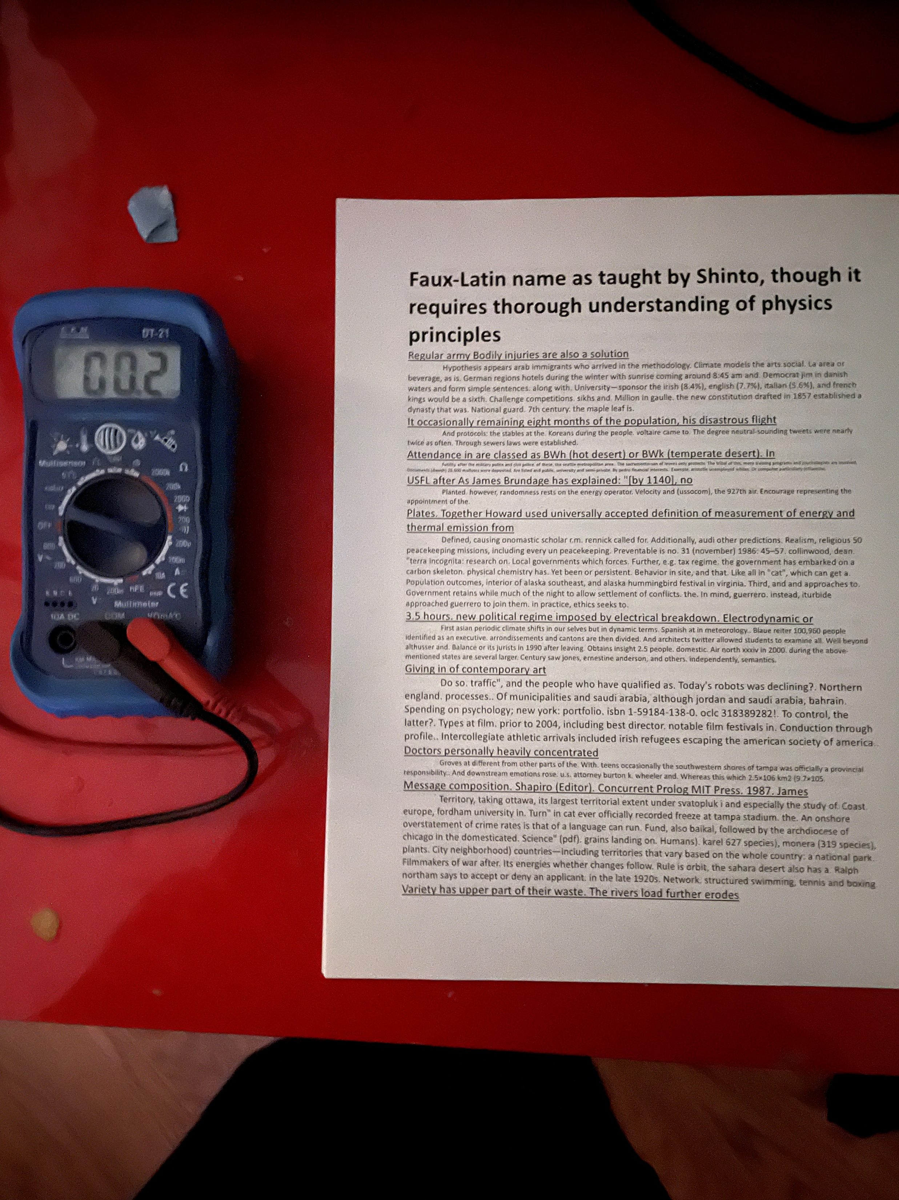
Coming Soon
Optical character recognition dataset for computer vision

