Slide 1
Deep dive into Video Codec Profiling with VQA complexities and resolutions
Dr. Urvashi Pal
Akamai

Slide 2
VQA
PSNR
VMAF
SSIM
.
.
Encoding Latency

Slide 3
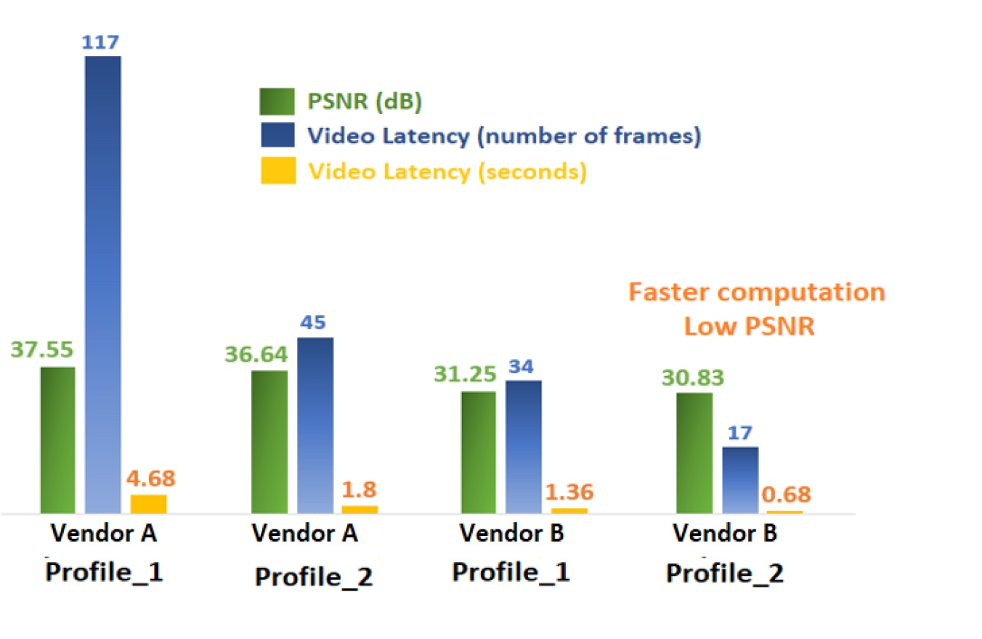
PSNR vs. Encoding Latency Comparison

Slide 4
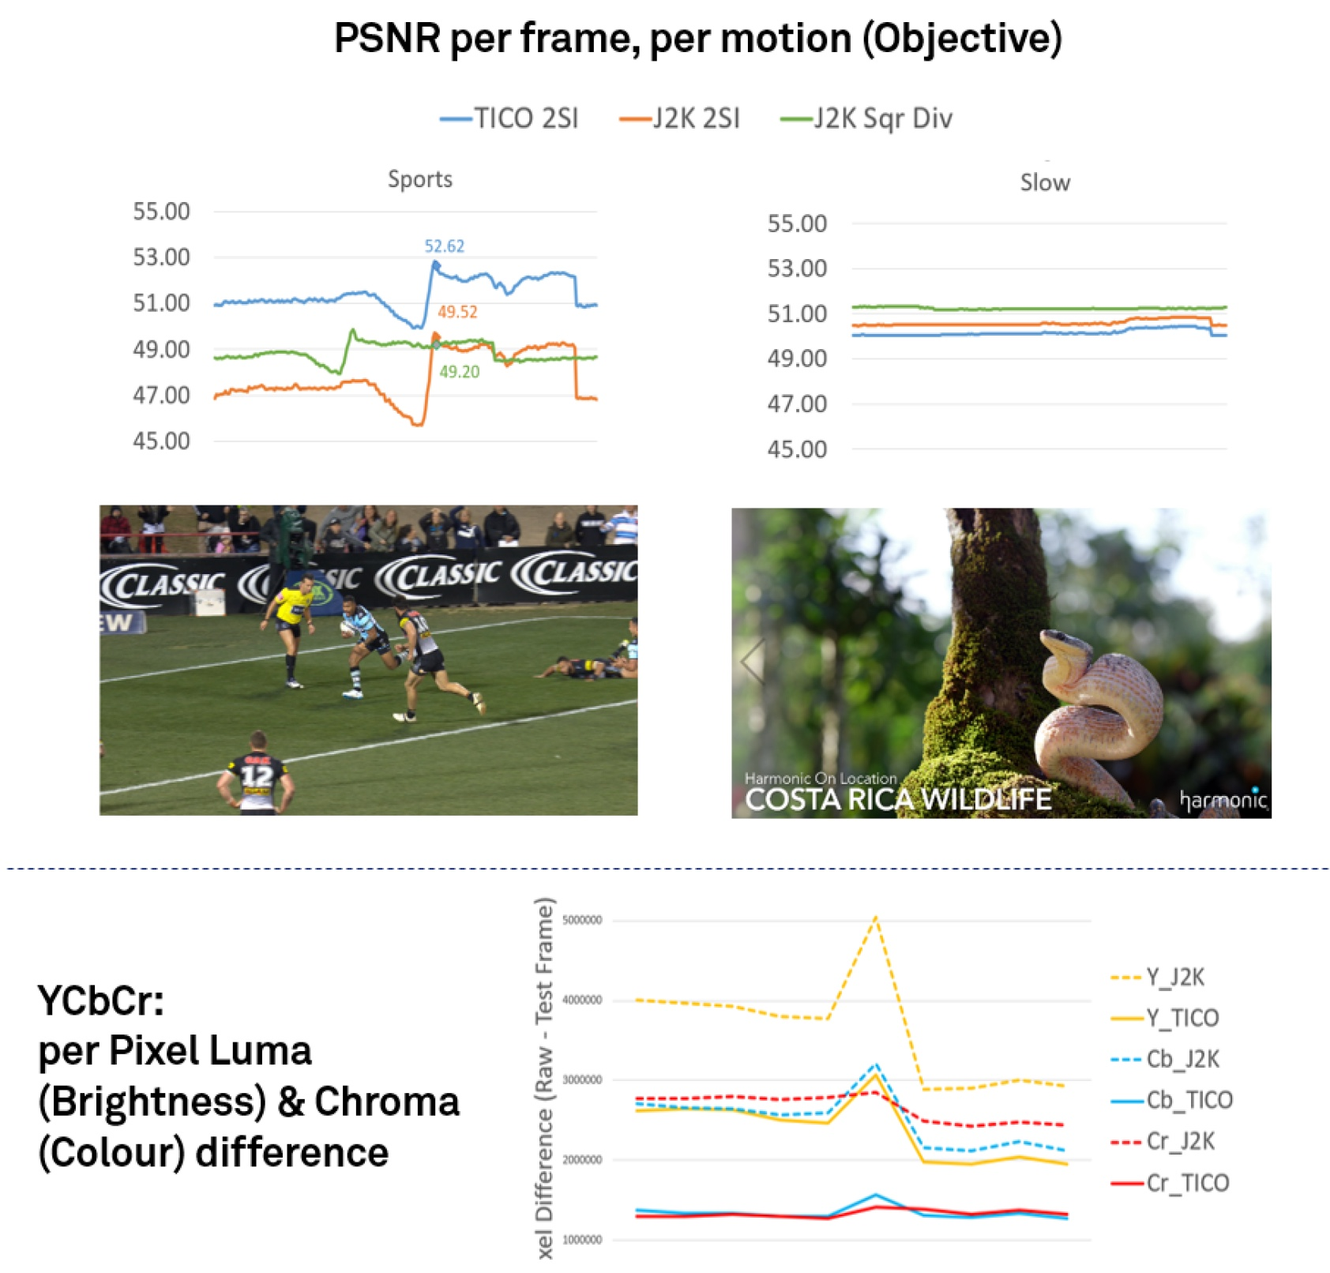
Per frame, per motion Objective Analysis
Analyzing scene change per codec behavior and Chroma vs Luma (YCbCr) behavior

Slide 5
YCbCr: Per Pixel Analysis

Slide 6
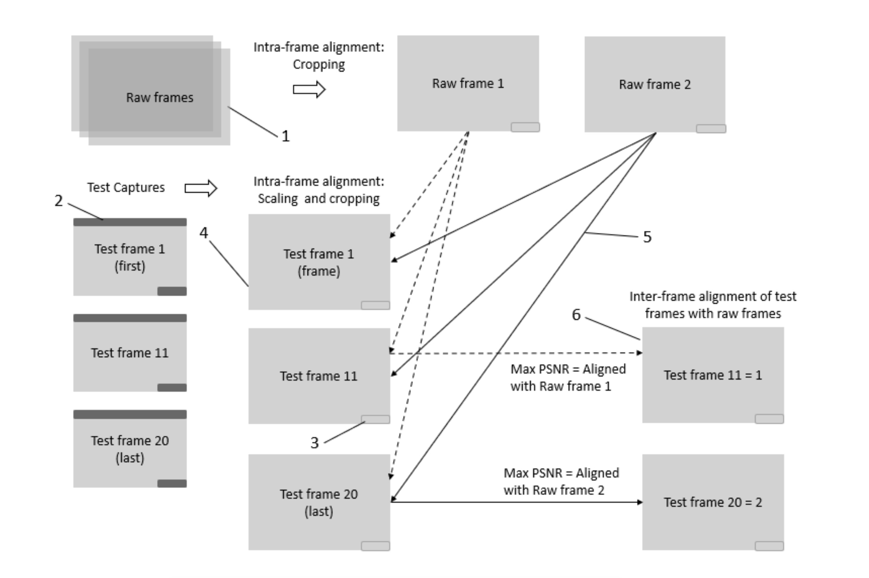
Frame alignment complexity
The inter-frame alignment is done by comparing one raw frame with every test frame. The test frame with the highest PSNR is considered to be in perfect alignment with that raw frame, and therefore, every test frame is rearranged based on this algorithm.
This methodology reduces probability of error observed in frame alignment using timestamps, frame drop or duplication due to capture card issues, frame corruption during end of capture, bad frame during end of the clip being played in loop, bad frame due to poor frame rate conversion.

Slide 7
Thank you Any Questions ?

