Slide 1
More Ecologically Valid Subjective Experiments Lucjan Janowski, Jakub Nawała, Rafał Figlus
5/9/22

Slide 2
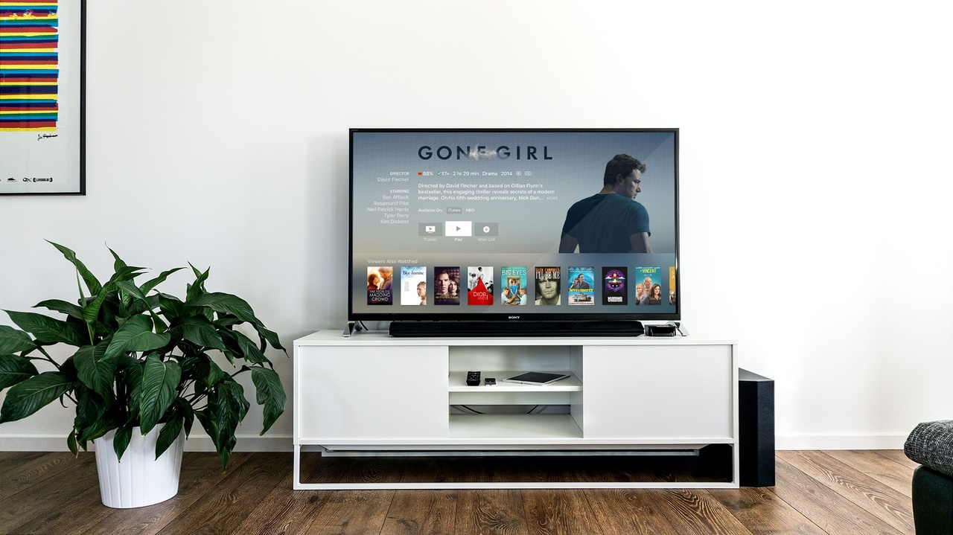
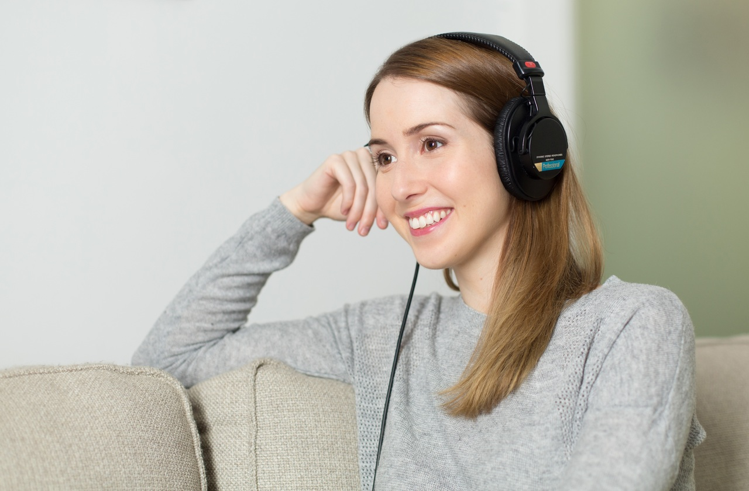
Different Measurement Points
Quality of Pixels
Quality of Display?
HVS Human Visual System
Quality of Experience
User Experience

Slide 3
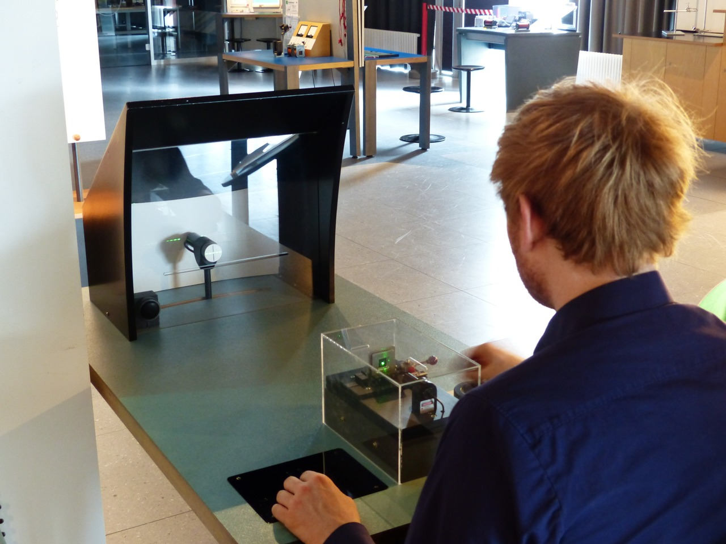
Examples
HVS: How much gaussian blur must be added that you are not able to recognized a face
Specific lab environment

Slide 4
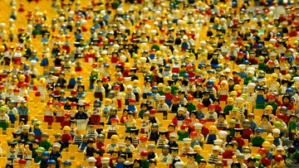
Examples
HVS: How much gaussian blur must be added that you are not able to recognized a face
Specific lab environment
QoP: Which compression setting is the best?
Lab or similar environment, comparing the same sources

Slide 5
Examples
HVS: How much gaussian blur must be added that you are not able to recognized a face
Specific lab environment
QoP: Which compression setting is the best?
Lab or similar environment, comparing the same sources
QoE: Which compression is best considering the current context of the user?
Watching what a user is doing

Slide 6
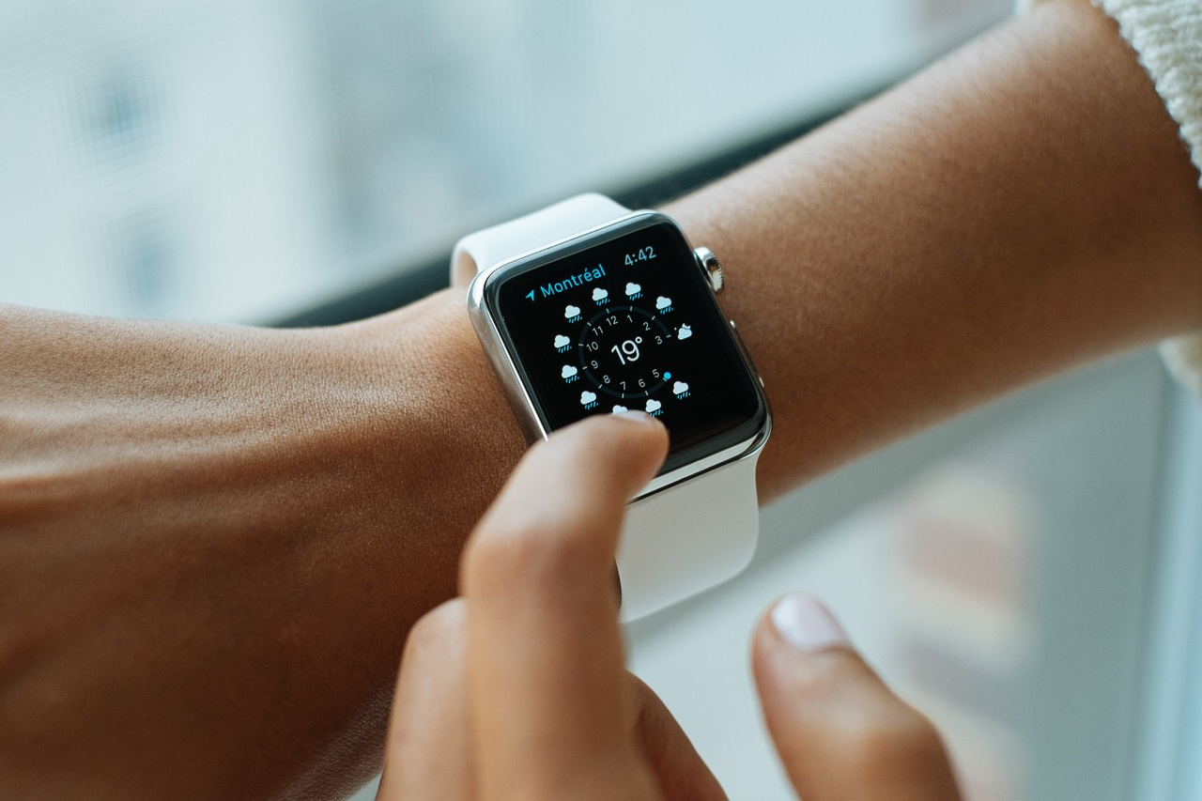
Examples
HVS: How much gaussian blur must be added that you are not able to recognized a face
Specific lab environment
QoP: Which compression setting is the best?
Lab or similar environment, comparing the same sources
QoE: Which compression is best considering the current context of the user?
Watching what a user is doing
UX: How to make a better product?
Watching what a user is doing

Slide 7
Experiments You Could Repeat
ACR Without the Scale
Your YouTube Our Lab
Notes:
If the color of lightening in your room is important this is difficult to measure (with reasonable precision)
7

Slide 8
ACR Without the Scale
Problem to solve:
We get very limited information from a tester
The process of selecting an answer is unknown
Solution:
Thinking aloud
A preselected world is changed to a speech description
It is ok to start description seeing the video
We see the evolution of the scoring system
We see all quality dimensions
The rest of the experiment is the same
Problems:
Data analysis is more challenging
We do not know if testers really say something

Slide 9
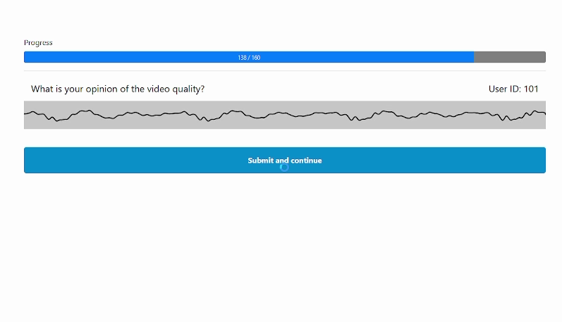
ACR Without the Scale The Interface
https://github.com/Qub3k/avrateNG
(which is a modified version of https://github.com/Telecommunication-Telemedia-Assessment/avrateNG)

Slide 10
Your YouTube Our Lab
Problem to solve:
10 second videos without the audio are not what a user watches
Normally we select the content based on our preferences
We are not forced to see the whole content
Solution:
A rare popup with a quality question
A user selects the content
Watching makes them forget about the task
Real experience
We use a standard quality scale
Problems:
People do not just watch YouTube
People are so much into the experience that quality is forgotten
It is difficult to follow what is the objective quality

Slide 11
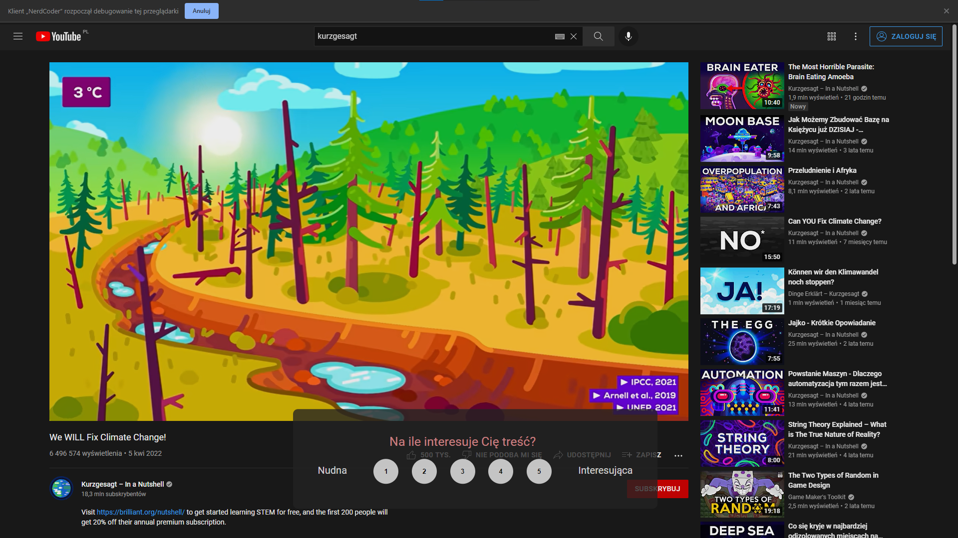
Your YouTube Our Lab The Interface

Slide 12
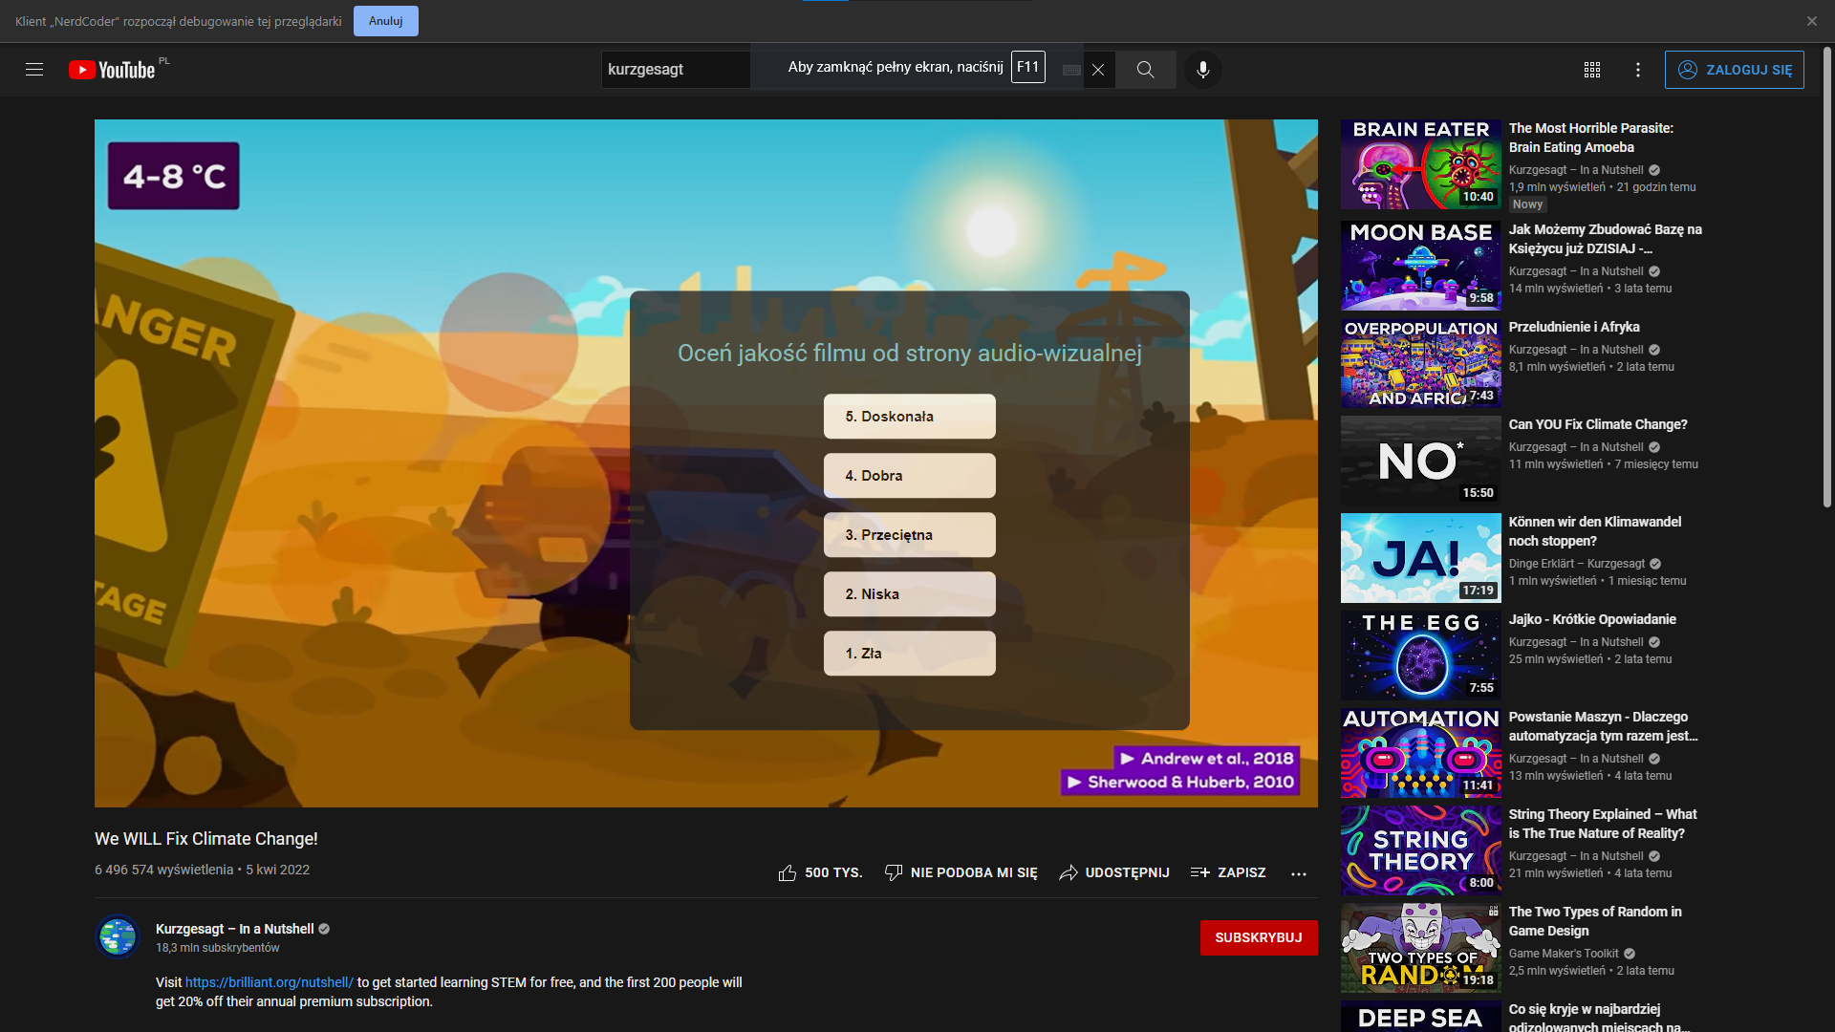
Your YouTube Our Lab The Interface

Slide 13
Thank you!
www.eeagrants.org Facebook, Twitter, LinkedIn, Instagram YouTube: EEANorwayGrants Mail: info-fmo@efta.int

