Slide 1
QAH working group Quality Assessment for Health Applications
13th December 2021
Chairs: Lu Zhang¹, Meriem Outtas¹, and Lucie Lévêque²
¹ IETR - INSA Rennes, ² LS2N - Nantes Université

Slide 2
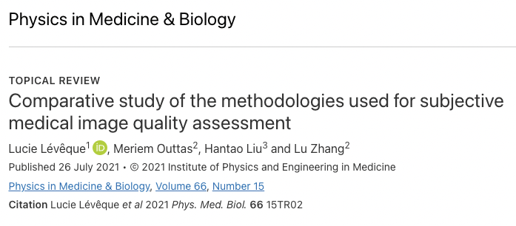
What we did in 2021
Topical review published in July in IOP Physics in Medicine & Biology
State-of-the-art of recent works on medical subjective QA + task-based approaches
Discussion on merits and drawbacks of the methodologies + recommendations
Lack of available annotated medical databases

Slide 3
What we did in 2021
Topical review for submitted to Medical Image Analysis

Slide 4
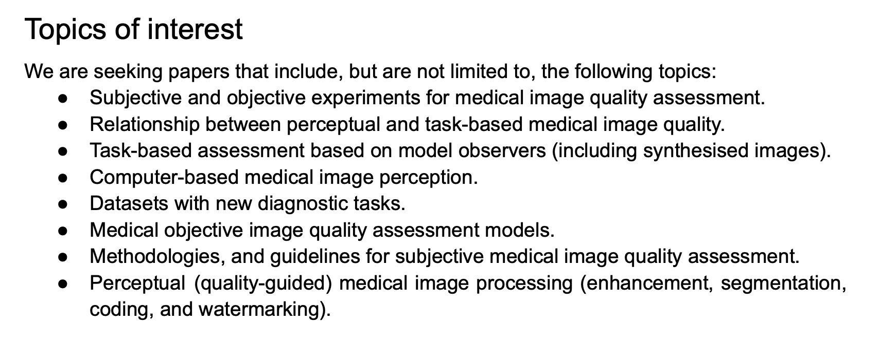
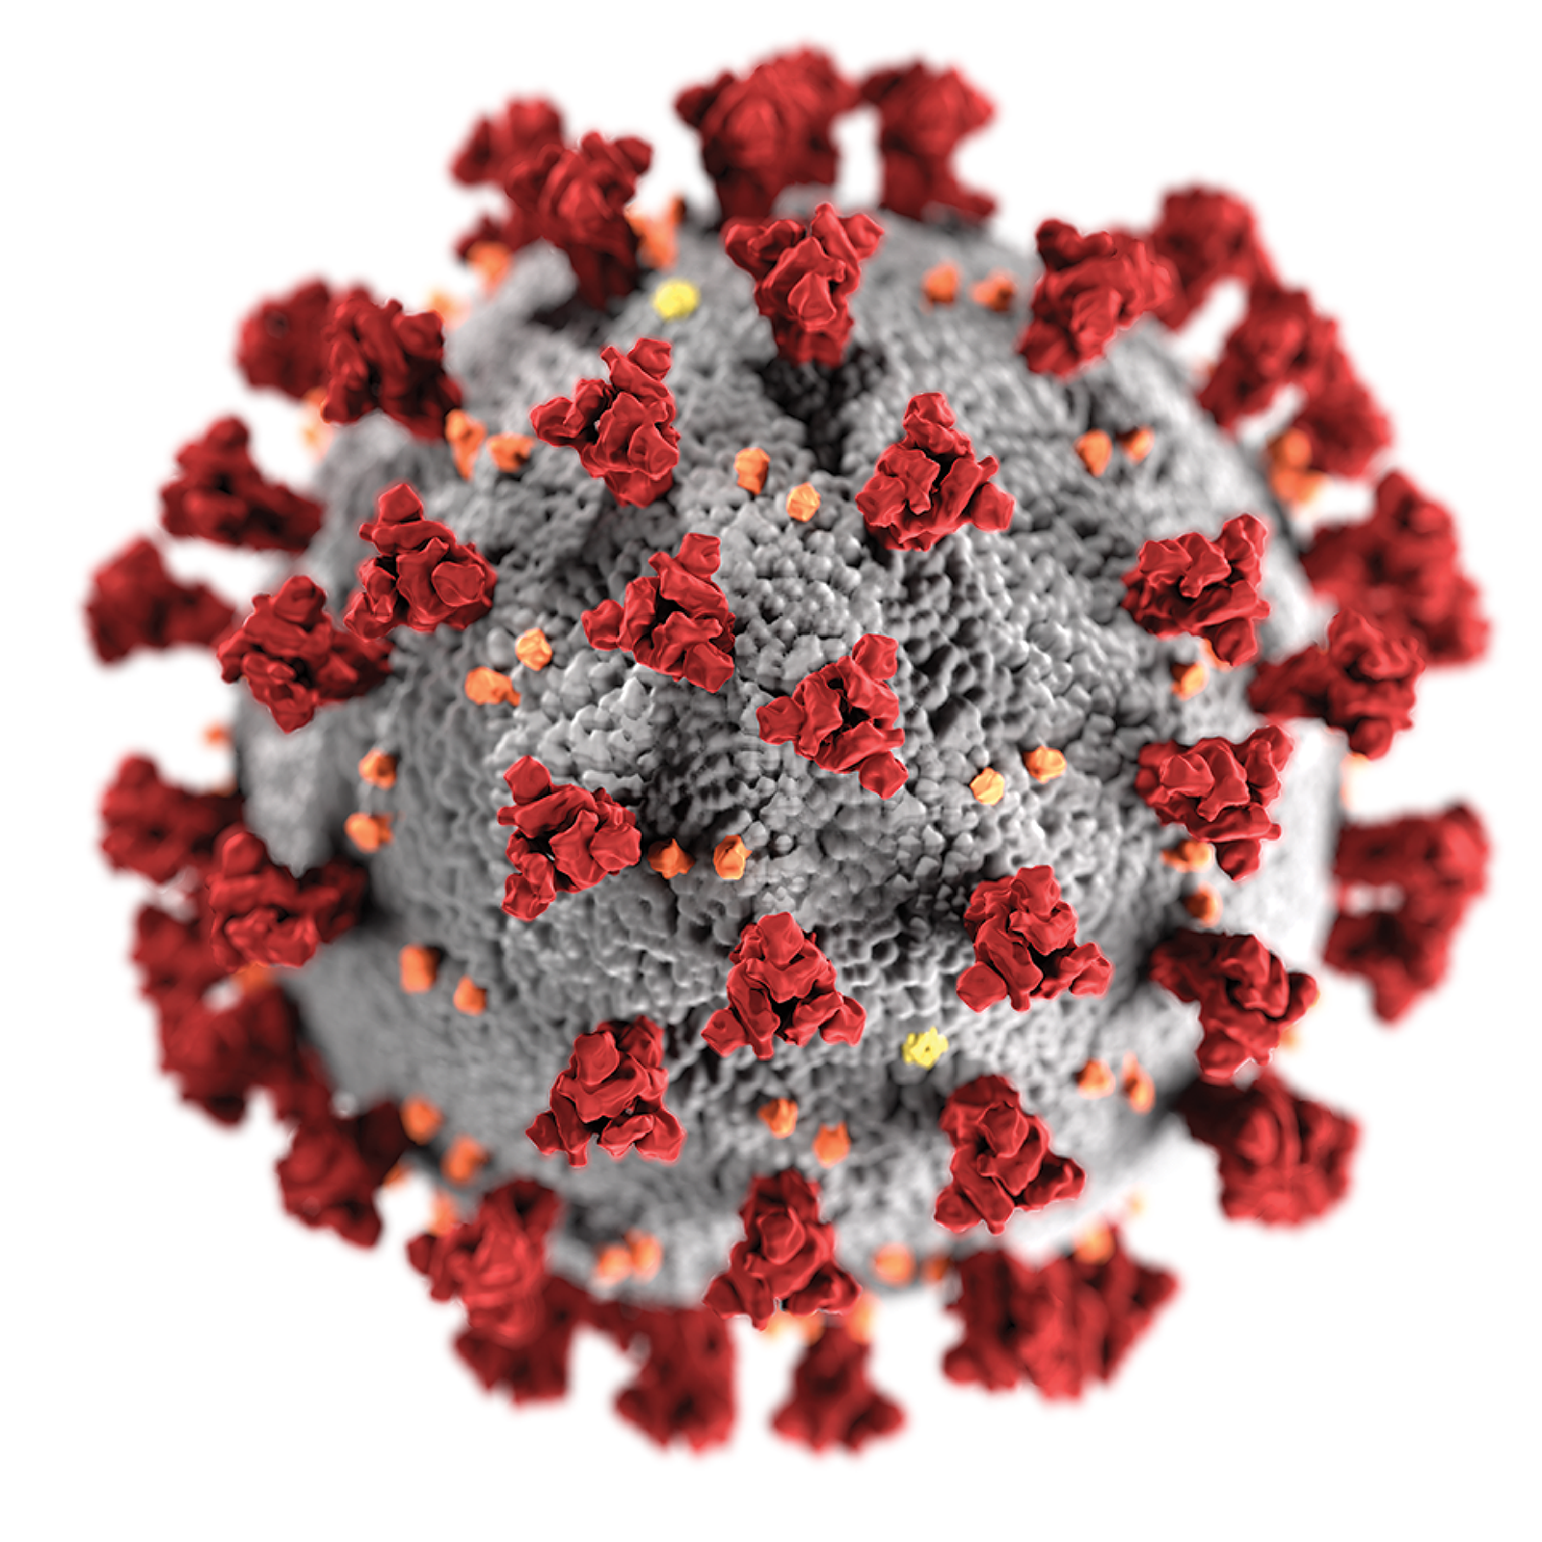
What we did in 2021
3) Special session for ICIP 2022: Quality Assessment for Medical Imaging Applications
Research works on COVID-19 are especially encouraged to be submitted.

Slide 5
Invitation for contributions
If you wish to take part in ICIP 2022 Special Session on Quality Assessment for Medical Imaging Applications, please send an email to lucie.leveque@univ-nantes.fr and/or meriem.outtas@insa-rennes.fr ASAP (before this evening…) including:
The title of your article
Authors’ names and affiliations
A short abstract

