Slide 1
QAH working group Quality Assessment for Health Applications
16th December 2021
Chairs: Lu Zhang, Meriem Outtas, and Lucie Lévêque lucie.leveque@univ-nantes.fr

Slide 2
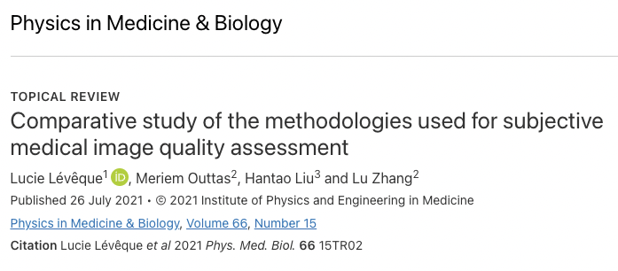
What we did in 2021
Topical review published in July:
State-of-the-art of recent works on subjective QA + task-based approaches
Discussion on merits and drawbacks of the methodologies + recommendations
List + lack of available annotated medical databases

Slide 3
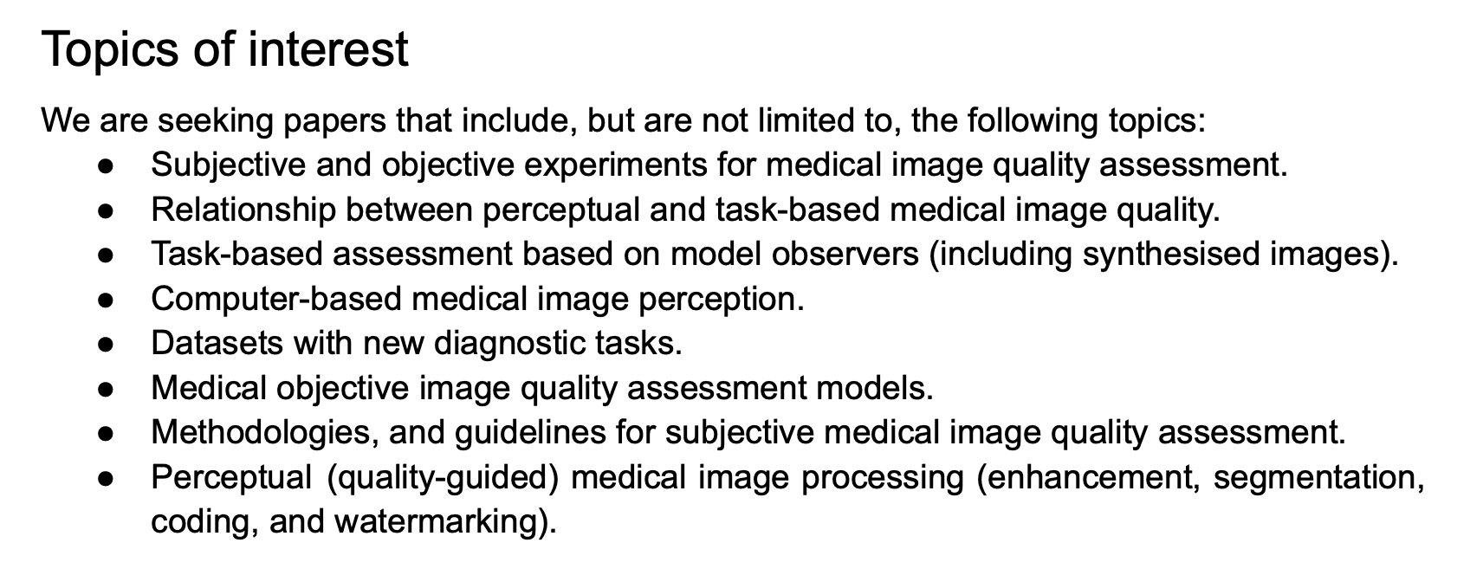
What we did in 2021
2) Special session submitted to ICIP 2022: Quality Assessment for Medical Imaging Applications
3) Topical review submitted to Medical Image Analysis, to be presented now!

Slide 4
Objective Quality Assessment of Medical Images and Videos:
Review and Challenges
Rafael Rodrigues¹, Lucie Lévêque², Jesús Gutiérrez³,
Houda Jebbari⁴, Meriem Outtas⁴, Lu Zhang⁴, Aladine Chetouani⁵,
Shaymaa Al-Juboori⁶, Maria G. Martini⁶, and Antonio M.G. Pinheiro¹
¹ Instituto de Telecomunicações & Universidade da Beira Interior, PORTUGAL
² Nantes Laboratory of Digital Sciences – Nantes Université, FRANCE
³ Information Processing and Telecommunications Center & Universidad Politécnica de Madrid, SPAIN
⁴ Department of Industrial Computer Science and Electronics – INSA Rennes, FRANCE
⁵ PRISME Laboratory – Université d’Orléans, FRANCE
⁶ School of Computer Science and Mathematics– Kingston University, UK
QAH Working Group

Slide 5
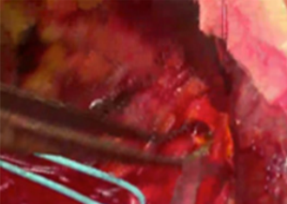
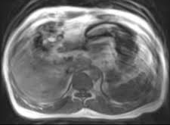
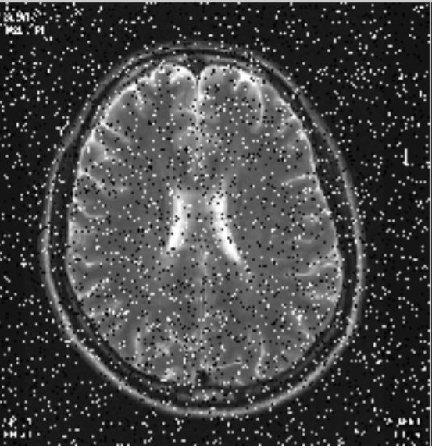
INTRODUCTION
Impairments in medical image and video depend on acquisition and reconstruction-related factors, specific to each imaging modality (e.g., radiation dose for CT scans, or magnetic field homogeneity for MRI).
Images and videos may also be subject to different processing, compression/encoding, transmission, and visualisation methods.
Image and video QA in health applications is a necessity, towards improving methodologies throughout the clinical workflow; but also a very challenging field, given the diversity of content, impairments, and applications.

Slide 6
OVERVIEW
OBJECTIVE QUALITY ASSESSMENT
SUBJECTIVE QUALITY ASSESSMENT
Lévêque et al., Physics in Medicine & Biology, 2021.
Visual quality-based approaches
Task-based approaches
Compute quality index directly from visual and/or structural information of the images and videos
Designed to approximate the performance of human observers on a given task

Slide 7
VISUAL QUALITY-BASED METHODS
Visual quality-based
methods
Full-reference metrics (FR)
Reduced-reference metrics (RR)
No-reference metrics (NR)

Slide 8
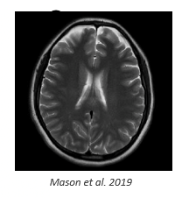
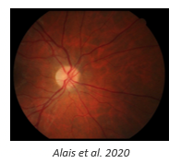
VISUAL QUALITY-BASED METHODS
References by imaging modality:
Magnetic Resonance Imaging (MRI) – 11
Retinal fundus photography – 7
Ultrasonography – 7
Computed Tomography (CT) – 5
Endoscopic/laparoscopic video – 5
Fused images (MRI, CT, PET, SPECT, US) – 2
X-ray (planar) – 1
Ocular Coherence Tomography – 1

Slide 9
TASK-BASED METHODS
Task-based
methods
Detection and classification
Estimation
Localisation
Segmentation
Characterisation

Slide 10
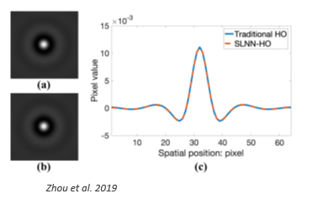
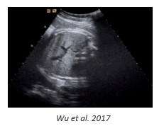
TASK-BASED METHODS
References by imaging modality:
Computed Tomography (CT) – 4 (phantom studies)
Computer-simulated images – 4
Retinal fundus photography – 2
Magnetic Resonance Imaging (MRI) – 1
Mammography - 1
Ultrasound – 1

Slide 11
DISCUSSION AND FUTURE WORK
Regarding FR and RR visual quality-based metrics, all the reviewed papers reported the use of metrics originally developed for natural content.
FR metrics: PSNR and SSIM were the most commonly used metrics (10 studies).
VIF and NQM were also used frequently.
Only one paper reported a FR metric specifically designed for medical content
(Razaak and Martini, 2016).
As for NR metrics, most papers proposed metrics tailored for the considered content.
Deep learning methods are becoming a staple in NR quality assessment of medical image and video: most recent studies used CNN instead of handcrafted features.
M. Razaak and M. G. Martini, “CUQI: cardiac ultrasound video quality index,” Journal of Medical Imaging, vol. 3, no. 1, p. 011011, 2016.

Slide 12
DISCUSSION AND FUTURE WORK
Lack of subjective annotated quality databases (Lévêque et al. (2021)): only 3 databases, by Suad et al. (2013), Outtas et al. (2018), and Khan et al. (2020).
Regarding task-based QA, annotated datasets should incorporate models of how clinicians perform diagnosis from images and videos, for example.
In order to address these issues, Willemink et al. (2020) suggested using human-in-the-loop machine learning. AI techniques promise a strong breakthrough in medical imaging objective QA.
- L. Lévêque, M. Outtas, H. Liu, and L. Zhang, “Comparative study of the methodologies used for subjective medical image quality assessment,” Physics in Medicine & Biology, vol. 66, no. 15, 2021.
- J. Suad and W. Jbara, “Subjective quality assessment of new medical image database,” International Journal of Computer Engineering and Technology,
vol. 4, pp. 155–164, 2013.
- M. Outtas, L. Zhang, O. Deforges, A. Serir, and W. Hamidouche, “Subjective and objective evaluations of feature selected multi output filter for speckle reduction on ultrasound images,” Physics in Medicine & Biology, vol. 63, no. 18, 2018.
- Z. A. Khan, A. Beghdadi, F. A. Cheikh, M. Kaaniche, E. Pelanis, R. Palomar, ̊A. A. Fretland, B. Edwin, and O. J. Elle, “Towards a video quality assessment based framework for enhancement of laparoscopic videos,” in Medical Imaging 2020: Image Perception, Observer Performance, and Technology Assessment, vol. 11316. International Society for Optics and Photonics, 2020, p. 113160P.
- M. Willemink, W. Koszek, C. Hardell, J. Wu, D. Fleischmann, H. Harvey, L. Folio, R. Summers, D. Rubin, and M. Lungren, “Preparing medical imaging data for machine learning,” Radiology, vol. 295, no. 1, 2020.

Slide 13
DISCUSSION AND FUTURE WORK
Another challenge for objective medical QA is artifact simulation. Collecting data with real artifacts may be impractical or not always possible.
However, simulated artifacts are normally limited in their range, which may hinder the application of developed QA methods to real clinical data (Oh et al., 2021).
Some efforts are reported, concerning the simulation of content-specific and realistic artifacts (Yang et al., 2019; Oktaviana et al., 2019; Hu et al., 2021; Oh et al., 2021).
Deep learning methods, e.g., Generative Adversarial Networks (GANs) may provide interesting solutions.
- G. Oh, J. E. Lee, and J. C. Ye, “Unpaired MR motion artifact deep learning using outlier-rejecting bootstrap aggregation,” IEEE Transactions on Medical Imaging, vol. 40, no. 11, pp. 3125–3139, 2021.
- J. Yang, M. Faraji, and A. Basu, “Robust segmentation of arterial walls in intravascular ultrasound images using dual path U-Net,” Ultrasonics, vol. 96, pp. 24–33, 2019.
- A. Oktaviana, S. Pawiro, T. Siswatining, and D. Soejoko, “Preliminary study of ring artifact detection in SPECT imaging using Jaszczak phantom,” in Journal of Physics: Conference Series, vol. 1248, no. 1. IOP Publishing, 2019, p. 012030.
- R. Hu, R. Yang, Y. Liu, and X. Li, “Simulation and mitigation of the wrap-around artifact in the MRI image,” Frontiers in Computational Neuroscience, vol.15, p. 89, 2021.

Slide 14
DISCUSSION AND FUTURE WORK
In task-based QA, traditional model observers are based on statistical characteristics of the images. Hence, many studies rely on phantom or simulated images.
Currently, there is no evidence that studies conducted on simulated images ensure sufficient confidence to draw relevant conclusions on real clinical data.
DL methods could address these limitations, as task performance provides a direct quality measure. The challenge is to define which tasks may be reliably delegated.
To our knowledge, existing models are limited in terms of task range. Characterisation tasks are highly complex and involve a linguistic response (e.g., benign vs. malign). Other tasks include estimation tasks, which aim at determining a scalar or range of values for an object parameter (e.g., tumour diameter).

Slide 15
DISCUSSION AND FUTURE WORK
3D visualisation of medical content (e.g., using stereoscopic or light field) opens new opportunities, e.g., surgery training (Martini et al., 2013). But QA research is still behind.
Compression and transmission of 3D stereoscopic, as well of light field, medical content, require suitable metrics for the assessment of their performance. Studies on QA for light field medical images have started (Kara et al., 2017).
Future research might focus on evaluating the performance of existing metrics for generic 3D images and videos (e.g., Han et al., 2016; Battisti et al., 2015) and light field data (e.g., Ak and Le Callet, 2019; Tamboli et al., 2018) on medical data.
The availability of medical datasets in stereoscopic and light field formats is in demand.
- M. G. Martini, C. T. Hewage, M. M. Nasralla, R. Smith, I. Jourdan, and T. Rockall, “3D robotic tele-surgery and training over next generation wireless networks,” in 2013 35th Annual International Conference of the IEEE Engineering in Medicine and Biology Society (EMBC). IEEE, 2013, pp. 6244–6247.
- P. A. Kara, P. T. Kovacs, S. Vagharshakyan, M. G. Martini, S. Imre, A. Barsi, K. Lackner, and T. Balogh, “Perceptual quality of reconstructed medical images on projection-based light field displays,” in eHealth 360°. Springer, 2017, pp. 476–483.
- Y. Han, Z. Yuan, and G.-M. Muntean, “An innovative no-reference metric for real-time 3D stereoscopic video quality assessment,” IEEE Transactions on Broadcasting,
vol. 62, no. 3, pp. 654–663, 2016.
- F. Battisti, E. Bosc, M. Carli, P. Le Callet, and S. Perugia, “Objective image quality assessment of 3D synthesized views,” Signal Processing: Image Communication,
vol. 30, pp. 78–88, 2015.
- A. Ak and P. Le Callet, “Investigating epipolar plane image representations for objective quality evaluation of light field images,” in European Workshop on Visual Information Processing, Oct. 2019, pp. 135–139.
- R. R. Tamboli, P. A. Kara, A. Cserkaszky, A. Barsi, M. G. Martini, B. Appina, S. S. Channappayya, and S. Jana, “3D objective quality assessment of light field
video frames,” in 3DTV-Conference: The True Vision-Capture, Transmission and Display of 3D Video, Jun. 2018.

Slide 16
REFERENCES
Visual quality-based metrics
Full-reference metrics:
- Y. Zhou, D. Chen, C.-f. Li, X.-o. Li, and H.-q. Feng, “A practice of medical image quality evaluation,” in International Conference on Neural Networks and Signal Processing, vol. 1, 2003, pp. 204–207.
- I. A. Kowalik-Urbaniak, J. Castelli, N. Hemmati, D. Koff, N. Smolarski-Koff, E. R. Vrscay, J. Wang, and Z. Wang, “Modelling of subjective radiological assessments with objective image quality measures of brain and body CT images,” in International Conference Image Analysis and Recognition. Springer, 2015, pp. 3–13.
- A. Panayides, M. S. Pattichis, C. S. Pattichis, C. P. Loizou, M. Pantziaris, and A. Pitsillides, “Atherosclerotic plaque ultrasound video encoding, wireless transmission, and quality assessment using H.264,” IEEE Transactions on Information Technology in Biomedicine, vol. 15, no. 3, pp. 387–397, 2011.
- M. Razaak, M. G. Martini, and K. Savino, “A study on quality assessment for medical ultrasound video compressed via HEVC,” IEEE Journal of Biomedical and Health Informatics, vol. 18, no. 5, pp. 1552–1559, 2014.
- M. Razaak and M. G. Martini, “CUQI: cardiac ultrasound video quality index,” Journal of Medical Imaging, vol. 3, no. 1, p. 011011, 2016.
- A. E. Kumcu, K. Bombeke, H. Chen, L. Jovanov, L. Platisa, H. Q. Luong, J. Van Looy, Y. Van Nieuwenhove, P. Schelkens, and W. Philips, “Visual quality assessment of H.264/AVC compressed laparoscopic video,” in Medical Imaging 2014: Image Perception, Observer Performance, and Technology Assessment, vol. 9037. International Society for Optics and Photonics, 2014, p. 90370A.
- M. A. Usman, M. R. Usman, and S. Y. Shin, “Quality assessment for wireless capsule endoscopy videos compressed via HEVC: from diagnostic quality to visual perception,” Computers in Biology and Medicine, vol. 91, pp. 112–134, 2017.

Slide 17
REFERENCES
Visual quality-based metrics
Full-reference metrics:
- B. Kumar, S. P. Singh, A. Mohan, and H. V. Singh, “MOS prediction of SPIHT medical images using objective quality parameters,” in International Conference on Signal Processing Systems, 2009, pp. 219–223.
- B. Kumar, S. B. Kumar, and C. Kumar, “Development of improved SSIM quality index for compressed medical images,” in IEEE International Conference on Image Information Processing, 2013, pp. 251–255.
- G. P. Renieblas, A. T. Nogués, A. M. González, N. G. León, and E. G. Del Castillo, “Structural similarity index family for image quality assessment in radiological images,” Journal of Medical Imaging, vol. 4, no. 3, p. 035501, 2017.
- A. Chaabouni, Y. Gaudeau, J. Lambert, J.-M. Moureaux, and P. Gallet, “H.264 medical video compression for telemedicine: a performance analysis,” Innovation and Research in Biomedical Engineering, vol. 37, no. 1, pp. 40–48, 2016.
- A. Mason, J. Rioux, S. E. Clarke, A. Costa, M. Schmidt, V. Keough, T. Huynh, and S. Beyea, “Comparison of objective image quality metrics to expert radiologists’ scoring of diagnostic quality of MR images,” IEEE Trans. on Medical Imaging, vol. 39, no. 4, pp. 1064–1072, 2019.
- L. S. Chow, H. Rajagopal, R. Paramesran, Alzheimer’s Disease Neuroimaging Initiative et al., “Correlation between subjective and objective assessment of magnetic resonance (MR) images,” Magnetic Resonance Imaging, vol. 34, no. 6, pp. 820–831, 2016.

Slide 18
REFERENCES
Visual quality-based metrics
Reduced-reference metrics:
- S. C. Lee and Y. Wang, “Automatic retinal image quality assessment and enhancement,” in Medical Imaging 1999: image Processing, vol. 3661. International Society for Optics and Photonics, 1999, pp. 1581–1590.
- M. Lalonde, L. Gagnon, M.-C. Boucher et al., “Automatic visual quality assessment in optical fundus images,” in Proceedings of Vision Interface, vol. 32. Ottawa, 2001, pp. 259–264.
- B. M. Planitz and A. J. Maeder, “A study of block-based medical image watermarking using a perceptual similarity metric,” in Digital Image Computing: Techniques and Applications, Dec. 2005.
- K. M. Nasr and M. G. Martini, “A visual quality evaluation method for telemedicine applications,” Signal Processing: Image Communication, vol. 57, pp. 211–218, 2017.

Slide 19
REFERENCES
Visual quality-based metrics
No-reference metrics:
- A. Liebgott, T. Küstner, S. Gatidis, F. Schick, and B. Yang, “Active learning for magnetic resonance image quality assessment,” in 2016 IEEE International Conference on Acoustics, Speech and Signal Processing (ICASSP), 2016, pp. 922–926.
- L. S. Chow and H. Rajagopal, “Modified-BRISQUE as no reference image quality assessment for structural MR images,” Magnetic Resonance Imaging, vol. 43, pp. 74–87, 2017.
- M. Osadebey, M. Pedersen, D. Arnold, K. Wendel-Mitoraj et al., “Bayesian framework inspired no-reference region-of-interest quality measure for brain MRI images,” Journal of Medical Imaging, vol. 4, no. 2, p. 025504, 2017.
- S. J. Esses, X. Lu, T. Zhao, K. Shanbhogue, B. Dane, M. Bruno, and H. Chandarana, “Automated image quality evaluation of T2-weighted liver MRI utilizing deep learning architecture,” Journal of Magnetic Resonance Imaging, vol. 47, no. 3, pp. 723–728, 2018.
- R. Obuchowicz, M. Oszust, M. Bielecka, A. Bielecki, and A. Piórkowski, “Magnetic resonance image quality assessment by using non-maximum suppression and entropy analysis,” Entropy, vol. 22, no. 2, p. 220, 2020.
- J. J. Ma, U. Nakarmi, C. Y. S. Kin, C. M. Sandino, J. Y. Cheng, A. B. Syed, P. Wei, J. M. Pauly, and S. S. Vasanawala, “Diagnostic image quality assessment and classification in medical imaging: opportunities and challenges,” in 2020 IEEE 17th International Symposium on Biomedical Imaging (ISBI). IEEE, 2020, pp. 337–340.
- S. Chabert, J. S. Castro, L. Muñoz, P. Cox, R. Riveros, J. Vielma, G. Huerta, M. Querales, C. Saavedra, A. Veloz et al., “Image quality assessment to emulate experts’ perception in lumbar MRI using machine learning,” Applied Sciences, vol. 11, no. 14, p. 6616, 2021.

Slide 20
REFERENCES
Visual quality-based metrics
No-reference metrics:
- T. Köhler, A. Budai, M. F. Kraus, J. Odstrcilik, G. Michelson, and J. Hornegger, “Automatic no-reference quality assessment for retinal fundus images using vessel segmentation,” in Proceedings of the 26th IEEE International Symposium on Computer-based Medical Systems. IEEE, 2013, pp. 95–100.
- S. Wang, K. Jin, H. Lu, C. Cheng, J. Ye, and D. Qian, “Human visual system-based fundus image quality assessment of portable fundus camera photographs,” IEEE Transactions on Medical Imaging, vol. 35, no. 4, pp. 1046–1055, 2015.
- A. S. Coyner, R. Swan, J. P. Campbell, S. Ostmo, J. M. Brown, J. Kalpathy-Cramer, S. J. Kim, K. E. Jonas, R. P. Chan, M. F. Chiang et al., “Automated fundus image quality assessment in retinopathy of prematurity using deep convolutional neural networks,” Ophthalmology Retina, vol. 3, no. 5, pp. 444–450, 2019.
- A. Raj, N. A. Shah, A. K. Tiwari, and M. G. Martini, “Multivariate regression-based convolutional neural network model for fundus image quality assessment,” IEEE Access, vol. 8, pp. 57 810–57 821, 2020.
- Y. Shen, B. Sheng, R. Fang, H. Li, L. Dai, S. Stolte, J. Qin, W. Jia, and D. Shen, “Domain-invariant interpretable fundus image quality assessment,” Medical Image Analysis, vol. 61, p. 101654, 2020.
- S. I. Niwas, V. Jakhetiya, W. Lin, C. K. Kwoh, C. C. Sng, M. C. Aquino, K. Victor, and P. T. Chew, “Complex wavelet based quality assessment for AS-OCT images with application to Angle Closure Glaucoma diagnosis,” Computer Methods and Programs in Biomedicine, vol. 130, pp. 13–21, 2016
- Z. A. Khan, A. Beghdadi, M. Kaaniche, and F. A. Cheikh, “Residual networks based distortion classification and ranking for laparoscopic image quality assessment,” in 2020 IEEE International Conference on Image Processing (ICIP). IEEE, 2020, pp. 176–180.

Slide 21
REFERENCES
Visual quality-based metrics
No-reference metrics:
- S. Ali, F. Zhou, A. Bailey, B. Braden, J. E. East, X. Lu, and J. Rittscher, “A deep learning framework for quality assessment and restoration in video endoscopy,” Medical Image Analysis, vol. 68, p. 101900, 2021.
- A. H. Abdi, C. Luong, T. Tsang, G. Allan, S. Nouranian, J. Jue, D. Hawley, S. Fleming, K. Gin, J. Swift et al., “Automatic quality assessment of echocardiograms using convolutional neural networks: feasibility on the apical four-chamber view,” IEEE Transactions on Medical Imaging, vol. 36, no. 6, pp. 1221–1230, 2017.
- L. Tang, C. Tian, J. Qian, and L. Li, “No reference quality evaluation of medical image fusion,” International Journal of Imaging Systems and Technology, vol. 28, no. 4, pp. 267–273, 2018.
- L. Tang, C. Tian, L. Li, B. Hu, W. Yu, and K. Xu, “Perceptual quality assessment for multimodal medical image fusion,” Signal Processing: Image Communication, vol. 85, p. 115852, 2020.
- M. Outtas, L. Zhang, O. Deforges, W. Hammidouche, A. Serir, and C. Cavaro-Menard, “A study on the usability of opinion-unaware no-reference natural image quality metrics in the context of medical images,” in 2016 International Symposium on Signal, Image, Video and Communications (ISIVC), Nov 2016, pp. 308–313.

Slide 22
REFERENCES
Task-based metrics
Detection/Classification:
- B. L. Eck, R. Fahmi, K. M. Brown, S. Zabic, N. Raihani, J. Miao, and D. L. Wilson, “Computational and human observer image quality evaluation of low dose, knowledge-based CT iterative reconstruction,” Medical Physics, vol. 42, no. 10, pp. 6098–6111, 2015.
- D. Racine, A. H. Ba, J. G. Ott, F. O. Bochud, and F. R. Verdun, “Objective assessment of low contrast detectability in computed tomography with Channelized Hotelling Observer,” Physica Medica, vol. 32, no. 1, pp. 76–83, 2016.
- J. Greffier, J. Frandon, A. Larbi, J. Beregi, and F. Pereira, “CT iterative reconstruction algorithms: a task-based image quality assessment,” European Radiology, vol. 30, no. 1, pp. 487–500, 2020.
- F. K. Kopp, M. Catalano, D. Pfeiffer, A. A. Fingerle, E. J. Rummeny, and P. B. No ̈el, “CNN as model observer in a liver lesion detection task for X-ray computed tomography: a phantom study,” Medical Physics, vol. 45, no. 10, pp. 4439–4447, 2018.
- W. Zhou, H. Li, and M. A. Anastasio, “Approximating the Ideal Observer and Hotelling Observer for binary signal detection tasks by use of supervised learning methods,” IEEE Transactions on Medical Imaging, vol. 38, no. 10, pp. 2456–2468, 2019.
- M. Alnowami, G. Mills, M. Awis, P. Elangovanr, M. Patel, M. Halling-Brown, K. Young, D. R. Dance, and K. Wells, “A deep learning model observer for use in alterative forced choice virtual clinical trials,” in Medical Imaging 2018: Image Perception, Observer Performance, and Technology Assessment, vol. 10577. International Society for Optics and Photonics, 2018, p. 105770Q.
- K. Li, W. Zhou, H. Li, and M. A. Anastasio, “Assessing the impact of deep neural network-based image denoising on binary signal detection tasks,” IEEE Transactions on Medical Imaging, vol. 40, no. 9, pp. 2295– 2305, 2021

Slide 23
REFERENCES
Task-based metrics
Localisation:
- L. Wu, J.-Z. Cheng, S. Li, B. Lei, T. Wang, and D. Ni, “FUIQA: Fetal ultrasound image quality assessment with deep convolutional networks,” IEEE Transactions on Cybernetics, vol. 47, no. 5, pp. 1336–1349, 2017.
- W. Zhou, H. Li, and M. A. Anastasio, “Approximating the Ideal Observer for joint signal detection and localization tasks by use of supervised learning methods,” IEEE Transactions on Medical Imaging, vol. 39, no. 12, pp. 3992–4000, 2020.
-I. Lorente, C. K. Abbey, and J. G. Brankov, “Deep learning based model observer by U-Net,” in Medical Imaging 2020: Image Perception, Observer Performance, and Technology Assessment, vol. 11316. International Society for Optics and Photonics, 2020, p. 113160F.
Segmentation:
- R. Welikala, M. Fraz, P. Foster, P. Whincup, A. R. Rudnicka, C. G. Owen, D. Strachan, S. A. Barman et al., “Automated retinal image quality assessment on the UK Biobank dataset for epidemiological studies,” Computers in biology and medicine, vol. 71, pp. 67–76, 2016.
- R. Rodrigues and A. M. G. Pinheiro, “A quality of recognition case study: texture-based segmentation and MRI quality assessment,” in 2019 27th European Signal Processing Conference (EUSIPCO), Nov. 2019.
- R. Alais, P. Dokladal, A. Erginay, B. Figliuzzi, and E. Decencière, “Fast macula detection and application to retinal image quality assessment,” Biomedical Signal Processing and Control, vol. 55, p. 101567, 2020. (Localisation and segmentation)

Slide 24
Rafael Rodrigues
Multimedia Signal Processing Group,
Instituto de Telecomunicações – UBI, Covilhã, PT
rafael.rodrigues@ubi.pt
QAH Working Group

