Slide 1
Objective Video Quality Assessment Method for Recognition Tasks
Mikołaj Leszczuk, Lucjan Janowski, Jakub Nawała

Slide 2
Introduction

Slide 3
Metrics for General Quality of Experience (QoE)
Full-Reference:
Peak Signal-to-Noise Ratio (PSNR)
Structural SIMilarity (SSIM)
VMAF
No-Reference:
AGH Video Quality Indicators (AGH VQI, http://vq.kt.agh.edu.pl/)
Conventionally used in video processing systems for video quality evaluation

Slide 4
Metrics for Target Recognition Video (TRV)
Not appropriate for recognition tasks in video analytics (TRV)
Correct estimation of video processing pipeline performance - still significant research challenge in Computer Vision (CV) tasks

Slide 5
Research Goal
New proposal of objective video quality assessment method for recognition tasks
Method to be trained and tested on representative set of video sequences

Slide 6
General Research Content and Technical Approach
Acquisition of existing Source Reference Circuits (SRC)
Preparation of Hypothetical Reference Circuits (HRC)
Preparation of Processed Video Sequences (PVS)
Experimental comparison of recognition results and quality scores
Development of new objective video quality assessment model for recognition tasks

Slide 7
Acquisition of Existing Reference Circuits (SRC)

Slide 8
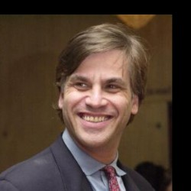
Face Recognition (FR)
Source: The Labelled Faces in the Wild (LFW) database
Resolution: 250×250
Count: 13,233 images of 5,749 different people

Slide 9
Object Recognition/Detection (OR)
The KITTI Vision Benchmark Suite
Source: Karlsruhe Institute of Technology and Toyota Technological Institute at Chicago
Resolution: 1242×375
Count: 3 categories (“City” - 18 sequences, “Residential” - 13 sequences, and “Road”' - 7 sequences), from 28 frames (00:02 minutes) to 809 frames (01:20 minutes), 7,480 frames in total

Slide 10
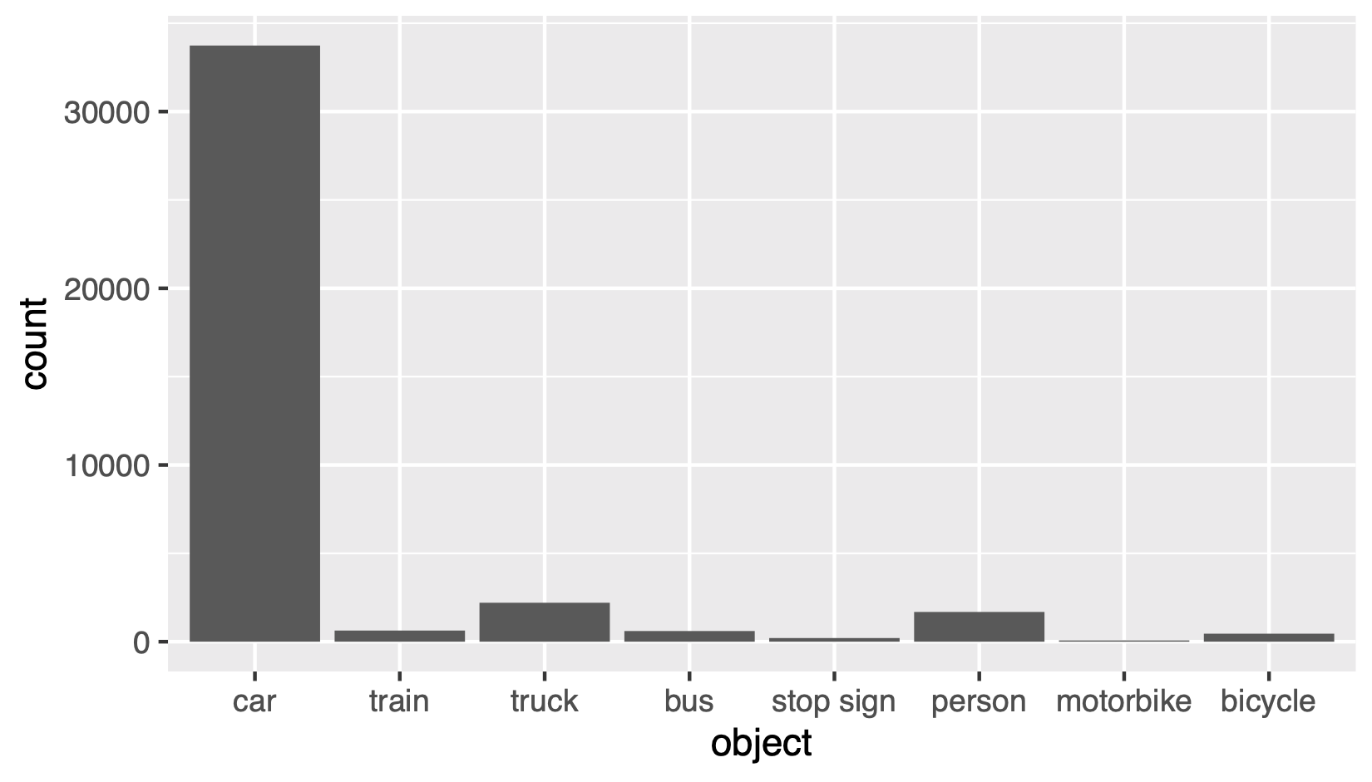
Statistics for the Frames for KITTY

Slide 11
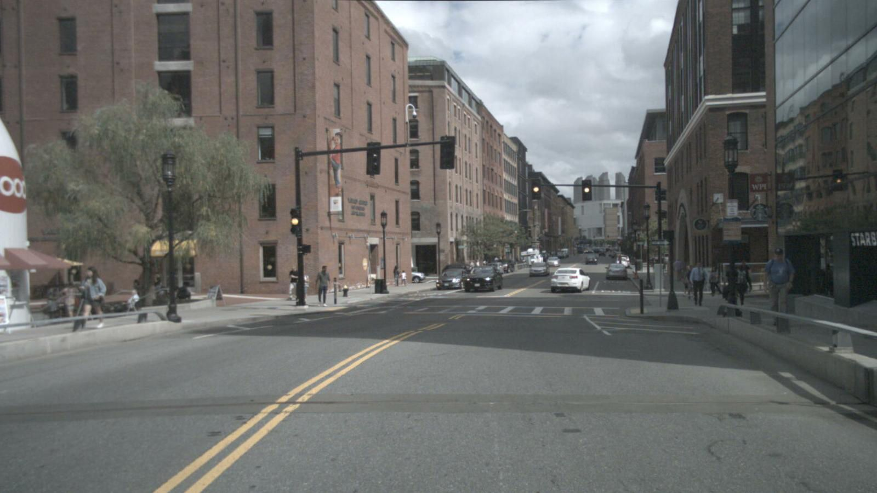
Object Recognition/Detection (OR)
nuScenes Data-Set
Source: Aptiv Autonomous Mobility
Resolution: 1600×900 (HD+)
Count: sweeps images, 4 Boston and 4 Singapore scenes (1,938 frames in total)

Slide 12
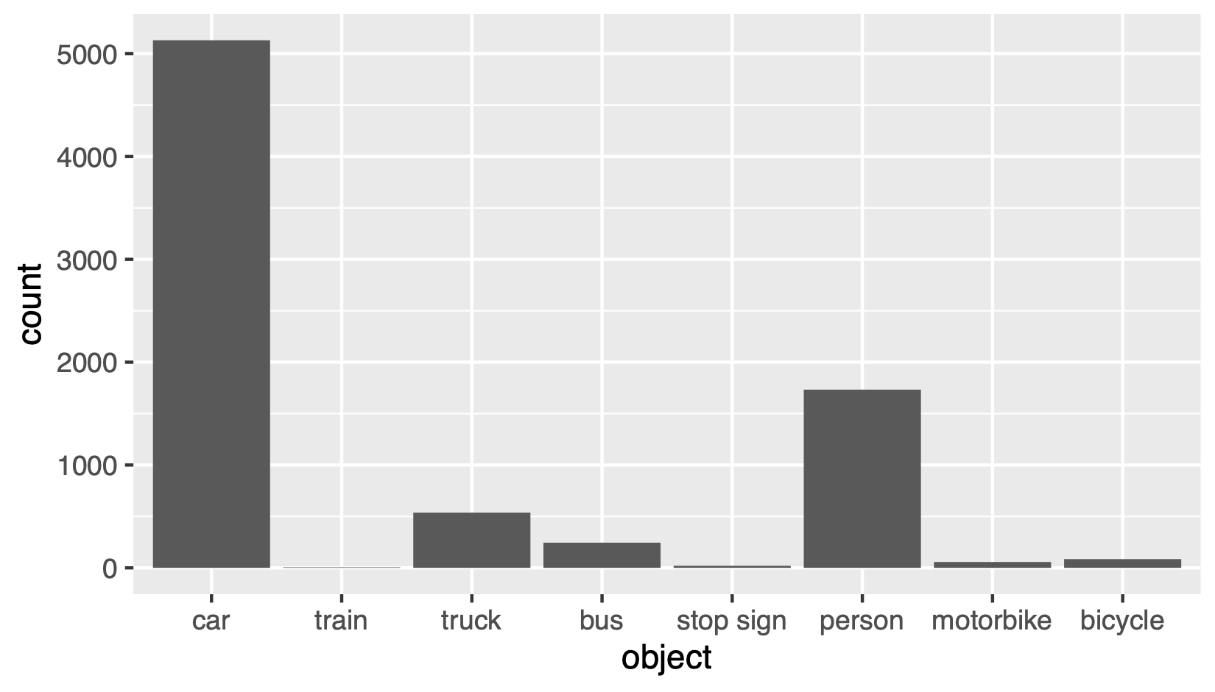
Statistics for the Frames for nuScenes

Slide 13
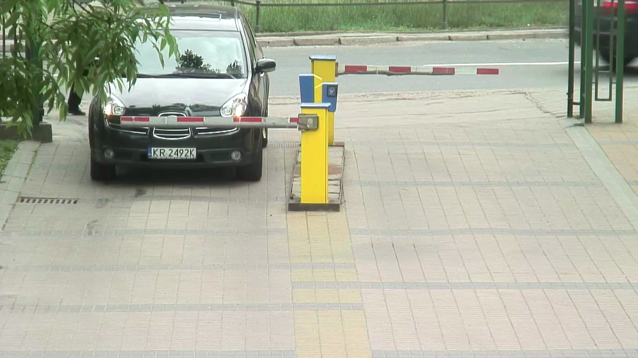
Automatic License/Number-Plate Recognition (ALPR)
Source: AGH University of Science and Technology (AGH)
Resolution: 1280×720 (HD)
Count: 22 video sequences, each one containing approximately 500 frames (11,000 frames in total)

Slide 14
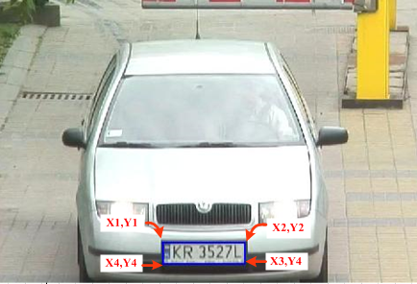
ALPR Annotations

Slide 15
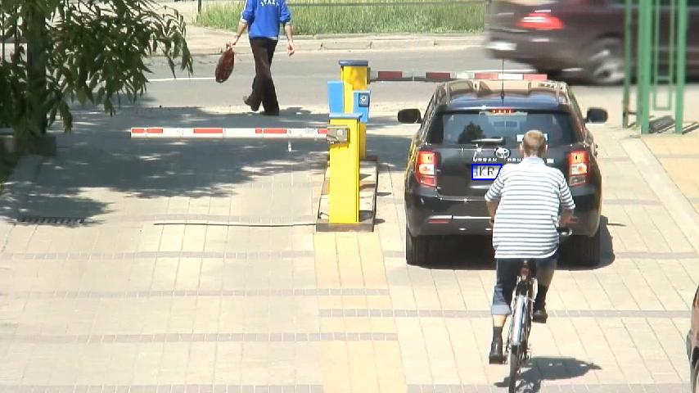
ALPR Occlusions

Slide 16
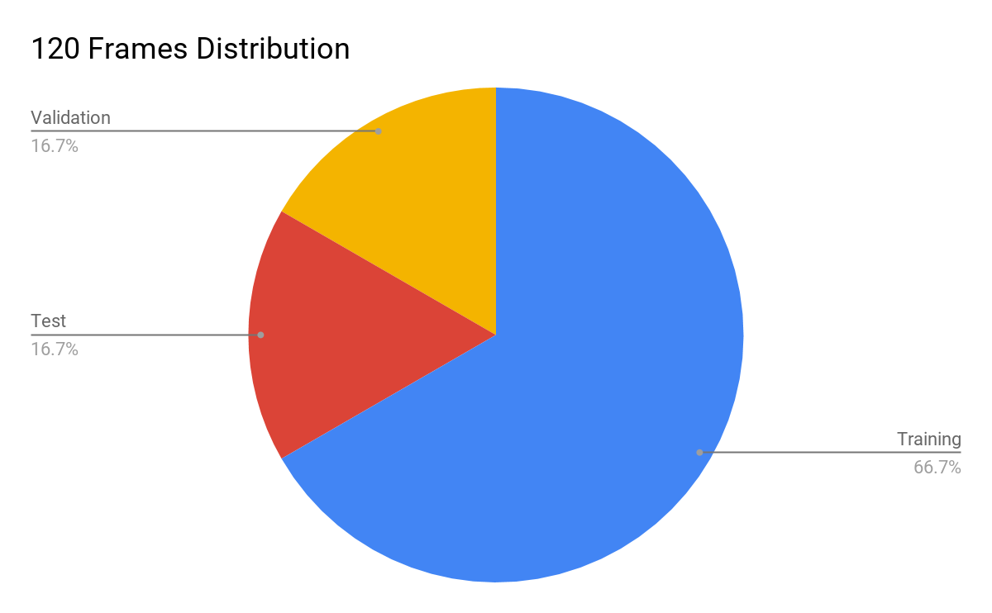
Subsets

Slide 17
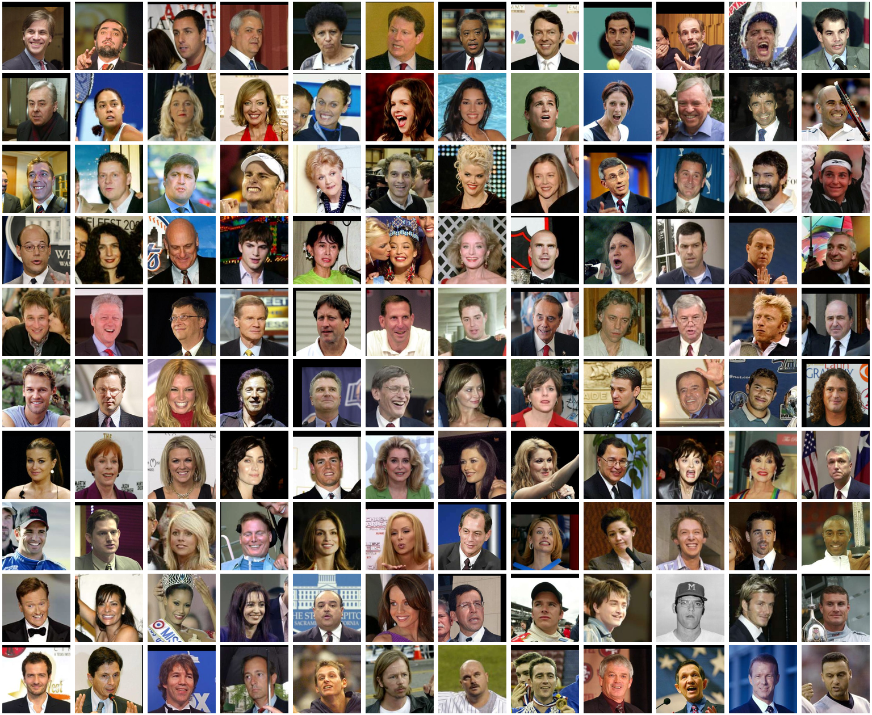
FR Subset

Slide 18
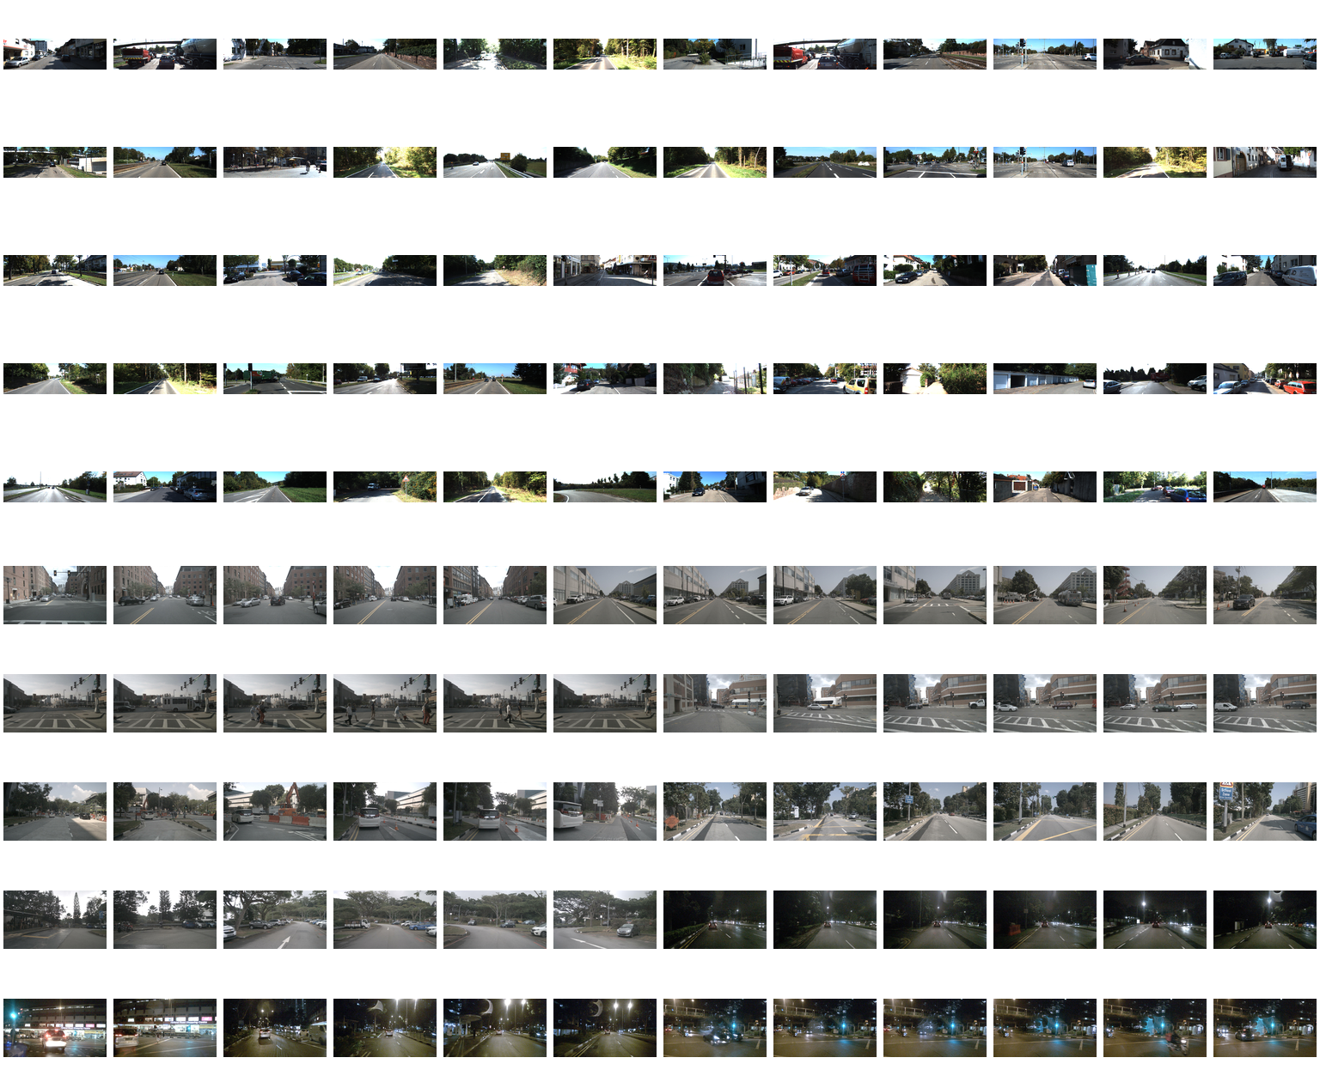
OR Subset

Slide 19
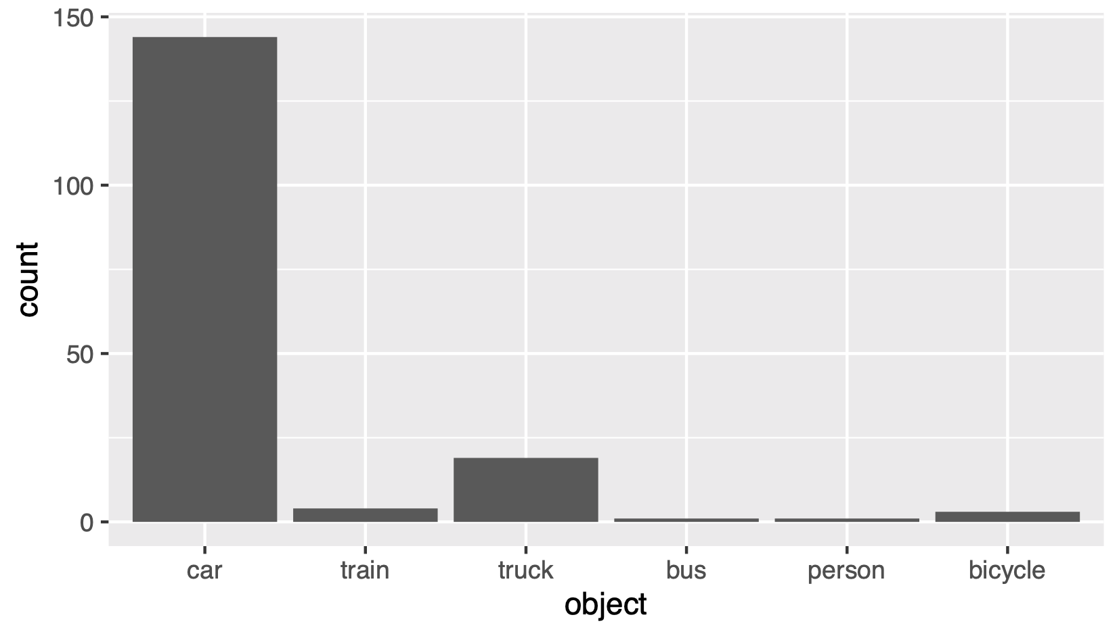
Statistics for the Selected Frames for KITTY

Slide 20
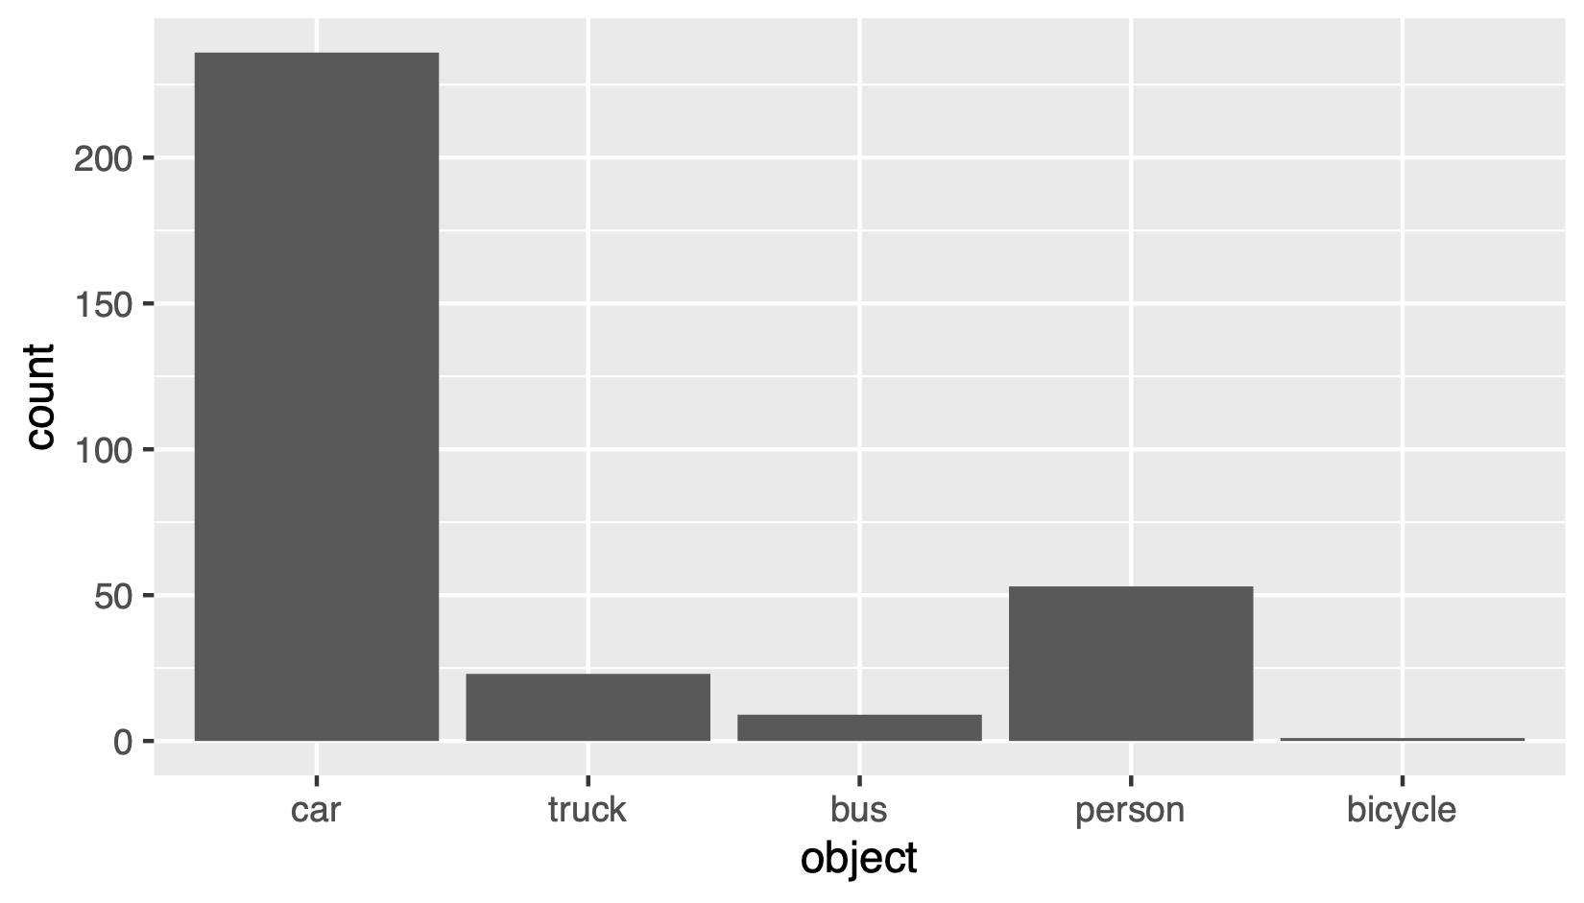
Statistics for the Selected Frames for nuScenes

Slide 21
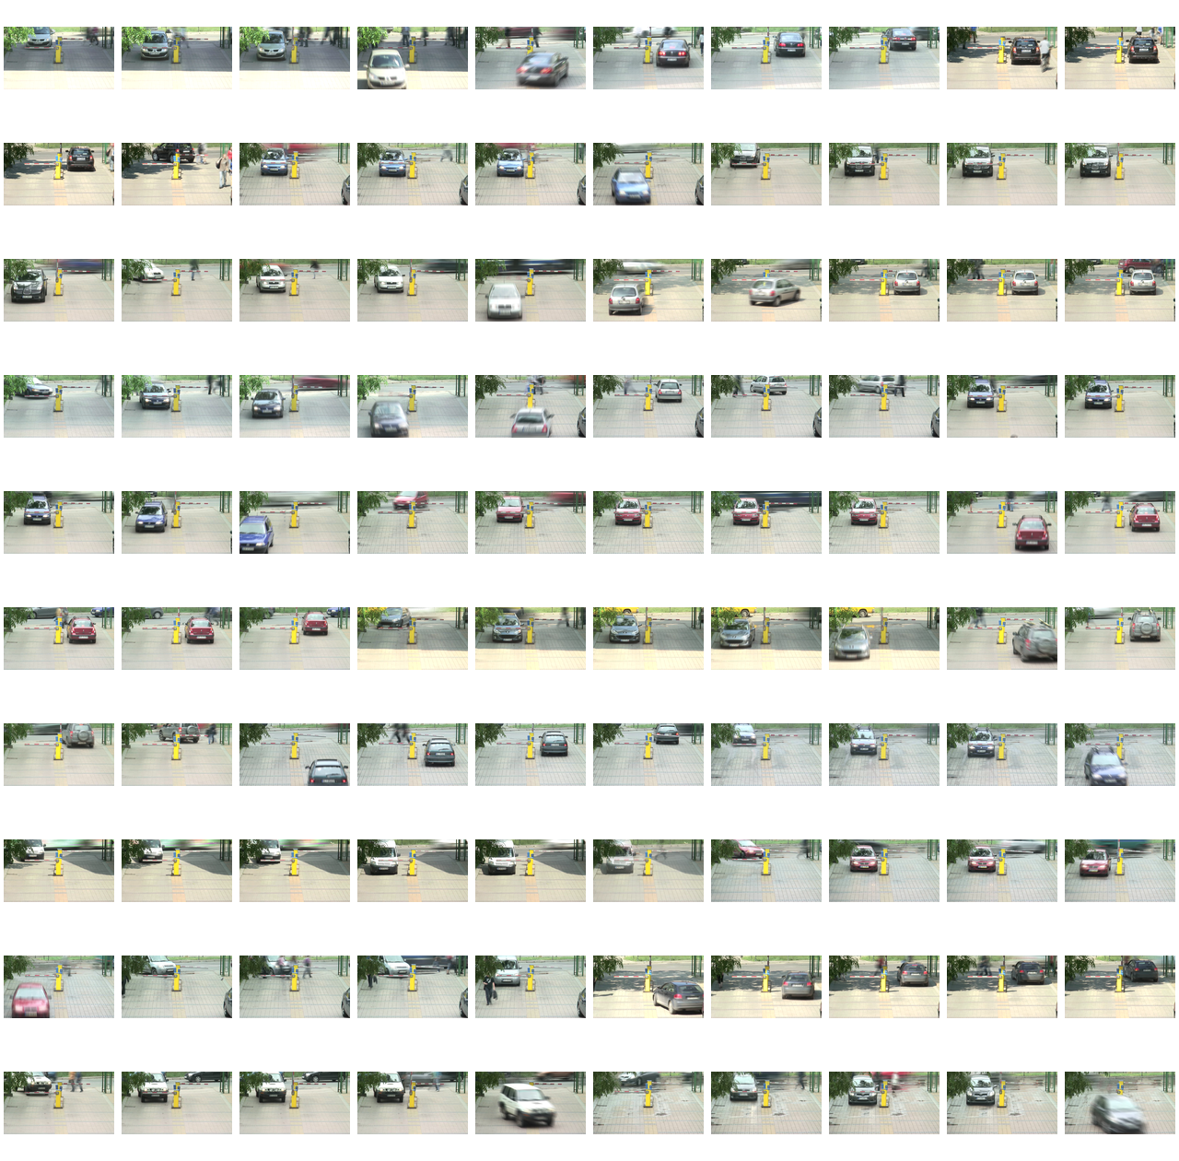
ALPR Subset

Slide 22
Preparation of Hypothetical Reference Circuits (HRCs)

Slide 23
Preparation of HRCs
7 distortion types
Gaussian Noise (GN),
Defocus,
Exposure Time Distortion
Over-Exposure (OE),
Under-Exposure (UE),
Motion Blur (MB),
Snow,
Droplets,
JPEG Compression.
All artificially injected.
Injected on multiple levels to make a Computer Vision (CV) algorithm performance drop.
In general, only one distortion at once, with 3 exceptions:
MB vs. GN,
OE vs. GN,
UE vs. MB*.
Notes:
* We do the MB first to avoid problems with the frame interpolation

Slide 24
Notes:
This is an original frame. Next slides present the most interesting distortions: motion blur, droplets, sparse and dense snow, respectively.

Slide 25
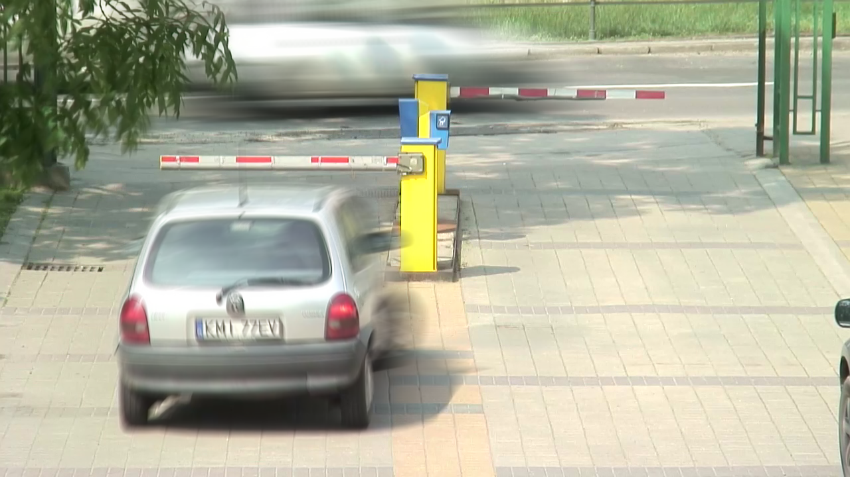

Slide 29
Recognition Experiment

Slide 30
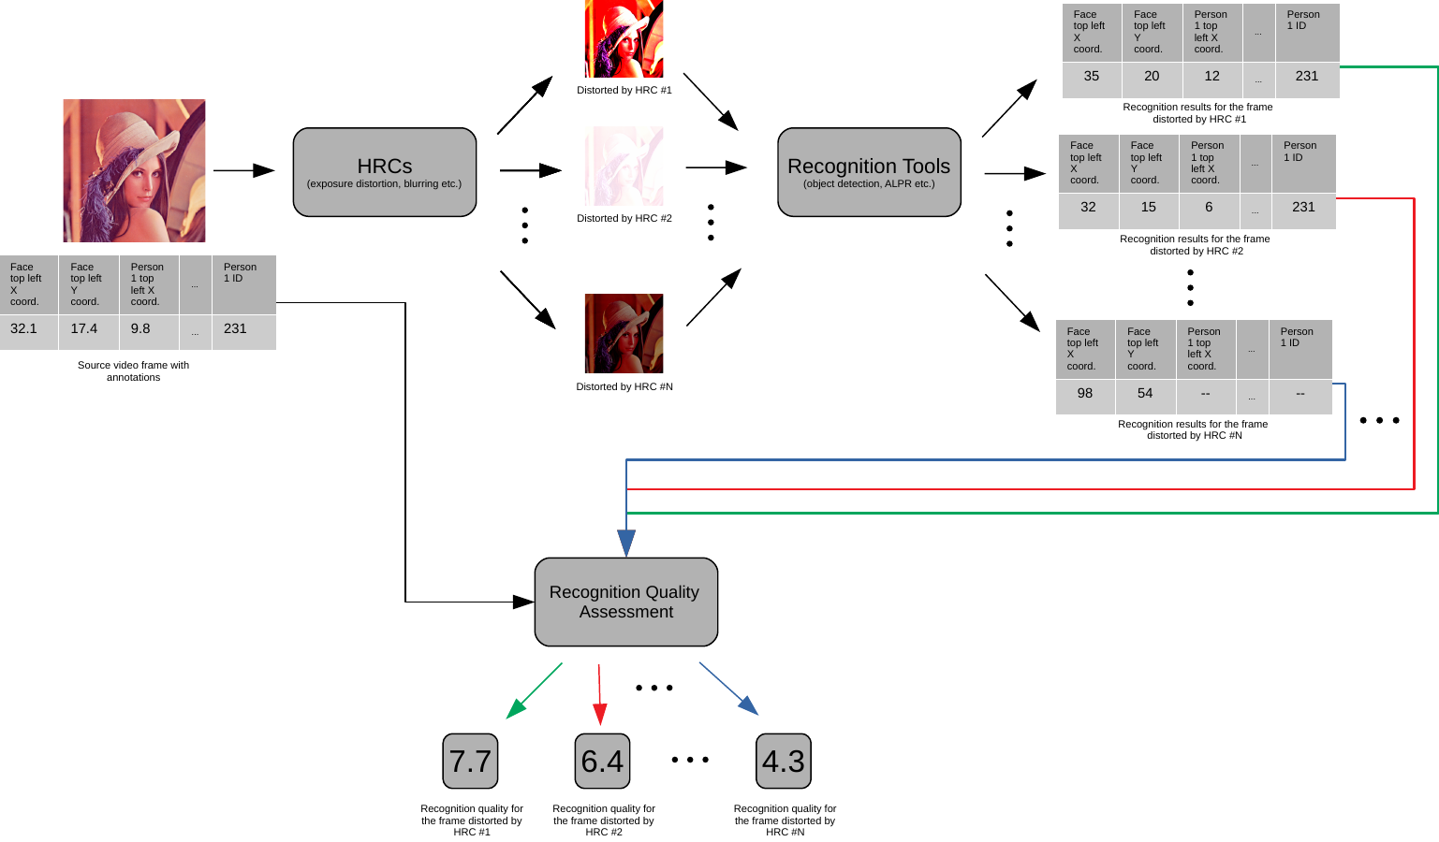
Overview

Slide 31
Face Recognition - dlib
An example of output:
unknownpictures/Example1.jpg, Barack Obama
unknownpictures/Example1.jpg, unknown_person
Final answer is 0-1
Strongly related to the database we use

Slide 32
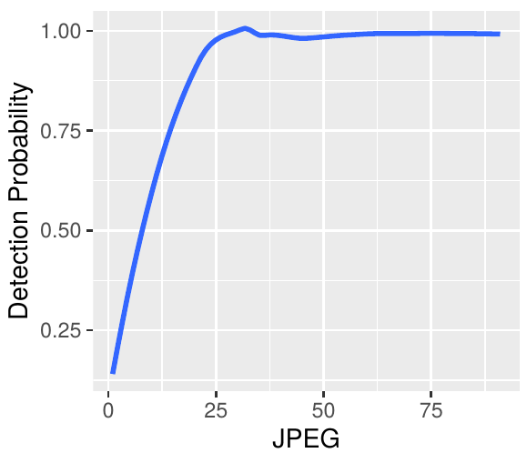
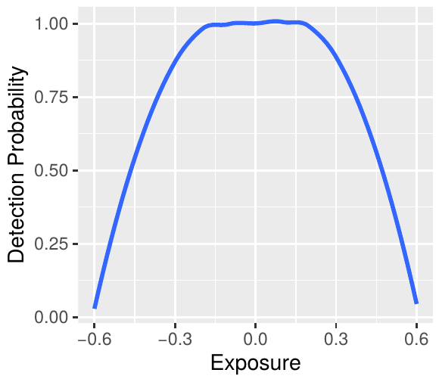
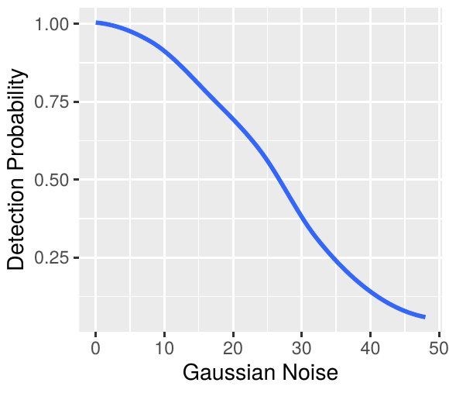
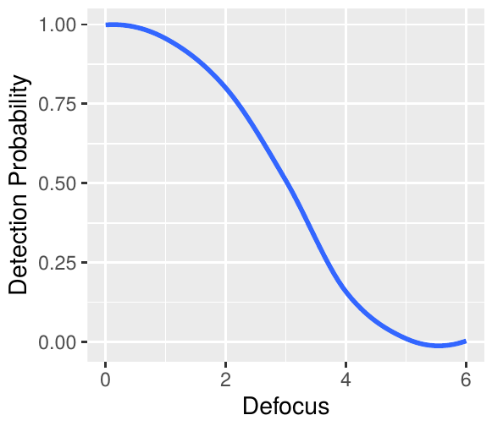
FR - Example Results

Slide 33
Object Detection - YOLO
An example of the obtained output
{”000001.png” :
{”car”: [−5, 186, 44, 70, 0.679]},
”000002.png”:
{”car”: [558, 186, 50, 17, 0.598],
”motorbike”: [275, 228, 82, 54, 0.529]},
}
Numerous different way to compare results, per object, area, number of objects, ...

Slide 34
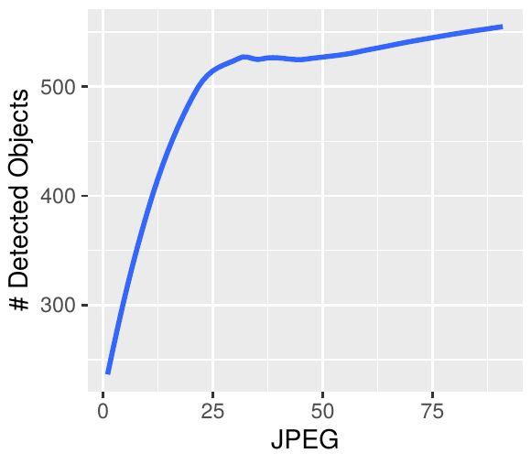
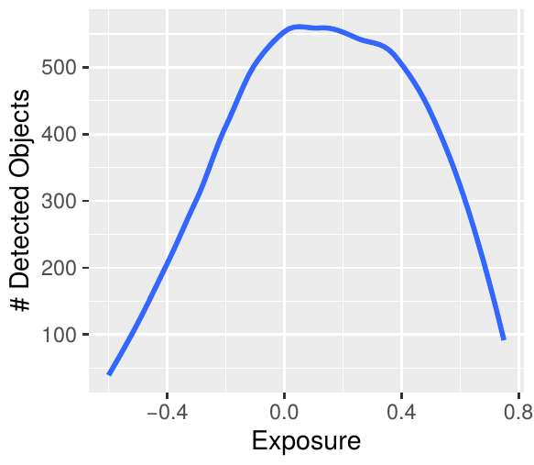
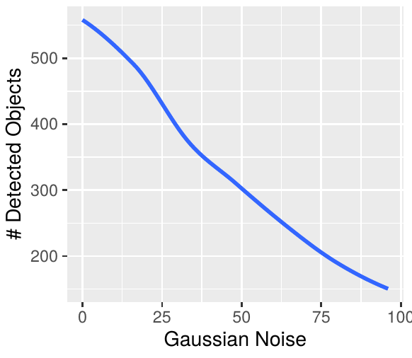
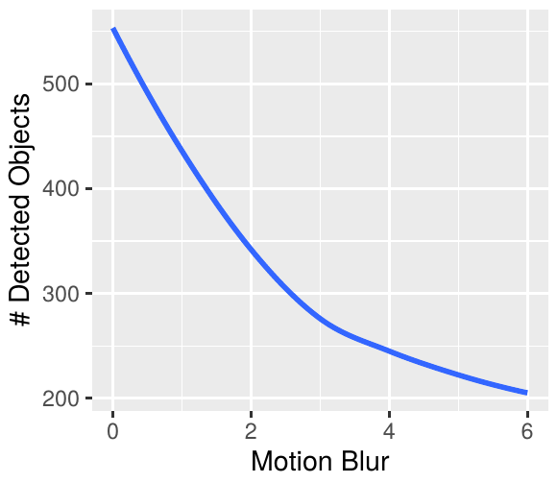
OR - Example Results

Slide 35
Automatic License-Plate Recognition - OpenALPR
An example of the obtained output
Frame:
plate0 : 10 results
−KM77EV confidence: 85.47
−UKM77EV confidence: 80.78
−DKM77EV confidence: 78.91
−...
Numerous different way to compare results, Mean confidence, 0-1, Levenshtein distance, ...

Slide 36
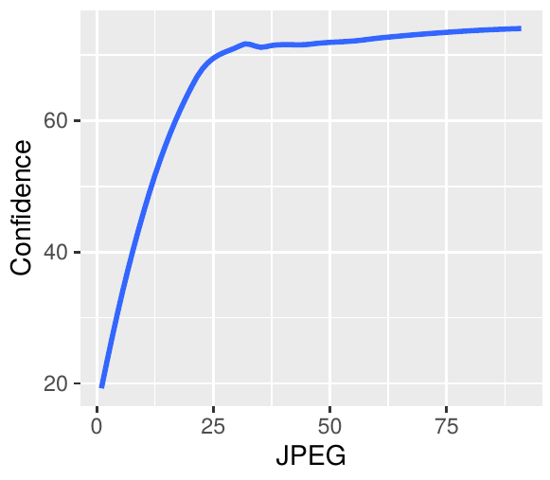
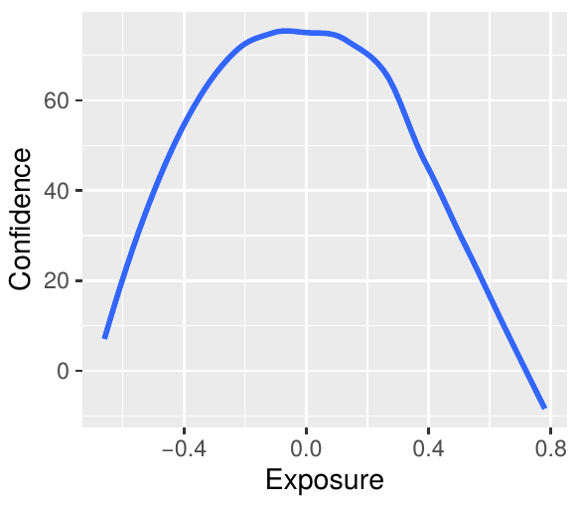
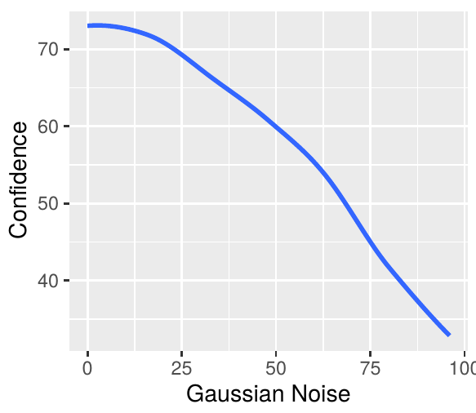
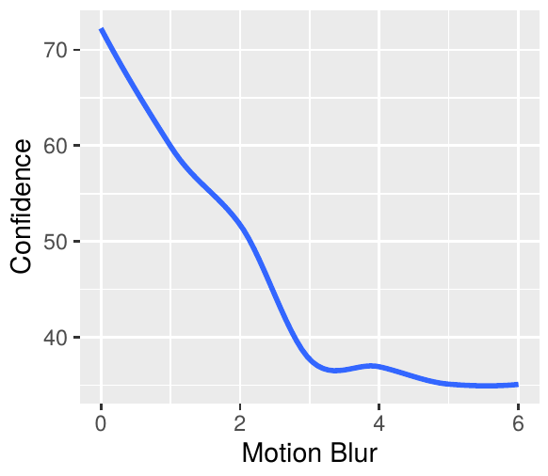
Example Results

Slide 37
Quality Experiment (In Progress)

Slide 38
Quality Experiment
21 no-reference (NR) metrics
11 Video Quality Indicators from AGH,
7 from the LIVE team,
CORNIA,
HOSA and
1 from Yonsei Univ.
We do not train trainable NR metrics
we apply them “out-of-the-box”.
NR metrics are the execution time bottleneck
In total, they take 72.66 s to compute for a single video frame
frame resolution of approx. 0.72 MP,
tested on a laptop with Intel Core i7-3537U (launch date: first quarter of 2013).
Notes:
* We do the MB first to avoid problems with the frame interpolation
MP = million pixels

Slide 39
Next Steps

Slide 40
Next Steps
Quality experiment (finalisation)
Development of a new objective video quality assessment model for recognition tasks
Implementation of a proof-of-concept prototype for the proposed solution

Slide 41
Thank You For Your Attention!

