Slide 1
Final Version of Lip Sync Quality Indicator
Mikołaj Leszczuk, Lucjan Janowski, Jakub Nawała, Wiktoria Rewer, Wojciech Zima, Łukasz Pułka, George Heston

Slide 2
Lip Sync
Also known as:
Audio-to-video synchronization
Lip sync error (lack of)
Lip flap (lack of)
Issue in:
Television
Videoconferencing
Film
Referring to relative timing of audio (sound) & video (image) parts during:
Creation,
Post-production (mixing)
Transmission
Reception
Play-back processing

Slide 3
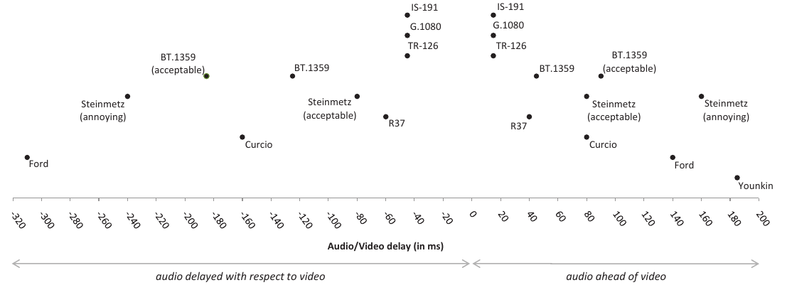
Lip Sync Influence (1/2)
Staelens, Nicolas, Jonas De Meulenaere, Lizzy Bleumers, Glenn Van Wallendael, Jan De Cock, Koen Geeraert, Nick Vercammen, et al. 2012. “Assessing the Importance of Audio/video Synchronization for Simultaneous Translation of Video Sequences.” Multimedia Systems 18 (6): 445–457.

Slide 4
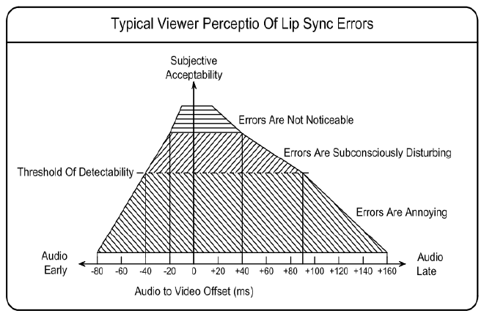
Lip Sync Influence (2/2)
S. Kunić, Z. Šego and B. Z. Cihlar, "Analysis of audio and video synchronization in TV digital broadcast devices," 2017 International Symposium ELMAR, Zadar, 2017, pp. 67-72.

Slide 5
“Quality Indicator - Lip Sync” Project

Slide 6
No-Reference Measurement
Internet Protocol TeleVision, IPTV
Over-The-Top, OTT, media services
Local video files
UDP/RTP Unicast, UDP/RTP Multicast, ...
MPEG-DASH, Adobe HDS, Apple HLS, ...
MPEG (ES, PS, TS, PVA), AVI, ASF / WMV / WMA, ...
Lip Sync Quality Indicator
Implemented in the product that allows analysis from any source

Slide 7
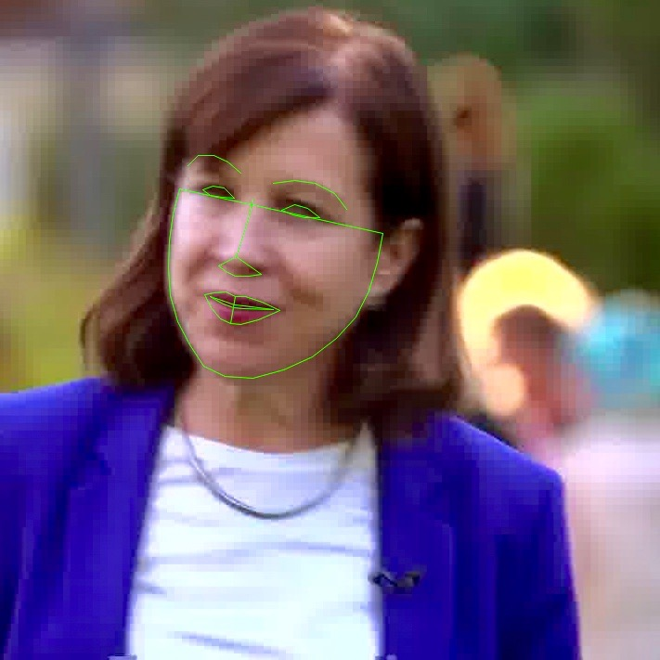
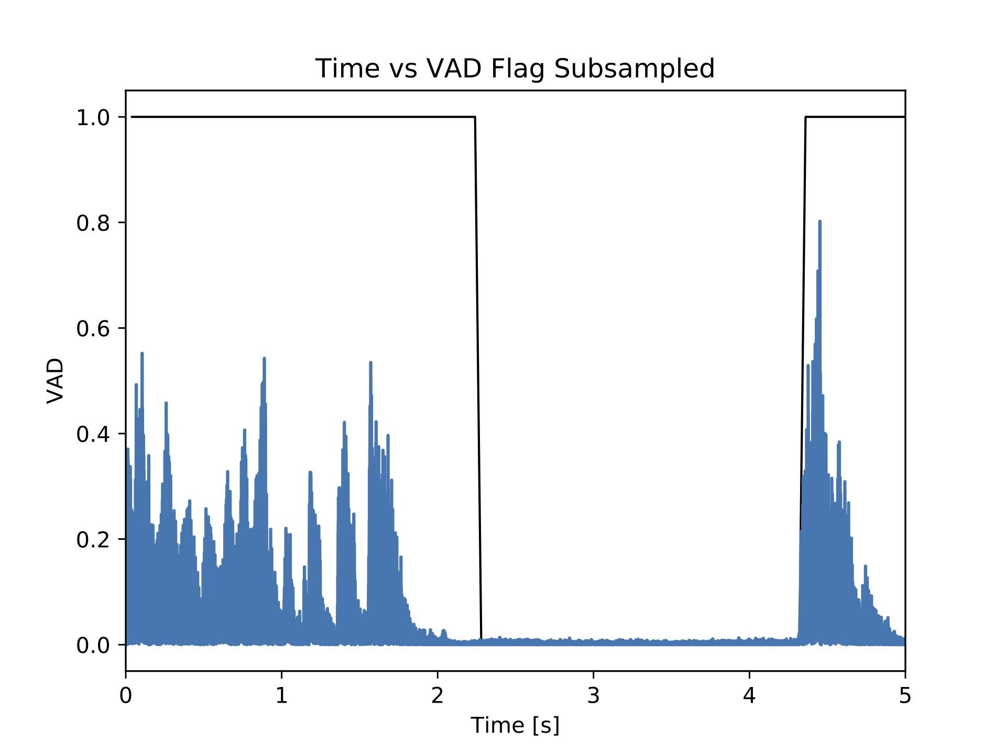
Detection and Tracking
Voice Activity
Lip Motion

Slide 8
Current Test Results
Tested on:
8 SRC, each ~30 min long (mainly YouTube channels of news TV)
~600 shorter video clips extracted:
Exactly 1 face visible for whole duration
Each having 300 frames (12 s)
Further filtering: minimum ~20-25% of silence
Artificially introduced Lip Sync search window of +/- 25 frames (+/- 1 s)

Slide 9
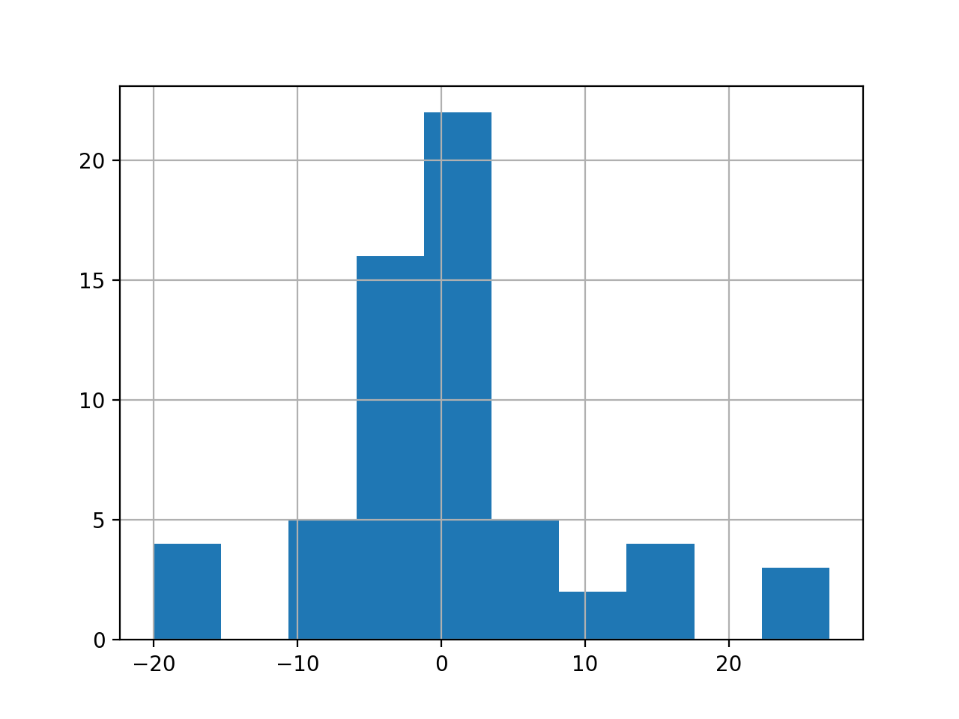
Results (Histogram of Errors)
Quantities of errors expressed in video frames

Slide 10
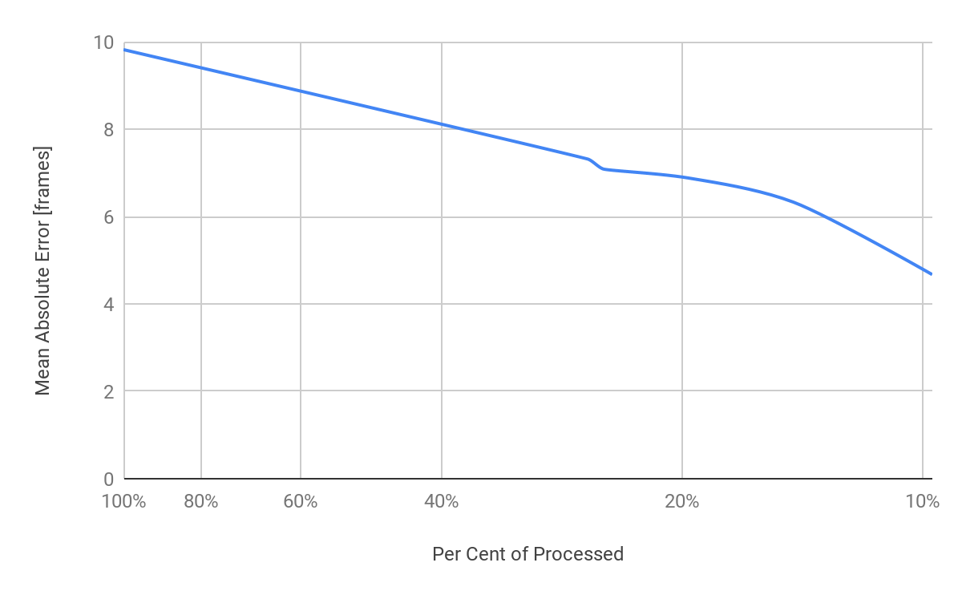
Results (Confidence Level Dilemma)

Slide 11
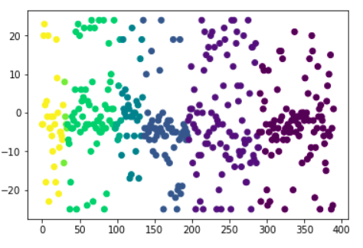
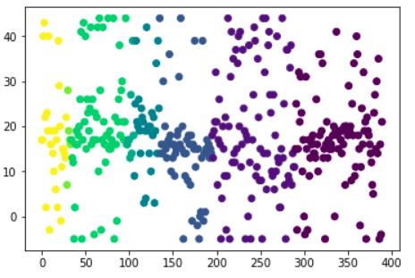
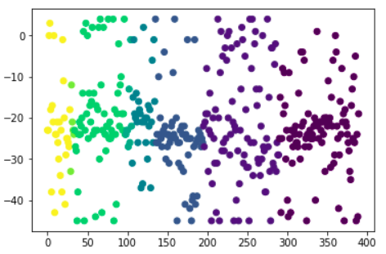
Combine Results
Shift = 0
0
0
0
Shift = 20
0
Shift = -20
20
-20

Slide 12
Implementation
Separate modules for extraction of voice activity and lip motion
Offline processing
long portion of video material must be available locally
Written mostly in C/C++
easily portable to many platforms

Slide 13
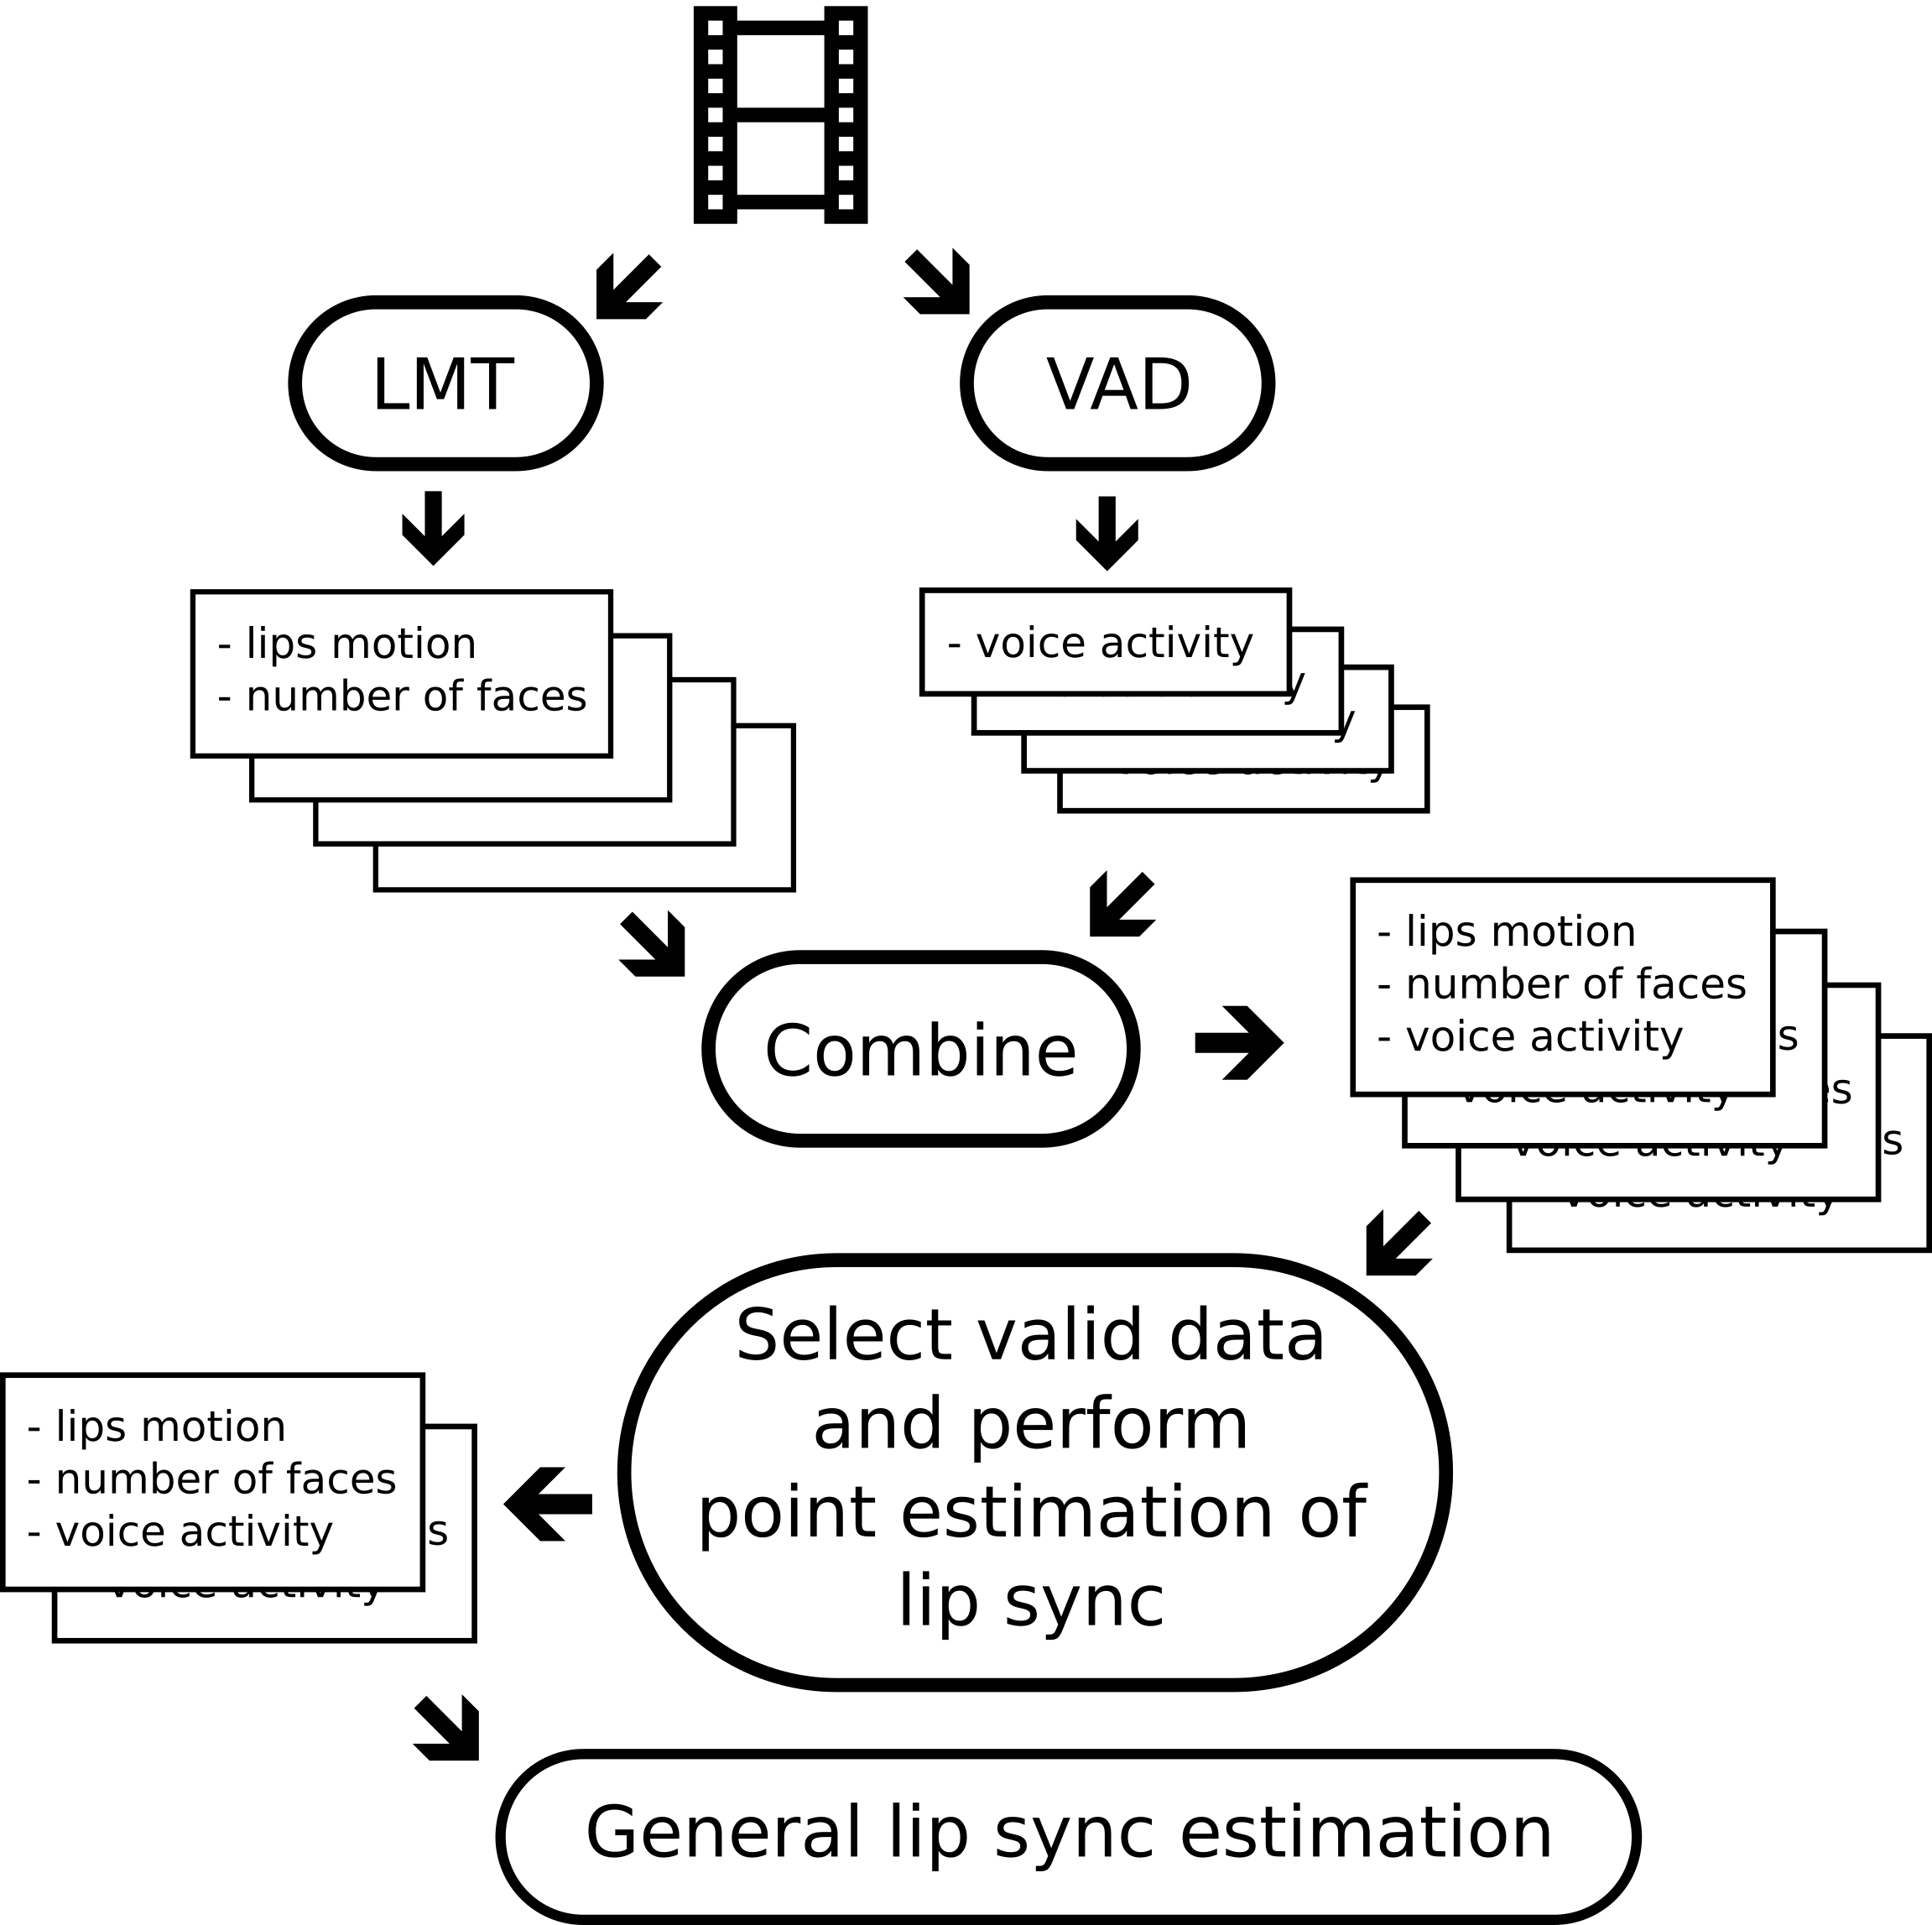
LMT - Lips Movement Tracker
VAD - Voice Activity Detector
Notes:
Different number of samples from LMT and VAD
“Point estimation” does not mean lip sync for each video frame, but for a certain portion of those

Slide 14
Main Software Components
Dlib - video processing
Parts of Web RTC - Voice Activity Detector
Armadillo - linear algebra
FFmpeg - various multimedia files transformations

Slide 15
Conclusions & Further Work
Final (implemented) results to be delivered soon
Commercial Lip Sync Indicator software licensing to be offered
Looking forward to advancing our solution (Artificial Intelligence?) - collaboration?
Notes:
Final meaning operating during a playback of a video content and, ideally, being able to analyse many video streams in parallel

Slide 16
Thank You for Your Attention!

