Slide 1
Machine Learning based No-Reference Gaming Video Quality Estimation
Nabajeet Barman, Maria G. Martini
Kingston University, London
VQEG Meeting - Mountain View, California, USA,
12 November, 2018

Slide 2
Introduction: Motivation
Previous work [Barman et al., PV2018] evaluated the most popular Full-Reference (FR), Reduced-Reference (RR) and No-Reference (NR) metrics
FR Metric VMAF performs well, NR metrics not so well
Passive Gaming video streaming – No reference available
Need for high performing NR metrics to evaluate end user QoE.

Slide 3
Introduction: Motivation ctd…
Machine-learning based quality evaluation methods have gained much attention
Previous work proposing NR metrics considering non-gaming videos has shown high potential

Slide 4
Introduction
Three machine learning based models:
NR-GVSQI: No-Reference Gaming Video Streaming Quality Index
NR-GVSQE: No-Reference Gaming Video Streaming Quality Estimator
NR-GVQM: No-Reference Gaming Video Quality Metric
Note: The models presented here are developed in collaboration with other researchers
The involved persons are as follows:
Model 1 and 2: N. Barman, E. Jammeh, S. A. Ghorashi, M. Martini
Model 3: S. Zadtootaghaj, N. Barman, S. Schmidt, M. Martini, S. Möller

Slide 5
NR-GVSQI and NR-GVSQE

Slide 6
Datasets
GamingVideoSET [Barman et al. NG2018]:
Open Source dataset available at https://kingston.box.com/v/GamingVideoSET
KUGVD:
Newly designed dataset
Similar to GamingVideoSET

Slide 7
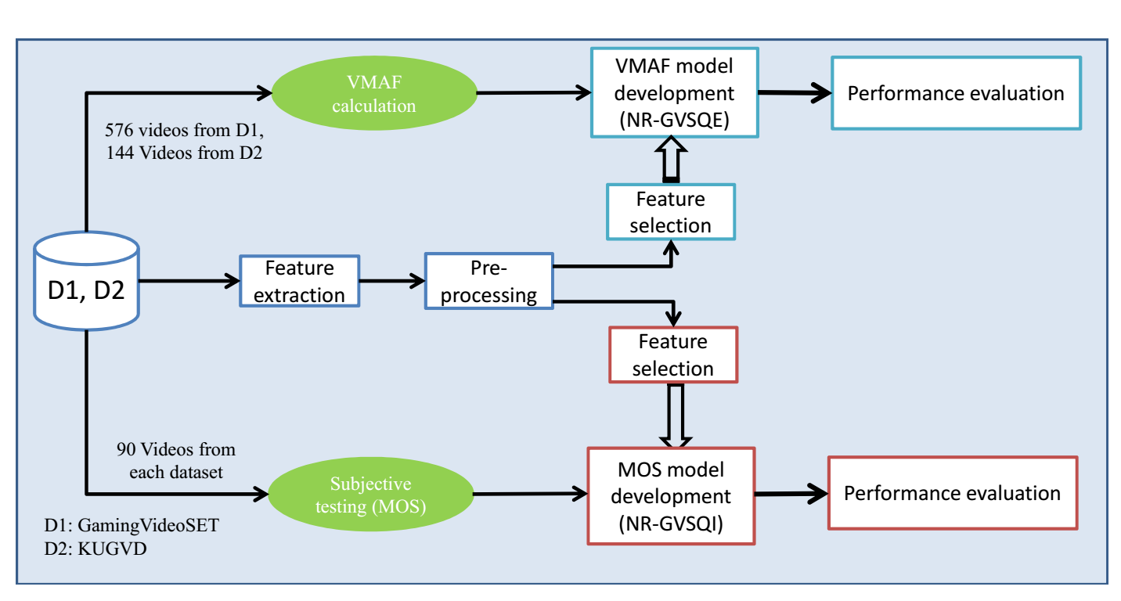
Methodological Framework

Slide 8
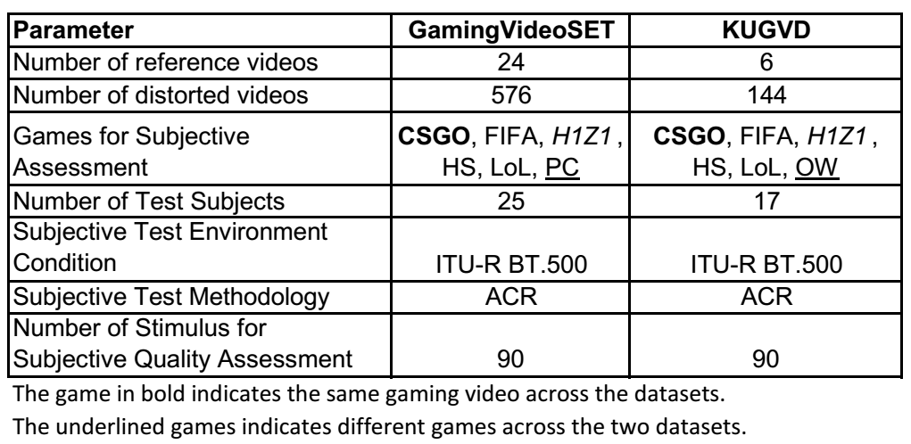
Overview of the two datasets

Slide 9
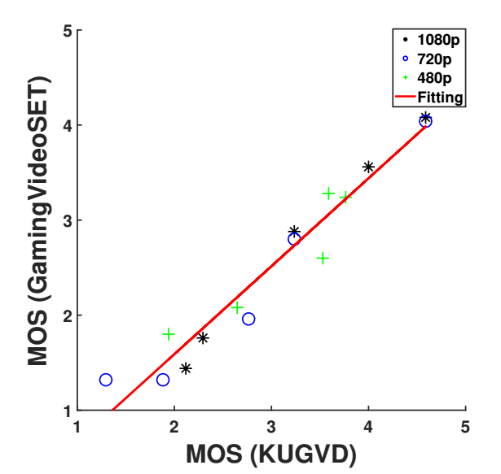
Scatter plot of MOS scores from two datasets for anchor video (CSGO)

Slide 10
NR features
15 NR features extracted
Three NR metrics considered
Additional features considered:
Game Name, Resolution, Bitrate, SI and TI
Feature reduction was used to reduce the number of features to be used as input for the ML algorithm

Slide 11
NR-GVSQI
Trained and tested using the MOS ratings from GamingVideoSET and KUGVD
-Total 165 ratings (90 from D1 + 90 from D2 – 15 common conditions)

Slide 12
Key Observations
Prediction performance of the combinations of features is completely different from their individual performance.
Feature selection not so straightforward based on correlation between different features
10% to 40% degradation of the prediction performance when different datasets are used for training and testing
Optimal number of features is found to be seven

Slide 13
NR-GVSQE
Trained and tested using the VMAF ratings from GamingVideoSET and KUGVD
Total 696 samples (576 from D1 + 144 from D2 – 24 common conditions)

Slide 14
Machine Learning Algorithms Considered
Support Vector Regression (SVR)
Gaussian Process Regression (GP)
Multilayer perceptron (MLP)
Random Forest (RF)

Slide 15
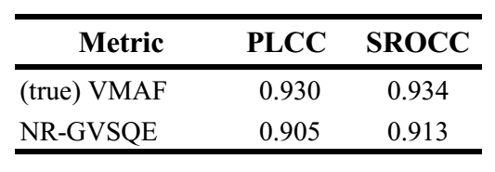
Prediction performance of the NR-GVSQE vs. VMAF on MOS scores of KUGVD

Slide 16
Key Observations
Prediction performance of SVR is the best among the four considered model algorithms.
VMAF scores can be used to train a NR model (increased sample side) which can achieve high correlation with subjective scores.
Optimal number of features is found to be seven

Slide 17
NR-GVQM

Slide 18
NR-GVQM
Trained and tested using the VMAF ratings from GamingVideoSET
Using per-frame scores
Total 576 videos – over 500k samples (each video of 30 sec duration at 30 fps)

Slide 19
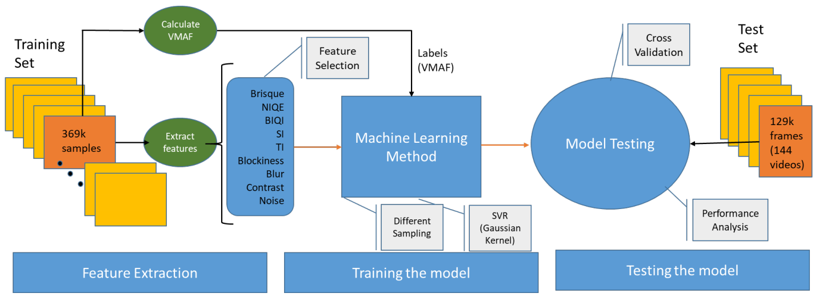
Methodological Framework

Slide 20
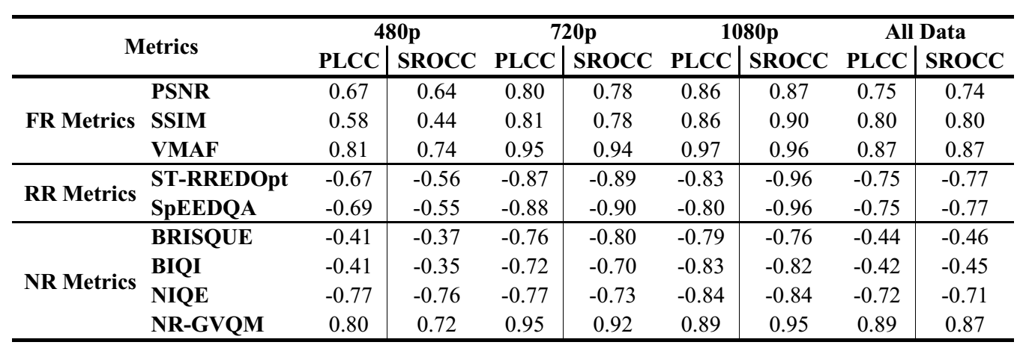
Performance of the VQA metrics with respect to MOS scores

Slide 21
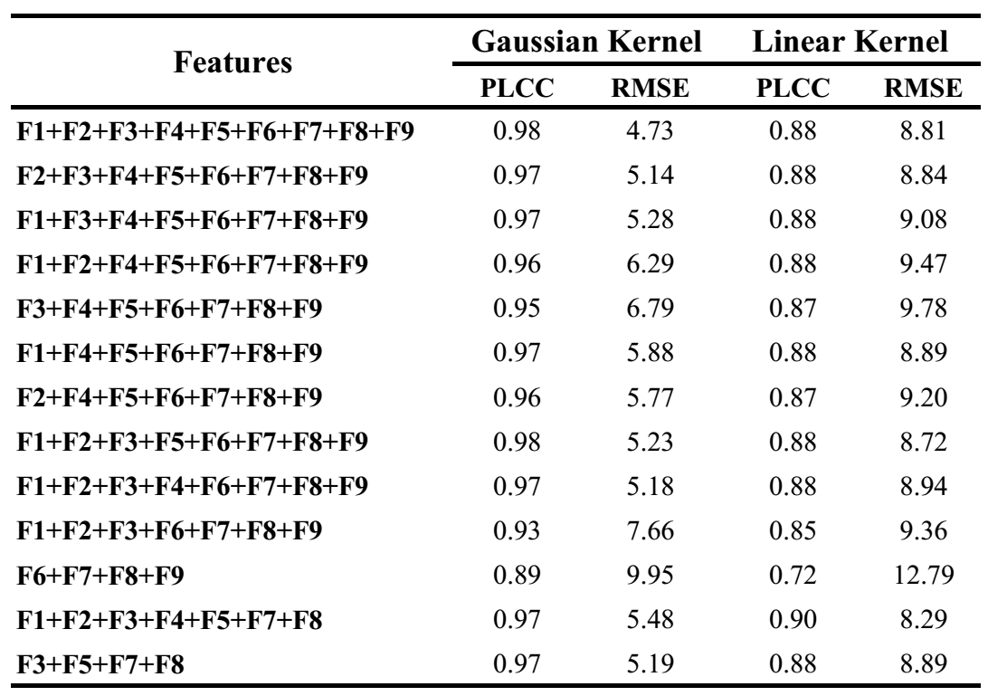
VMAF score prediction quality performance for different combinations of features
F1 to F9 corresponding to BIQI, BRISQUE, NIQE, SI, TI, Contrast, Blockiness, Blur and Noise respectively

Slide 22
Key Observations
Four features (NIQE, TI, Blockiness and Blur)
Model with an accuracy of 0.966
Low computation but still a high correlation.
Considering NR metrics, NIQE, BIQI and BRISQUE, removing BIQI and BRISQUE does not affect the performance much.
Temporal Pooling (with difference Interval size)
PLCC did not change much with the change in pooling interval,
RMSE is very sensitive initially, even for small changes in pooling interval.

Slide 23
Conclusion
Three different approaches for Machine learning based NR metric design were explored.
Our results show that using the extracted NR features and existing NR metrics, the designed machine learning based NR metrics for gaming video streaming have a high correlation with subjective (MOS) score

Slide 24
References
[Barman et al., PV2018] N. Barman, S. Schmidt, S. Zadtootaghaj, M. G. Martini, and S. Möller, “An Evaluation of Video Quality Assessment Metrics for Passive Gaming Video Streaming”, Proceedings of 23rd Packet Video Workshop 2018 (PV 2018), (Amsterdam, Netherlands), June 2018.
[Barman et al., NG2018] N. Barman, S. Zadtootaghaj, S. Schmidt, M. G. Martini, and S. Möller, “GamingVideoSET: A Dataset for Gaming Video Streaming Applications”, 16th Annual Workshop on Network and Systems Support for Games (NetGames), (Amsterdam, Netherlands), June 2018
[Zadtootaghaj et al., ISM2018] S. Zadtootaghaj, N. Barman, S. Schmidt, M. G. Martini, and S. Möller, “NRGVQM: A No Reference Gaming Video Quality Metric”, in 20th IEEE International Symposium on Multimedia, Dec 2018 (Taiwan).
[Leszczuk et al., SIU2014] M. Leszczuk, M. Hanusiak, I. Blanco, A. Dziech, J. Derkacz, E. Wyckens, and S. Borer, “Key indicators for monitoring of audiovisual quality,” in 22nd Signal Processing and Communications Applications Conference (SIU), pp. 2301–2305, April 2014.
[Leszczuk et al., MTA2016] M. Leszczuk, M. Hanusiak, M. C. Q. Farias, E. Wyckens, and G. Heston, “Recent developments in visual quality monitoring by key performance indicators,” Multimedia Tools and Applications, vol. 75, pp. 10745–10767, Sep 2016.

Slide 25
Thank you!
This presentation is part of a project that has received funding from the European Union’s Horizon 2020 research and innovation programme under the Marie Skłodowska-Curie grant agreement No 643072.

