Slide 1
Device characterization for content adaptation
VQEG Krakow 2017
Mateo Cámara*, César Díaz*,, Juan Casal†, Jorge Ruano† and Narciso García*
narciso@gti.ssr.upm.es
*Grupo de Tratamiento de Imágenes (GTI)
Universidad Politécnica de Madrid
†Nokia Spain
Madrid

Slide 2
Presentation scheme
Motivation
Content selection and spatial ladder
Devices and test environment
Testing procedure
Some results
Subjects debriefing
Conclusions

Slide 3
Motivation
Multimedia delivery based on Nokia conditional encoding.
  Technique for content and device oriented encoding
Need for device characterization
Initial activity on nomadic/mobile multimedia users
  Mobile devices (smartphones or tablets)
  Static (w.r.t. the platform) consumption (“nomadic use”)

Slide 4
Content selection
Looking for adequate temporal and spatial complexity.
Low spatial and temporal complexity: Fish (Spanish National Dramatic Center)
Low temporal and high spatial complexity: Maldives
High temporal and low spatial complexity: Goku (Dragon Ball)
High temporal and spatial complexity:
  Initial choice, The Martian, discarded due to non-16:9 ratio
  Final choice, CHiPs

Slide 5
Spatial ladder
Sources:
  Apple Technical Note 224
  Netflix Per-Title Encode Optimization
Decision: keep 16:9 frame aspect ratio along the spatial ladder
Ladder
  1920x1080p (Full HD)
  1280x720p (HD ready)
  960x540p (Wide SD, approx.)
  640x360p (Wide HVGA, approx.)
  480x270p (Wide QVGA, approx.)

Slide 6
Devices
LG-P720
  Screen: 4.3 inches with 800x480 pixel resolution
Samsung A3 (2017)
  Screen: 4.7 inches with 1280x720 pixel resolution
Samsung Galaxy S7
  Screen: 5.1 inches with 2560x1440 pixel resolution
iPad Air 2
  Screen 9.7 inches with 2048x1536 pixel resolution (4:3 ratio)
  Use of a letterbox display approach to show 16:9 content
  So, equivalent to 2048x1152 within 8.9 inches

Slide 7
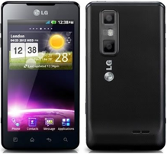
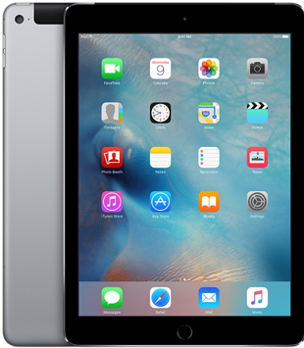
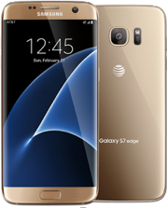
Devices

Slide 8
Test considerations
Classical audiovisual consumption and, therefore, QoE assessment:
  Seated subjects looking at a fixed screen from a pre-set distance
  Content narrative governing subject attention
  Audio (very) important for subject opinion score
Presuming audiovisual engagement, therefore looking for opinion scores

Slide 9
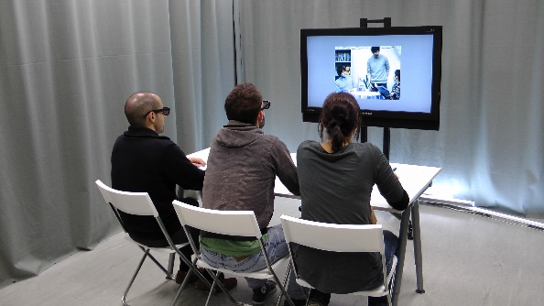
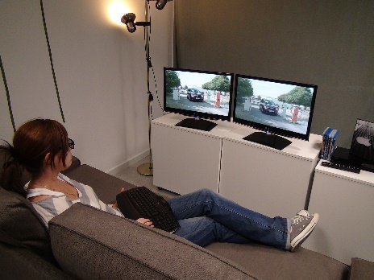
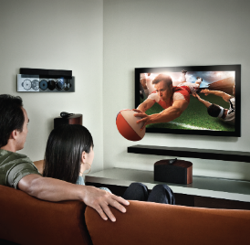
Looking for realistic environments

Slide 10
Test environment
Multimedia consumption in isolation from the environment
  Use of headphones
  Audiovisual (video plus audio) content
Seated assessment
Sequential assessment on different devices
User to display distance decided by user preferences
  Mainly: device on the table
  Some cases: device hand-held
  So, around 40 cm
Individual consumption, although parallel assessments available, due to the acoustic isolation

Slide 11
Environment and device settings
Meeting room with neutral background
Room illumination measures:
  Front background ~100 lux
  Left/right background (door) ~50 lux
  Right/left background (window) ~250 lux (sunny day before blind attenuation) ~100 lux (cloudly day)
Device illumination settings:
  Brightness at 90% of maximum for smartphones
  Content: Fish ~120 lux, Maldives ~160 lux, Goku ~300 lux, CHiPs ~60 lux
  Automatic brightness for iPAD
  Content: Fish ~60 lux, Maldives ~60 lux, Goku ~110 lux, CHiPs ~60 lux

Slide 12
Test procedure
Neither naïve users, nor experts, … although large audiovisual experience
Subject screening for visual acuity
Explanation of the assessment procedure (ACR rating)
For each device:
  Initial (adaptation) neutral sequence with smooth music
  User adjustment of headphone sound level to his/her comfort level
  Random sequence of contents and qualities of ten seconds
  Five seconds grey level sequence between tests sequences for voting time
Final debriefing asking for comments and suggestions

Slide 13
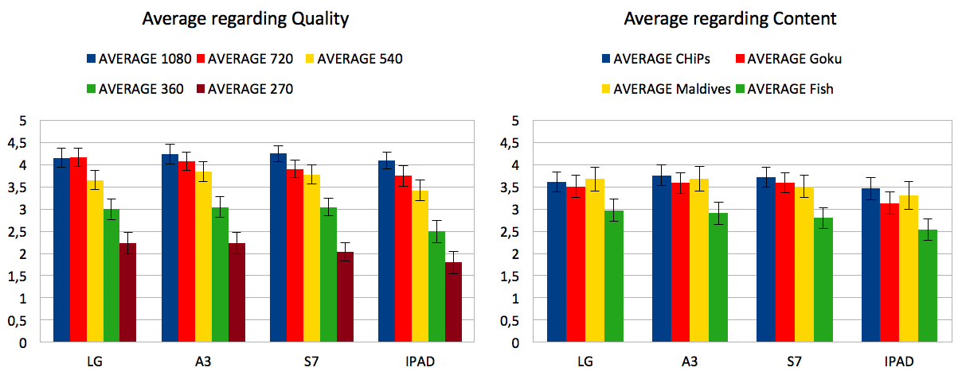
Results of the first evaluation round

Slide 14
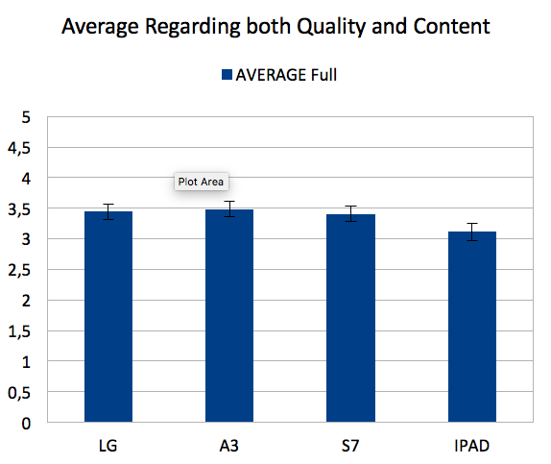
Results of the first evaluation round

Slide 15
Main debriefing comments
Device order is important, mainly between smartphones and tablets. So, possible assessment bias.
Spatial ladder with small number of sequences on several devices can affect assessments, as users could vote according to their remembrance and not according to the current perception.
Possible biases due to repetition and personal preferences on device characteristics.
General doubts about user interpretation of “good” and “bad” connected with device performance. Requests to re-evaluate the opinion scores.
Influence of content selection

Slide 16
Analysis of the debriefing comments
Contents:
  Fish: initial defocused object biases quality, mainly if subjects vote before the sequence is completely displayed … attention to user behavior!
  Maldives: water sequences are mistreated by the coder
  Goku: quick and sudden changes avoid user fixation
  CHiPs: no specific user comments
Need for hidden references
Consideration of DCR rating
Possible initial adjustment of “excellent” before the beginning of the test
Selection of adequate contents as reference for high/low temporal and/or spatial complexities

Slide 17
Conclusions
Usefulness of preliminary exploratory rounds in new scenarios
Smartphones/tablets are used at a similar distance (human anatomy)

Slide 18
Finally, … do not forget!

Slide 19
Questions – Discussion – Debate - …
Grupo de Tratamiento de Imágenes (GTI)
Universidad Politécnica de Madrid
Nokia Spain
Madrid
This work has been partially supported by the Ministerio de Economía, Industria y Competitividad (AEI/FEDER) of the Spanish Government under project TEC2016-75981 (IVME) and the Spanish Administration agency CDTI under project IDI-20170572 (BUSTOP)

