Slide 1
NTIA/ITS Status Report and Questions
Margaret H. Pinson
mpinson@ntia.doc.gov
+1 303-497-3579

Slide 2
What Exactly Is Our Goal?
UX / QoE problem?
Acceptable constraints?
NR metric traits?
NR parameters traits?
Dataset design?

Slide 3
NTIA/ITS Status Report

Slide 4
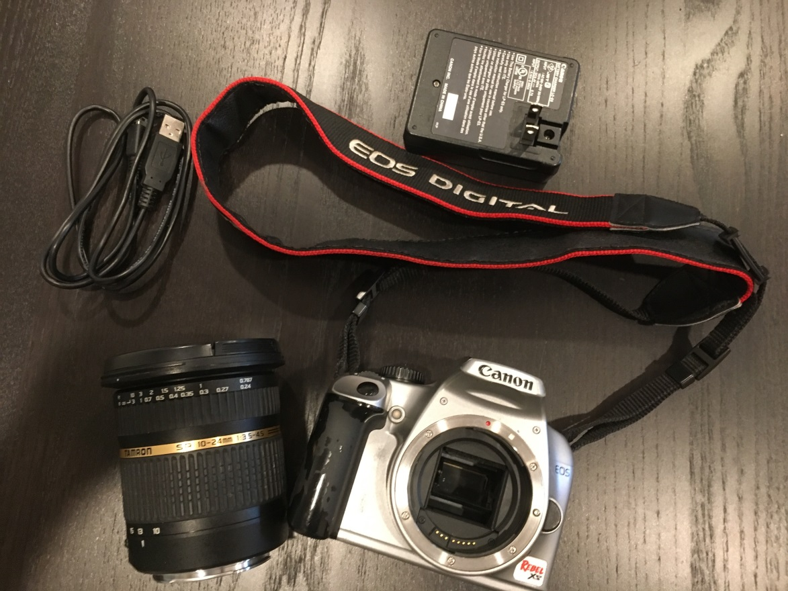
No Reference (NR) Metric Goal
Intelligent cameras
Intelligent networks
Quality of experience (QoE)
Notes:
“DSLR Camera” © Michele Saad, Intel

Slide 5
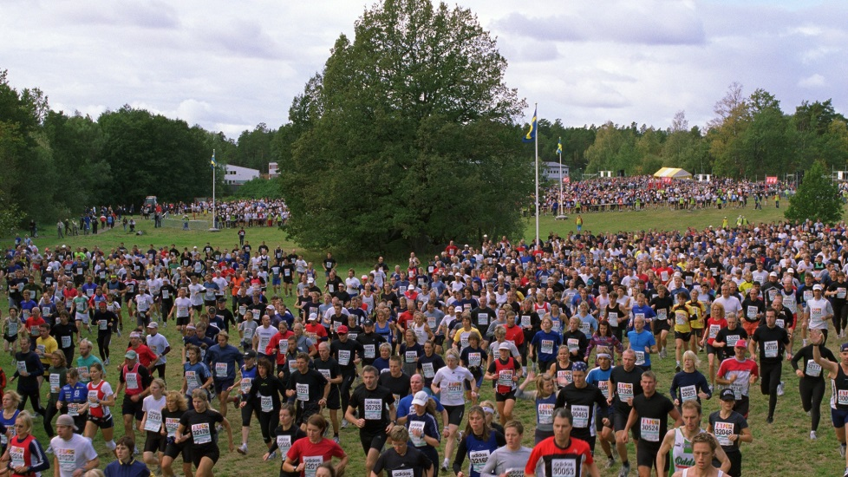
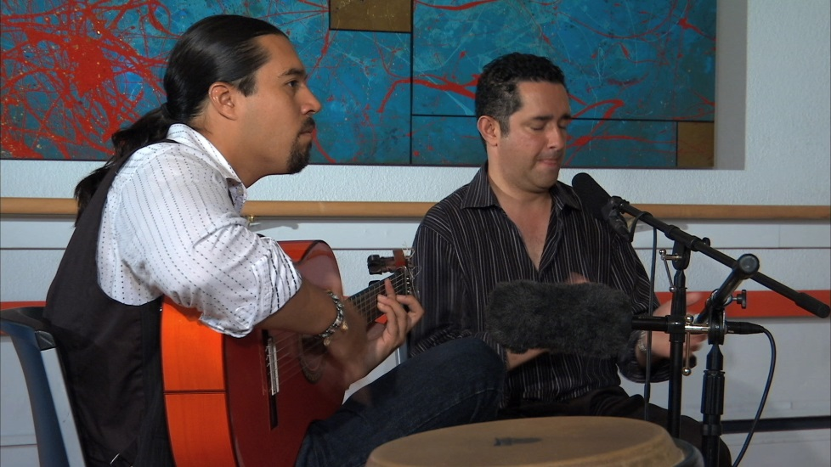
Roadblocks
Accuracy
Industry trust
Suboptimal training datasets
Missing subjective information
MOS ≠ QoE
Amateur ≠ professional
Task

Slide 6
New Datasets, January 2018
VIME1
101 photos from VIME photoshoot in Glasgow
CCRIQ2
4 SRC × 23 cameras
Extra images from Content Resolution and Image Quality (CCRIQ) Dataset
its4s
813 unfamiliar video sequences
Professional videography
4 sec duration
32% 720p 24fps, contribution quality
3% 720p 60fps, contribution quality
Simple adaptive streaming ladder, 2.34 to 0.5 Mbps

Slide 7
New Dataset its4s2, in progress
1,444+ images from Flickr
VIME image database
41% public safety
Tablets, 1920 × 1080
Display as 4 sec videos
Consumer cameras
Amateur photography
Lenses
Aspect ratio
Task dependency
Photographic vision
Separate spatial response from temporal response

Slide 8
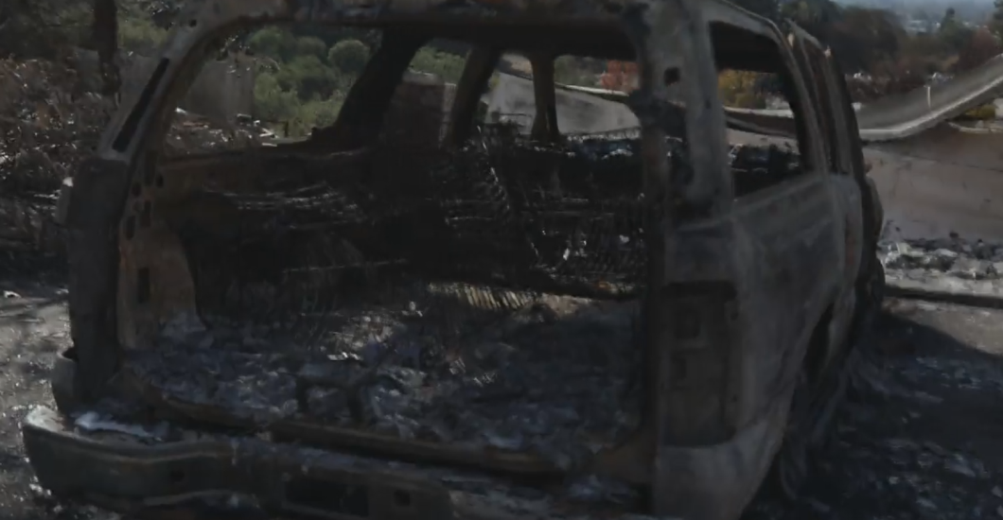
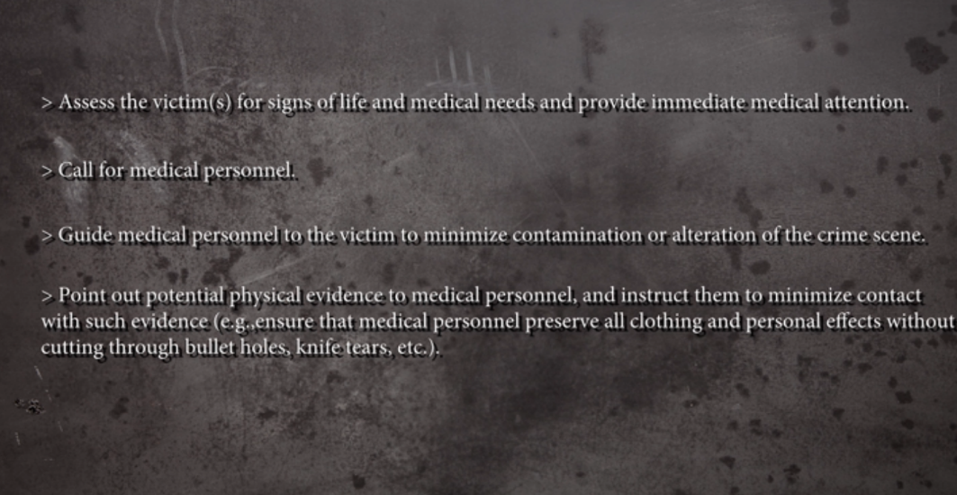
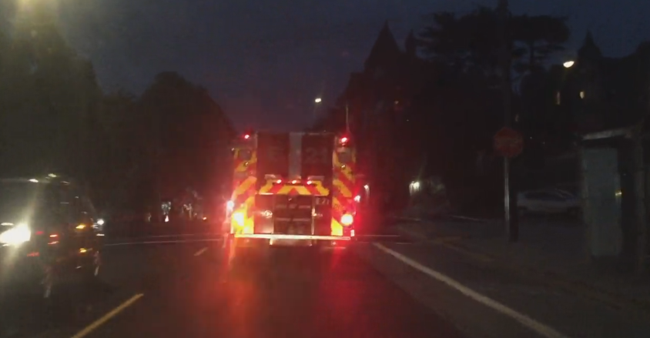
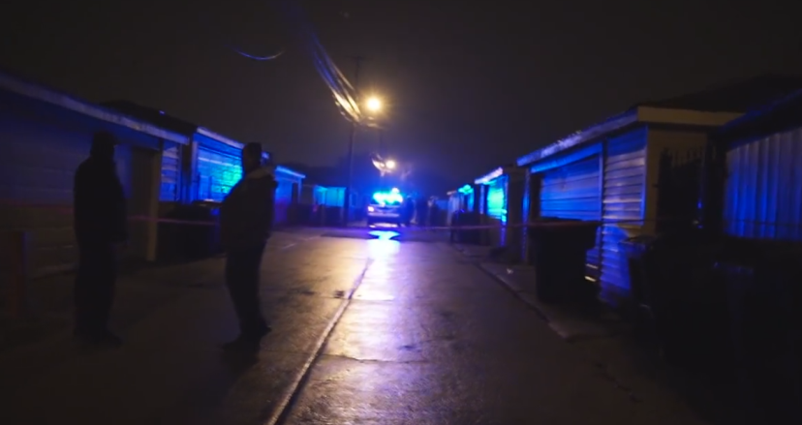
New Dataset its4s3, planning
New public safety content
Crime scene
Inclement weather
Drone footage
Professional videographers
Intentionally sloppy technique
HRCs
I want your advice

Slide 9
Example NR Parameter—Fraction Munsell Red
Why Red?
Computation
Characteristic of original content
Not impacted by bitrate, resolution, coding artifacts
Red is “important”
Photographers, linguists, visual psychologists, anthropologists, …
Very different conventional video or image quality metric
Blocking, blurring, noise, …
Color naming system with 7 colors
Black, grey, white, red, yellow, green & blue
Fraction of red pixels in Munsell color space
Chroma > 2, hue between 2.5YR and 2.5P
Mean over all frames
Square root

Slide 10
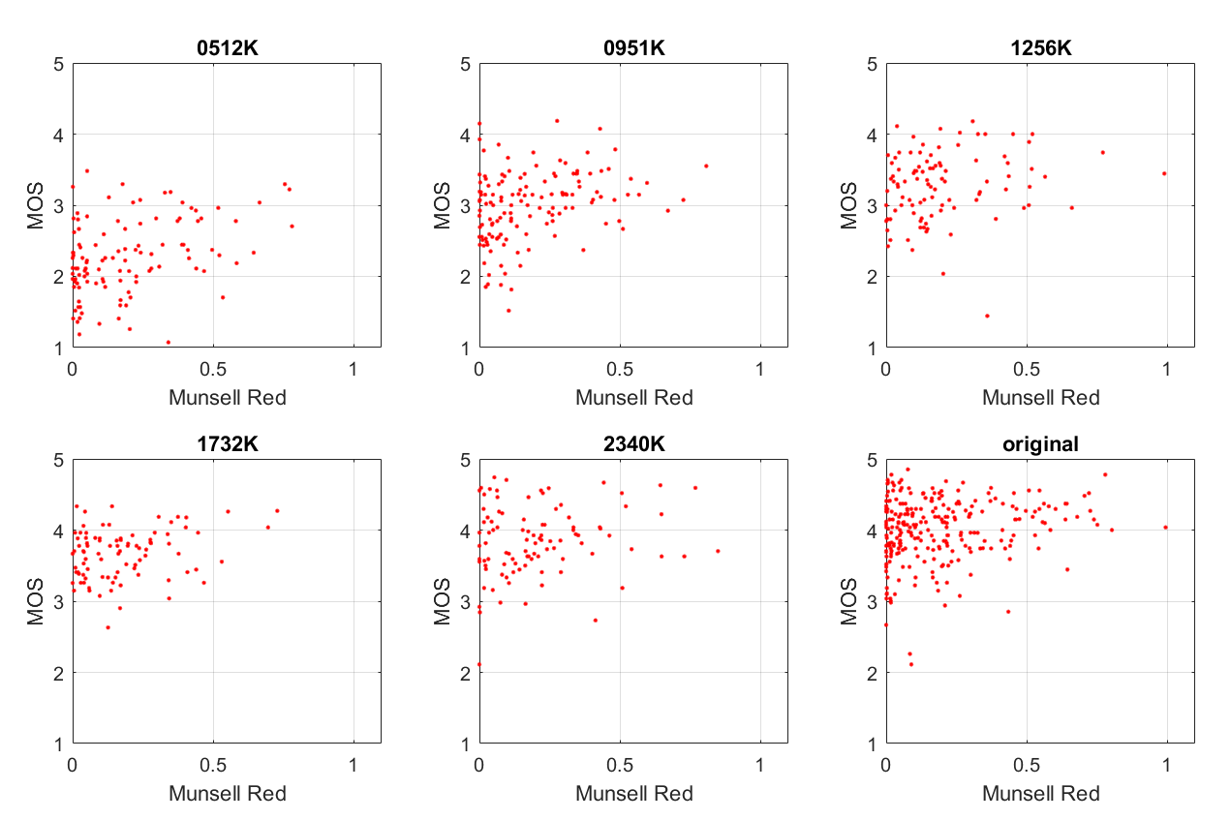
Video | Original | SRCpls | 2340K | 1732K | 1256K | 0951K | 0512K | Full Dataset
PVS | 0.44 | 0.40 | 0.48 | 0.33 | 0.47 | 0.46 | 0.48 | 0.77
Reference | 0.44 | 0.40 | 0.48 | 0.34 | 0.47 | 0.47 | 0.49 | 0.77

Slide 11
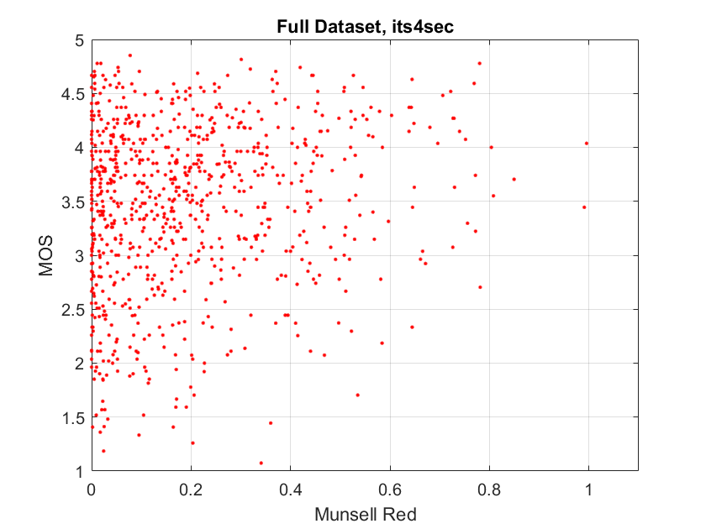
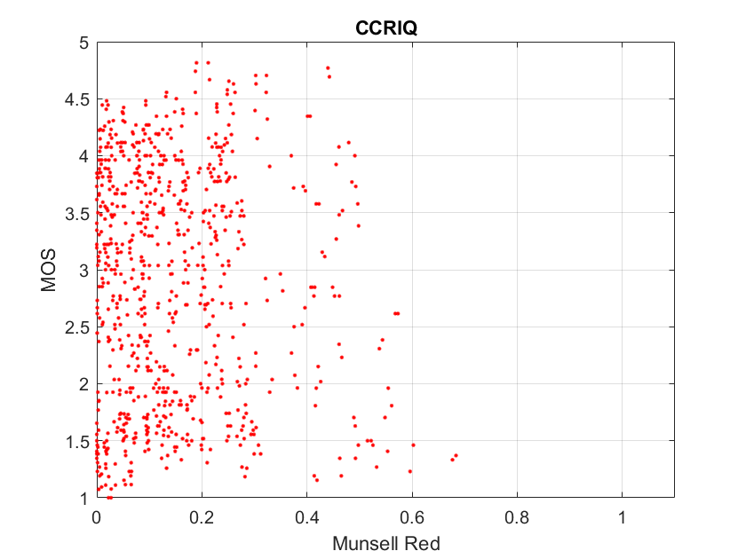
Dataset Comparison: its4s vs CCRIQ

Slide 12
What exactly is our goal?

Slide 13
What Exactly Is Our Goal?
UX / QoE problem?
Acceptable constraints?
NR metric traits?
NR parameters traits?
Dataset design?
Note: from here to the end, the slides include comments and answers from all VQEG participants

Slide 14
UX / QoE Problem
Intelligent network
Intelligent camera
Industry application where no reference is available; specific use case (social media, entertainment, …); different MOS scale (meaning of 5)
Change coding? Service level agreement? Need true absolute quality level (not relative impairment)
Live service workflow (de-interlace, transcode), how trust MOS?
Analyze my own content, can we tell the user how to improve the photo?
Validate devices, camera driven
Ideally check all points in pipeline, but unrealistic starting point
Compliment FR with NR (later in chain)
Overall quality impairment
Local artifact detect (e.g., green block)
Adapt communication system real time (on receiver side)

Slide 15
UX / QoE Problem
Big business decisions, how benchmark?
Focus by use case (indoors, outdoors, nighttime, first responder, medical) and location (outdoors, elevator,…), simplify the problem
Score differently based on expectations
Does the image metric scale to temporal / video?
Consumed by human vs consumed by an algorithm
Ensure professional service content delivery is really good quality? Can I take the person out of the loop? How much quality can I get out of the available bandwidth?
Two problems, must treat differently:
Capture side (true NR metric), generic problem
Consumer side, application specific (medical, first responder, entertainment, …), specialized, application specific problem
What do we call a “5”? False positive from artistic intent. Use case may solve (quality intended)

Slide 16
UX / QoE Problem
KPI between network exchange contract (what quality I deliver, what quality I receive from vendor); ensure contract based on quality (service level agreement)
Understand artistic intention (include)
Explicitly ignore artistic intention, aesthetics (exclude); provider has paid for the content so incoming footage quality is irrelevant
Give way to measure “this is HD service”; what do we mean (replace “1920x1080 resolution is HD service quality” assumption)

Slide 17
Acceptable Constraints—Simplify the Problem
Specify bitrate range per application
Instead, MOS range needs to be mapped to the use case (e.g., bitrate range doesn’t apply sometimes)
Specify amateur vs professional
Specify task
Entertainment, understand events, recognize people, …
Ignore quality change over time
Recency effect
Quality as viewed right now
e.g., ignore potential value of 40 MP image
Need to solve actionable business case (value)

Slide 18
Desirable NR Metric Traits
Same metric for images & video
Predict quality of originals
Real world subject, camera operator, lens, camera electronics, aesthetics, …
Extrapolate “what if”
Change bitrate, resolution, frame rate, …
Root cause analysis
Why is the quality bad?
Immediate quality response
2 frames, ¼ sec, 4 sec
Short observation window
Real-time implementation (compute problem)
Degrades gracefully (doesn’t just fail on unexpected conditions; no division by zero)
Less accurate but not random results
Warn user when moving outside of intended usage
Confidence in rating
Accuracy level, confidence interval
Help users trust and understand the values

Slide 19
Desirable NR Metric Traits
Open source usage rights
Many organizations can only participate if the goal is an open source NR metric
Must agree upon exact open source licensing terms
Distortion flexibility; work on different types of impairments
Should work with the type of artifacts that are appropriate for the current application
Not static; multi-faceted model that can be trained on new applications
No hard coded constants
User expectations change; NR metric can change with them
Produces both experience values & engineering values
Scalable: no requirement for a specific frame size, resolution, frame rate, …

Slide 20
Desirable NR Parameter Traits (Building Blocks of the NR Metric)
Only respond to a unique factor
Upper or lower triangle scatter plot
Often ignore coding artifacts, resolution, …
Sensitivity to a single factor
Diverse types of factors
Characterize the scene, operator’s actions, lens, camera, video format, compression, …
Easily explained to naïve user
Computationally scalable
Accuracy may depend on quality, task
More accurate, less accurate, irrelevant
Robust response to new content
May not be willing or able to have NR parameters respond to unique factors; cannot decouple some factors
Scalability of complexity; can scale down the implementation
May trade off performance and decoupled factors
Implementation: Collect historical data; feedback loop; self learning model? Users could optionally contribute to the pool of knowledge
Parameter indicates what is visually wrong

Slide 21
Dataset Design
First factor is use case
Unfamiliar SRC
4 sec, no reuse, no scene cuts
May not be applicable for some use cases
Include bad quality SRC
Training data for specific parameters, specific use cases
Common way to feed datasets into training
Subjective evaluation documented (how you got ratings, environment); but have wide flexibility on environments, rating scales
What questions do you ask? Will need to use different scales
Task oriented testing; ask specific questions (not always quality)
Ask doctor, “can you do diagnostics on this picture?”
“is this question clear enough?”
“How much can you rely upon this media?”
Compile new questions to extract
Could be binary rating (reject or keep)
Like JND

Slide 22
Dataset Design
Medical image quality assessment has another community of research: detection, localization and characterization
There are statistical tests to analyze these factors (JAFROC)
Characterization has not been done yet
Non-conventional databases
e.g., pull videos from YouTube with 1 million hits and assume those videos have MOS=5
Use humans to evaluate failure cases
Iterative approach to training

Slide 23
Who is interested? What can you contribute? What projects do you want to drive?
Margaret Pinson (NTIA/ITS) video content, subjective datasets, objective metric development, access to first responders
Mikolaj (AGH), objective metric development, class once per year for subjective ratings (potentially)
Ioannis (Netflix), content, new content as need arises, artistic talent, indirectly subjective datasets, objective metric development through university collaboration
Maria (Kingston University), objective metric development, subjective datasets, time scale unknown
Florence (Sky UK), video content, (depends upon application),
Phil (Intel), subjective databases, objective model development
Kjell (RISE Acreo) subjective databases, some objective metrics, industrial applications of AR/VR and 360 video (depending on funding)

Slide 24
Who is interested? What can you contribute? What projects do you want to drive?
Jeremy and Mike (Spirent) objective metric development and validation, test methodologies (how to put NR metric into operation)
Narciso (UPM) objective metrics, test methodologies, immersive applications, tools (like to run subjective test)
Lucjan (AGH) subjective methodology
Glenn (Ghent University) objective metric development
Lu (INSA Rennes) medical image subjective database, knowledge of other medical databases, objective metrics for immersive media applications, objective metrics and subjective dataset for DIBR synthesized views

Slide 25
What use cases do you want to pursue?
Medical imaging
Virtual reality
Augmented reality
360 degree video
Immersive environment (feedback, latency, perceive you are in another place, functionality, telepresence, …)
Streaming video on demand, professionally produced content
Streaming live video content , professionally produced content
Video chat
Free viewpoint video
Social media video, user produced content
Source quality, artifact detection on incoming professionally produced content, emphasis on finding problems / specific distortions
Camera capture, entire pipeline (sensor, image processing, encode, decode and display), optimizing recording bandwidth
Encode / decode quality on devices

Slide 26
What use cases do you want to pursue?
Different networks (5G, wireless, …)
Quality for non-human vision based systems
Digital surveillance (automotive, camera to steer LIDAR, …)
Sensors (video sensor used by device for automated response)
Live video streaming for situational awareness (UAV, video surveillance, first responder applications, military applications, need for immediate response)

Slide 27
Path Forward / Next Steps
Announce this new effort on the main reflector (Margaret)
Make list of use cases, put online (Phil)
Make list of commits (what can you bring to table), put online (Phil)
Get feedback from organizations on interests and commits (Everyone)
Start doing real work before Spring 2018 VQEG meeting

