Slide 1
NTIA/ITS Status Report and Questions
Margaret H. Pinson
mpinson@ntia.doc.gov
+1 303-497-3579

Slide 2
What Exactly Is Our Goal?
UX / QoE problem?
Acceptable constraints?
NR metric traits?
NR parameters traits?
Dataset design?

Slide 3
NTIA/ITS Status Report

Slide 4
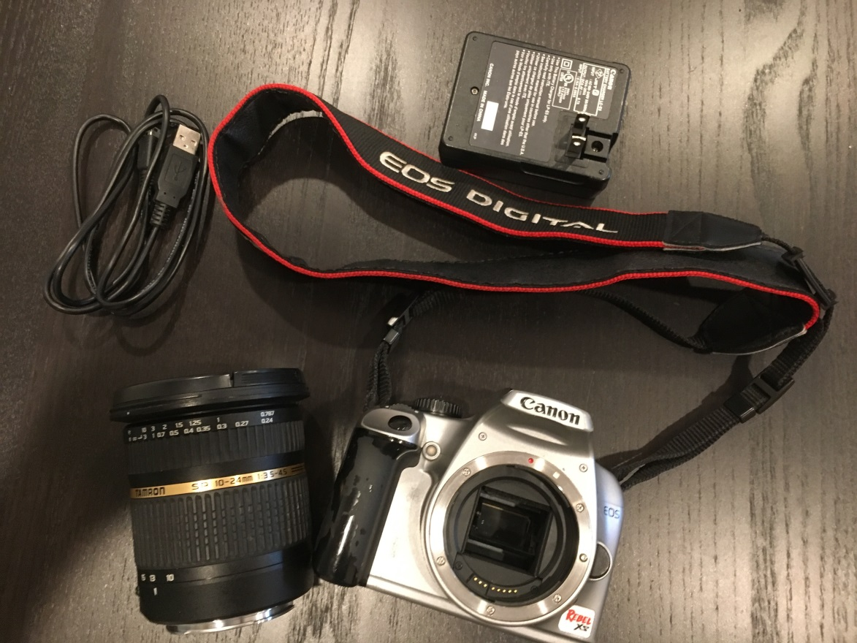
No Reference (NR) Metric Goal
Intelligent cameras
Intelligent networks
Quality of experience (QoE)
Notes:
“DSLR Camera” © Michele Saad, Intel

Slide 5
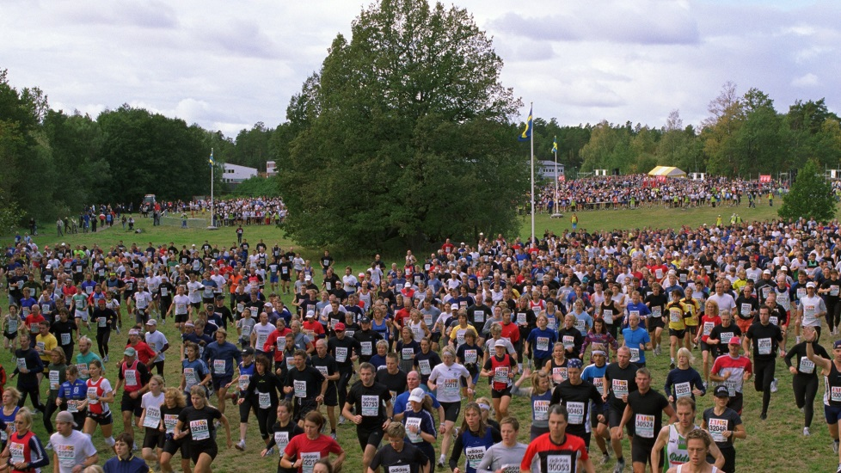
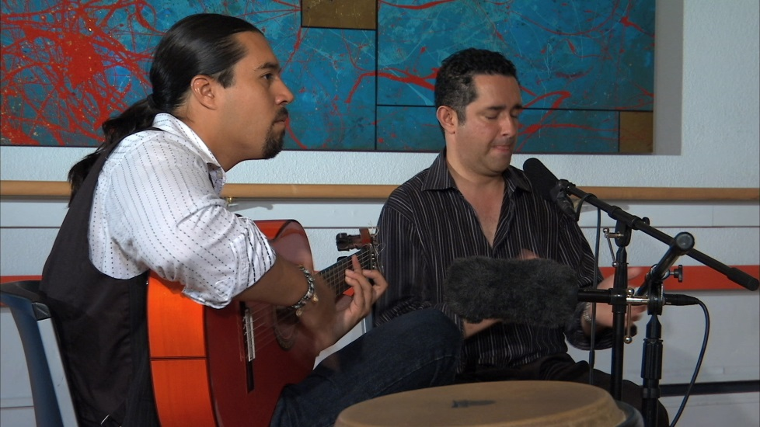
Roadblocks
Accuracy
Industry trust
Suboptimal training datasets
Missing subjective information
MOS ≠ QoE
Amateur ≠ professional
Task

Slide 6
New Datasets, January 2018
VIME1
101 photos from VIME photoshoot in Glasgow
CCRIQ2
4 SRC × 23 cameras
Extra images from Content Resolution and Image Quality (CCRIQ) Dataset
its4s
813 unfamiliar video sequences
Professional videography
4 sec duration
32% 720p 24fps, contribution quality
3% 720p 60fps, contribution quality
Simple adaptive streaming ladder, 2.34 to 0.5 Mbps

Slide 7
New Dataset its4s2, in progress
1,444+ images from Flickr
VIME image database
41% public safety
Tablets, 1920 × 1080
Display as 4 sec videos
Consumer cameras
Amateur photography
Lenses
Aspect ratio
Task dependency
Photographic vision
Separate spatial response from temporal response

Slide 8
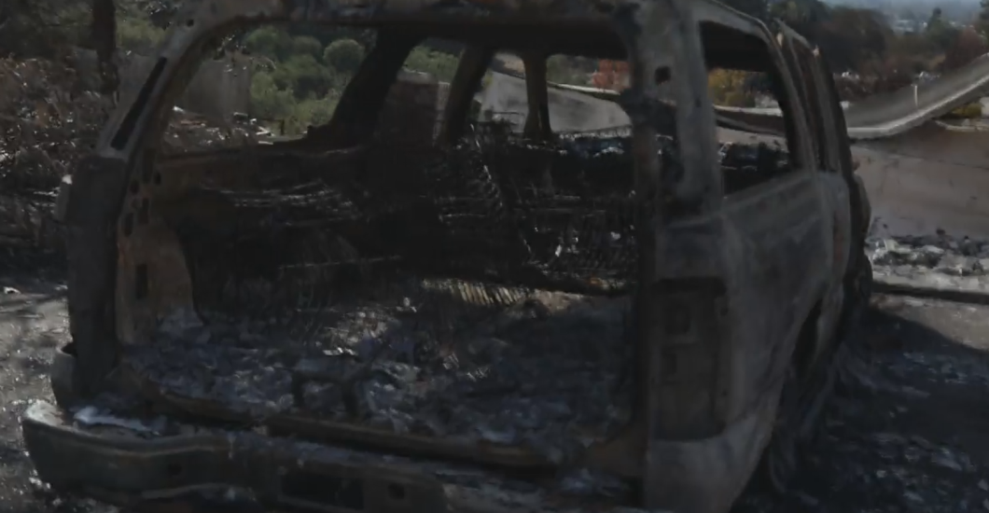
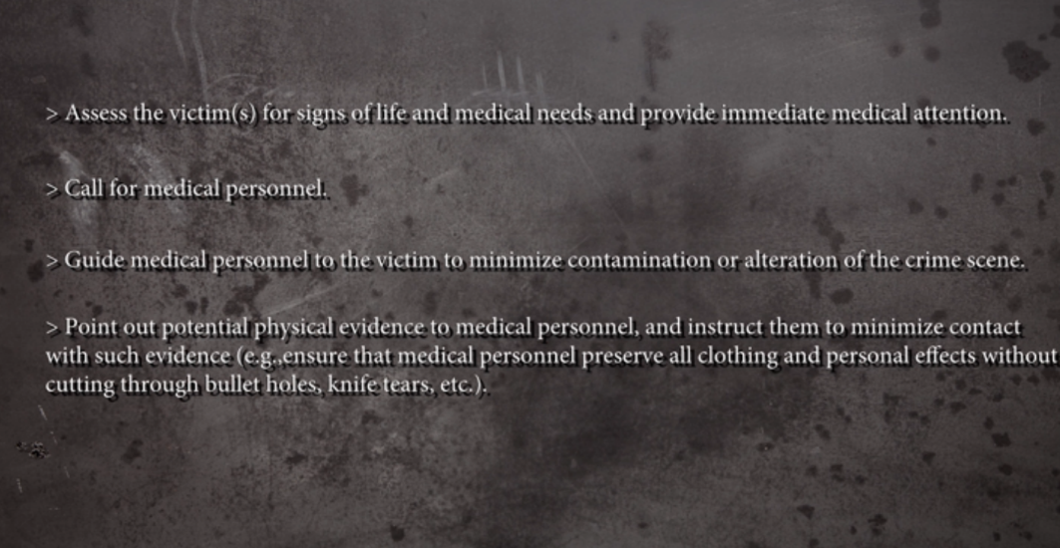
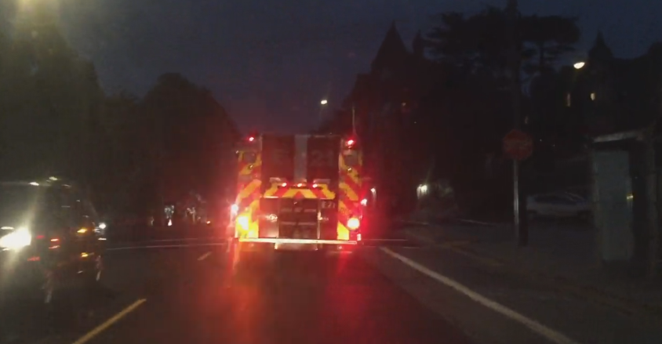
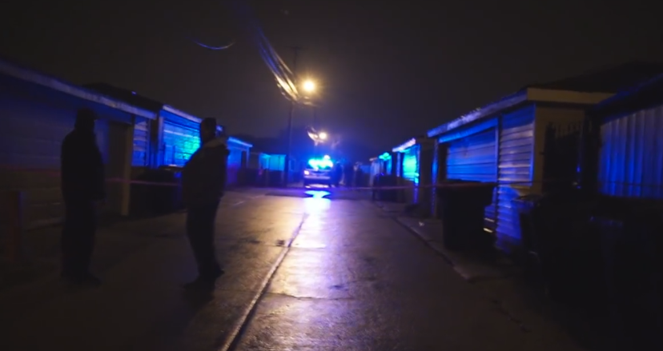
New Dataset its4s3, planning
New public safety content
Crime scene
Inclement weather
Drone footage
Professional videographers
Intentionally sloppy technique
HRCs
I want your advice

Slide 9
Example NR Parameter—Fraction Munsell Red
Why Red?
Computation
Characteristic of original content
Not impacted by bitrate, resolution, coding artifacts
Red is “important”
Photographers, linguists, visual psychologists, anthropologists, …
Very different conventional video or image quality metric
Blocking, blurring, noise, …
Color naming system with 7 colors
Black, grey, white, red, yellow, green & blue
Fraction of red pixels in Munsell color space
Chroma > 2, hue between 2.5YR and 2.5P
Mean over all frames
Square root

Slide 10
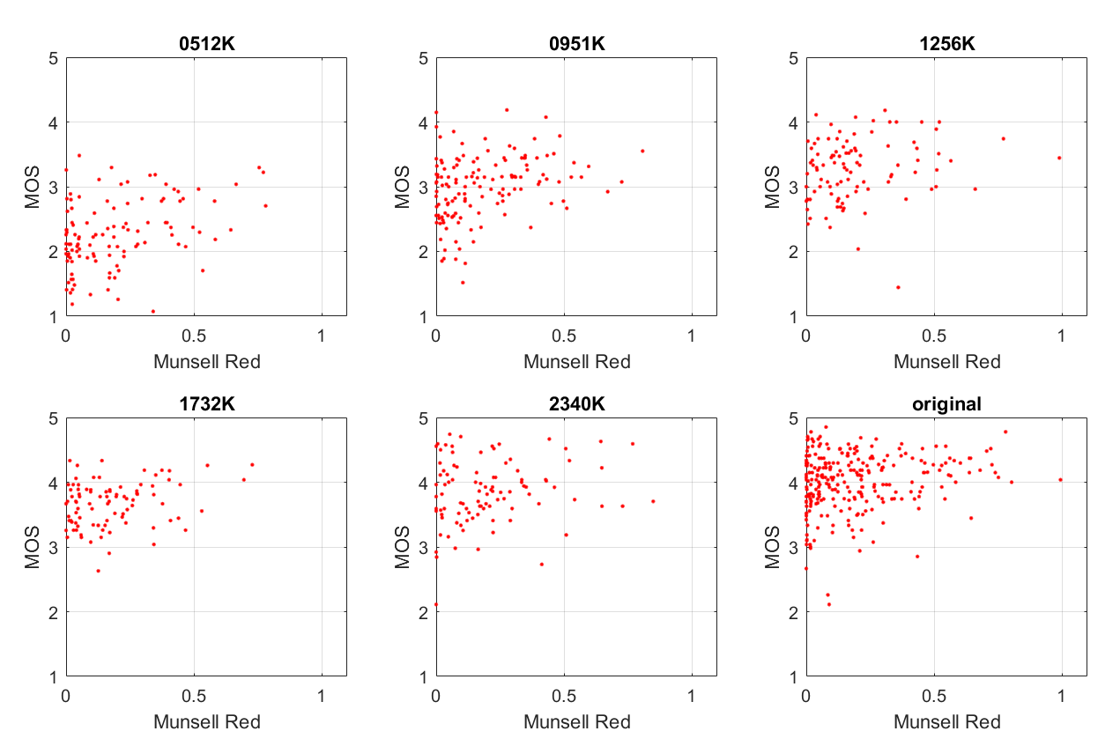
Video | Original | SRCpls | 2340K | 1732K | 1256K | 0951K | 0512K | Full Dataset
PVS | 0.44 | 0.40 | 0.48 | 0.33 | 0.47 | 0.46 | 0.48 | 0.77
Reference | 0.44 | 0.40 | 0.48 | 0.34 | 0.47 | 0.47 | 0.49 | 0.77

Slide 11
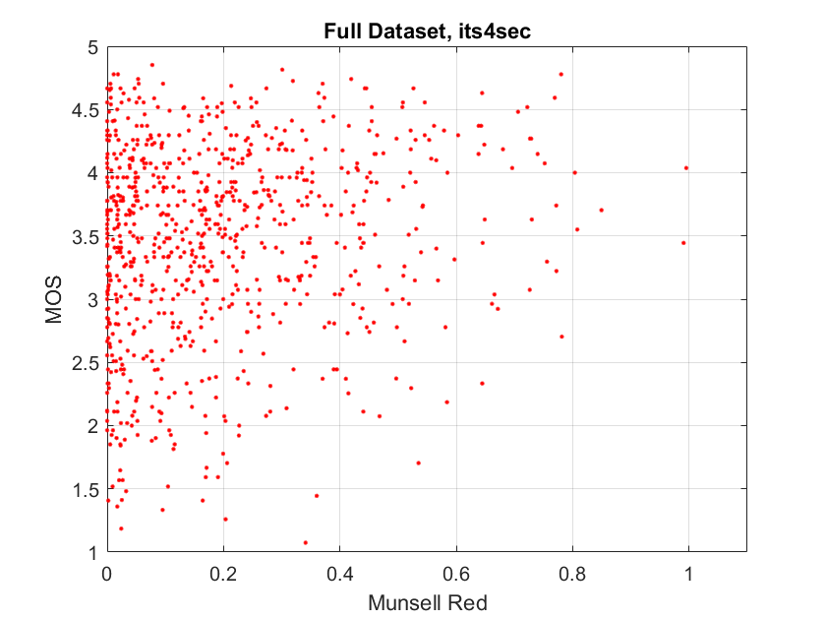
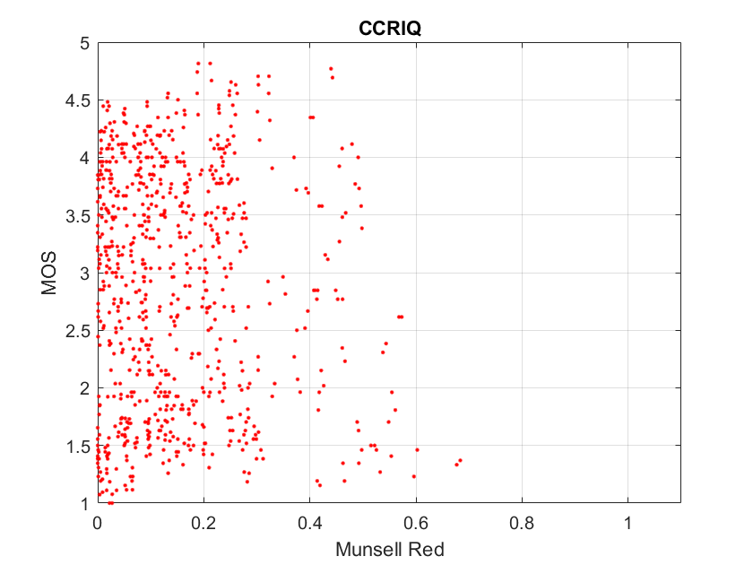
Dataset Comparison: its4s vs CCRIQ

Slide 12
What exactly is our goal?

Slide 13
What Exactly Is Our Goal?
UX / QoE problem?
Acceptable constraints?
NR metric traits?
NR parameters traits?
Dataset design?

Slide 14
UX / QoE Problem
Intelligent network
Impact of bandwidth limits on quality
Priority access
Intelligent camera
Minimum bandwidth for specific task
Covert surveillance
Bodycam
Remote learning

Slide 15
Acceptable Constraints—Simplify the Problem
Specify bitrate range per application
Specify amateur vs professional
Specify task
Entertainment, understand events, recognize people, …
Ignore quality change over time
Recency effect
Quality as viewed right now
e.g., ignore potential value of 40 MP image

Slide 16
Desirable NR Metric Traits
Same metric for images & video
Predict quality of originals
Real world subject, camera operator, lens, camera electronics, aesthetics, …
Extrapolate “what if”
Change bitrate, resolution, frame rate, …
Root cause analysis
Why is the quality bad?
Immediate quality response
2 frames, ¼ sec, 4 sec

Slide 17
Desirable NR Parameter Traits
Only respond to one factor
Upper or lower triangle scatter plot
Often ignore coding artifacts, resolution, …
Diverse types of factors
Characterize the scene, operator’s actions, lens, camera, video format, compression, …
Easily explained to naïve user
Computationally simple
Accuracy may depend on quality, task
More accurate, less accurate, irrelevant
Robust response to new content

Slide 18
Dataset Design
Unfamiliar SRC
4 sec, no reuse, no scene cuts
Include bad quality SRC
Training data for specific parameters

Slide 19
Who is interested? What can you contribute?
NTIA/ITS, subjective datasets

