Slide 1
IEEE standard working group HFVE (Human Factors for Visual Experiences) reaching out VQEG
Patrick LE CALLET
VQEG meeting – Krakow November 2017

Slide 2
Chair: Sanghoon Lee
Vice-chair: Patrick Le Callet

Slide 3
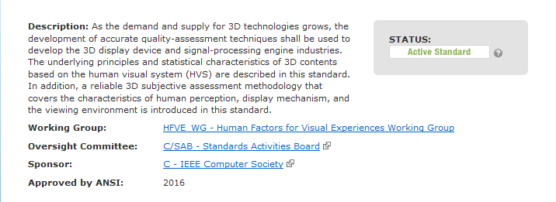

Slide 7
What can be standardized ?
Testing methodologies
Datasets
Metrics

