Slide 1

Monitoring app of video quality experience in real time
VQEG Krakow 2017
Javier Escobar*, César Díaz*,, Fernando Jaureguizar*, Pablo Pérez† and Narciso García*
jer@gti.ssr.upm.es
narciso@gti.ssr.upm.es
*Grupo de Tratamiento de Imágenes (GTI)
Universidad Politécnica de Madrid
†Nokia Bell Labs
Madrid

Slide 2
Presentation scheme
Motivation - General
Motivation - Specific
Main characteristics
Tool description
User guide - Methodology and Customization
Architecture
Example tests
… ... ... Demo available !!!

Slide 3
Motivation - General
On going work on 360VR User Behavior:
  360VR cinematic stereoscopic streaming system
  Adaptive bitrate (ABR) streaming over HTTP delivery
  Experiments and assessments with users watching 360VR video
Looking for realistic environments
Looking for automatic procedures
Need for user immersion and engagement while user assessment is conducted

Slide 4
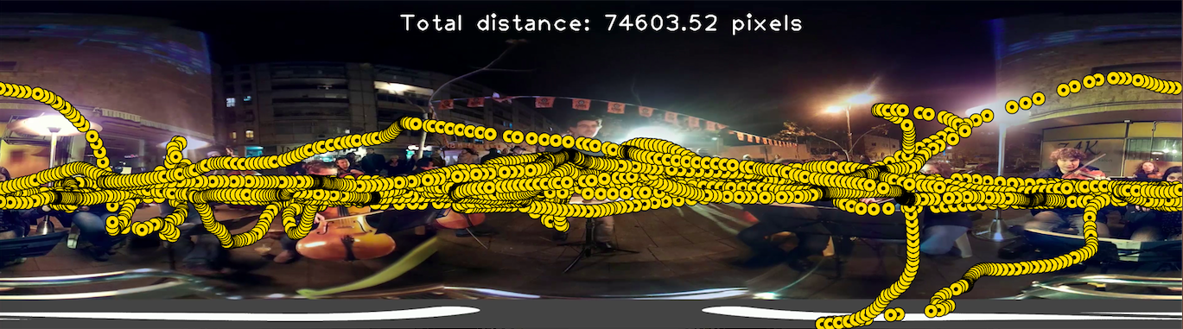
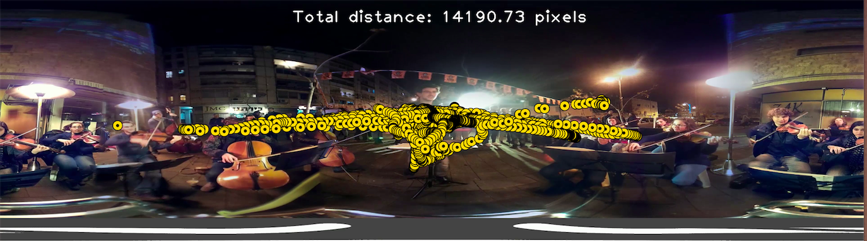
Example: Tracking results (extreme cases)

Slide 5
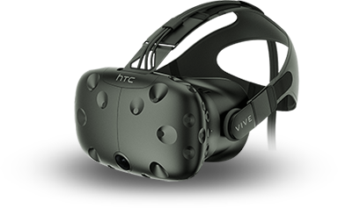
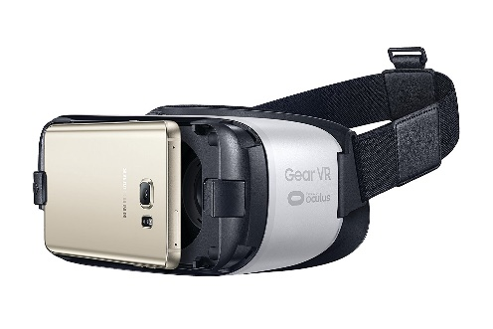
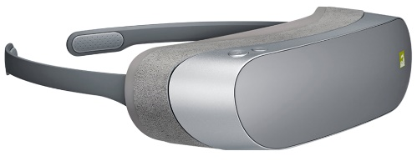
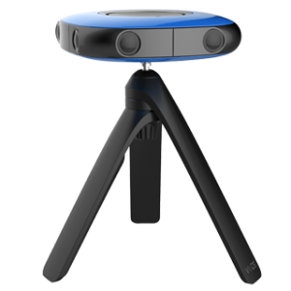
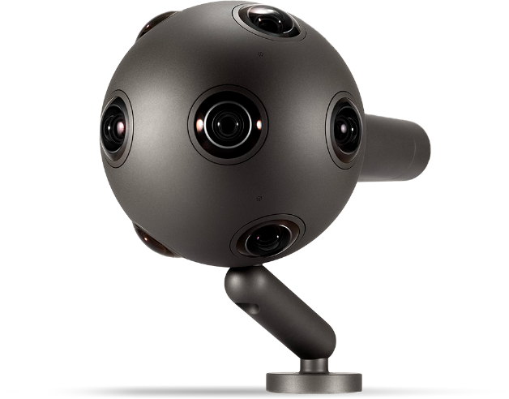
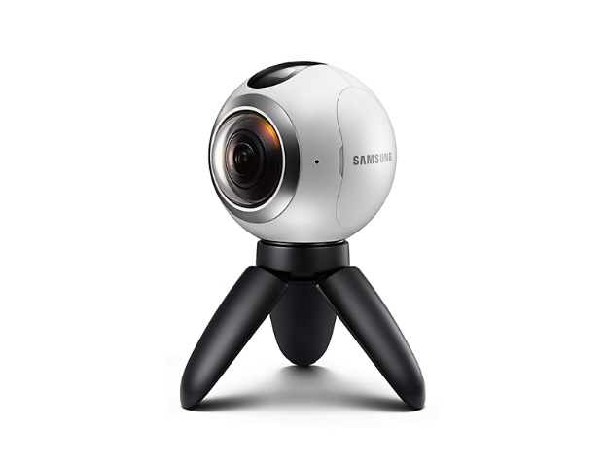
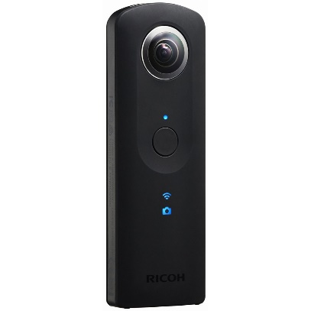
Motivation - Specific
Needs
Minimum-intrusive subjective video quality assessment
User opinions gathered within immersive environment
Self-guided operation, not requiring in-test assistance
Therefore, … non-predetermined response time
Moreover
Easy access to and use of the application
Available for multiple platforms and devices
Real-time feedback (display and analysis) of test results

Slide 6
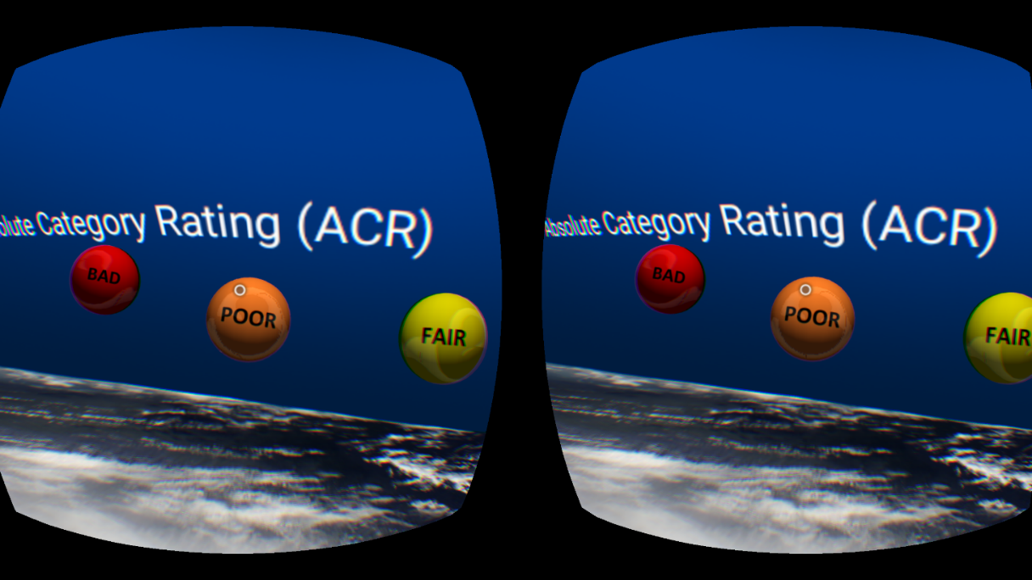

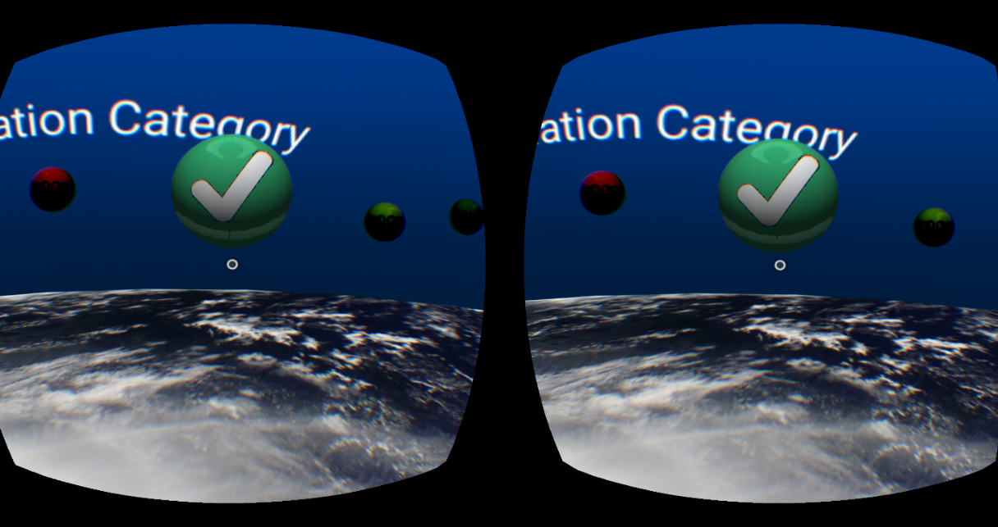
User (stereo) view
Available voting options
Headset tracking information
Voting choice

Slide 7
Main Characteristics
  Operation within an Adaptive bitrate (ABR) streaming over HTTP delivery:
  Requirement: Short segments and strict buffer control to vary the quality in the precise moment.
  Requirement: Same segment length (timespan) to be able to perform the test.
Test preparation:
  Application "MoviseDataTest" to configure the specific individual user-oriented test. A different random sequence can be set for each observer.
Operation:
  End users can perform the test autonomously after training. No need to tailor anything.

Slide 8
Main Characteristics
Test scenario
  Possible different video sequence for each observer.
  Predefined fixed display time for each test condition.
  Variable voting period to avoid user dis-engagement from the immersive experience.
  Any grading scale allowed.
Therefore
  Deterministic start of the voting period.
  Driven-based start of the display of the next test condition.

Slide 9
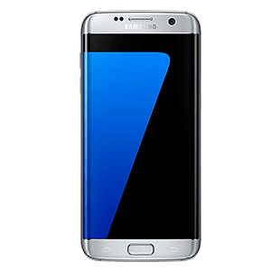




Tool description
Main objective: Design an architecture to measure QoE.
Resources:
  ”Android” --> ”Exoplayer”
  ”Grafana”
Operation:
  According to the configuration parameter set, the application reproduces the selected content and periodically asks the user about his/her opinion and experience on the video quality.
  To monitor the experiment, all characteristic data are stored in “Grafana”, to make them available for future analysis.
ExoPlayer

Slide 10

User guide (methodology)
System split into three apps, one common and two alternatives depending on the display:
  1) MoviseDataTest: Definition of experiment to be carried out and recollection of the following data:
    Gender
    Age
    Configuration file
      Data in “json” format: URL, Time to launch the test (in seconds) , stereo mode (False,True), Qualities (array with the order of qualities that we want to reproduce).
    Test file
      With the methodology of test (ACR,DCR,etc...)

Slide 11

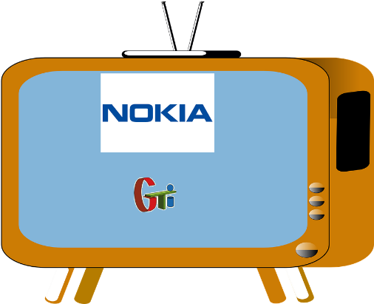
User guide (methodology)
Type of experiment:
  2) 360 app: ***** VQEG DEMO *****
  3) DRS player (natural video)

Slide 12
Customization
Format of files:
  Configuration File:
  Test File:
  Result File:

Slide 13
Customization
Choice of either time or number of segments elapsed before launching voting period:
    Alternative:
    voting period begins at the end of the specified number of adaptive streaming segments
startTimeUs
startTimeUs
startTimeUs
Example for specific time:
voting period begins at “Start test”,
while player is displaying ”Seg2”
Seg0
Seg1
Seg2
Start test

Slide 14




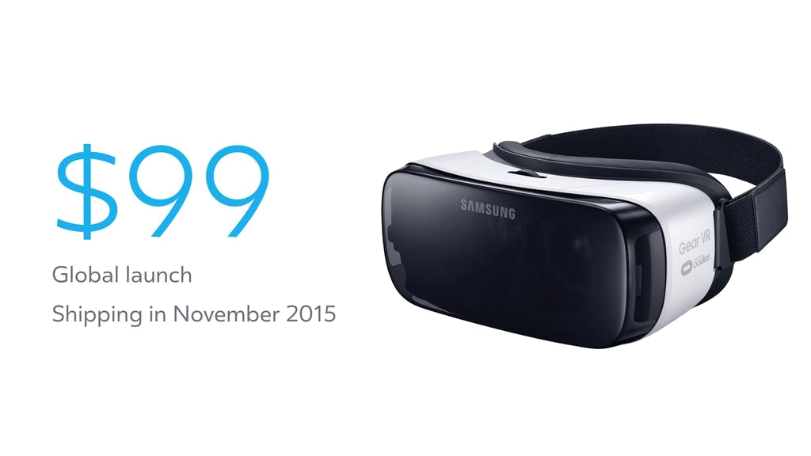


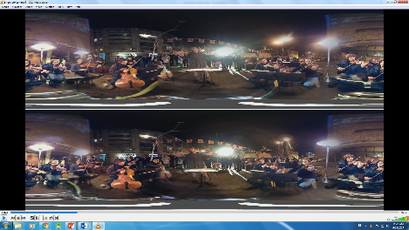



Architecture
Grafana server
manifest.mpd
Data
segments
playlist.m3u8
Movise App
Apache Server
ExoPlayer

Slide 15
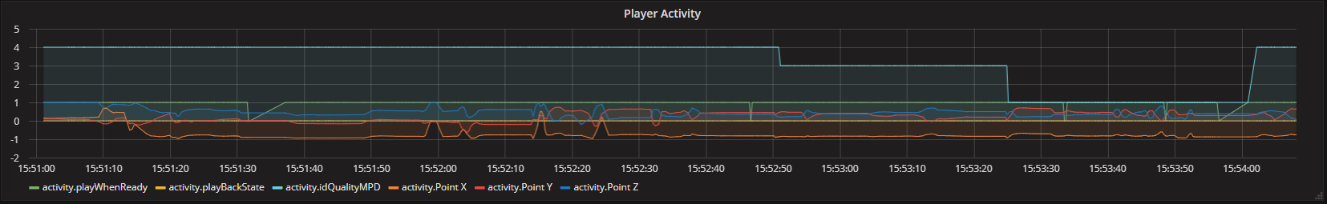
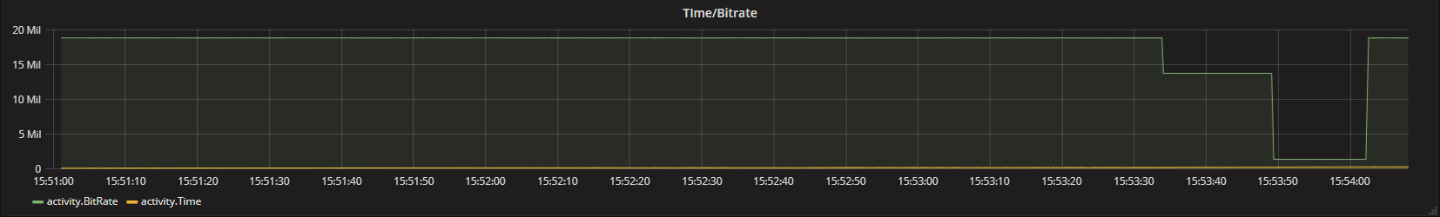
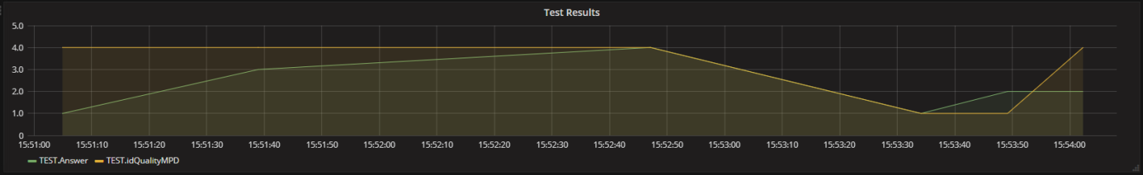
Grafana Data
Player Activity: It shows the overall state throughout the test, including variables like : “state of player”, ”current quality”, ”viewpoint (X,Y,Z)”, etc.
Time/Bitrate: Shows the bitrate of the played sequence along the test:
Test Results: Shows the answers provided by the user depending on the current quality that is reproducing.

Slide 16
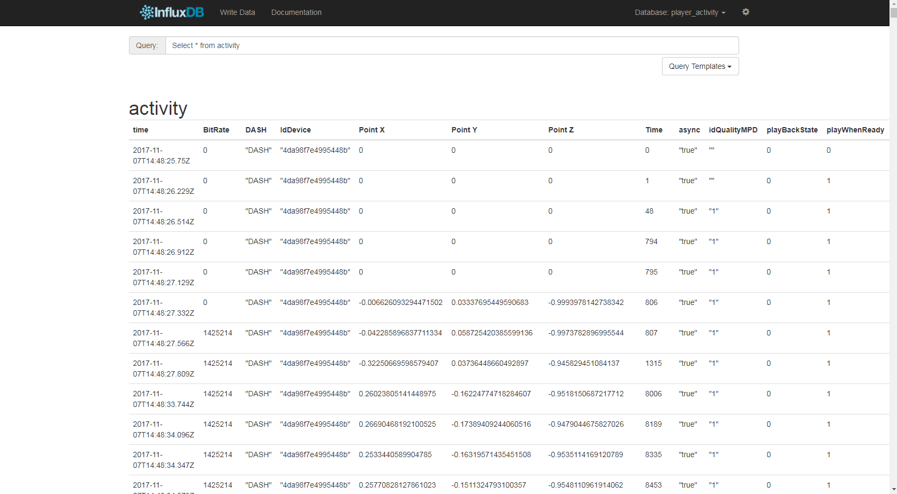
Influx Data (Activity)

Slide 17
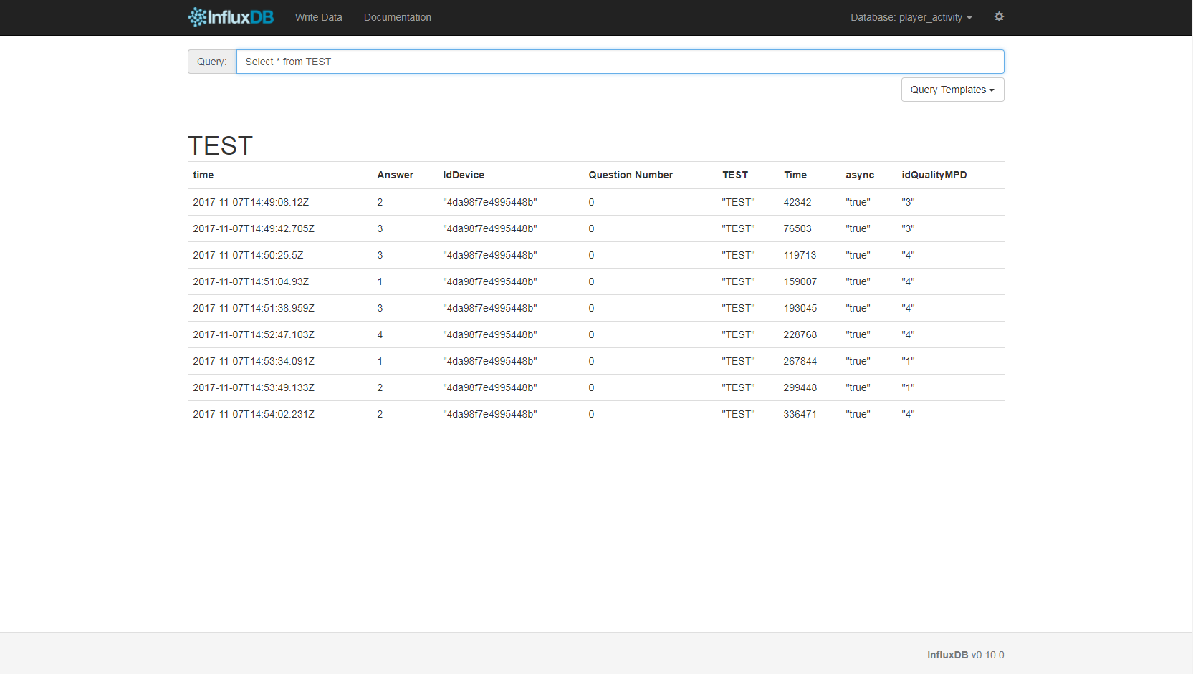
Influx Data (TEST)

Slide 18
Questions – Discussion – Debate - …
Open for research cooperation and non-profit use
Grupo de Tratamiento de Imágenes (GTI)
Universidad Politécnica de Madrid
Nokia Bell Labs
Madrid
This work has been partially supported by the Ministerio de Economía, Industria y Competitividad (AEI/FEDER) of the Spanish Government under projects TEC2016-75981 (IVME) and RTC-2015-4133-7 (MOVISE )

