Slide 1
Selecting contents for QoE studies: Perceptual characterization for WCG content
Toinon Vigier, Patrick Le Callet
LS2N, Université de Nantes, France
Junghyuk Lee, Jong-Seok Lee
MCML Group, Yonsei University, South Korea

Slide 2
Motivations
Subjective studies should be conducted on a representative content
Diverse content -> high generalizability
Pinson and al. “Selecting scenes for 2D and 3D subjective video quality tests” JIVP 2013
Narwaria and al. “An objective method for High Dynamic Range source content selection“, Qomex 2014
High number of possible contents to choose from
Subjective selection is impractical (and can be biased)
Objective way to characterize the content is highly desirable
Simple characteristics are not sufficient in WCG and Gamut Mapping applications
objectively predict color perception for natura content is still challenging
better understanding of impact of color on perceptual quality of images and videos is required

Slide 3
WCG content selection?
How a content is reacting to gammut mapping
=> perceptual impact of gammut reduction

Slide 4
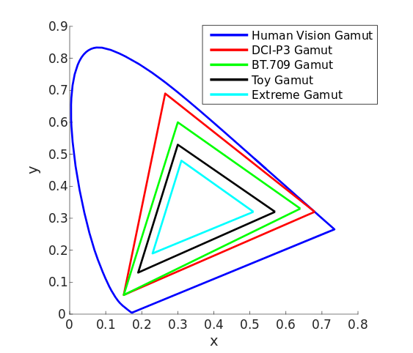
Subjective study - Perceptual color difference
Stimuli
30 source images in BT2020
3 HRCs
Gamut P3
Gamut BT709
Gamut Toy
Gamut mapping: clipping
Side-by-side half images

Slide 5
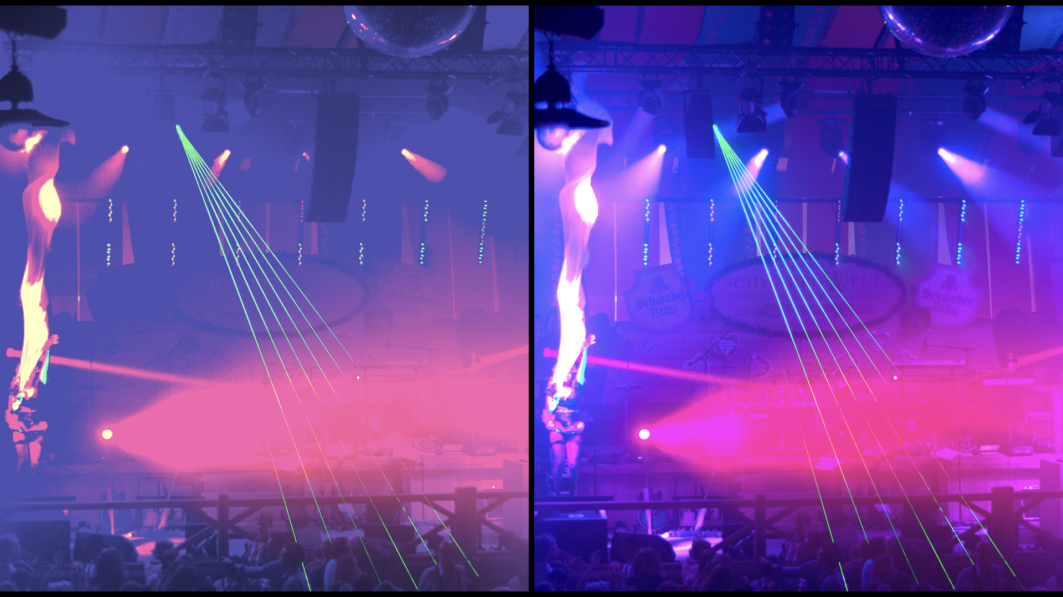
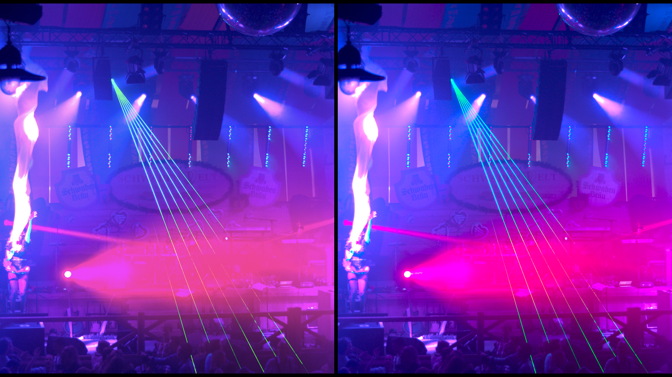
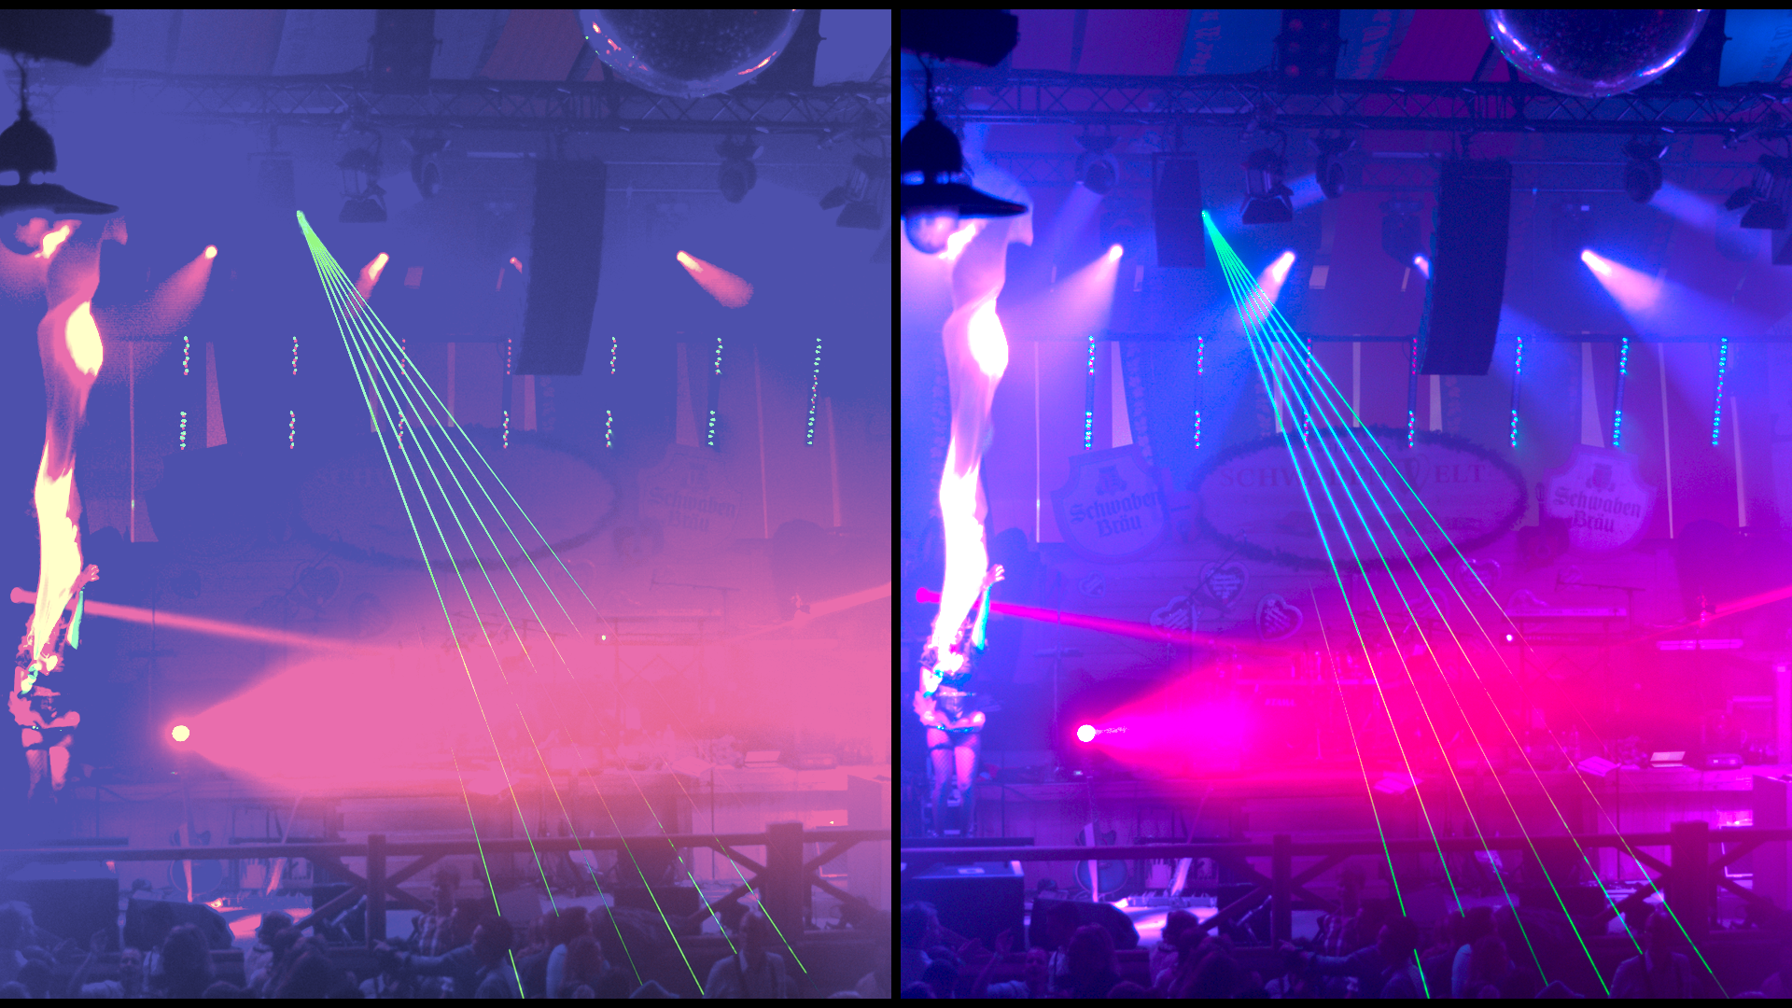
Subjective study - Perceptual color difference
Stimuli
Toy / BT709
BT709 / P3
Toy / P3

Slide 6
Subjective study - Perceptual color difference
Test methodology
Pair comparison on 3-point scale
I cannot see any difference (0)
I can see slight differences (1)
I can clearly see differences (2)
Randomization of sources / pairs / left-right images
Replication of the same test in University of Nantes and Yonsei University
30 x 3 = 90 stimuli per session (~15 minutes)

Slide 7
Subjective study - Perceptual color difference
Test setup
Eizo screen Color Edge - HD resolution - Gamut P3
Viewing distance = 3H
ITU standardized test rooms
Participants
Nantes: 31 observers (22 females, mean age=28.4, std=11.6, min=19, max=65)
Yonsei: 20 observers (3 females, mean age=22.9, std=1.37, min=19, max=25)

Slide 8
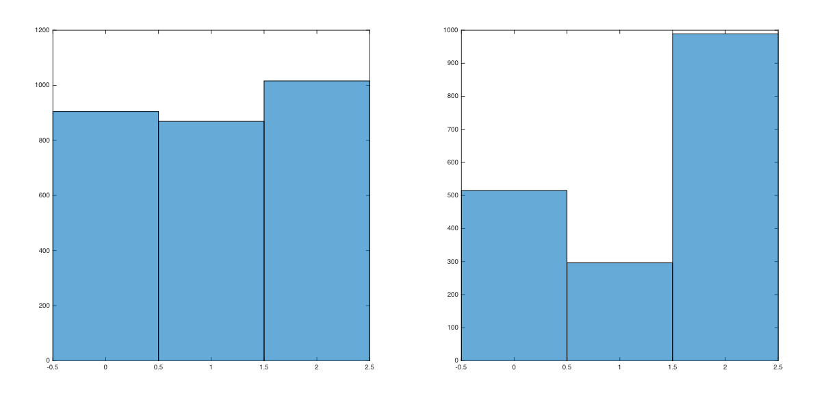
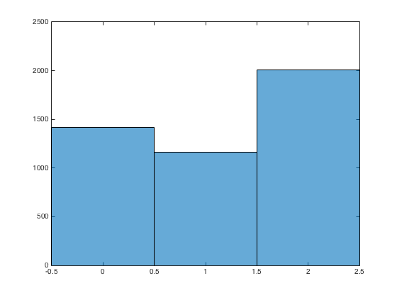
Subjective study - Perceptual color difference
Results
Distribution of results
Nantes
Yonsei
All

Slide 9
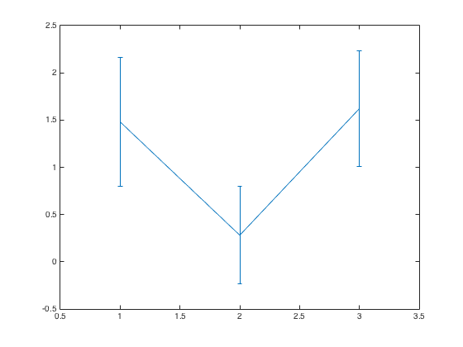
Subjective study - Perceptual color difference
Results
Toy/BT709
BT709/P3
Toy/P3
Notes:
Error bars = std

Slide 10
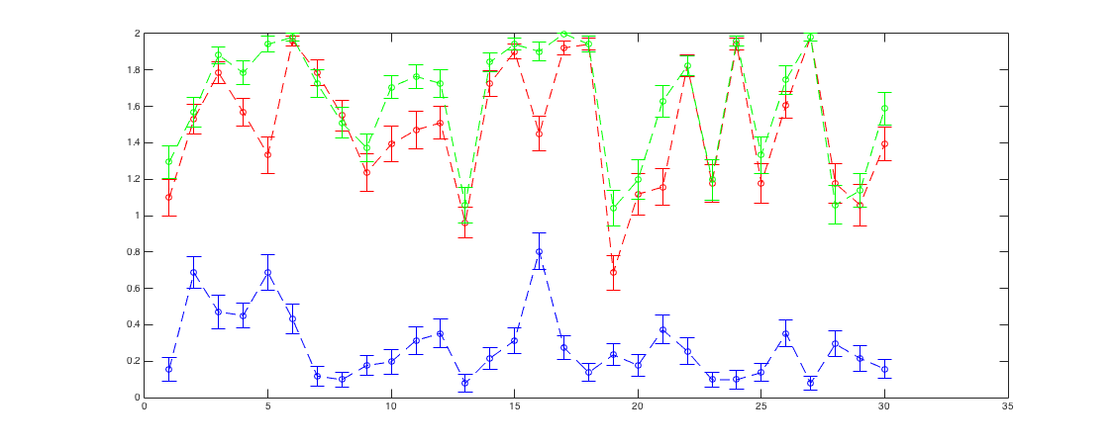
Subjective study - Perceptual color difference
Results per content
Toy / P3
Toy / BT709
BT709 / P3
Notes:
Error bars = standard errors (std/sqrt(51))

Slide 11
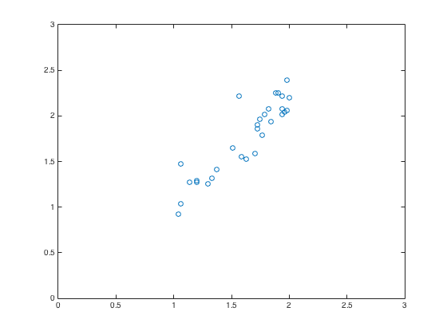
Perceptual difference as a distance
It works!
Predicted_MOS(Toy/P3) = MOS(Toy/BT709) + MOS(BT709/P3)
Correlation between Predicted_MOS(Toy/P3) and MOS(Toy/P3):
R = 0.91
p < 0.001

Slide 12
Next - Characterization of WCG content
Benchmarking of color difference metrics on this dataset
Development of a new framework to perceptually characterize color content (as SI and TI but for color) based on this 3 anchor gamuts
Validation of this framework with a new subjective experiment
Application of this framework
Compare content behavior for gamut mapping algorithms (or even TMO)
Select content for subjective tests
Benchmark of objective metrics on “comparable” datasets

