Slide 1
AVHD-AS/P.NATS Phase 2 Project
Alexander Raake (Deutsche Telekom/ TU Ilmenau, Germany)
Jörgen Gustafsson (Ericsson, Sweden)
Shahid Mahmood Satti (OPTICOM GmbH, Germany)
Silvio Borer (Rohde & Schwarz, Switzerland)

Slide 2
Model Types:
Pixel-based Models:
- FR, NR, RR Models
- Validated using short (10 sec) and long (upto 300 sec) test conditions
Hybrid Models:
- Hybrid NR
- Validated using short (10 sec) and long (upto 300 sec) test condition
Parametric Models:
- Mode 0 – 3 models, Mode 0: header info only, Mode 3: Full bitstream parsing
- Validated using short (10 sec) test conditions
Codecs: H.264, H.265,
VP9
Max FPS: 60
Max Res: UHD1 (2160p)
Bit depth: 8, 10
HDR: No
Display: Mobile,
Tablet, PC Monitor, TV
Services: YT, Vimeo,
Bitmovin
AVHD-AS/PNATS Phase 2

Slide 3
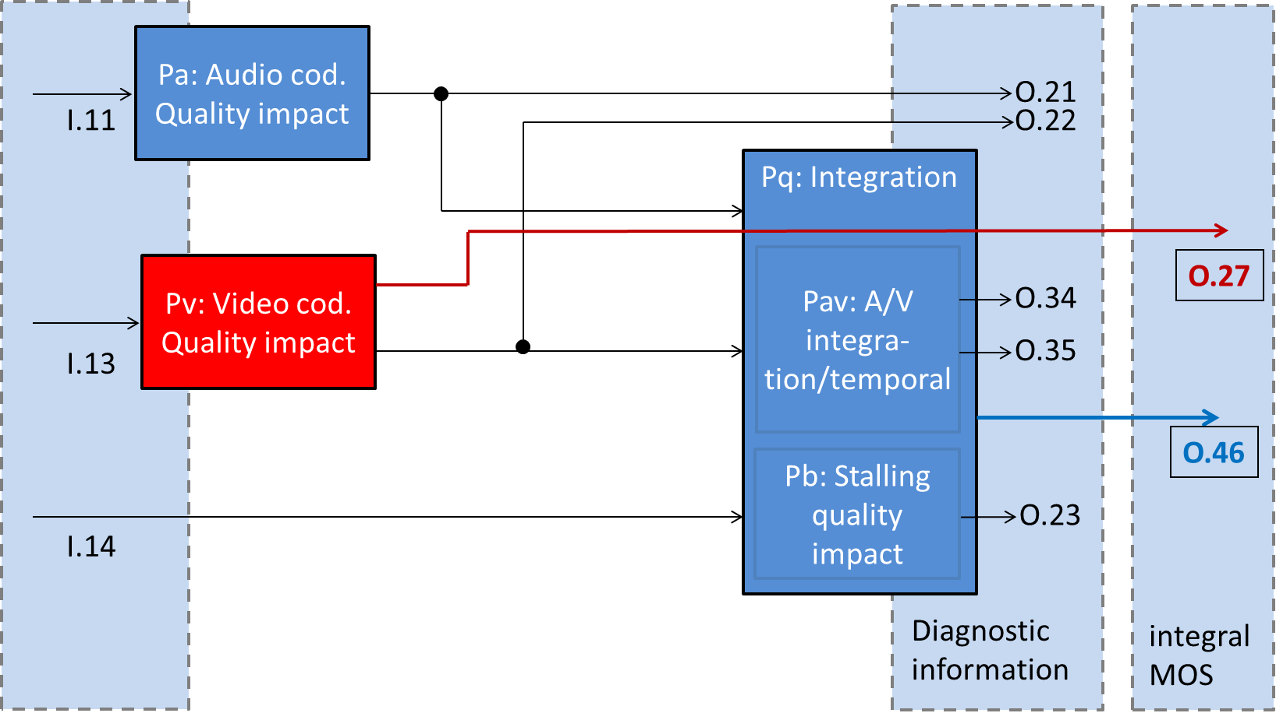
Parametric Models:
Parametric models will be validated for O.27 output only
Parametric audio input
Video Quality Short-term
Parametric video input
Video Quality Long-term
Rebuffering Information
Fig: Block diagram for parametric models
Fig: Modes of operation for parametric models

Slide 4
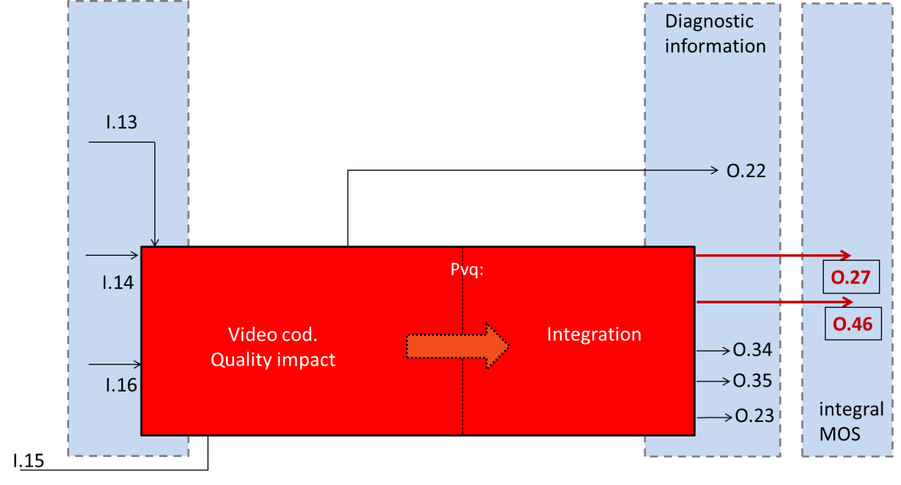
Pixel (FR,RR,NR) and Hybrid NR Models:
Pixel-based and hybrid models will be validated for O.27 and O.46 output
Parametric video input
(Hybrid models only)
Rebuffering Information
Video Quality Short-term
Video Quality Long-term
Degraded Video Pixels
Ref Video Pixels
(FR, RR models only)
Fig: Block diagram for Pixel-based and hybrid models

Slide 5
10 Proponents : 6 P.NATS Phase 1, 4 New

Slide 6
Subjective Databases: 17 TR, 23 VL
40 databases, 4 databases per proponent
 | Method | DB Type | Impairments | What is rated? | Number of databases
Long-sequence tests | ACR | Audiovisual. Only high quality audio. | Compression, initial-buffering, quality switching, Rebuffering | Integral (overall) AV quality | 13 (TR: 3, VL: 10) (weights: TR=10% VL=90%) (Mobile: 7, PC/TV: 6)
Short-sequence tests | ACR | Video only | Coding distortions with different codec parameters (bitrate, res, preset, gop-len ) | Video quality | 27 (TR: 14, VL: 13) (weights: TR=10% VL=90%) (Mobile: 7, PC/TV: 20)

Slide 7
Task Forces:
AVHD-AS/PNATS P2
TF1: SRC
- Review footage
- Conversion to a common format
- Define cut points for SRC creation
- SRC to HRC mapping
TF2: HRC
- Parameter ranges
- HRC definitions
- Common conditions
- Distribution of HRCs in DBs
TF3: Processing-Chain
- Scripts for Transcoding
- Scripts for Meta Data
- Scripts for PVS generation
- Integrating online services
TF4: Subjective Test System
- Smooth playout on TV/PC-monitor
- Smooth playout on Android mobile, tablet platforms

Slide 8
Current Status:
Creation/Testing of DBs (X)
TF1: SRC
- Review footage (✓)
- Conversion to a common format (✓)
- Define cut points for SRC creation(✓)
- SRC to HRC mapping (X)
TF2: HRC
- Parameter ranges (✓)
- HRC definitions (✓)
- Common conditions (✓)
- Distribution of HRCs in DBs (✓)
TF3: Processing-Chain
- Scripts for Transcoding (✓)
- Scripts for Meta Data(✓)
- Scripts for PVS generation (✓)
- Integrating online services (X)
TF4: Subjective Test System
- Smooth playout of TV/PC-monitor (✓)
- Smooth playout on Android mobile, tablet platforms (✓)
- All proponents tested (X)

Slide 9
Database Design Workflow:
✓
Outside processing chain environment
✓
YAML
✓
✓
✓
Messy Footage
any format
Clean Footage
yuv422p
yuv420p
yuv422p10le
yuv420p10le
ffv1 in AVI
ProRes
… (or any copied codec readable by ffmpeg)
SRC
yuv420p
yuv422p
yuv420p10le
yuv422p10le
ffv1 in AVI
PCM audio
Processing
Chain
AVPVS
yuv420p
yuv422p
yuv420p10le
yuv422p10le
ffv1 in AVI
PCM audio
cleanup_messy_footage.py
create_SRC_from_cleaned_footage.py
02_.py
01_.py
Metadata
(VFI, AFI, .qchanges,
.buff)
Bitstreams
only for subjective tests
.buff
Restricted YAML
04_.py
Bitstream
Models
CPVS
uyvy422 / V210
AVI
CPVS Mobile
yuv420p
x264/CRF15 MP4
Pre-Processing (same pixel formats as SRC)
✓
OptiPlay/TV
✓
Mobile Device
ref
deg
Pixel-based models
(pre-processing allowed)

Slide 10
Topics for Breakout Sessions:
Review of SRCs (short and long sequences)
PVS verification (quality range, variation in terms of sequences, distortions etc.)
HRCs for long-sequence tests (adaptivity, buffering patterns)
TF review (to be sure to have all relevant points considered)
Model inputs pixel-based models for mobiles
SRC repetition strategy within and across databases for short-length databases
Per-title encoding, should we make it part of our tests?
Time plan and responsibilities

Slide 11
Project Time Plan:
Date when done | Activity | Comment
December 2017 | Prepare for subjective test of training databases | Ongoing
February 2018 | Subjective test, training databases | ~2 months for subjective test
May 2018 | Model submission | 3 months for model training
June/July 2018 | Prepare for subjective testing, validation databases | ~1 - 2 months
September 2018 | Subjective test, validation databases | ~2 months for subjective test
October 2018 | Determine winning models | ~1 month (including statistical evaluation)
December 2018 | Merging and optimization of winning models | ~2 months for merging
December 2018 | First draft recommendation of P.120X | Write draft recommendation in parallel with merging
January/February 2019 | Consent on new P.120X recommendation

Slide 12
Details:
Mailing List:
pnats2avhd@lists.itu.int
For subscription see https://www.its.bldrdoc.gov/vqeg/projects/audiovisual-hd.aspx
Project Wiki:
https://extranet.itu.int/sites/irg/avqa/pnats2/SitePages/Home.aspx
Conf-calls:
Each Thursday 1300-1400 hrs CET

