Slide 1






Balancing Type I Errors and Statistical Power in Video Quality Assessment
Kjell Brunnström and Marcus Barkowsky
ªRISE ICT/Acreo, Kista, Sweden
^{b}Mid Sweden University, Sundsvall, Sweden
^{c}University of Nantes, Nantes, France
Notes:
In this presentation we analyze how we can plan the size i.e. number of test subjects so that we can find the effects we are looking for.
In principal there is nothing new here, it is just applying known statistics on the problem of video quality assessement.
It is collaboration between myself and Marcus Barkowsky of University of Nantes

Slide 2
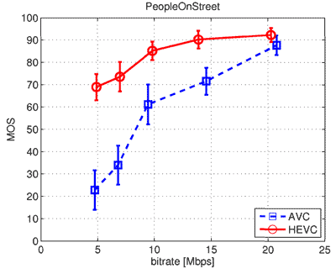
Introduction - example comparison compression algorithms
Subjects rate the video clips
Compare Mean Opinion Scores (MOS)
  i.e. mean over test subject for each video clip
Apply statistical hypothesis testing
  H₀: they are the same
  H₁: they are different
Reject H₀ gives a certain confidence that they are in fact different – not happened by chance
Common confidence level 95%
However, still 5% risk that there are no effect
Notes:
I will you an example when. Assume you would like to compare two compression algorithms

Slide 3
Introduction
How can we plan video quality experiments so that we can find the effect we would like to see?
This paper is about how we can balance a video quality test i.e.
  find an effect if it is there
  Not claim the effect is there if it is not

Slide 4
Introduction
Type I error: to claim that there is an effect while there is none
  The risk depends on confidence level, typically α = 0.05 (5%)
Type II error: to miss an effect if it is there
  Larger risk if we safeguard more against Type I error
  The risk to miss an effect if is there (β = 0.20)
  This gives 4 times higher risk for Type II than Type I, which is common

Slide 5
Introduction
Power (more common to use)
  The probability to correctly conclude that there is an effect if it is there (1 - β = 0.80)
We need to balance the experiments between Power and Type I error
Factor influencing are expected effect size, number of samples and significance level

Slide 6
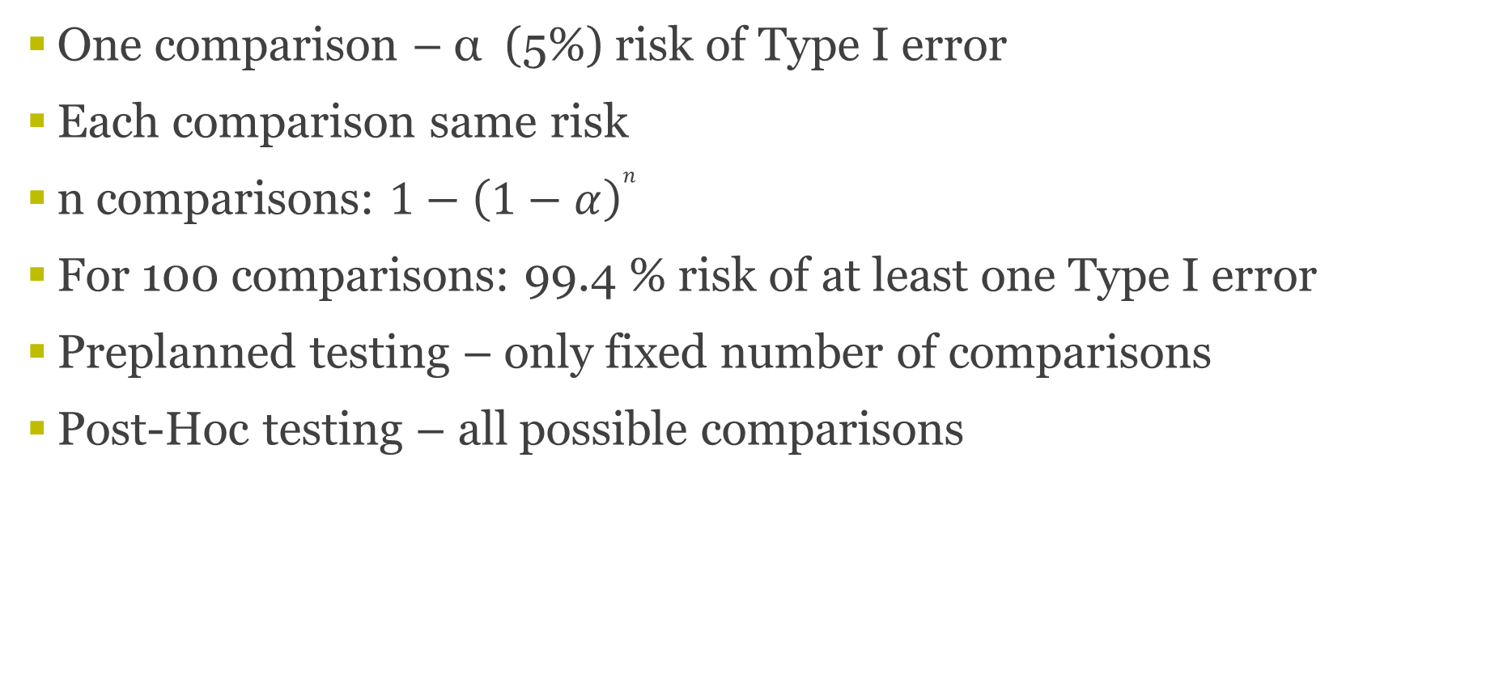
Introduction – Multiple comparisons
One comparison – α (5%) risk of Type I error
Each comparison same risk
n comparisons: $1−{\left(1−α\right)}^{n}$
For 100 comparisons: 99.4 % risk of at least one Type I error
Preplanned testing – only fixed number of comparisons
Post-Hoc testing – all possible comparisons

Slide 7
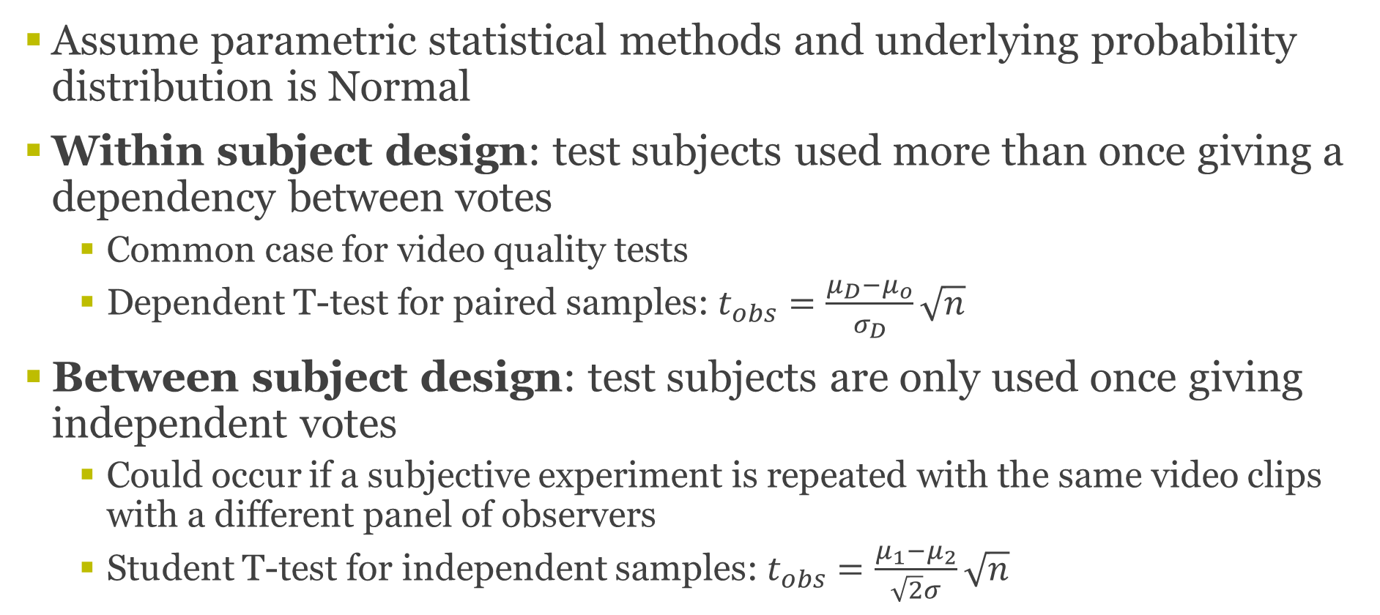
Method
Assume parametric statistical methods and underlying probability distribution is Normal
Within subject design: test subjects used more than once giving a dependency between votes
  Common case for video quality tests
  Dependent T-test for paired samples: $t_{obs}=\frac{μ_{D}−μ_{o}}{σ_{D}}\sqrt{n}$
Between subject design: test subjects are only used once giving independent votes
  Could occur if a subjective experiment is repeated with the same video clips with a different panel of observers
  Student T-test for independent samples:$t_{obs}=\frac{μ_{1}−μ_{2}}{\sqrt{2}σ}\sqrt{n}$

Slide 8
Method: Simulate influence
Number of video clips in experiment: n_PVS = 100
Assume pre-planned gives 100 comparisons
Post-hoc gives 100*99/2 = 4950
Method to compensate for multiple comparisons: Bonferroni (α/n)
Bonferroni significance levels:
  0.05 (1 comparison)
  0.0005 (100 comparisons)
  0.000011 (4950 comparisons)

Slide 9
Method: Simulate influence
Compute probability of significance i.e. p-value of the two T-tests
Interesting difference MOS = 0.5 and 1.0 on five graded scale
We have used σ = 0.8 (Typical experimental value e.g. VQEG HDTV)
Planning the number of test subjects based on power of 0.8 i.e. β = 0.20, α = 0.05, β/α = 4

Slide 10
Within subjects: Power analysis
1 comparison
34 subjects
10 subjects

Slide 11
Within subjects: Power analysis
100 comparisons
81 subjects
25 subjects

Slide 12
Within subjects: Power analysis
4950 comparisons
121 subjects
37 subjects

Slide 13
Between subjects: Power analysis
1 comparison
64 subjects
17 subjects

Slide 14
Between subjects: Power analysis
100 comparisons
153 subjects
41 subjects

Slide 15
Within subjects: Power analysis
4950 comparisons
227 subjects
61 subjects

Slide 16
Comparisons of object models
The previous arguments relevant for object model comparison
Looking for statistically signficant differences
Let’s assume comparison of 10 objective models
Performance metric Person correlation

Slide 17
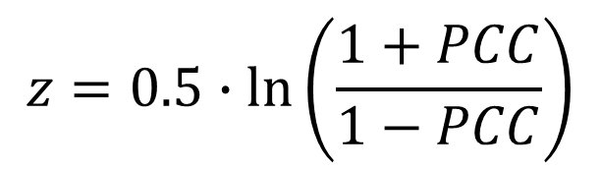
Person Correlation (PCC)
$$z=0.5∙\ln\left(\frac{1+PCC}{1−PCC}\right)$$
ITU-T Rec. P.1401
Make PCC Normally distributed
  (Fisher z transformation)
Student T-test
Depends on difference and number of fitted points

Slide 18
Influence on correlation
> 0.92 significant for one comparison
1 comp
9 comp
45 comp

Slide 19
Discussion
Fairly simple model for compensating for multiple comparison (maybe too conservative).
Parametric model and Normal assumption are not suitable for all scales – should be a limiting case though

Slide 20
Parametric vs non-parametric: Introduction
  How could we estimate the difference it makes using parametric vs non-parametric statistics?
  Absolute Category Rating (ACR) is ordinal scale and based on this should be analyzed with non-parametric statistics
  If certain care is taken and specific instructions are given, then (in theory) it can be made into a interval scale e.g. instructions and graphical repressentation of equal distances between the categories.
  In this study we will compare the difference in decision when applying statics test based either on parametric and non-parametric methods

Slide 21
Parametric vs non-parametric: Method
  Parametric test
    Independent two-sample T-test (ITT)
    Dependent T-test (DTT) for paired samples
  Non-parametric test
    Mann-Whitney U test independent (IMW)
    Mann-Whitney U test dependent (DMW)

Slide 22
Parametric vs non-parametric: Method
Case 1: 95% confidence level i.e α= 0.05
Case 2: Compensating for Type-I error based on the number of the videos involved in the test, using Bonferroni method α/n (n = number of comparisons).
Case 3: Compensating for Type-I error, using Bonferroni, when full post-hoc pairwise comparison is performed per experiment.

Slide 23
Parametric vs non-parametric: VQEG HDTV phase I
6 different experiment with a common set
Independent: Common set 24 PVS inserted into all experiment
  6x24 = 144 independent hypothesis test cases
  Bonferroni α = 0.05/24 = 0.002
Dependent: Each experiment 168 PVS
  6x170x169/2=86160 hypothesis test
  Bonferroni α = 0.05/168 = 0.00030; α = 0.05/14028 = 3.6x10⁻⁶;

Slide 24
Parametric vs non-parametric: Adaptive streaming exp.
3 experiments 2 Labs same PVSs different lab conditions
Independent: 132 PVS seen by 3 different panels
  132 = 144 independent hypothesis test cases
  Bonferroni α = 0.05/132= 0.00038;
Dependent: Each experiment 168 PVS
  3x132x131/2=25938 hypothesis test
  Bonferroni α = 0.05/132 = 0.00038; α = 0.05/8646 = 5.8x10⁻⁶;

Slide 25
Parametric vs non-parametric: Results
Exp | HDTV test phase I |  | Adaptive streaming
 | Independ | Dependent | Independ | Dependent
Case 1 | 1% | 0.1% | 1% | 1%
Case 2 | 2% | 2% | 0% | 9%
Case 3 | N/A | 11% | N/A | 18%

Slide 26
Conclusions
More test subject are in general needed
  Within subject design and pre-planned number of comparison then the number recommended by VQEG (i.e. 24) can work
Pearson correlation – significance hard to get unless (PCC > 0.9 and n > 100)

Slide 27

Thank you
The work was funded partly by Vinnova (Sweden’s innovation agency), which is hereby gratefully acknowledged.

Slide 28
Thank you!
Kjell Brunnström
kjell.brunnstrom@acreo.er
+46708419105
RISE ICT
Acreo

