Slide 1
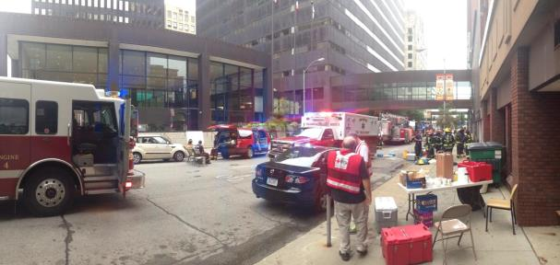
Image Quality for Public Safety
Margaret Pinson, NTIA/ITS

Slide 2
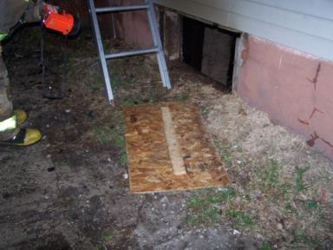
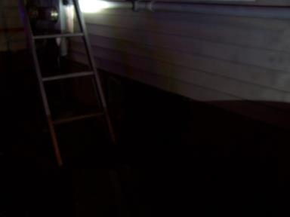
Evidence
All photos were provided by first responders.
These actual photos show recent cases

Slide 3
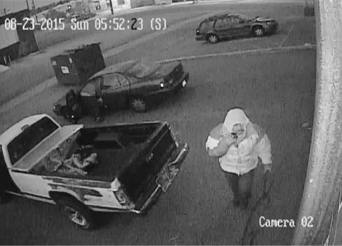
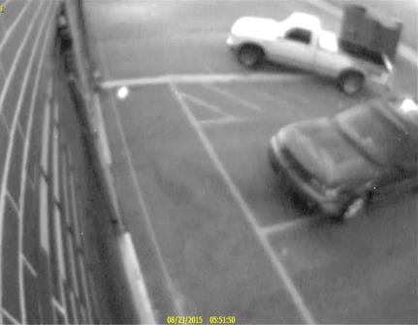
Surveillance systems

Slide 4
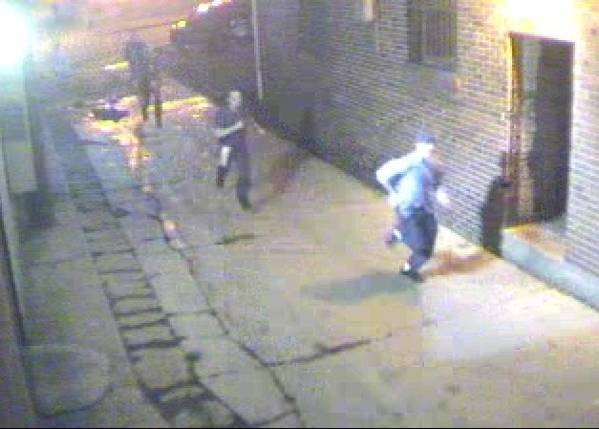
How do we avoid …

Slide 5
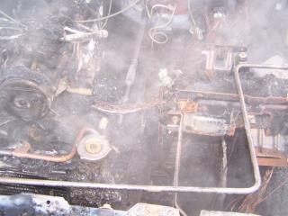
Mike Hartman Assistant Chief and Fire Marshal Muscatine, Iowa
Takes picture in field
Struggle with quality 75% of time
Low light & bad weather
Reshoot
Miss problems
Impact
Evidentiary needs not met
Must retain all images regardless
Time sink

Slide 6
Michael Bush Denver Police Crime Lab Forensic Imaging and Video Analysis
Photo from surveillance video
Monitor quality ≠ photo quality
Export frame
Face disappears
Struggle with quality 60% of time
Need identifying marks

Slide 7
Project Summary
Collect images
Realistic
Subjective test
Redistribute dataset
www.cdvl.org
Future
Objective model
Video

Slide 8
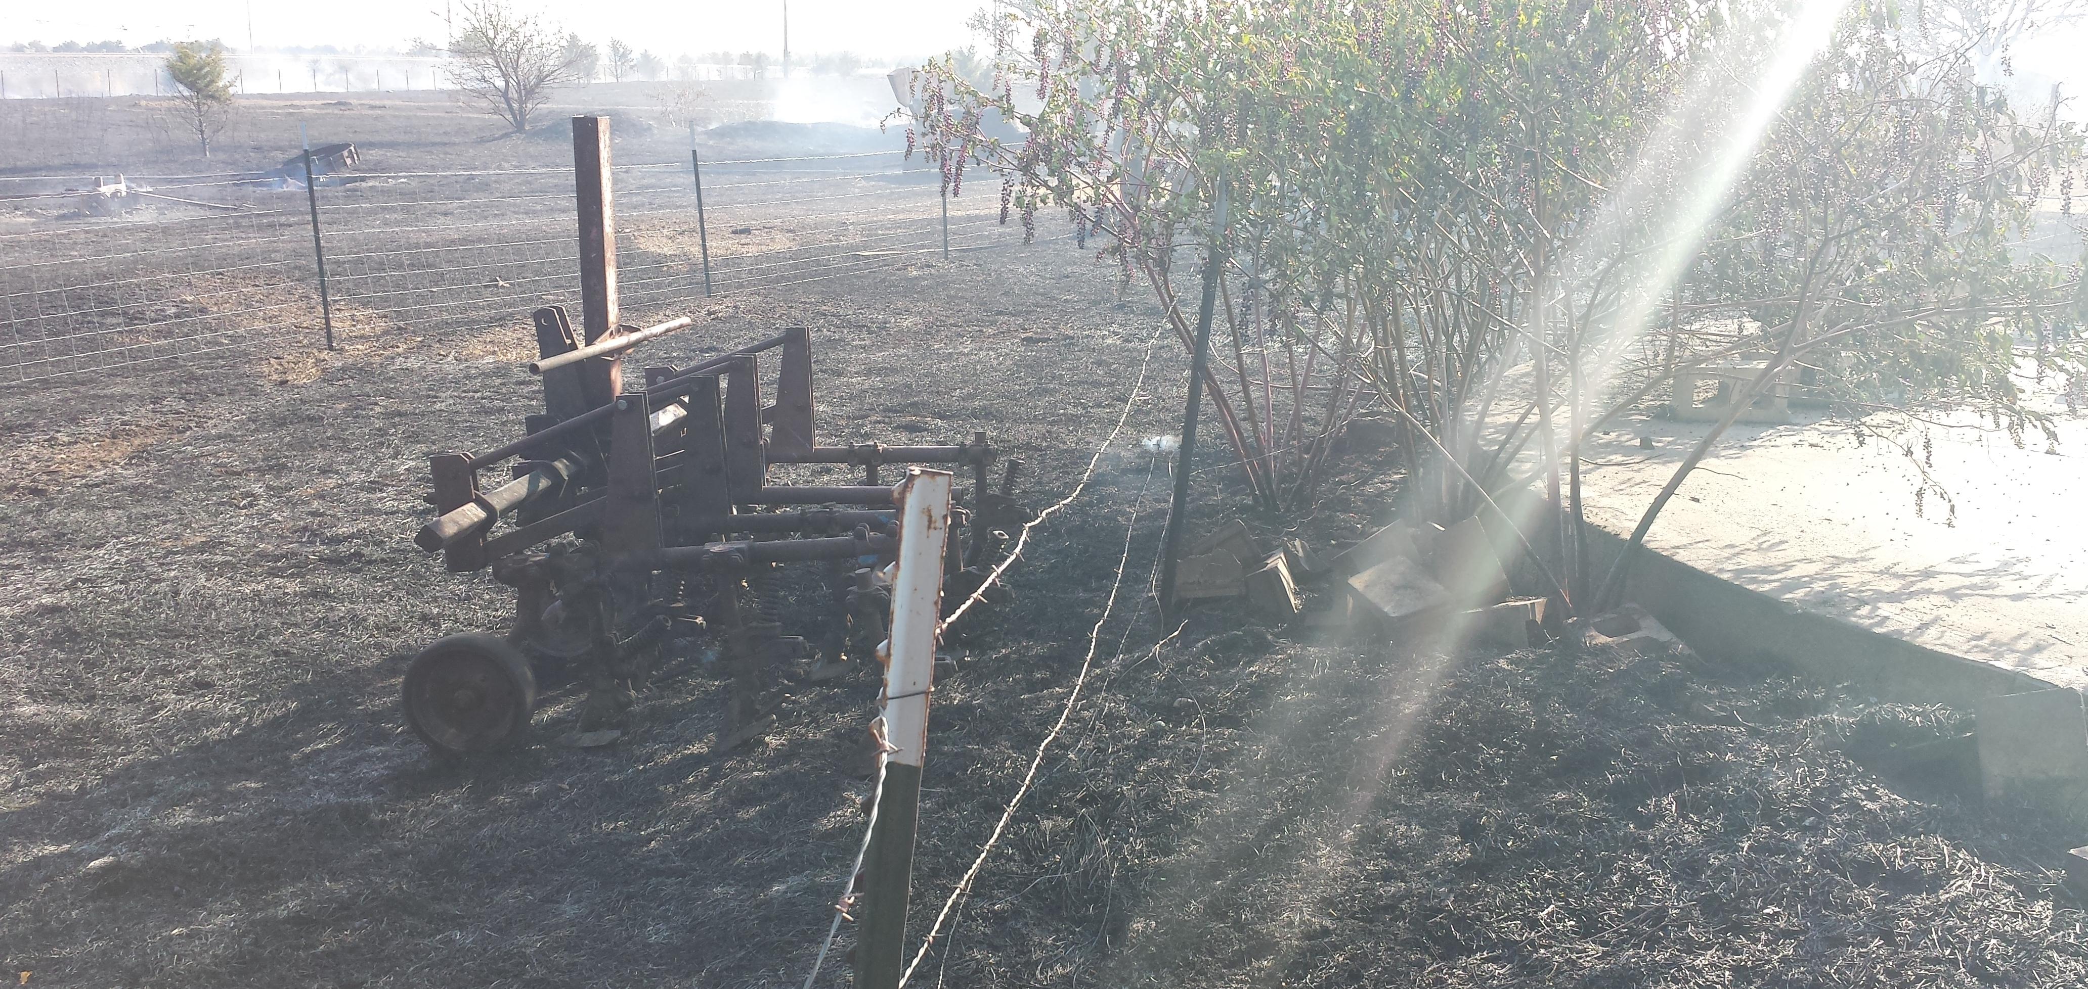
Rating Method

Slide 9
Rating Method Difficulty
ACR quality not appropriate
Excellent, good, fair, poor, bad
Does not indicate value for this application
Threshold not appropriate
Residual information
Specialized audience
Forensic video analysis
Police officers are “lay people”

Slide 10
Ideal Objective Metric
Easy to interpret
Numerical value
Indicates likely value of system
Multiple values
“Quality”
Composition, camera placement
Analysis of problems, can I get a better photo?

Slide 11
Subjective Options
Quantitative
5-level scale, like MOS
Yields nice statistics
Qualitative
Broad questions, free response
Statistics difficult

Slide 12
Subjective Options
Expert analysis
Independent rating by 2 to 3 experts
Follow procedure
Some closed questions
Some open questions (you missed this)

Slide 13
Objective Options
Video analytics
Algorithm performance

Slide 14
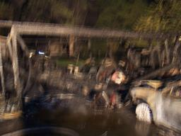
Ideas?

