Slide 1
UHD vs HD
Patrick Le Callet & Toinon Vigier
VQEG – San Diego meeting

Slide 2
Experiment
Pair comparison UHD vs upscaled HD (Lanczos3)
  69 reference sequences (300 frames, 10 sec)
  40 observers
  Screens : 55’’ Grundig (FINE ARTS 55 FLX 9492 SL)
  Viewing distance : 1.5H (103 cm)
  Test environment ITU-R BT.500
  Test duration about 40 min
  Randomization of pairs for each observer

Slide 3
Results
Mean preference ratio of UHD : 57.14% (SD=11.10%)
11 sequences significantly preferred in UHD (p<0.05) + 4 (p<0.07)

Slide 4
Impact of content
Estimation of sharpness using the gradient magnitude (sum of all gradient norms / number of pixels) for each frame + mean over all frames
No correlation Preference/Sharpness
  Pearson: R = 0.155 ; p = 0.204
  Spearman: R = 0.102 ; p = 0.406

Slide 5
Visual attention in UHD
As a component of QoE
Patrick LE CALLET, Matthieu Perreira Da Silva, Toinon ViGIER
VQEG-San diego meeting

Slide 6
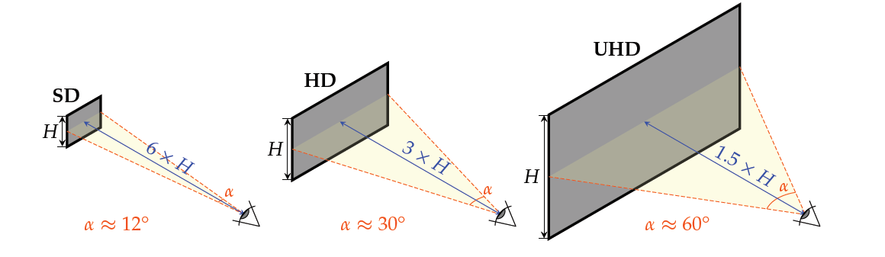
Viewing angle from SD to UHD
Impact on visual attention and viewing behavior?

Slide 7
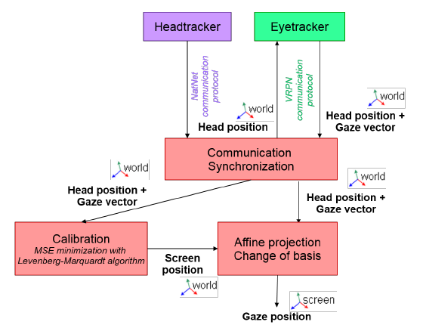
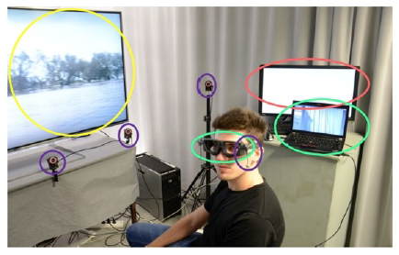
A new eye tracking setup for UHD
The Eye Head Tracker = SMI eye tracking glasses + OptiTrack ARENA (head tracker)

Slide 8
A new eye tracking HD and UHD dataset
37 video sources seen by 34 observers in HD and 36 in UHD
Gaze points
Fixations and saccades
http://ivc.univ-nantes.fr/en/databases/HD UHD Eyetracking Videos/

Slide 9
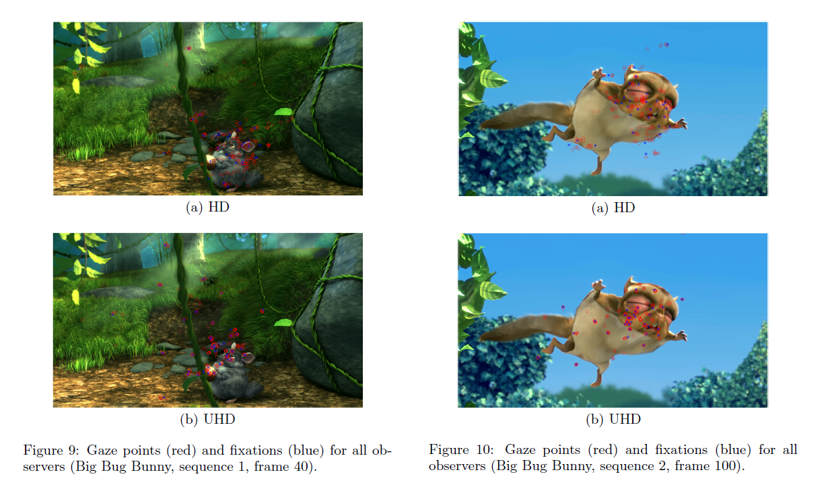
A new eye tracking HD and UHD dataset

Slide 10
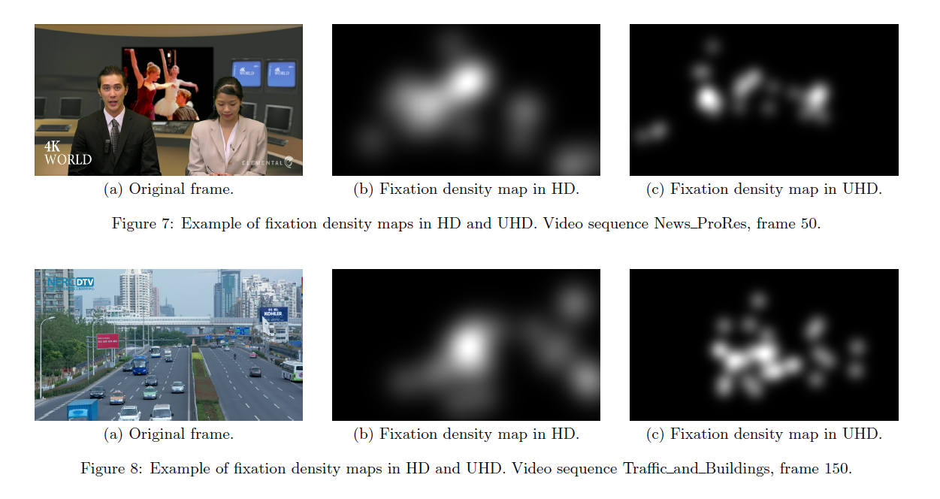
A new eye tracking HD and UHD dataset

Slide 11
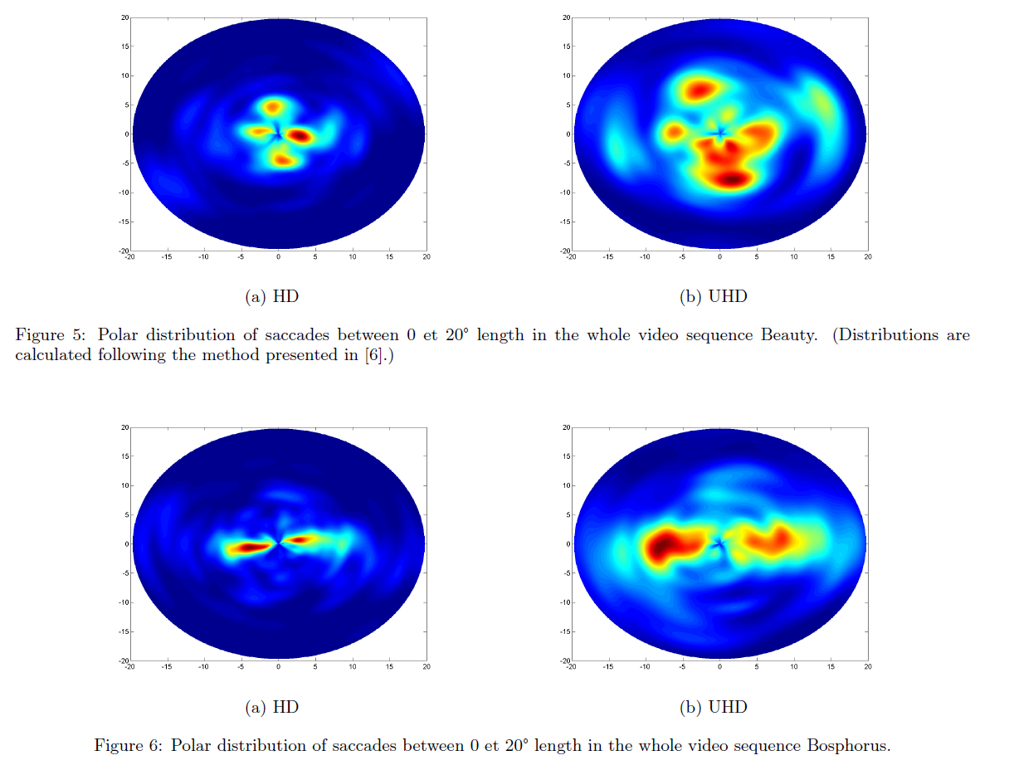
A new eye tracking HD and UHD dataset

Slide 12
Visual attention of logos and subtitles display in UHD
Visual attention as a dimension of QoE for
  Logos
  Subtitles
Objective: provide guidelines for UHD

Slide 13
Visual attention of subtitles in UHD
Same vertical visual angle as in HD

Slide 14
Visual attention of subtitles in UHD
Same vertical visual angle as in HD, one line

Slide 15
Visual attention of subtitles in UHD
Same vertical visual angle ratio as in HD

Slide 16
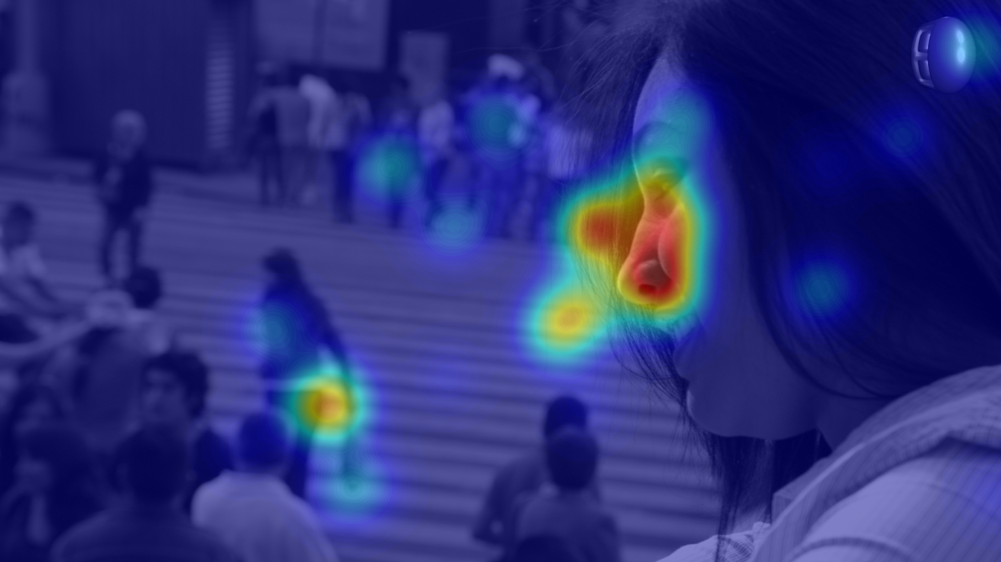
Visual attention of logos in UHD
Impact of logo appearance (size, dynamism, color, SI, TI)
Impact of logo saliency (with respect to the background)
Impact of logo position
Impact of video content

