Slide 1
Emotion Recognition by Physiological Signals
Naeem Ramzan*, Sebastian Palke^, Thomas Cuntz^, Ryan Gibson*, and Abbes Amira*
*University of the West of Scotland, Paisley, UK
^H.T.W.K. Leipzig, Germany
Notes:
user’s affective state automatic recognition has become a popular research area
- Significant developments of new sensing techniques and pattern recognition methods have stimulated a growing investigation in the field of affective computing.

Slide 2
Outline:
Motivation
Introduction
Data collection
Analysis techniques
Results
Conclusions
Notes:
some warming words of welcome
structure overview

Slide 3
Human Computer Interaction (HCI)
Video
physiol. signals
Audio
########################
################# #####
################# #####
Notes:
recently many efforts have been done to recognise emotion from streams like video or audio, especially face expression detection shows high suitability
- contrarily emotion is a psycho-physiological procedure that activated by cognisant and/or uncognisant perception of an article or situation
Therefore the researches in our work are focussed on physiological signals, since they are less controlled cognisantly by humans
advantages: non-invasive, painless, real-time capability, many of them available
In our work a combination of signals is used to increase the recognition accuracy and to implement an application which is responsive to the emotions of a person

Slide 4
RSP
SC
EEG
EMG
ECG
BVP
GSR
body’s
information
app 1 a app 2
app 3 app 6
app 5
app 4 app 8 app 7
Emotion
Notes:
as mentioned before, several kinds of signals are suitable to obtaining information from the body’s surface
for instance, skin conductivity (SC), respiration(RSP), Electromyograam (EMG), Galvinic Skin Response (GSR), Blood Volume Pulse (BVP), EEG (electroencephalogram ) and ECG electrocardiogram so forth
apart of the non-invasive measurability, physiological signals have the advantage of being continuously recorded while the subject is connected to bio-sensors
especially that fact makes body’s information useable for the recognition of emotional states
emotions have the powerful feature of unconsciously changing, while referring to the cognitive and behavioural humans system
the proposed work investigates their usefulness to control targeted applications
the merging of several signals to detect one emotion could decrease difficulties in measuring without artefacts and different characteristics of each physiological signal
in the current case the ECG and EEG information should be merged to combine advantages and disadvantages of both

Slide 5
Two Dimensional Affective Space
Arousal
Anger
Joy
Fear
Pleasure
Valence
Sadness
Calm
Notes:
positive-negative arrangement accords to the x-axis and the level of excitement to the y-axis
ECG is used to categorise arousal in three sections, EEG for valence (literature has shown their suitability for specific dimensions)
For each of the 3 different arousal states 2 emotions (1 for pos, 1 for neg valence) can be placed into the chart as follows
Anger, joy – high; fear, pleasure – middle; sadness, calm – low

Slide 6
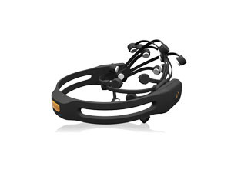
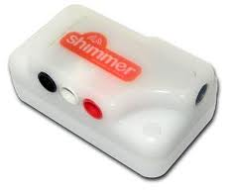
Experimental Setup
18 film clips
self-assessments → current emotional state
Notes:
for emotion recognition it is very helpful eliciting targeted emotions because of increased changes in evoked humans feelings
therefore subjects will be exposed to images, video clips or music to stimulate specific emotions ---- in the current work 18 video-clips are chosen to elicit the desired emotional states
eliciting emotional reactions from test participants is a difficult task and selecting the most effective stimulus materials is crucial
experimental setup → next slide
EEG signals are acquired using the Emotiv’s EPOC headset → wireless, 14 electrodes (see devices)
ECG data are measured by the SHIMMER device, during the entire experiment the RA-LL-ECG signal (limb lead II) is recorded from the subjects chest
devices:
EPOC: 14 channels
sampling rate 128sps (internal 2048Hz)
resolution 14bit
filtering digital 5th order, notch at 50Hz and 60Hz
connectivity wireless
battery life 12h
SHIMMER: 4 channels
sampling rate 256sps
resolution 24bit
filtering configurable by software
connectivity wireless
battery life -

Slide 7
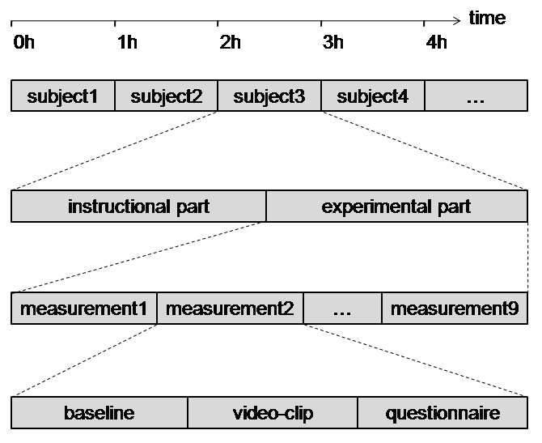
Experimental Setup
Notes:
The whole experiment consists of two parts for each test person.
Both of the parts took place on two different days where each of them lasts about 60 minutes.
In this way it is possible to investigate the influence of daily dependencies later on.
Subjects who decided to take part first had to read an information sheet, fill out a consent form and listen to some instructions in the instructional part.
After that the actual experiment started with nine measurements in a whole.
For the baseline measurements a video was used that brings people in a neutral state.
After that the main video clip was shown.
Finally the participants had to answer a self assessment questionnaire.

Slide 8
Experimental Setup
Video Dataset
Titans, Pride, Gentlemen, Departed, Fly, Searching, Bourne, Modern, Dead, Ring, Hangover, Crash, My Girl, Shawshank, Wall, 300, Psycho, National Lampoon's Van Wilder (Gabert-Quillen et al. )
C.A. Gabert-Quillen, E.E. Bartolini, B.T. Abravanel, C.A. Sanislow, Ratings for emotion film clips, Behavior research methods (2014): 1-15.
Participants
Eight subjects aged from 23 to 30 (M = 26.8, SD = 2.1). To make results independent from genders we have recorded signals from 4 female and 4 male participants.
Notes:
Video dataset and participants detail

Slide 9
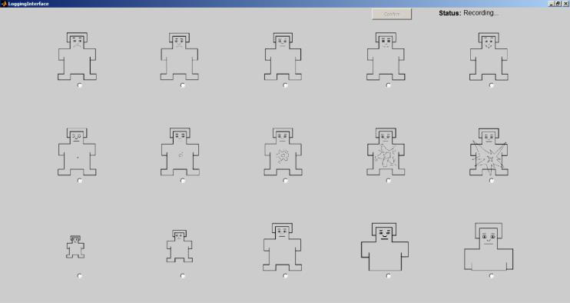
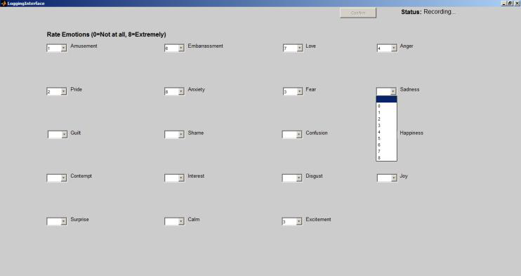
Subject‘s Self Assessment Screenshots
Notes:
The subject‘s self assessment is splitted into two parts.
In the first part so called self assessment manikins are shown by the graphical user interface.
From top to bottom the participants can choose one of five manikins for valence, arousal and dominance respectively.
The second part consists in a whole of 19 emotional expressions.
Dependent on how strong a subject the specific expression he has to choose a number from 0 to 8 for validation.
Zero means that expression matches the feeling not at all whereas eight means it matches very strong.

Slide 10
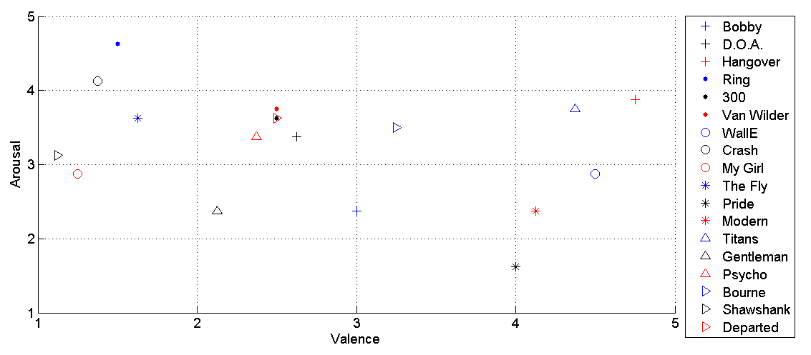
Subject‘s Self Assessment
Notes:
The described manner of the self assessment offers the opportunity to evaluate the video clips afterwards on their emotional content.
Since the creators of the video data base used the same self assessments for their experiment it is now possible to compare both.
According to the aforementioned two dimensionality of emotions the averages of all subjects choices for each clip are plotted into a arousal-valence-chart.
The comparison of our results to those from the creators of the video data base show that our test persons evaluated their feelings similar.
The averages of our eight participants almost align with the averages of the 300 participants, they investigated in their experiment.
Nevertheless with this comparison we can prove the emotional content of the captured signals.

Slide 11
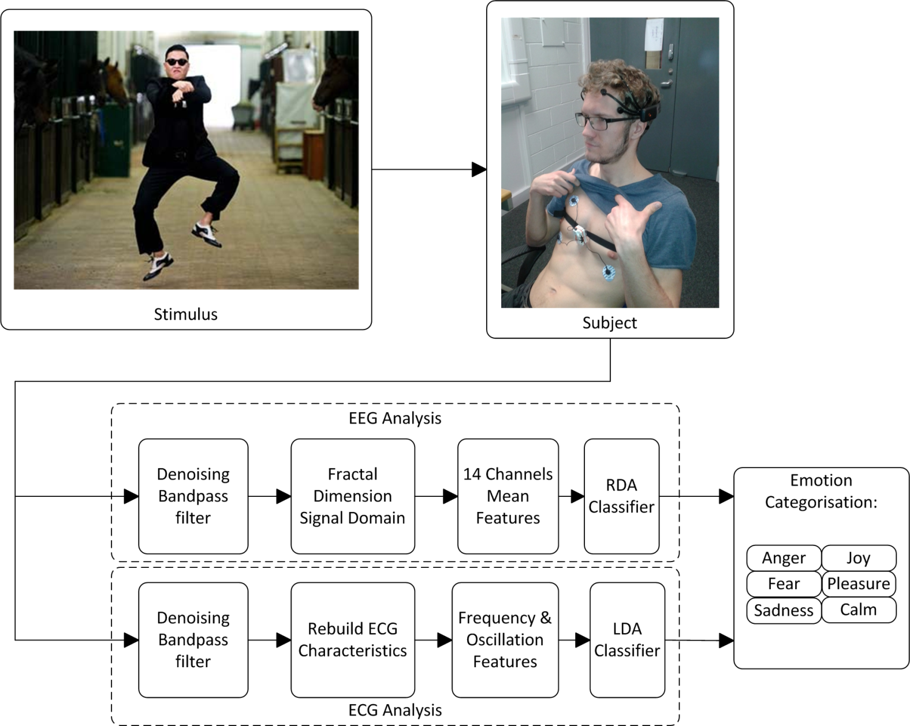
Data Collection & Processing Flow
output: current emotion
Notes:
As aforementioned EEG and ECG signals are used for the emotion recognition.
The very first step of each signal processing is a suitable preprocessing of the captured signals.
e.g….
The target at the end is to get the current emotion of the subject as output of the system.
In the first step of the recognition the recorded signals with their emotional labels are used to process a so called training.
As result a mathematical model of the classifier can be obtained.
After that this model can be used to get information about unknown data in the test processing.
Therefore the same features have to be extracted after the preprocessing.
Afterwards the mathematical model of the classifier compares the unknown data with the training data and gives the most convenient emotion label as output.

Slide 12
Results
 | LDA | NBC | KNN | TREE | SVM
Accuracy (%) | 72.9 | 70.2 | 74.5 | 73.1 | 73.4
Recall (%) | 85.3 | 75.5 | 83.3 | 78.0 | 88.2
Precision (%) | 74.8 | 76.5 | 77.4 | 78.6 | 74.6
Specificity (%) | 49.2 | 60.1 | 58.1 | 64.1 | 44.8
Average (%) | 70.6 | 70.6 | 73.3 | 73.4 | 70.2
Table 1. Valence classification results
Notes:
-accuracy describes the amount of trials which are corrected classified for all classes
-recall value indicates how many actual positive fall results were found, while
- precision indicates how many returned positive results were correct
-specificity demonstrates how many negative results were correctly classified.
-both tables show classification results better than chance level
no single classifier performs notably much worse than the others
however it is obvious that recall results are higher than specificity within valence classification. This situation occurs due to a unequal distribution of ratings for both classes
more labels for class one were rated and the classifiers tend to perform better for the left hemisphere of the confusion matrix
a similar case can be noticed within arousal classification results.

Slide 13
Results
 | LDA | NBC | KNN | TREE | SVM
Accuracy (%) | 61.9 | 60.8 | 65.6 | 63.4 | 65.7
Recall cl.1 (%) | 40.9 | 51.5 | 30.5 | 49.6 | 40.8
Precision cl.1 (%) | 47.3 | 47.5 | 46.0 | 46.1 | 52.0
Recall cl.2 (%) | 71.2 | 68.6 | 82.7 | 70.3 | 76.8
Precision cl.2 (%) | 67.4 | 70.2 | 67.7 | 70.7 | 68.2
Recall cl.3 (%) | 39.3 | 50.9 | 21.5 | 42.7 | 39.4
Precision cl.3 (%) | 39.6 | 39.5 | 42.6 | 46.9 | 45.1
Average (%) | 52.5 | 55.6 | 50.9 | 55.7 | 55.4
Table 2. Arousal classification results
Notes:
-accuracy describes the amount of trials which are corrected classified for all classes
-recall value indicates how many actual positive fall results were found, while precision indicates how many returned positive results were correct
-specificity demonstrates how many negative results were correctly classified.
-both tables show classification results better than chance level
no single classifier performs notably much worse than the others
however it is obvious that recall results are higher than specificity within valence classification. This situation occurs due to a unequal distribution of ratings for both classes
more labels for class one were rated and the classifiers tend to perform better for the left hemisphere of the confusion matrix
a similar case can be noticed within arousal classification results.

Slide 14
Conclusions
User’s effective state automatic recognition framework
Emotional state arousal and valence induced by watching video clips and are identified by physiological (EEG) and electroencephalogram (EEG) signals
Identical subjective emotional state are identified as compared to Gabert-Quillen et al.
71.6% for valence classification for two states and 54.0% for arousal classification for three states were achieved

Slide 15
Conclusions
Actual state
Further works
Target state
daily
influences
remove daily dependencies
day independent emotion recognition
fixed features
feature selection
optimal features to increase accuracy
several artefacts on the signals
reduce the percentage of artefacts
less influences of artefacts on recognition
Notes:
The presented accuracies are the results of the first recognition steps in the project.
In our future work we want to add several algorithms and procedures to increase the recognition accuracy.
One important point of the measurements is that people have different emotional basic states on different days.
The splitting of the experiment into two several sessions offers the opportunity to record the signals on different days and finally to investigate the daily influences and possibilities to remove them.
Up to now the recognition algorithm uses all of the calculated features. In our future it should be investigated which features are the most suitable ones and which not.
Another important task is the removement of artefacts caused by eyes and muscles. In comparison to the captured signals this interferences have very high amplitudes, so that a investigation in this direction will definitely increase the qualitiy of the whole system.
As you can see the first steps in this project are done. But there are still many things to do and to investigate to finally develop a trustworthy emotion recognition system.
Thanks for your attention...

Slide 16
Thank you for your time for further questions. Contact: Dr Naeem Ramzan naeem.ramzan@uws.ac.uk

Slide 17
Data Collection & Processing Flow
signal capturing
EEG, ECG
Preprocessing
filtering, segmentation…
known signals
unknown signals
training
test
feature extraction Calculation, Selection
feature extraction Calculation, Selection
build classifier model comparison with target labels
Apply Classifier Classification
output: current emotion
Notes:
As aforementioned EEG and ECG signals are used for the emotion recognition.
The very first step of each signal processing is a suitable preprocessing of the captured signals.
e.g….
The target at the end is to get the current emotion of the subject as output of the system.
In the first step of the recognition the recorded signals with their emotional labels are used to process a so called training.
As result a mathematical model of the classifier can be obtained.
After that this model can be used to get information about unknown data in the test processing.
Therefore the same features have to be extracted after the preprocessing.
Afterwards the mathematical model of the classifier compares the unknown data with the training data and gives the most convenient emotion label as output.

