Slide 1
MOAVI Findings on No-Reference Quality Indicators
Mikołaj Leszczuk, Lucjan Janowski, Jakub Nawała, Michał Zajdel

Slide 2
  Presentation Plan
H.264 quality indicators (update)
H.265 quality indicators (update)
Establishing (selected) perception thresholds (crowdsourcing experiment)
Exploitation (update)
Plans

Slide 3
H.264 Quality Indicators (Update)

Slide 4
  Signal-Based, NR Indicators for Artefacts of Various Origin
Capturing Artefacts: blurriness, exposure, interlace, etc.
Processing Artefacts: blockiness, blurriness, flickering, reduced spatial & temporal resolution, etc.
Transmission Artefacts: blackout, block loss, freezing, slicing, etc.
Displaying Artefacts: blackout, slicing,
etc.

Slide 5
Merging Exposure and Brightness
Internal similarities of both of metrics
Merged in order to:
  Accommodate for more efficient design of whole application, and
  Better use of available resources
Notes:
3/1/16
5
5

Slide 6
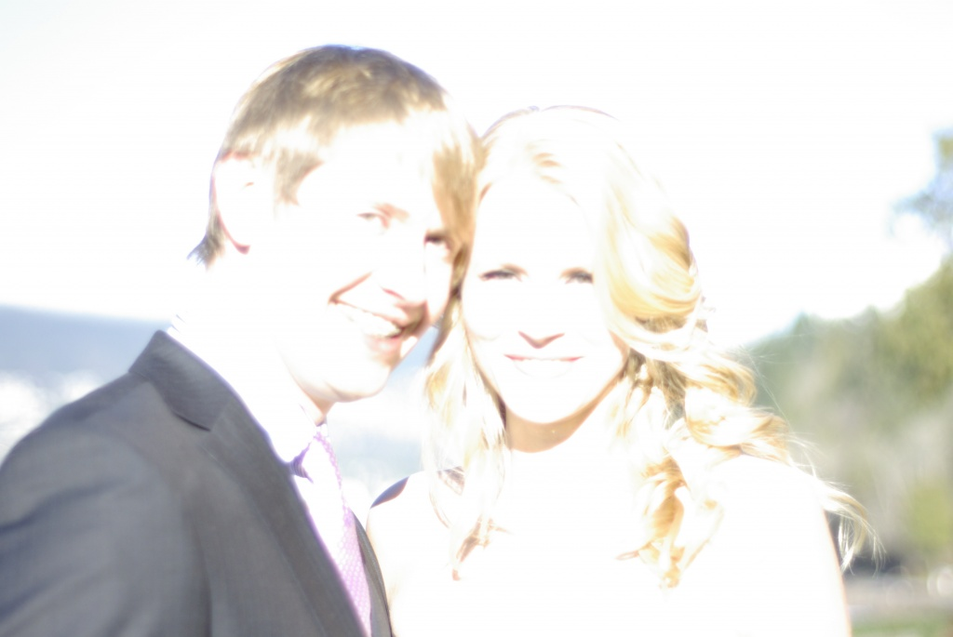

Exposure Detection (1/2)
Notes:
3/1/16
6
6

Slide 7
Exposure Detection (2/2)
Merging 3 metrics, namely:
  Blur,
  Contrast, and
  Exposure
Made it possible to detect over- and under-exposure
First tests giving promising results
More precise evaluation is required
Notes:
3/1/16
7
7

Slide 8
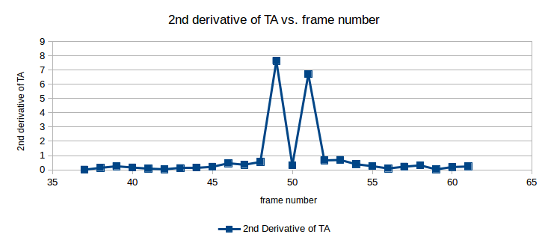
Frame Drop Detection
Possible to detect single/multiple frames drops by analysis of 1st/2nd derivative of Temporal Activity
Functionality currently in development
phase
Notes:
3/1/16
8
8

Slide 9
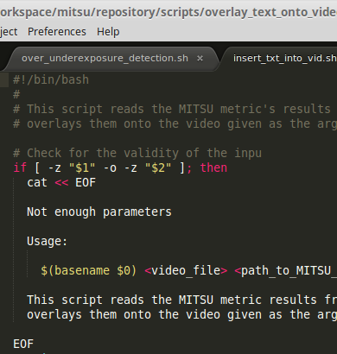
Overlaying Results onto Video (1/2)
Script merging metrics results with real-time video sequences
Notes:
3/1/16
9
9

Slide 10
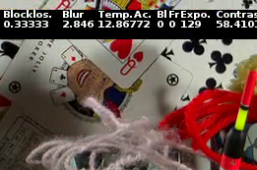
Overlaying Results onto Video (2/2)
Aiding further improvement of metrics’ algorithms
Serving as good tool for:
  Detection of erroneous results, and
  Elimination of erroneous results
Notes:
3/1/16
10
10

Slide 11
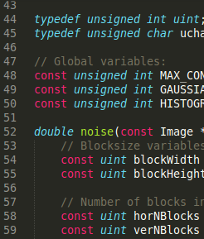
New Noise Metric
Severe instability of previous algorithm
Necessary to introduce brand new code
Based on: “Block-Based Noise Estimation Using Adaptive Gaussian Filtering” (Dong-Hyuk Shin, Rae-Hong Park, Seungjoon Yang, Jae-Han Jung)
Notes:
3/1/16
11
11

Slide 12
H.265 Quality Indicators (Update)

Slide 13

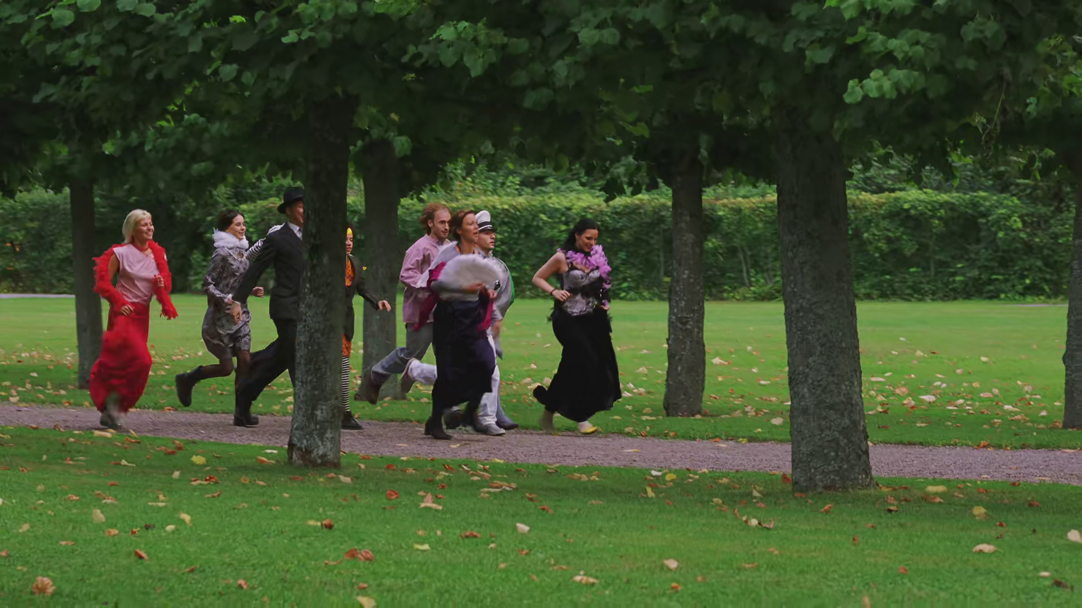
New Video Sequences & Scores (1/2)
Notes:
3/1/16
13
13

Slide 14
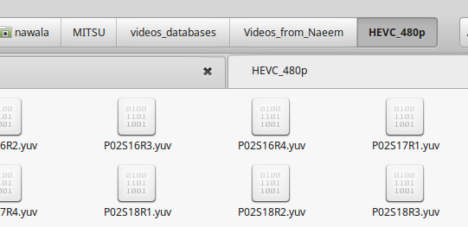
New Video Sequences & Scores (2/2)
Got access to new H.265 video sequences & Mean Opinion Scores:
  16 ⨉ 480p
  14 ⨉ 1080p
Source – University of the West of Scotland
Next step – experimenting with new codec
Notes:
3/1/16
14
14

Slide 15
Establishing Perception Thresholds

Slide 16
Crowdsourcing Experiment Process Preparation
Objective: set alarm thresholds
Imposed constrains:
  Images, not videos
  8 SRC (reasonable)
W=900 px to fit most displays
51 HRC:
  Blur
  Blockiness
  Contrast
  Noise
408 PVS
9 in common training set

Slide 17
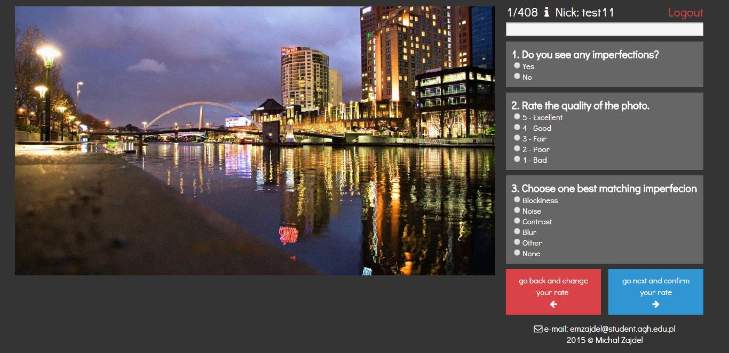
Crowdsourcing Experiment Interface and Questions

Slide 18
Crowdsourcing Experiment Subjects
173 subjects:
  Projects
  VQEG
  Social networks
Order:
  Fixed common training set
  Remaining in random
10 scores/picture

Slide 19
Crowdsourcing Experiment Results (1/2)

Slide 20
Crowdsourcing Experiment Results (2/2)

Slide 21
Crowdsourcing Experiment Results Analysis

Slide 22
Exploitation (Update)

Slide 23
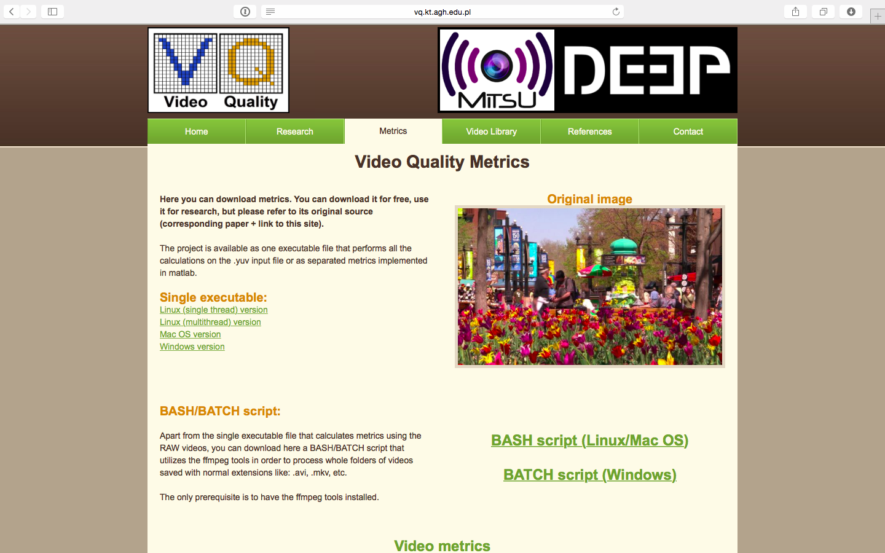
  Free A/V Quality Indicators Online at http://vq.kt.agh.edu.pl/

Slide 24
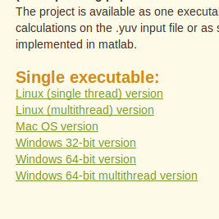
Maintaining Multi-Platform Binaries Available Online
Goal: to provide up-to-date platform-independent executable
Serving as reference implementation for algorithms developed
To be found at: http://vq.kt.agh.edu.pl/metrics.html
Notes:
3/1/16
24
24

Slide 25
Plans

Slide 26
  Plans
H.264:
  More precise evaluation of exposure detection
  Development of frame drop detection functionality
  Constant development of overlaying results onto video
H.265:
  Further experimenting with new codec
Funding only until end of September 2016
New idea: standardising quality indicators
(spanning beyond funding period)
Discussed commercial exploitation by Net Research

