Slide 1
The large database approach for loss-impaired video sequences
Enrico Masala
Politecnico di Torino, Italy
enrico.masala@polito.it
Contribution to VQEG JEG-Hybrid session in San Diego, Mar 2016

Slide 2
Context and Aim
Joint work with
Glenn Van Wallendael
Marcus Barkowsky
Ahmed Aldahdooh
Large dataset of 59,520 HEVC-encoded video sequences (details in [1], already presented in previous meetings)
5 metrics available: PSNR, SSIM, VIF, VQM, PVQM
Final video quality and frame-level granularity (for each one of the 250 frames)
Previously: only encoding distortion
Now: what is the effect of packet losses on the objective video quality measures?

Slide 3
Current Main Idea
Compare each PVS with all the others (within the same sequence)
Decide about agreement of the measures for PVS A vs PVS B
Agreement: all measures prefer A over B or vice-versa
Disagreement: all the other cases
With 3 measures (PSNR, SSIM, VIF):
There is always one and only one that “disagrees”
Example: Agreement
Sequence | PSNR | SSIM | VIF
A | 35 | 0.98 | 0.93
B | 33 | 0.96 | 0.92
A-B | +2 | +0.02 | +0.01

Slide 4
Current Main Idea
Decide about agreement of the measures for PVS A vs PVS B
Agreement: all measures prefer A over B or vice-versa
Disagreement: all the other cases
With 3 measures (PSNR, SSIM, VIF):
There is always one and only one that “disagrees”
Example: Disagreement
Work in VPQM 2015 [3]
Sequence | PSNR | SSIM | VIF
A | 35 | 0.98 | 0.92
B | 33 | 0.96 | 0.93
A-B | +2 | +0.02 | -0.01

Slide 5
Issues with “Small” Disagreement
When difference is small, disagreement might not be so significant
Consider normalized distance (Euclidean distance)
Legend
Red: agreement, green: due to PSNR, blue: due to SSIM, light blue: due to VIF

Slide 6
Loss-Impaired Video Sequences
25 loss traces using a 2-state Markov model with good and bad state
Packet loss rate: 0.5% and 1%
Average burst length: 1, 1.5, 2
Total: 25 realization of the loss traces
Robust “reference” HM decoder [2]
Each event affects one slice of the source sequence. Depending on the encoding parameters of the sequence, the affected area can be:
The whole frame
A slice with a fixed number of macroblocks
A slice with a maximum number of bytes

Slide 7
Status
Status:
Resolution 960x544
all 19,840 sequences have been subject to all loss traces
total 496,000 objective video quality values for each metric (PSNR, SSIM, VIF, VQM, PVQM) with frame-level granularity
Resolution 1280x720 and 1920x1080
All high-priority combinations tested until now
Total 22,500 combinations done, more on the way
Freely available at [4][5] (links also on the wiki pages)

Slide 8
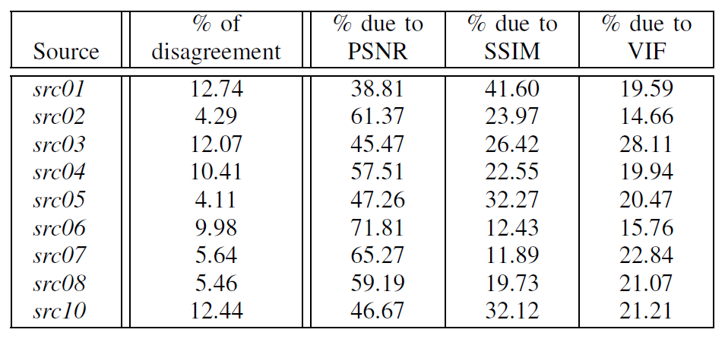
Results
Preliminary results: amount of disagreement and “reason”

Slide 9
References
[1] M. Barkowsky, E. Masala, G. Van Wallendael, K. Brunnstrom, N. Staelens, P. Le Callet, Objective Video Quality Assessment – Towards large scale video database enhanced model development, IEICE Transactions on Communications, vol. E98-B, n. 1, pp. 2-11, Jan 2015
[2] ftp://vqeg.its.bldrdoc.gov/Documents/VQEG_Stockholm_Jul14/ MeetingFiles/VQEG_JEG-Hybrid_2014_126_robust_decoder_Stockholm2014_EnricoMasala.pdf
[3] Van Wallendael, Glenn, Nicolas Staelens, Enrico Masala, and Marcus Barkowsky. "Full-HD HEVC-encoded video quality assessment database." In Ninth International Workshop on Video Processing and Quality Metrics (VPQM). 2015.
[4] ftp://ftp.ivc.polytech.univ-nantes.fr/VQEG/JEG/HYBRID/hevc_database/
[5] http://media.polito.it/downloads/jeg/

