Slide 1
(JEG) HDR-WCG Project:
March 2016
Patrick Le Callet

Slide 2
Progress: experimental methodologies for QoE assessement in the context of HDR
Methodologies to assess QoE in the context of HDR (QoE is not only Image quality)
considering various scenario (post production, distribution and various Range)
focus on artistic intention
method: not only MOS but inferred through visual attention deployement

Slide 3
TONE-MAPPING activity summary
Impact of tone-mapping on HDR compression [1] and the resulting visual attention (VA) [2]
TMOs influence the VA for images more than for videos.
Relationship of the VA with the resulting quality is not linear
Performance of automatic saliency estimators has been proven not sufficient to replace human observers in the given application
Comparison of various TMOs with single-exposure photograph in representing the HDR scene [3]
no statistically significant difference has been found, suggesting that the extra details provided by the TMOs do not suffice to better represent the scene if the naturalness is not maintained.
Methods for content selection for HDR studies [4] and the influence of the experimental design on the final outcome [5].
These studies lead to the preparation of a novel, representative dataset of tone-mapped images
TMOs parameters tuning has been addressed in multimedia applications [7].
attempts to maintain the image’s naturalness while minimizing the reversal of contrast.
The naturalness is quantified in terms of a novel measure based on intensity, contrast, and colorfulness estimators [8].

Slide 4
References
[1] Manish Narwaria, Matthieu Perreira da Silva, Patrick Le Callet, Romuald Pépion. IMPACT OF TONE MAPPING IN HIGH DYNAMIC RANGE IMAGE COMPRESSION. VPQM, Jan 2014, Chandler, United States. pp. 1-6, 2014.
[2] Manish Narwaria, Matthieu Perreira da Silva, Patrick Le Callet, Romuald Pépion. Tone mapping based HDR compression: Does it affect visual experience?. Signal Processing: Image Communication, Elsevier, 2014, 29 (2), pp.257-273.
[3] Manish Narwaria, Matthieu Perreira da Silva, Patrick Le Callet, Romuald Pepion. SINGLE EXPOSURE VS TONE MAPPED HIGH DYNAMIC RANGE IMAGES: A STUDY BASED ON QUALITY OF EXPERIENCE. 22nd European Signal Processing Conference (EUSIPCO), Sep 2014, Libon, Portugal.
[4] Manish Narwaria, Claire Mantel, Matthieu Perreira da Silva, Patrick Le Callet, Søren Forchhammer. An objective method for High Dynamic Range source content selection. Sixth International Workshop on Quality of Multimedia Experience (QoMEX), Sep 2014, Singapore, Singapore. 2014
[5] L. Krasula, M. Narwaria, K. Fliegel, P. Le Callet “Influence of HDR reference on observers preference in tone-mapped images evaluation,” 7th International Workshop on Quality of Multimedia Experience (QoMEX), 2015.
[6] L. Krasula, M. Narwaria, P. Le Callet, “An Automated Approach for Tone Mapping Operator Parameter Adjustement in Security Applications,” Proc. SPIE 9138, Optics, Photonics, and Digital Technologies for Multimedia Applications III, 913803 (May 15, 2014); doi:10.1117/12.2054504
[7] L. Krasula, M. Narwaria, K. Fliegel, P. Le Callet “Rendering of HDR content on LDR displays: An objective approach,” Proc. SPIE 9599, Applications of Digital Image Processing XXXVIII, 95990X (September 22, 2015); doi:10.1117/12.2186388
[8] L. Krasula, K. Fliegel, P. Le Callet, M. Klíma, “Objective Evaluation of Naturalness, Contrast, and Colorfulness of Tone-Mapped Images,” Proc. SPIE 9217, Applications of Digital Image Processing XXXVII, 92172D (September 23, 2014); doi:10.1117/12.2075270

Slide 5
Progress: studies and datasets
ETHyma Eye tracking data for HDR and Tone Mapped images :Eyetracker database for HDR images (displayed on an real HDR display) and 88 tone mapped images with 37 observers.
http://ivc.univ-nantes.fr/test/en/databases/ETHyma/
PairCompTMO Pair Comparison between Tone Mapping Operators for still images :The database contains 100 images in FullHD, 10 High Dynamic Range (HDR) images were processed with 9 sets of parameter of Tone Mapping Operators to produce 90 LDR images. The HDR contents were displayed like a reference for the half of participants. 40 observers compare these images with the Pair Comparison method.
http://ivc.univ-nantes.fr/test/en/databases/PairCompTMO/
- Quality of JPEG HDR Images :10 different still image contents were used. 7 JPEG compression are choosen with different bitrates optimized to used the full range of the quality scale. These 7 bitrates are used with the 2 versions of optimization (SSIM and MSE) to generate 14 different degradations. For each content, the reference and the degradations were subjectively evaluated with the ACR-HR method and 26 observers.
http://ivc.univ-nantes.fr/test/en/databases/JPEG_HDR_Images/

Slide 6
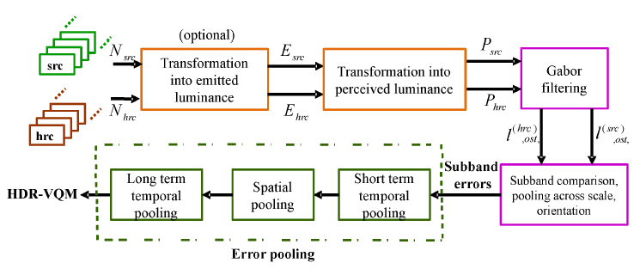
Progress: Objective measures for HDR content
Tested and validated:
improvement of HDR VDP2 => HDR VDP2.2
new pooling strategies
VQM-HDR: a new measure designed for Video HDR
tradeoff between performance and complexity
=> contribution to MPEG through Samsung

Slide 7
References
[9] Manish Narwaria, Matthieu Perreira da Silva, Patrick Le Callet, Romuald Pépion. On Improving the Pooling in HDR-VDP-2 towards Better HDR Perceptual Quality Assessment. Human Vision and Electronic Imaging 2014, Feb 2014, San Francisco, United States.
[10] Manish Narwaria, Rafal Mantiuk, Matthieu Perreira da Silva, Patrick Le Callet. HDR-VDP-2.2: A calibrated method for objective quality prediction of high-dynamic range and standard images: Journal of Electronic Imaging, Society of Photo-optical Instrumentation Engineers, 2014, 24 (1), pp.010501. <http://dx.doi.org/10.1117/1.JEI.24.1.010501>
[11] Manish Narwaria, Matthieu Perreira da Silva, Patrick Le Callet. HDR-VQM: An Objective Quality Measure for High Dynamic Range Video. Signal Processing: Image Communication, Elsevier, 2015, 35, pp.46-60. <10.1016/j.image.2015.04.009>
[12] Manish Narwaria, Matthieu Perreira da Silva, Patrick Le Callet. “Study of high dynamic range video quality assessment,” Proc. SPIE 9599, Applications of Digital Image Processing XXXVIII, 95990V (September 22, 2015); doi:10.1117/12.2189178
[13] Manish Narwaria, Matthieu Perreira da Silva, Patrick Le Callet. High Dynamic Range Visual Quality of Experience Measurement: Challenges and Perspectives. Visual Signal Quality Assessment - Quality of Experience (QoE), Springer International Publishing, pp.129-155, 2015, 978-3-319-10368-6.
[14] Manish Narwaria, Matthieu Perreira da Silva, Patrick Le Callet. Dual Modulation for LED-Backlit HDR Displays. High Dynamic Range Video. Elsevier Ltd. pp. 2016.
[15] Manish Narwaria, Matthieu Perreira da Silva, Patrick Le Callet, Giuseppe Valenzise, Francesca De Simone, Frederic Dufaux. Quality of Experience and HDR: Concepts and How to Measure it. High Dynamic Range Video. Elsevier Ltd. 2016.
[16] Rafal Mantiuk, Manish Narwaria, Patrick Le Callet, Giuseppe Valenzise, Francesca De Simone, Frederic Dufaux. HDR Image and Video Quality Prediction. High Dynamic Range Video. Elsevier Ltd. 2016.

Slide 8
On going efforts: extending objective measure profiles
Extend profiles for HDR-VQM
Including some scenarios defined in MPEG CfE ISO/IEC JTC1/SC29/WG11 MPEG2014/M35464
“Call for Evidence (CfE) associated with technology for possible extensions of High Efficiency Video Coding (HEVC) standard for High Dynamic Range (HDR) and Wide Colour Gamut (WCG) video coding applications”
Some works are planned on the evaluation of the new MPEG HDR encoder in subjective tests and with objective metrics as HDR-VQM
Address Wide Color Gammut scenarios
First step: subjective assessement studies

Slide 9
Towards Extended profile for objective quality metrics
Question: robustness of the metric regarding upcoming video encoding standard
Scenario 1 – Evaluation of categories 1 and 3a of MPEG CfE for HDR video coding (no backward compatibility)
New HDR Encoders
Decoders
Objective metrics
HDR-VQM
HDR-VDP2.2 …
HDR contents
Display
Subjective evaluation

Slide 10
Test scenarios: on going VQEG effort
Scenario 1a
SRC content selection
Test methodology ACR (as for HDR-VQM)
Target: extended profile for the metrics with new codec
Schedule: mid-april , first round of subjective evaluation completed
HDR Encoders
Decoders
Objective metrics
HDR-VQM
HDR-VDP2.2 …
HDR contents
2K
4000 nits
Gamut BT 709
HDR display
Subjective evaluation

Slide 11
Towards a profile for HDR 4K
Scenario 1b
SRC content selection (more are always welcome)
Test methodology ACR (as for HDR-VQM)
Target: extended profile for the metrics with new codec and Resolution
Issue: needs for Consummer grade display
Schedule: mid-april , first round of subjective evaluation completed (pending to display availability)
HDR Encoders
Decoders
Objective metrics
HDR-VQM
HDR-VDP2.2 …
HDR contents
4K
1000 nits
Gamut BT 709 or 2020
UHD
‘HDR’ display
Subjective evaluation

Slide 12
Color Volume Conversion (with & without compression)
Scenario 2 – Evaluation of Color Volume Conversion to display HDR/WCG sources in consumer-grade screen with lower capabilities (categories 2c & 2d of MPEG CfE for HDR/WGC video coding)
‘LDR’ graded content
Gamut BT709
MPEG HDR Encoders
Decoders
Metadata
Color Volume Converter
Metadata Generator
Metadata
(CRI)
HDR content
Gamut P3
Encapsulated in BT2020
HDR content
Gamut P3
Encapsulated in BT2020
Subjective evaluation
‘LDR’ Display
Gamut BT709
Reconstructed ‘LDR’ content
Gamut BT709

Slide 13
Color Volume Conversion: Pilot test
Scenario 2 – Evaluation of Color Volume Conversion to display HDR/WCG sources in consumer-grade screen with lower capabilities (categories 2c & 2d of MPEG CfE for HDR/WGC video coding)
Color volume conversion=
Industrial solution
Clipping
Others?
Methodology: SAMVIQ
open issue on what is the color preference (higher level process)
Schedule/results: end of April first subjective study completed

Slide 14
Notes:
Ce qui est rayé est facultatif -> on peut tester CVC sans encodage
Mais aussi avec metada (donc garde SDR) ou sans -> quid de l’algo de gamut mapping

Slide 15
Recommendation ITU-R BT.2020
Rec. ITU-R BT.2020 for ultra-high definition television systems has been last released in August 2012
=> defines parameters values for production and international programs exchange that goes beyond the levels of HDTV. Those specifications were built from spatial and temporal resolution, tone and color reproduction requirements

Slide 16
Tone Reproduction
Rec.2020 specifies a quantization bit-depth of 10 bits or 12 bits. The tone response curve (or Electro Optical Transfer Function - EOTF can either be constant luminance or non-constant luminance as in ITU-R-BT Rec709

Slide 17
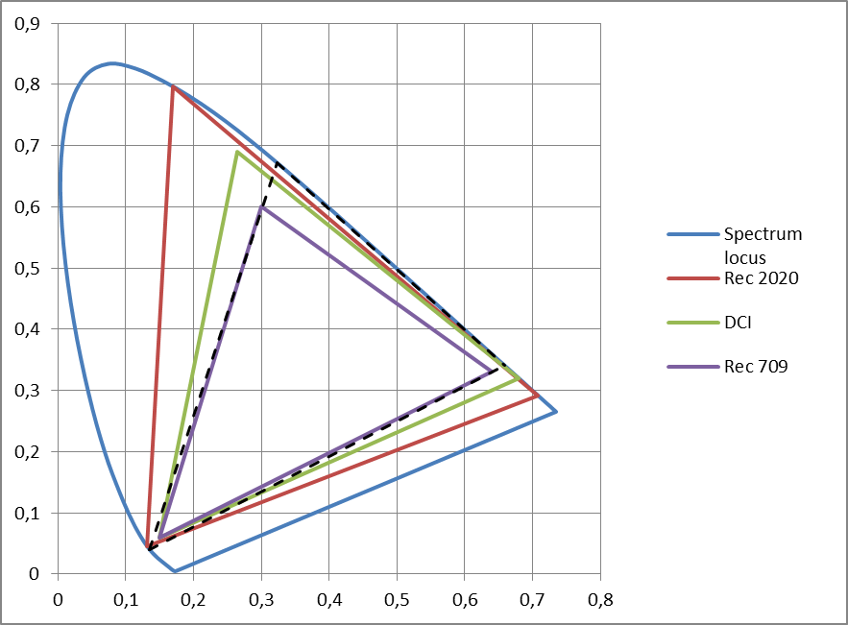
Color reproduction
Flat panel displays progress allows to reproduce a wider range of colors
some non-broadcast video systems already handle a wider color gamut.
Rec.2020 adopted a wide color gamut (achievable using laser light sources)

Slide 18
Color reproduction: observer metamerism
Wide colour gamut displays have narrow band primaries in general because of the technology used (OLED, LASER) and are particularly susceptible to observer variability : observer METAMERISM
scheduled for discussion in the EBU Strategic Programme “FTV - DISPLAY”.

Slide 19
Wide Gammut and Gammut mapping
From master to consumer display capability:
A new HRC condition (in addition to previously considered TMO)
= > Standard efforts on signaling WCG metadata

Slide 20
Wide Gammut and Color mapping: mastering color volume (MDCV)
Standard
Definition: SMPTE ST 2086, HEVC v2 (SEI), CEA-861.3-F,
Application: HDMI 2.0a, BDA (Ultra HD Blu-ray), DECE (HDR10)
Definition
Characteristics of the Mastering Display used for grading the content:
Tri-Color and white points primaries
Min & Max mastering Display luminance
Purpose
Information for the HDR/WCG mapping towards the actual end device capability

Slide 21
Wide Gammut and Color mapping: Frame-Average Light Level (MaxFALL) Max Content Light Level information (MaxCLL)
Standardization
Definition: HEVC-v3 (SEI), CEA-861.3-F
Application: BDA (Ultra HD Blu-ray), HDMI2.0a…Max
Signals the maximum Light Level for the whole sequence:
MaxCLL: Maximum value in cd/m2
MaxFALL: Maximum value of the Frame Average LL
Information for the display to manage appropriate tone mapping

Slide 22
Color remapping information (CRI)
Standard
Definition: HEVC-v2 (SEI), draft SMPTE ST 2094-30
Application: BDA (UltraHD Blu-ray)
Definition
Parameters for remapping the reconstructed color samples of the output pictures (ex: HDR to SDR)
1D LUTs, 3X3 Matrix
remapped signal characteristics
Purpose
To enable support of legacy video formats/displays

