Slide 1
(JEG) HDR & WCG? Project:
September 2015
Patrick Le Callet

Slide 2
Progress: experimental methodologies for QoE assessement
Methodologies to assess QoE in the context of HDR (QoE is not only Image quality)
considering various scenario (post production, distribution and various Range)
focus on artistic intention
method: not only MOS but inferred through visual attention deployement

Slide 3
References
M. Narwaria, M. Silva, P. Callet and R. Pepion “Tone mapping Based High Dynamic Range Compression: Does it Affect Visual Experience?”, Signal Processing: Image Communication, 2013.
M. Narwaria, M. Silva, P. Callet and R. Pepion, “Effect of Tone Mapping on Visual Attention Deployment”, SPIE Conference on Applications of Digital Image Processing XXVII , vol. 8499, 2012.
M. Narwaria C. Mantel, M. Perreira Da Silva, P. Le Callet et S. Forchammer “An objective method for High Dynamic Range source content” In Sixth International Workshop on Quality of Multimedia Experience (QoMEX), Septembre, 2014, Singapore, Singapore
L. Krasula, K. Fliegel, P. Le Callet et M. Klima. “Objective evaluation of naturalness, contrast, and colorfulness of tone-mapped images” In Applications of Digital Image Processing XXXVII, Août, 2014

Slide 4
Progress: studies and datasets
Several experimental studies and datasets produced
e.g Single Exposure vs Tone Mapped High Dynamic Range Images: A Study Based on Quality of Experience
M. Narwaria, M. Silva, P. Callet and R. Pepion “Tone mapping Based High Dynamic Range Image Compression: Study of Optimization Criterion and Perceptual Quality”, Optical Engineering, vol. 52, no. 10, 2013.
M. Narwaria, M. Silva, P. Callet and R. Pepion “Impact of Tone Mapping In High Dynamic Range Image Compression”, Proc. Eighth International Workshop on Video Processing and Quality Metrics for Consumer Electronics (VPQM), 2014.
M. Narwaria, M. Silva, P. Callet and R. Pepion, “Adaptive Contrast Adjustment for Postprocessing of Tone Mapped High Dynamic Range Images”, IEEE International Symposium on Circuits and Systems (ISCAS 2013), 2013.

Slide 5
Datasets
ETHyma Eye tracking data for HDR and Tone Mapped images :Eyetracker database for HDR images (displayed on an real HDR display) and 88 tone mapped images with 37 observers.
http://ivc.univ-nantes.fr/test/en/databases/ETHyma/
PairCompTMO Pair Comparison between Tone Mapping Operators for still images :The database contains 100 images in FullHD, 10 High Dynamic Range (HDR) images were processed with 9 sets of parameter of Tone Mapping Operators to produce 90 LDR images. The HDR contents were displayed like a reference for the half of participants. 40 observers compare these images with the Pair Comparison method.
http://ivc.univ-nantes.fr/test/en/databases/PairCompTMO/
- Quality of JPEG HDR Images :10 different still image contents were used. 7 JPEG compression are choosen with different bitrates optimized to used the full range of the quality scale. These 7 bitrates are used with the 2 versions of optimization (SSIM and MSE) to generate 14 different degradations. For each content, the reference and the degradations were subjectively evaluated with the ACR-HR method and 26 observers.
http://ivc.univ-nantes.fr/test/en/databases/JPEG_HDR_Images/

Slide 6
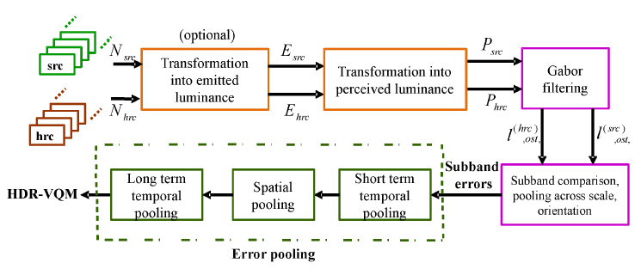
Progress: objective measures
Objective measures for quality:
improvement of HDR VDP2 => HDR VDP2.2
new pooling strategies
VQM-HDR: a new measure designed for Video HDR
tradeoff between performance and complexity

Slide 7
References
M. Narwaria, M. Perreira Da Silva et P. Le Callet “HDR-VQM : An Objective Quality Measure for High Dynamic Range Video” Signal Processing : Image Communication, Juillet, 2015, 35 : 46–60. Elsevier.
M. Narwaria, R. Mantiuk, M. Perreira Da silva et P. Le Callet. “HDR-VDP-2.2 : a calibrated method for objective quality prediction of high-dynamic range an d standard images “ Journal of Electronic Imaging, 2014, 24(1)
M. Narwaria, M. Perreira Da Silva, P. Le Callet et R. Pépion “On Improving the Pooling in HDR-VDP-2 towards Better HDR Perceptual Quality Assessment”. In Human Vision and Electronic Imaging 2014

Slide 8
Next steps
Address Wide Color Gammut scenarios

Slide 9
Recommendation ITU-R BT.2020
Rec. ITU-R BT.2020 for ultra-high definition television systems has been last released in August 2012
=> defines parameters values for production and international programs exchange that goes beyond the levels of HDTV. Those specifications were built from spatial and temporal resolution, tone and color reproduction requirements

Slide 10
Tone Reproduction
Rec.2020 specifies a quantization bit-depth of 10 bits or 12 bits. The tone response curve (or Electro Optical Transfer Function - EOTF can either be constant luminance or non-constant luminance as in ITU-R-BT Rec709

Slide 11
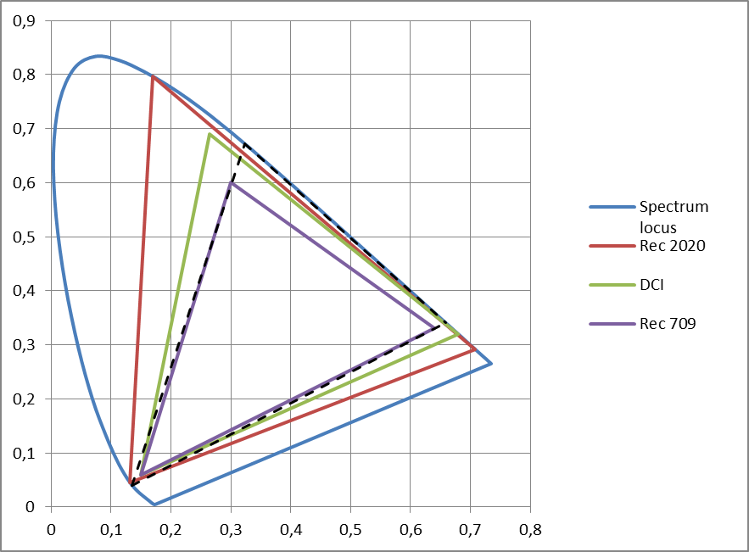
Color reproduction
Flat panel displays progress allows to reproduce a wider range of colors
some non-broadcast video systems already handle a wider color gamut.
Rec.2020 adopted a wide color gamut (achievable using laser light sources)

Slide 12
Color reproduction: observer metamerism
Wide colour gamut displays have narrow band primaries in general because of the technology used (OLED, LASER) and are particularly susceptible to observer variability : observer METAMERISM
scheduled for discussion in the EBU Strategic Programme “FTV - DISPLAY”.

Slide 13
Wide Gammut and Gammut mapping
From master to consumer display capability:
A new HRC condition (in addition to previously considered TMO)
= > Standard efforts on signaling WCG metadata

Slide 14
Wide Gammut and Color mapping: mastering color volume (MDCV)
Standard
Definition: SMPTE ST 2086, HEVC v2 (SEI), CEA-861.3-F,
Application: HDMI 2.0a, BDA (Ultra HD Blu-ray), DECE (HDR10)
Definition
Characteristics of the Mastering Display used for grading the content:
Tri-Color and white points primaries
Min & Max mastering Display luminance
Purpose
Information for the HDR/WCG mapping towards the actual end device capability

Slide 15
Wide Gammut and Color mapping: Frame-Average Light Level (MaxFALL) Max Content Light Level information (MaxCLL)
Standardization
Definition: HEVC-v3 (SEI), CEA-861.3-F
Application: BDA (Ultra HD Blu-ray), HDMI2.0a…Max
Signals the maximum Light Level for the whole sequence:
MaxCLL: Maximum value in cd/m2
MaxFALL: Maximum value of the Frame Average LL
Information for the display to manage appropriate tone mapping

Slide 16
Color remapping information (CRI)
Standard
Definition: HEVC-v2 (SEI), draft SMPTE ST 2094-30
Application: BDA (UltraHD Blu-ray)
Definition
Parameters for remapping the reconstructed color samples of the output pictures (ex: HDR to SDR)
1D LUTs, 3X3 Matrix
remapped signal characteristics
Purpose
To enable support of legacy video formats/displays

