Slide 1
Test Designs
1) (SRC X HRC) – Standard HRC test design.
2) (RSRC X HRC) – Related sources per HRC.
3) (CD-SRC X HRC) – Random sources with the “O Metric” calculated.
4) (RSRC X HRC) – Reused footage from 2, but different HRC mapping.
5) (CD-SRC X HRC) – Reused footage from 3 with same “O Metric” calculated, but with different HRC mapping.
6) (CD-SRC X HRC) – Reused footage from 3, but used a random number generator for coding complexity calculation.

Slide 2
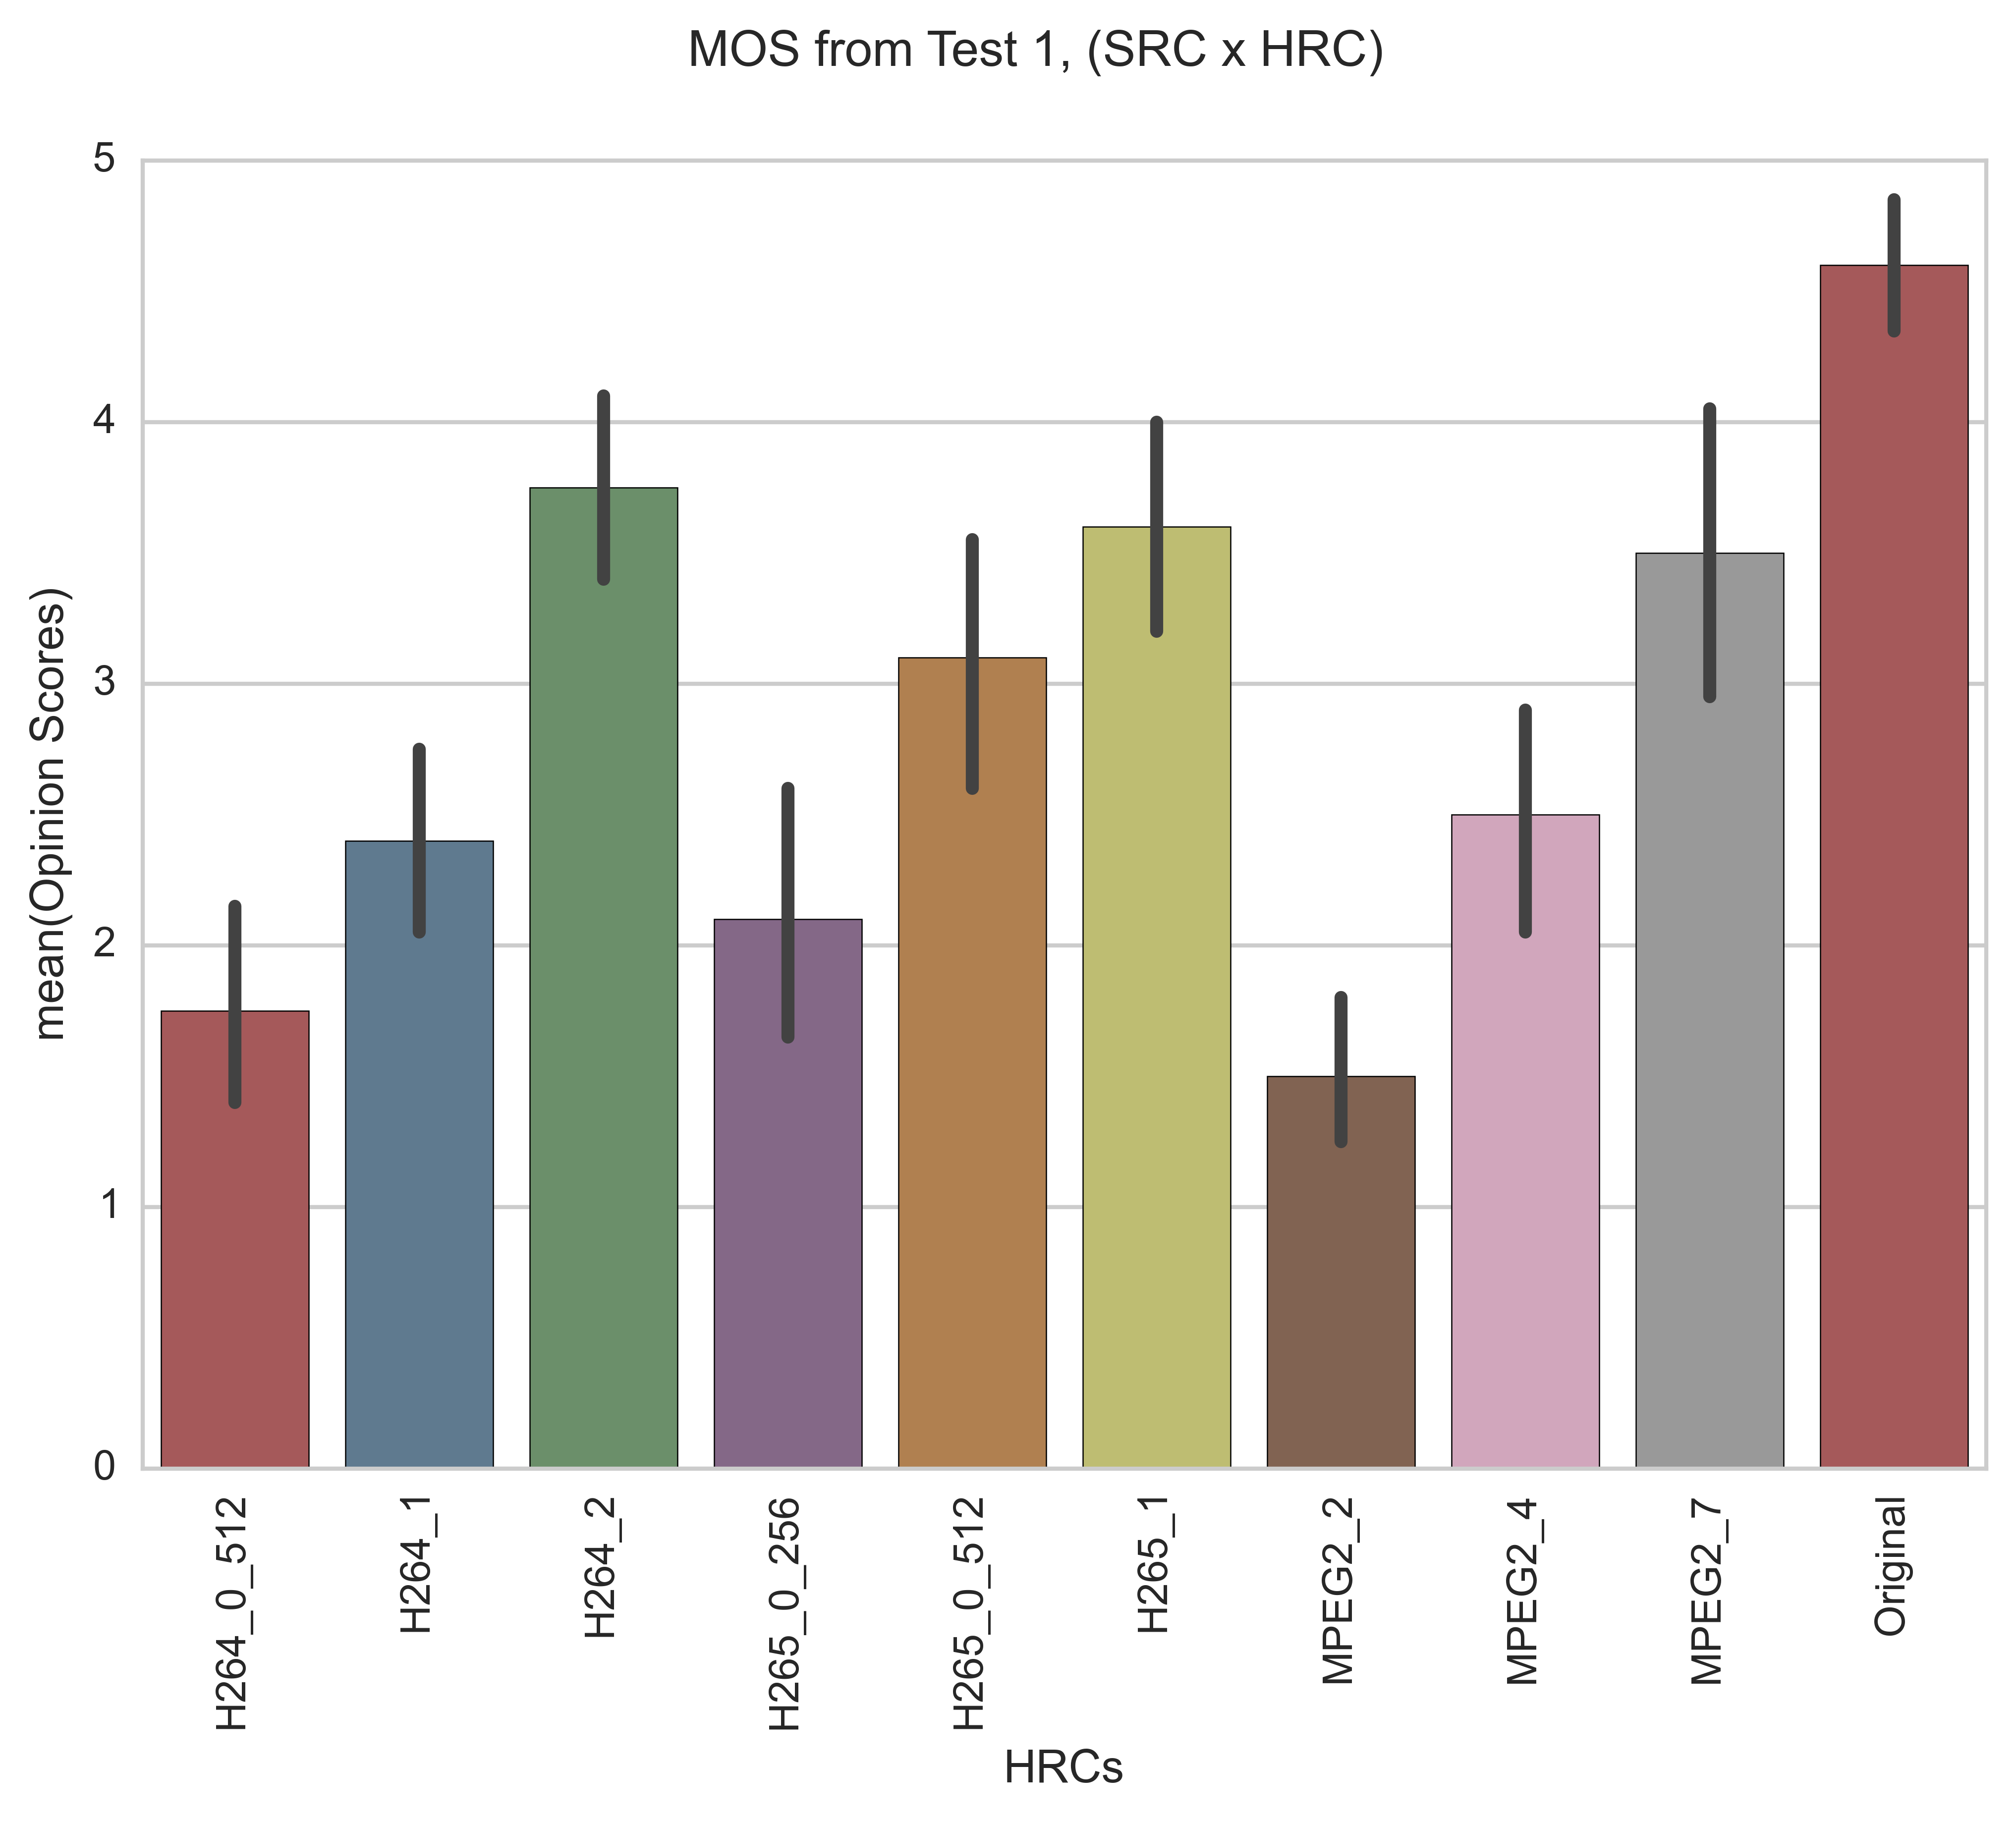
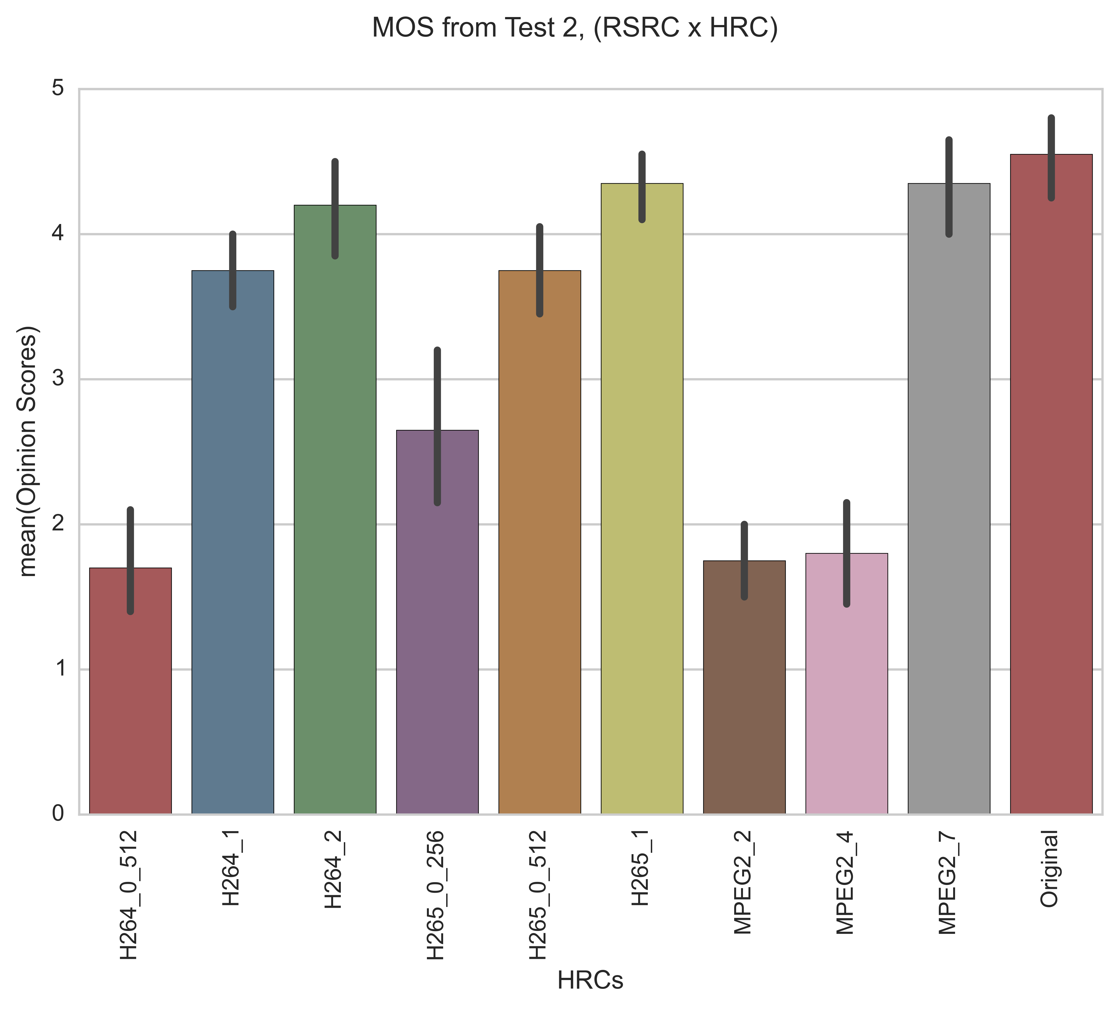
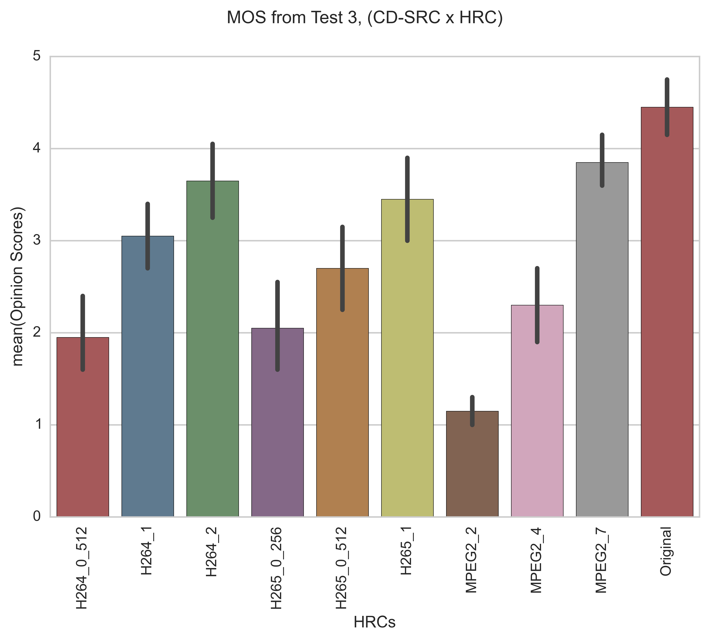
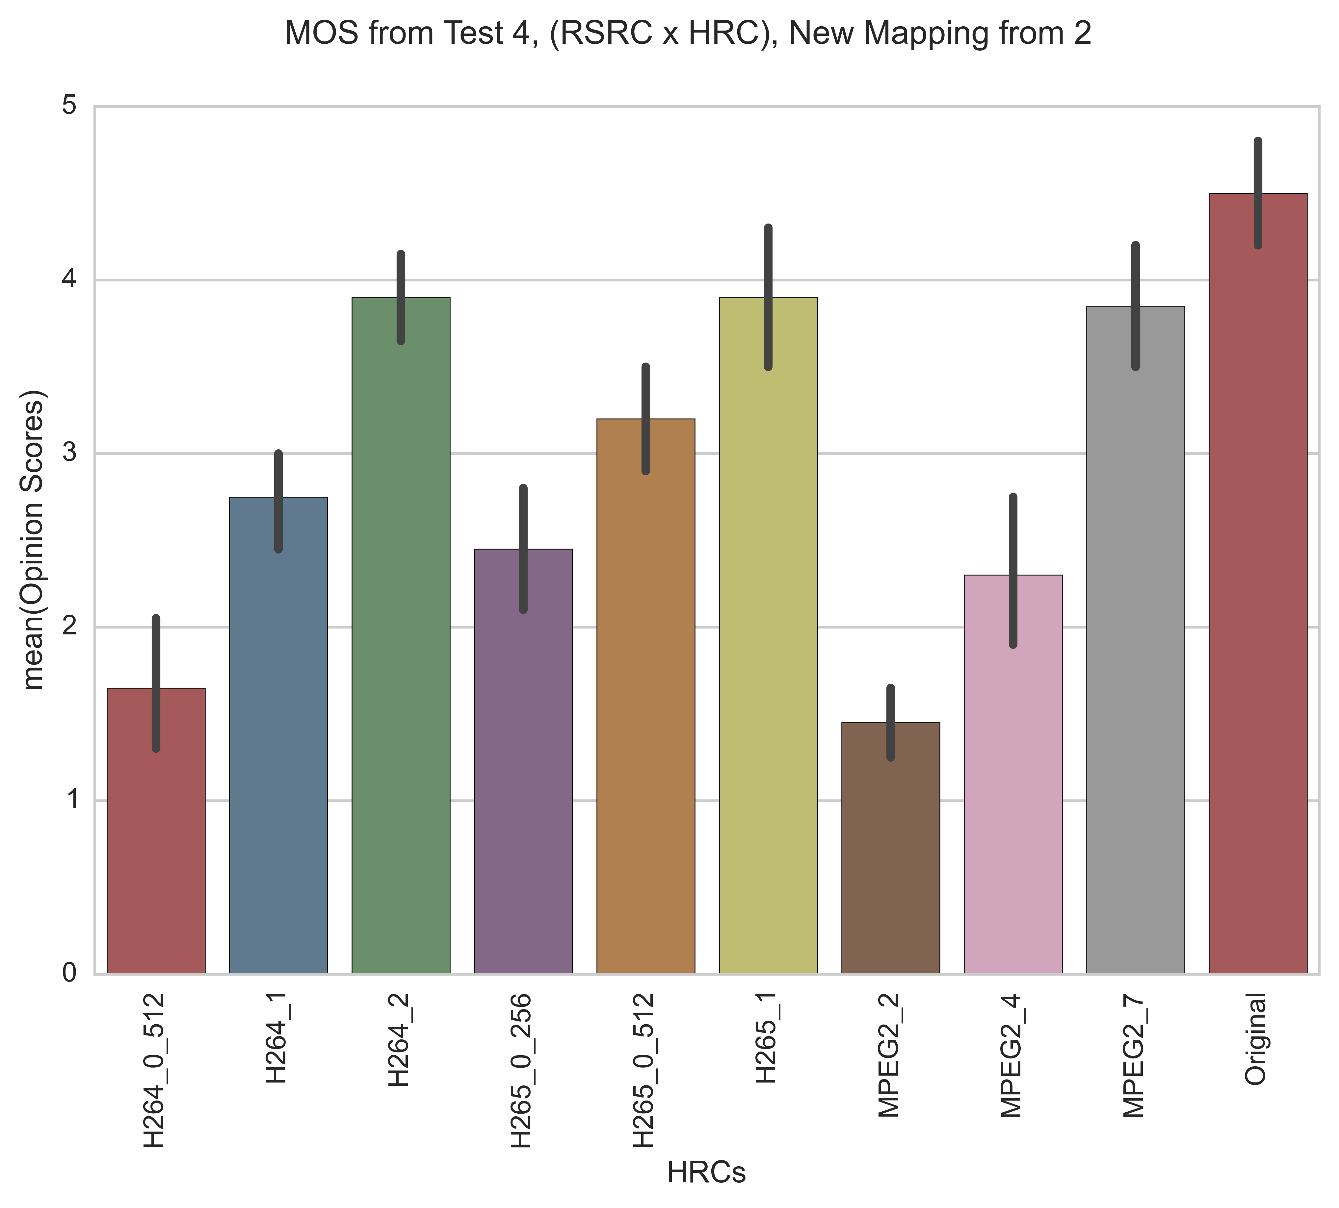
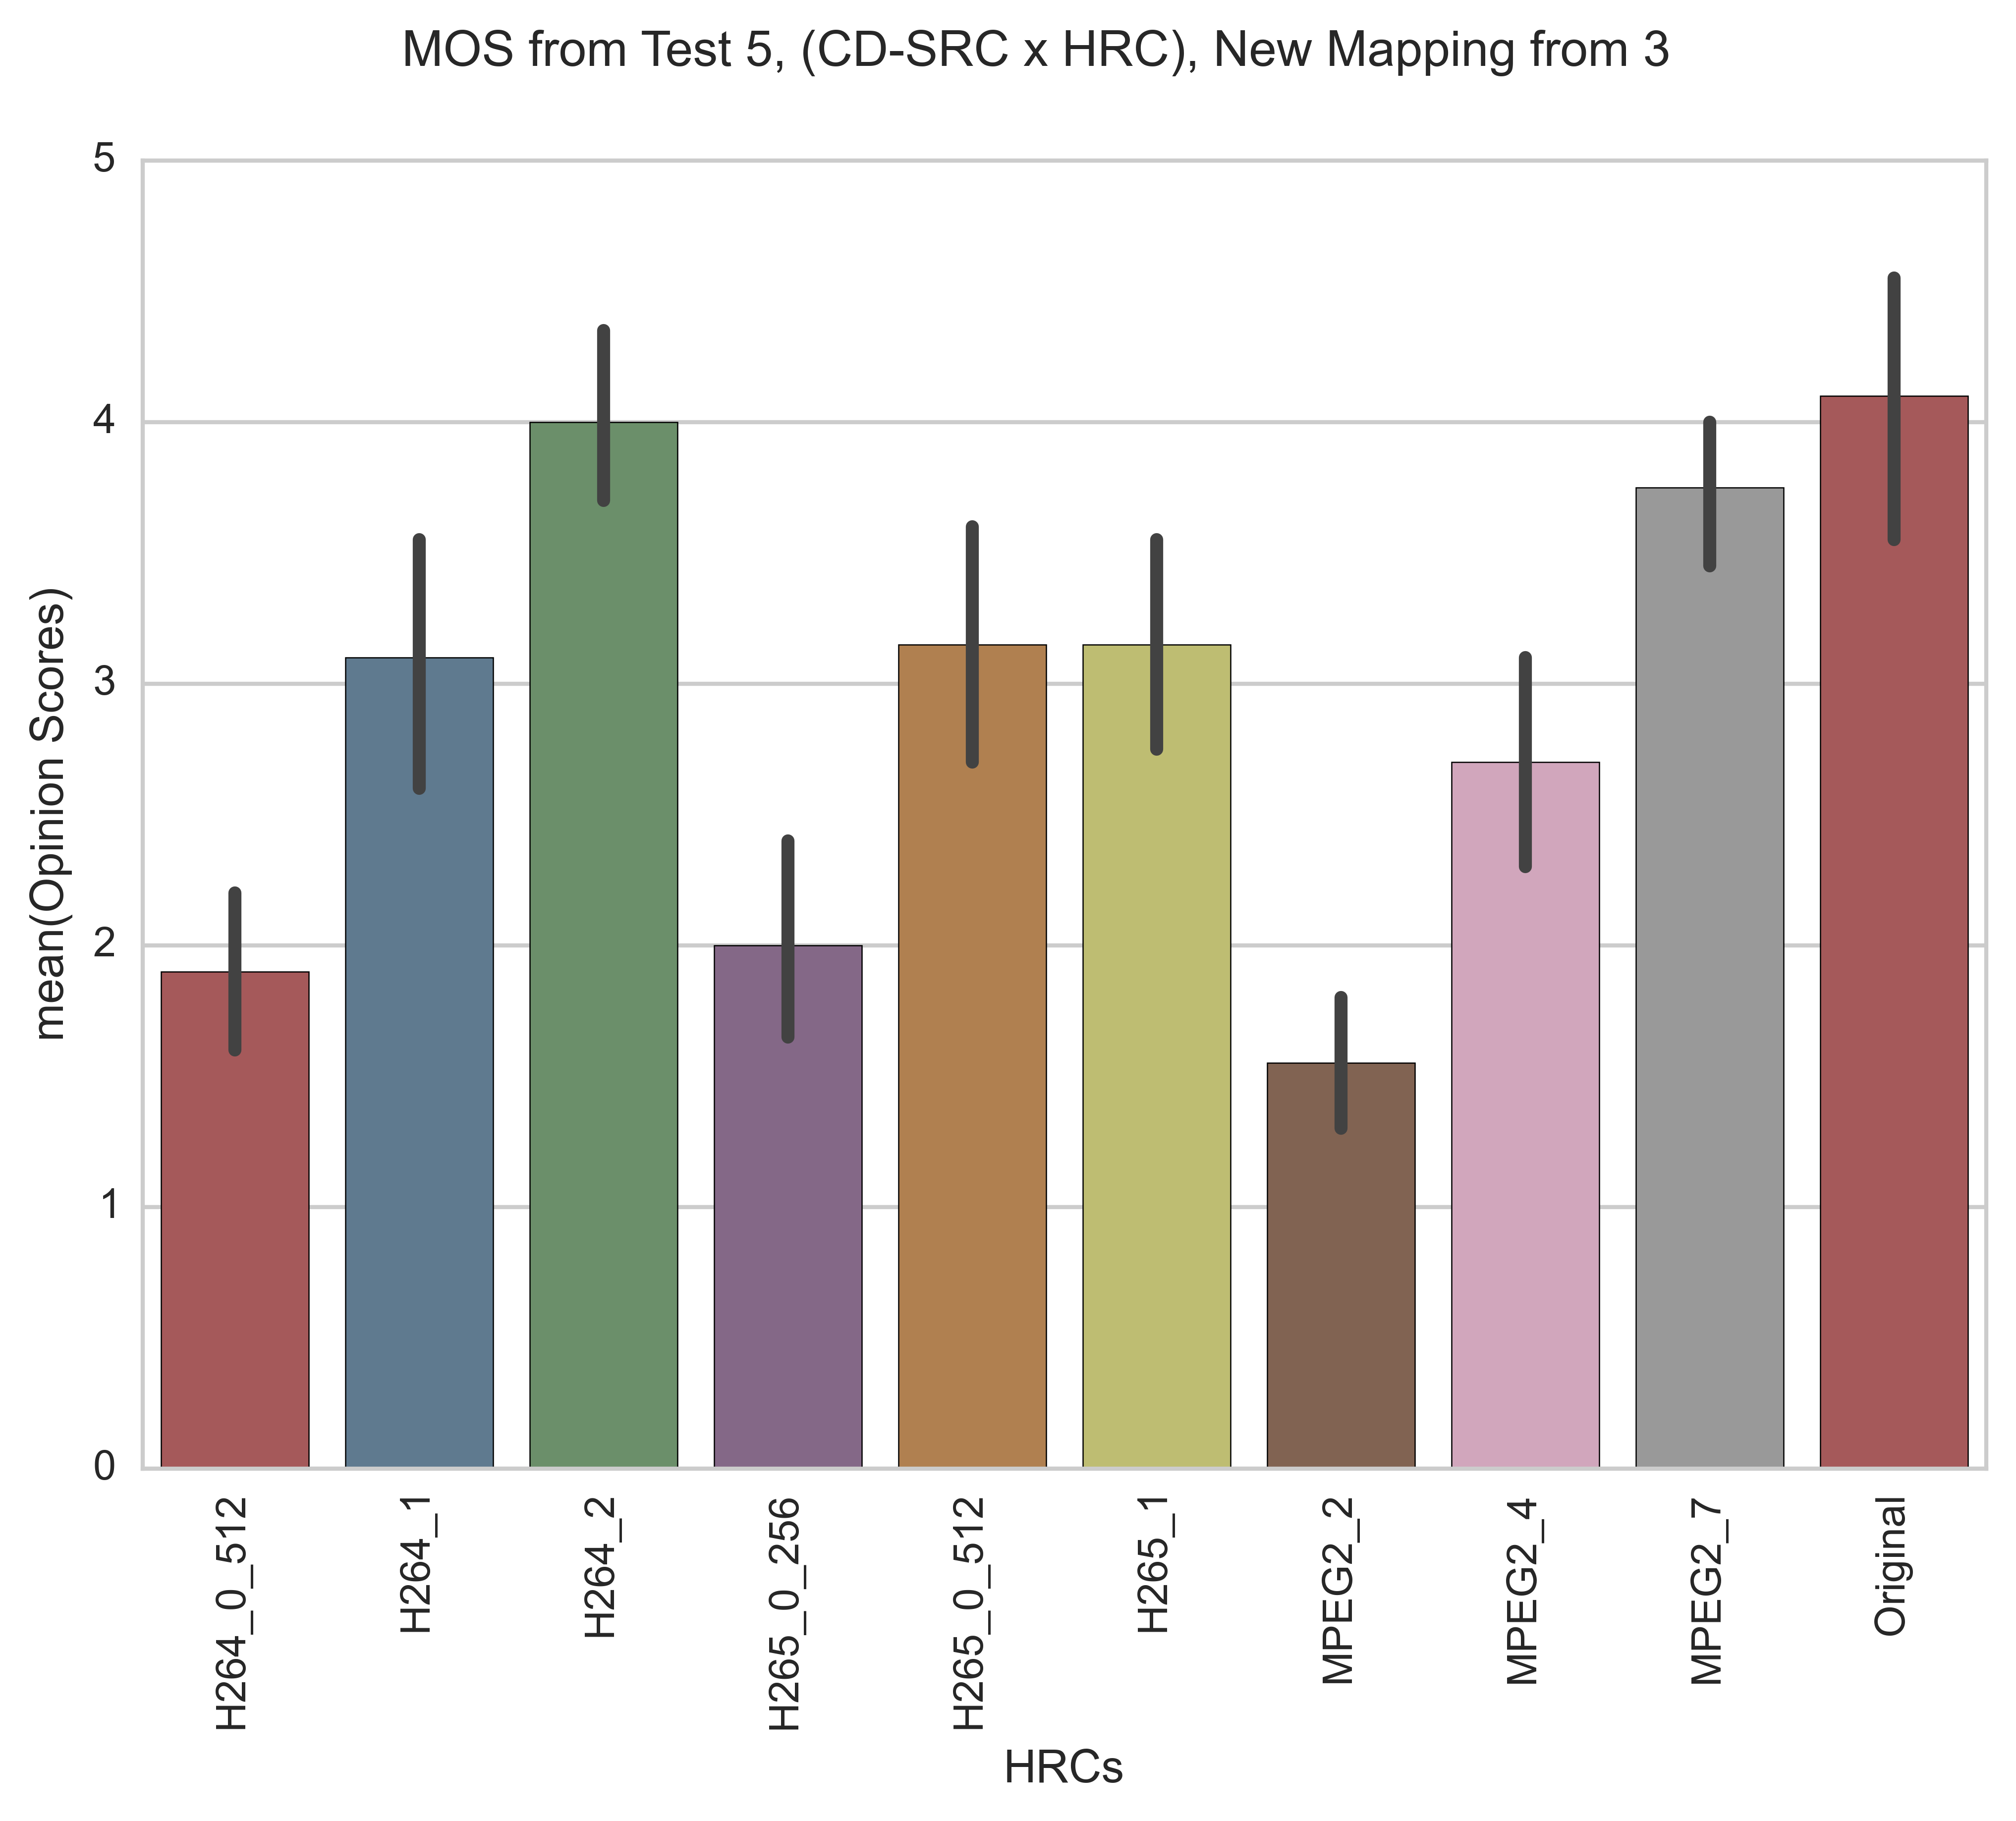
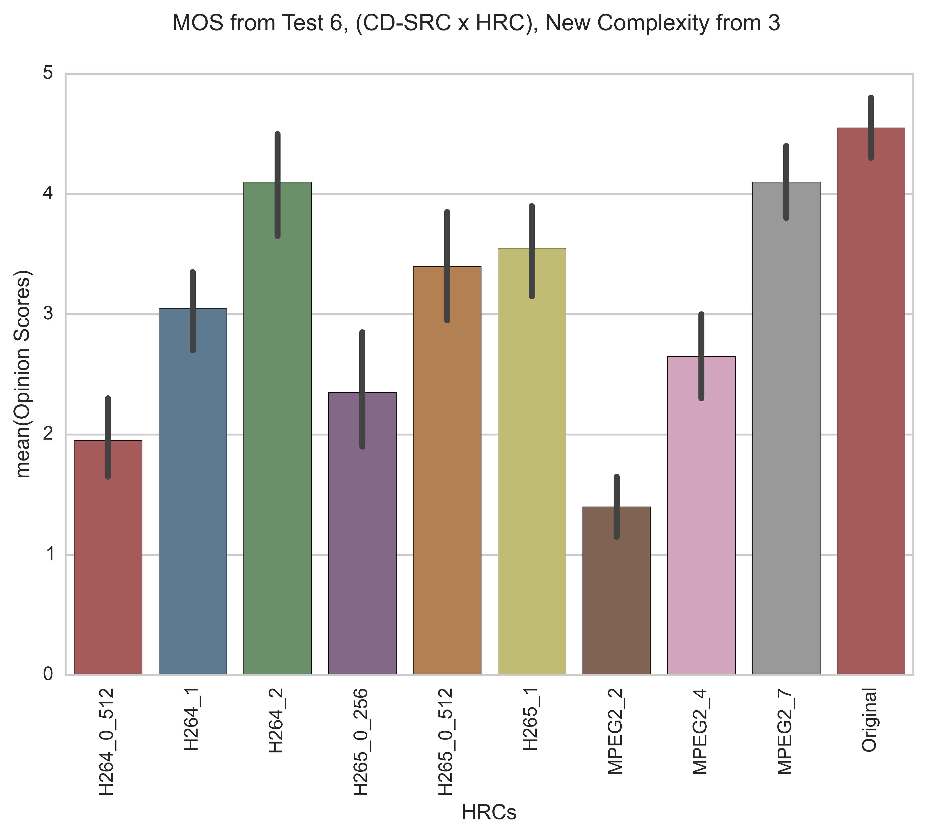
MOS per Test

Slide 3
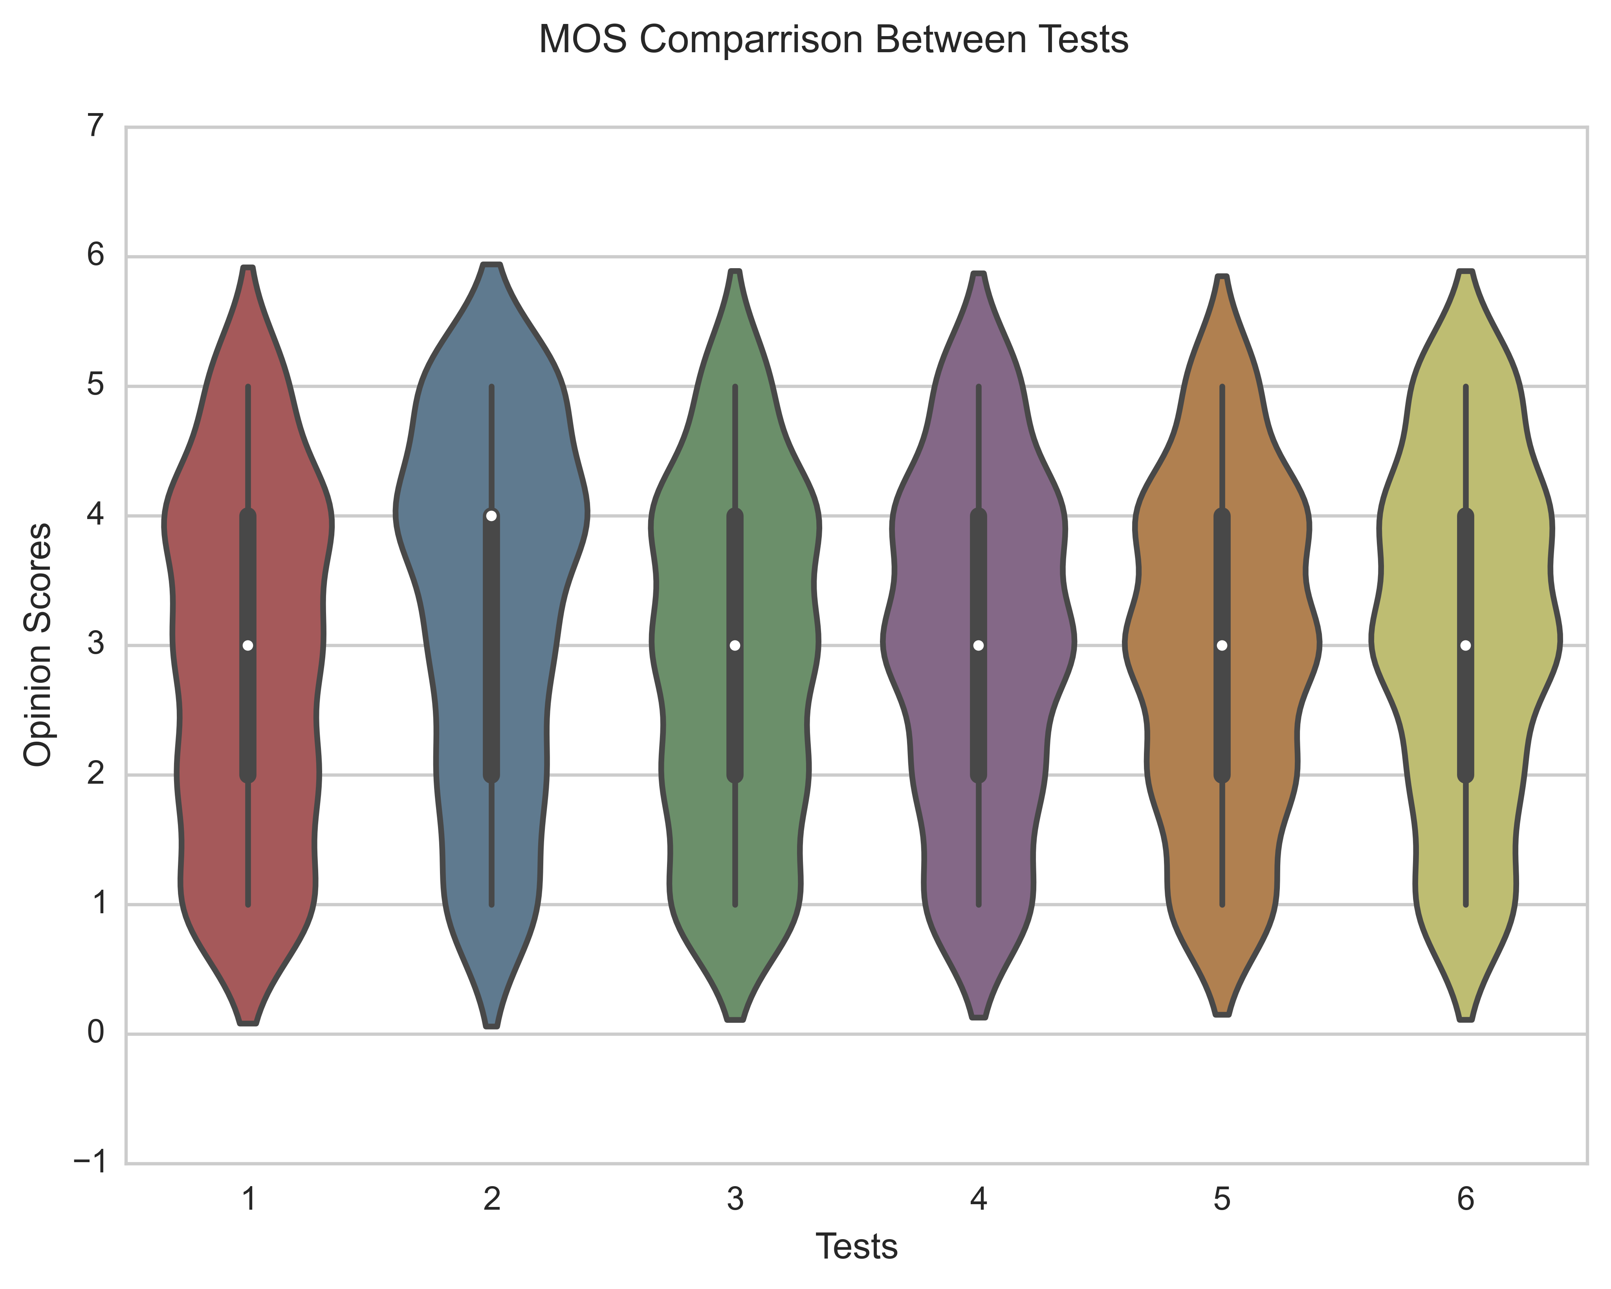
Test Comparisons

Slide 4
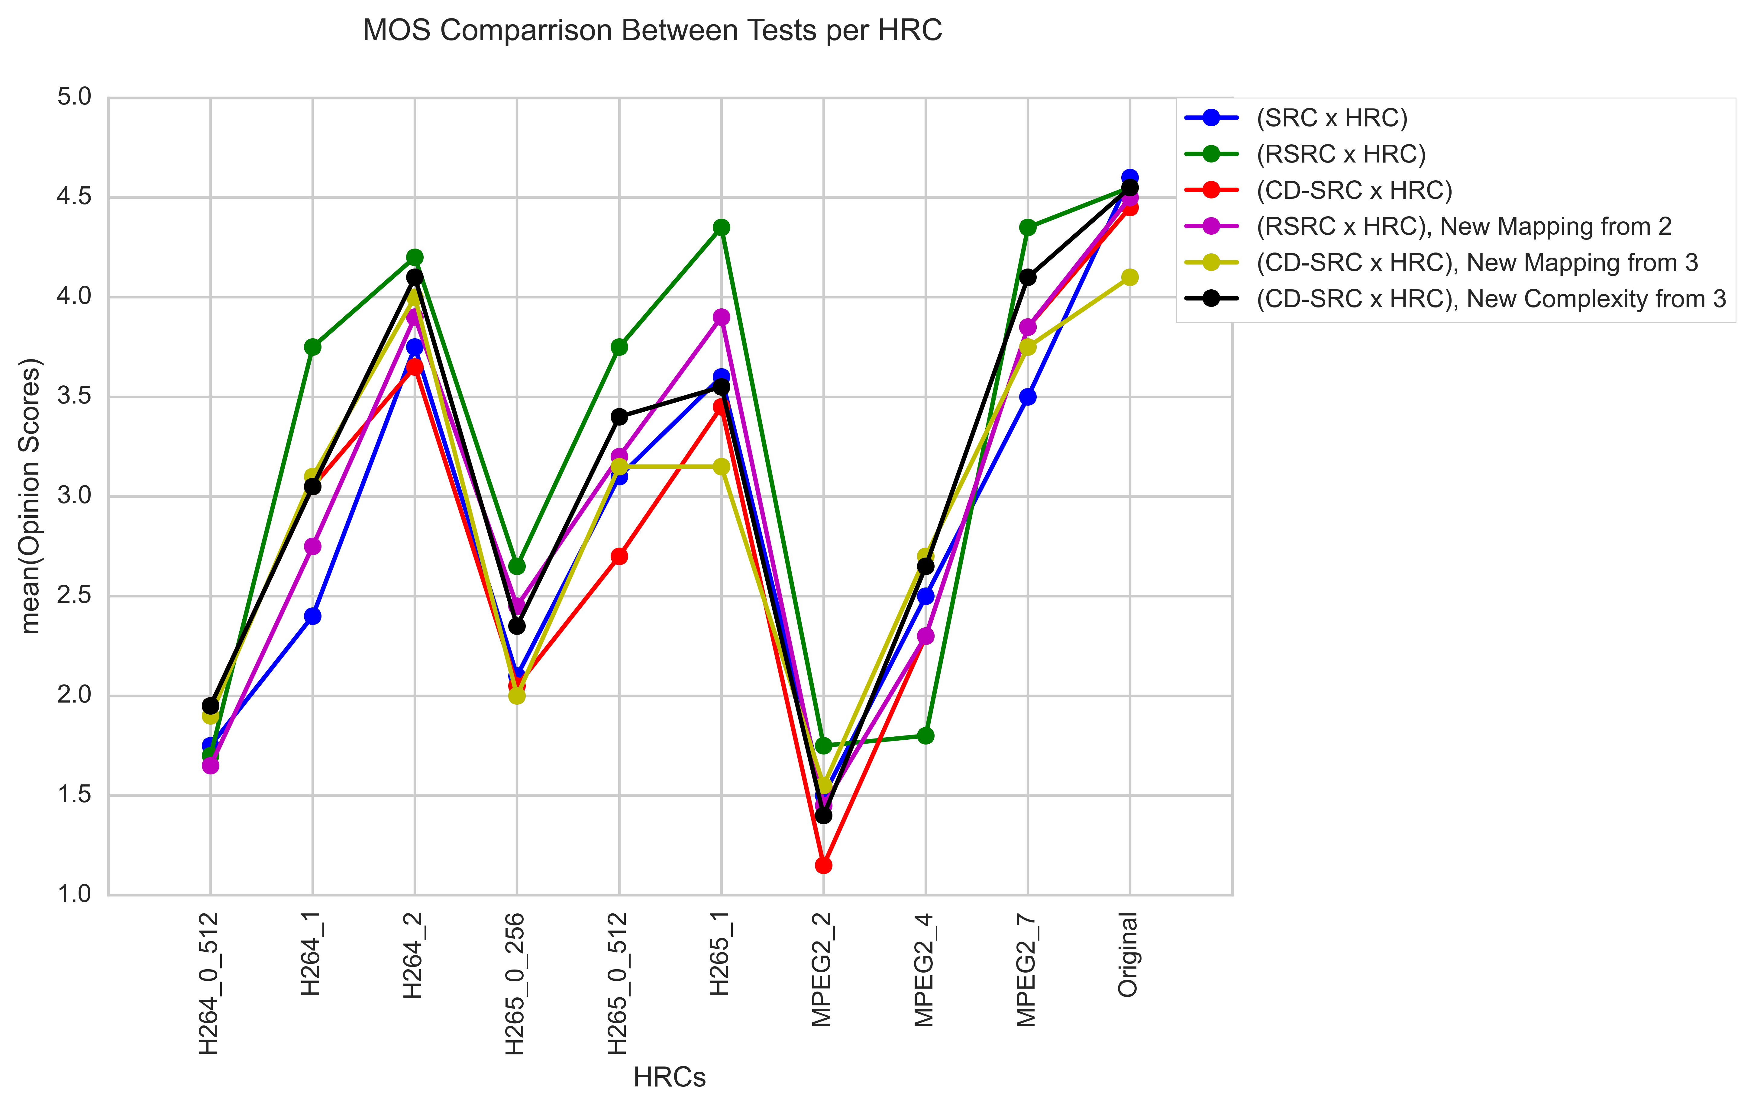
Test Comparisons

