Slide 1
Objective Consumer Device Photo Quality Evaluation
Philip Corriveau
Michele A. Saad

Slide 2
Introduction
Explosive growth in consumer photo and video content
Smartphones and tablets increasingly becoming primary cameras
Photo & Videos sharing on social networks (Instagram, Facebook, Vine)
Strong industry need and opportunity for VQEG in no-reference consumer image and video quality assessment
Working with VIME objective to address the challenging area of blind or no-reference perceptual quality evaluation
Share our research on no-reference photo quality evaluation based on statistical assessment of real-world photos
M.Saad et al., "Objective Consumer Device Photo Quality Evaluation“, IEEE Signal Processing Letters, 2015 (to appear).

Slide 3
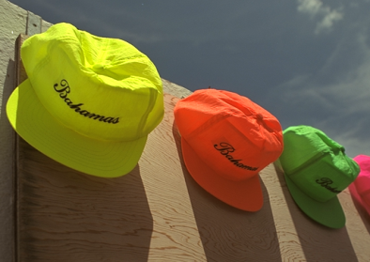
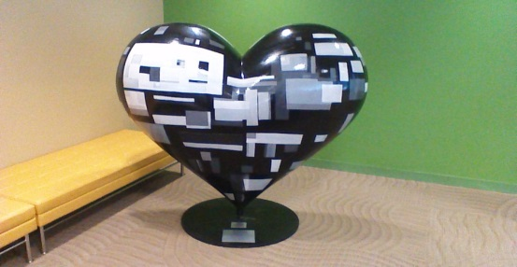
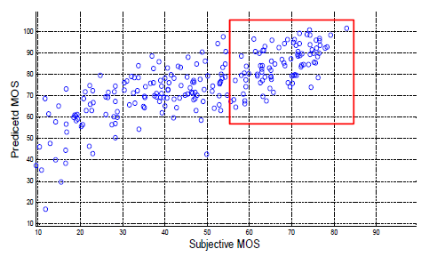
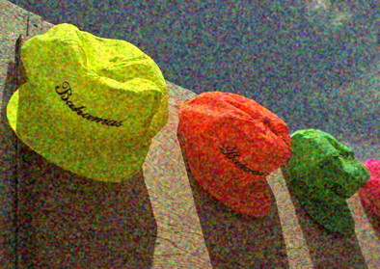
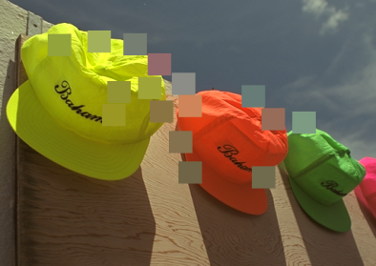
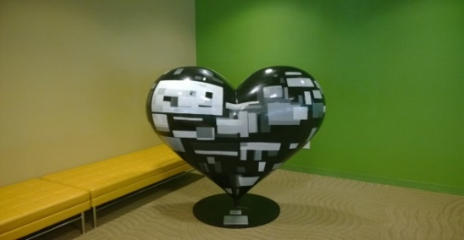
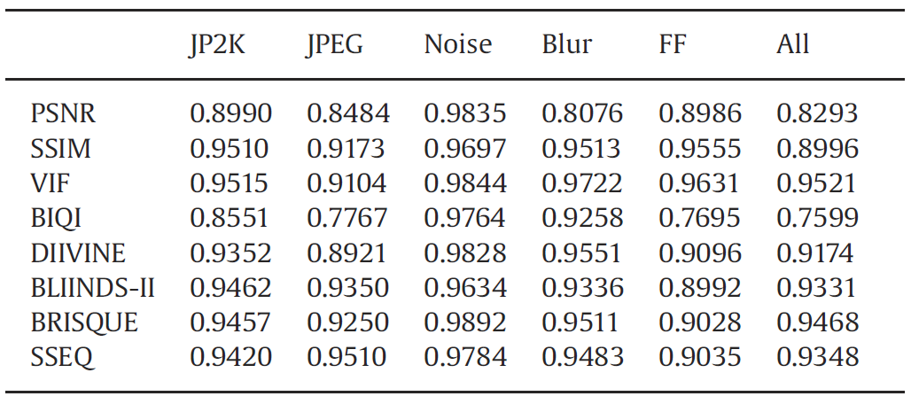
Example SROCC values on LIVE IQA Database
Current Status of IQA on Consumer Photos
Examples from IQA databases
(very large quality range)
Example consumer photos
(narrower quality range)
Illustration of the range effect
Example SROCC values on consumer photos
Method | SROCC
SSEQ (2014) | 0.405
C-DIIVINE (2014) | 0.522
DESIQUE (2013) | 0.539
BRISQUE (2012) | 0.523
BIQI (2010) | 0.129
Ref. L. Liu et al. “ No-reference image quality assessment based on spatial and s
pectral entropies,” Signal Processing: Image Communication, June 2014

Slide 4
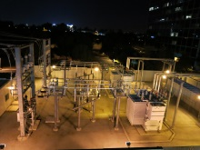
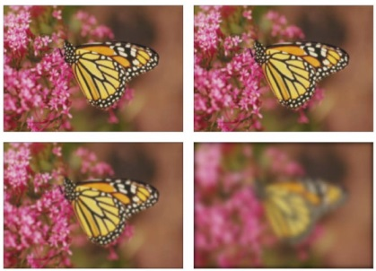
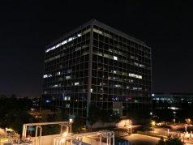
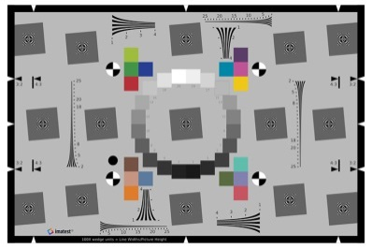
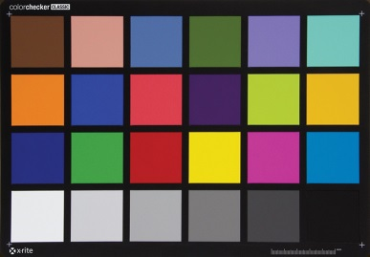
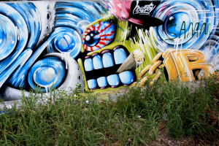
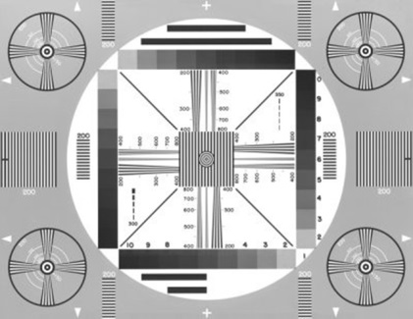
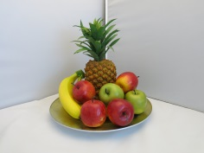
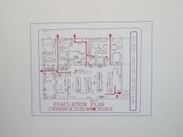
Photo Quality Evaluation Modalities
Laboratory Setup
Charts +
well-defined
lighting
Full-reference image to image comparison
No-reference but defined
image space
General abstract no-reference problem
Ref. LIVE IQA Database
Ref. Imatest Website
Proposed solution belongs to this modality
Since the general no-reference problem is under defined, constraining the image space/scoping the general problem allows the development of more tractable and more accurate prediction models.

Slide 5
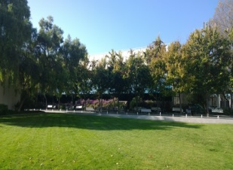
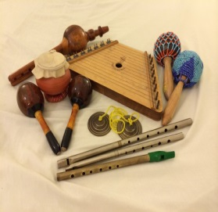
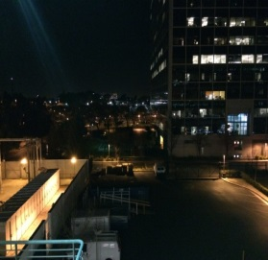
Proposed Approach Building Blocks
Methodology
Defines image space as a set of guiding categories
Quantitative Measures
Objective algorithms
MOS Prediction
Subjective studies
Outdoor Day – Landscape
Indoor – Wall Hanging
Indoor – Arrangements
Outdoor Night – Landmark
Interpretable quality aware features
NSS Model
Training and testing on representative data
Examples from 4 test photo categories

Slide 6
Proposed Approach Building Blocks
Methodology
Defines image space as a set of guiding categories
Quantitative Measures
Objective algorithms
MOS Prediction
Subjective studies
Outdoor Day – Landscape
Indoor – Wall Hanging
Indoor – Arrangements
Outdoor Night – Landmark
Interpretable quality aware features
NSS Model
Training and testing on representative data
Interpretable quality aware features
Multi-scale edge acutance
Multi-scale texture acutance
Noise signature index
Illumination
Dynamic range
Color warmth
Saturation
NSS Model
DCT statistics found to be highly regular for natural scenes. Deviations from pristine image statistics provide key to predicting quality of distorted image.
Generalized Gaussian family of distributions found to be a good fit to each frequency within a local DCT block.
Bandpass and orientation NSS model based features indicative of image quality
Notes:
Quality aware features are interpretable by consumers and users of the tool, also help explain the overall predicted score

Slide 7
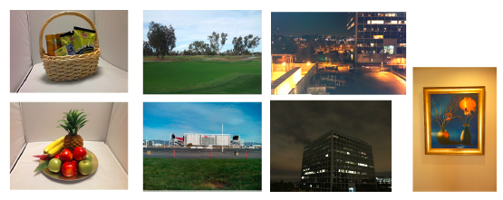
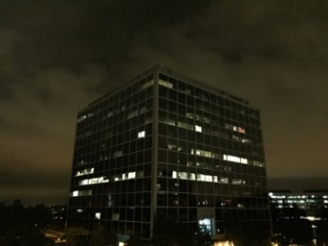
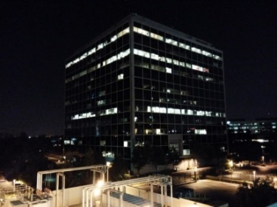
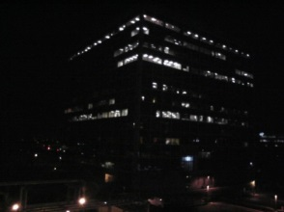
Proposed Approach Building Blocks
Methodology
Defines image space as a set of guiding categories
Quantitative Measures
Objective algorithms
MOS Prediction
Subjective studies
Outdoor Day – Landscape
Indoor – Wall Hanging
Indoor – Arrangements
Outdoor Night – Landmark
Interpretable quality aware features
NSS Model
Training and testing on representative data
Subjective Study
Data collected from 27 devices (15 scenes per device)
Each scene per device is similar but not identical due to inherent device differences and capture conditions
Single stimulus evaluation method on 1900x1200 monitor
5 point Likert scale
Subjects with some imaging experience
Notes:
Quality aware features are interpretable by consumers and users of the tool, also help explain the overall predicted score

Slide 8
Proposed Approach Building Blocks
Methodology
Defines image space as a set of guiding categories
Quantitative Measures
Objective algorithms
MOS Prediction
Subjective studies
Outdoor Day – Landscape
Indoor – Wall Hanging
Indoor – Arrangements
Outdoor Night – Landmark
Interpretable quality aware features
NSS Model
Training and testing on representative data
Training and testing
Mapping learned via linear kernel support vector regression
405 photos, 15 scenes (per each of the 27 devices)
Spearman rank order correlation coefficient computed as prediction performance measure
Leave-one scene -out for train/test
SROCC results
Method | SROCC
Proposed | 0.720
SSEQ (2014) | 0.405
C-DIIVINE (2014) | 0.522
DESIQUE (2013) | 0.539
BRISQUE (2012) | 0.523
BIQI (2010) | 0.129
Notes:
Quality aware features are interpretable by consumers and users of the tool, also help explain the overall predicted score

Slide 9
Reference Tool to Build Upon the Proposed Approach

Slide 10
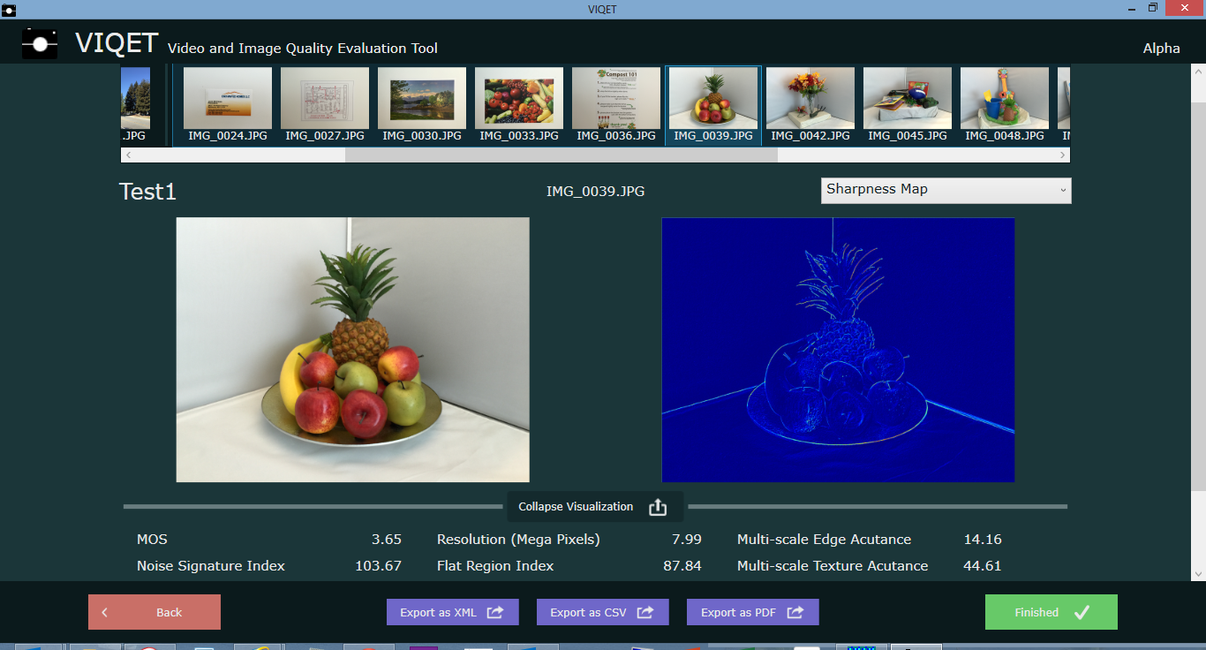
Proposed Approach Building Blocks
Contributing a blueprint tool to VIME on which the project can build upon.
Tool implements the features presented above and predicts a MOS score based on preliminary subjective studies

Slide 11
Future Work Through VIME
Collaborate on additional subjective studies to get more accurate and discriminative subjective scores
More scene categories (portraits, motion)
Incorporate higher level image features (example depth of field)
Color aspects
Video

Slide 12
References
L. Liu et al., “No-reference image quality assessment based on spatial and spectral entropies”, Signal Processing: Image Communication, vol. 29, no. 8, pp. 856–863, September 2014. (SSEQ: spatial and DCT)
Y. Zhang et al., “C-DIIVINE: No-reference image quality assessment based on local magnitude and phase statistics of natural scenes”, signal Processing: Image Communication, vol. 29, no. 7, pp. 725–747, May 2014. (C-DIIVINE: complex steerable pyramid)
Y. Zhang and D. Chandler, “No-reference image quality assessment based on log derivative statistics of natural scenes”, Journal of Electronic Imaging, vol. 22, no. 4, December 2013. (DESIQUE: spatial and log-Gabor domains)
A. Mittal et al., “No-reference image quality assessment in the spatial domain”, IEEE Transactions on Image Processing, vol. 21, no. 12, pp. 4695–4708, December 2012. (BRISQUE: spatial domain)
A. Moorthy et al., “A two-step framework for constructing blind image quality indices”, IEEE Signal Processing Letters, vol. 17, no. 5, pp. 587–599, May 2010. (BIQI: wavelet domain)

