Slide 1
HEVC Commentary and a call for local temporal distortion metrics
Mark Buxton - Intel Corporation

Slide 2
Poll –which best describes you?
I’m working on an HEVC encoder now
I expect to work on an HEVC encoder in the future
I’m interested in the science of video coding in general
Meh. Computer vision or analysis is much more interesting to me.

Slide 3
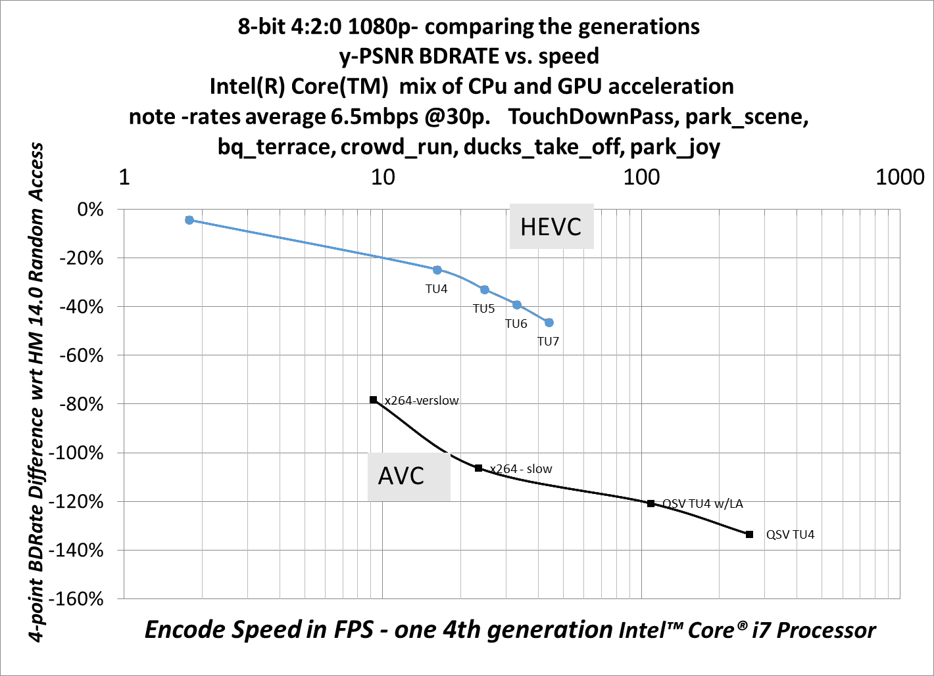
Quality vs. performance
This is the “Machine friendly” view - no perceptual optimizations or clever content analysis.

Slide 4
Nature of HEVC – Prediction Modes
Data gathered from the Intel® Video Pro Analyzer

Slide 5
Nature of HEVC – Transform Sizes
Data gathered from the Intel® Video Pro Analyzer

Slide 6
Key findings
PSNR less useful on HEVC than on AVC
- HEVC mostly being exploited for its rate savings rather than quality enhancement
→ PSNR already less useful at low rate
- HEVC coding tools cover larger spatial and temporal domains
→ PSNR is a pixel metric

Slide 7
Key findings
Some Artifacts are worse, proportionally, than in AVC
Mosquito
Flickering and temporal instability
Glass-plate and dragging
Hmm, these are all primarily temporal artifacts

Slide 8
Good encoder – (Within 5% of HM)
Frame 46
Data captured with the Intel® Visual Quality Caliper

Slide 9
Speedy Encoder
Frame 46
Data captured with the Intel® Visual Quality Caliper

Slide 10
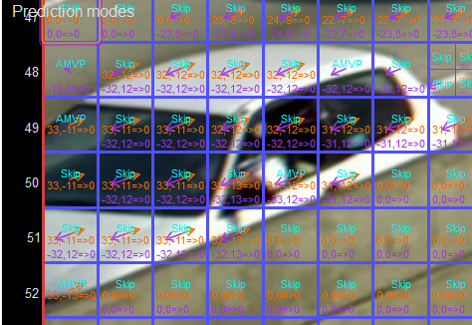
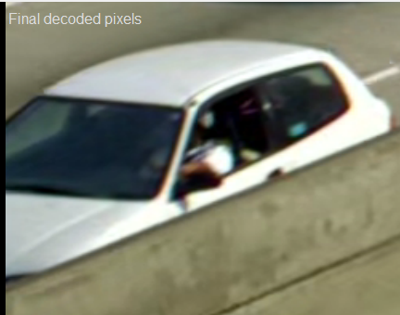
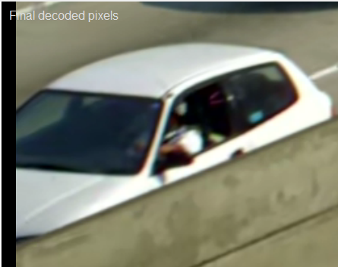
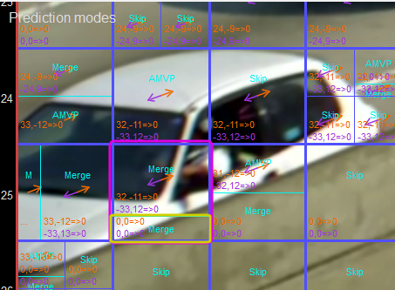
Illustration of low (top) and high complexity modes
Showing the perils of skip
Temporal variation due to changing large block partitions

Slide 11
What is needed?
HEVC large blocks are both a key coding benefit and key challenge for perceived quality
Sharp local differences across frames result from CU split and TU shape
in areas of zero or low motion these are highly visible
Want a quality metric sensitive to these (local temporal) effects

Slide 12
Example of some ongoing work, from our Seattle abs
Crowd Run 720p; HEVC TU7 CQP37. Played at half speed.
Data captured with the Intel® Visual Quality Caliper

Slide 13
Ongoing deringing improvement
Crowd Run 720p; HEVC TU7 CQP37. Played at half speed.
Data captured with the Intel® Visual Quality Caliper

Slide 14
Legal Disclaimer & Optimization Notice
INFORMATION IN THIS DOCUMENT IS PROVIDED “AS IS”. NO LICENSE, EXPRESS OR IMPLIED, BY ESTOPPEL OR OTHERWISE, TO ANY INTELLECTUAL PROPERTY RIGHTS IS GRANTED BY THIS DOCUMENT. INTEL ASSUMES NO LIABILITY WHATSOEVER AND INTEL DISCLAIMS ANY EXPRESS OR IMPLIED WARRANTY, RELATING TO THIS INFORMATION INCLUDING LIABILITY OR WARRANTIES RELATING TO FITNESS FOR A PARTICULAR PURPOSE, MERCHANTABILITY, OR INFRINGEMENT OF ANY PATENT, COPYRIGHT OR OTHER INTELLECTUAL PROPERTY RIGHT.
Software and workloads used in performance tests may have been optimized for performance only on Intel microprocessors. Performance tests, such as SYSmark and MobileMark, are measured using specific computer systems, components, software, operations and functions. Any change to any of those factors may cause the results to vary. You should consult other information and performance tests to assist you in fully evaluating your contemplated purchases, including the performance of that product when combined with other products.
Copyright © 2014, Intel Corporation. All rights reserved. Intel, Pentium, Xeon, Xeon Phi, Core, VTune, Cilk, and the Intel logo are trademarks of Intel Corporation in the U.S. and other countries.
Optimization Notice
Intel’s compilers may or may not optimize to the same degree for non-Intel microprocessors for optimizations that are not unique to Intel microprocessors. These optimizations include SSE2, SSE3, and SSSE3 instruction sets and other optimizations. Intel does not guarantee the availability, functionality, or effectiveness of any optimization on microprocessors not manufactured by Intel. Microprocessor-dependent optimizations in this product are intended for use with Intel microprocessors. Certain optimizations not specific to Intel microarchitecture are reserved for Intel microprocessors. Please refer to the applicable product User and Reference Guides for more information regarding the specific instruction sets covered by this notice. Notice revision #20110804

