Slide 1
Brief Intro to CSIRO and Myself
Ulrich Engelke | Senior Research Scientist – Cognitive Informatics
21st January 2014
CSIRO computational informatics (CCI)

Slide 2
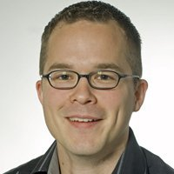
About me...
Masters in ICT at RWTH Aachen, Germany (2004)
PhD in Telecommunications at BTH, Sweden (2010)
Thesis: Modelling Perceptual Quality and Visual Saliency for Image and Video Quality Assessment
Post-doc at IVC group, University of Nantes, France (2011)
QoE for multimedia applications
Research Scientist at Philips Research, The Netherlands (2011-2013)
QoE for lighting applications
Senior Research Scientist at CSIRO, Australia (2013-)
Cognitive Informatics
(Bioinformatics)
Cologne, Germany

Slide 3
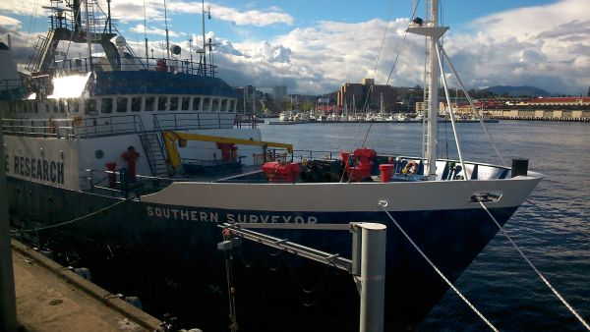
CSIRO
Commonwealth Scientific and Industrial Research Organisation
Darwin
People
6500
Cairns
Atherton
Townsville 2 sites
Divisions
11
Alice Springs
Rockhampton
Locations
58
Bribie Island
Murchison
Toowoomba
Brisbane
6 sites
Gatton
Geraldton 2 sites
Myall Vale
Armidale 2 sites
Flagships
11
Narrabri
Mopra
Newcastle
Perth
3 sites
Adelaide
2 sites
Parkes
Irymple
Griffith
Sydney 5 sites
Budget
$1B+
Wodonga
Canberra 7 sites
Werribee 2 sites
Belmont
Melbourne 5 sites
Geelong
Hobart
Top 1% of global research institutions in 14 of 22 research fields
Top 0.1% in 4 research fields
62% of our people hold university degrees
2000 doctorates
500 masters
Sandy Bay

Slide 4
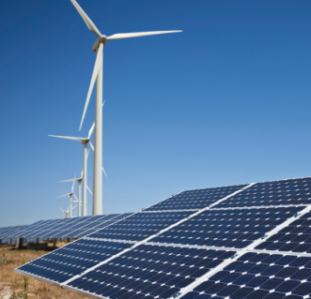
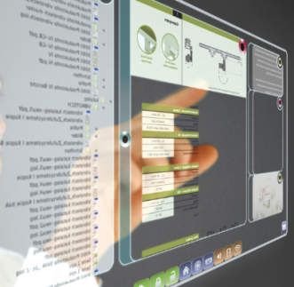
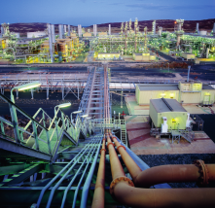
Our business units
Food, Health & Life Science Industries
Energy
Environment
Information & Communications
Manufacturing, Materials & Minerals
11
11
National Research Flagships
Research Divisions
+
+
National Research Facilities and Collections
Transformational Capability Platforms

Slide 5
National Research Flagships
biosecurity
Climate adaptation
Digital productivity and SERVICES
Energy transformed
Food futures
Future manufacturing
Minerals down under
Preventative health
Sustainable agriculture
Water for a healthy country
Wealth from oceans

Slide 6
Research Divisions

Slide 7
Our track record: top inventions
2. POLYMER BANKNOTES
3. RELENZA FLU TREATMENT
4. EXTENDED WEAR CONTACTS
1. FAST WLAN Wireless Local Area Network
5. AEROGARD
6. TOTAL WELLBEING DIET
7. RAFT POLYMERISATION
8. BARLEYMAX
9. SELF TWISTING YARN
10. SOFTLY WASHING LIQUID

Slide 8
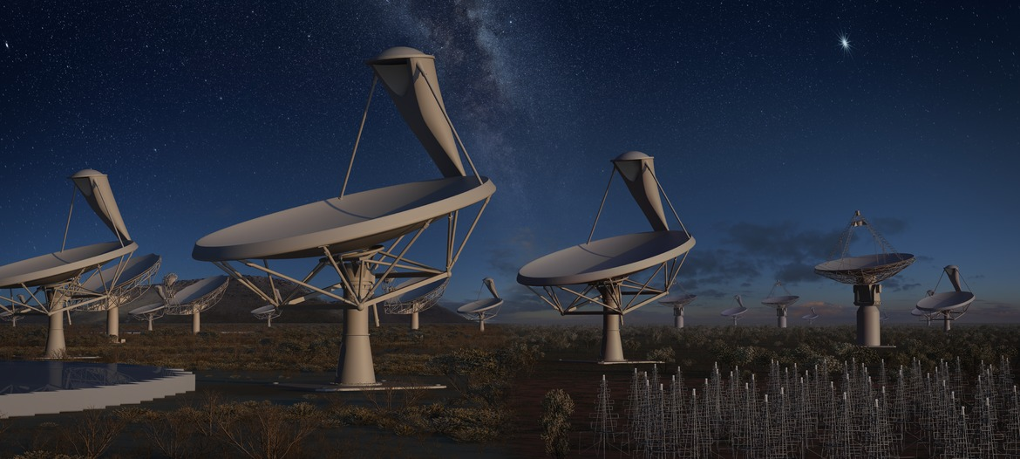
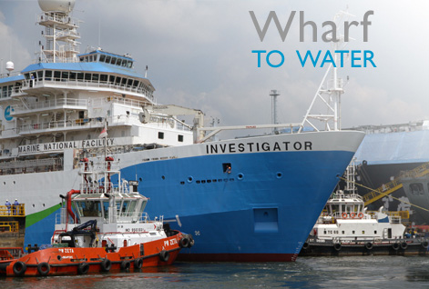
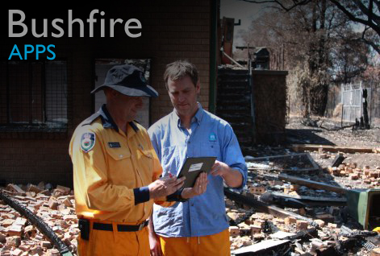
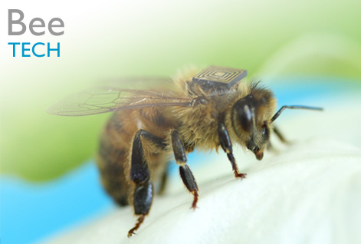
CSIRO Projects
SKA
https://www.skatelescope.org/

Slide 9
Cognitive Informatics
New capability within CSIRO
The team
Several research scientists, post-docs, and SW engineer
Couple of students
Quantitative and reproducible research in Cognitive Informatics
Applications
Human Robot Interaction
Preventative Health
Simulation
...

Slide 10
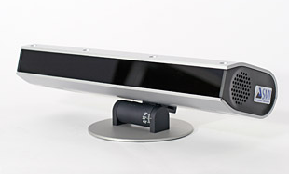
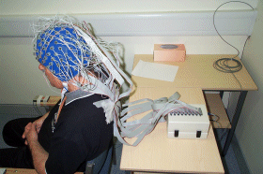
Facilities
Equipment
SMI RED 500 eye tracker
Biosemi ActiveTwo psychophysiological measurement equipment
Other lower cost solutions

Slide 11
Contribution to RICE and VQEG
Quantitative QoE assessment with psychophysiological measurements: eye tracking, EEG, EKG, EMG, GSR, ...
Correlates of psychophysiological measures and subjective scales.
Recommendations for concurrent use of subjective scales and psychophysiology measurements – definition of use cases.
Going ahead:
Laboratory is being built up at the new Sandy Bay site
Get student(s) onboard to support this work
Find collaborators within VQEG

Slide 12
Thank you
Computational Informatics
Ulrich Engelke Senior Research Scientist
t +61 3 6232 5431
e ulrich.engelke@csiro.au
w www.csiro.au/lorem
CSIRO Computational informatics (CCI)
Title picture: iyashisource.com

