Slide 1
Immersive Subjective Testing
Proof of Concept

Slide 2
Video Quality Subjective Testing
Psychophysics
Can you see a difference?
Notes:
BT.500, P.910
Psychophysics, JND
Benefits:
compare SRC and HRC
train and test objective models

Slide 3
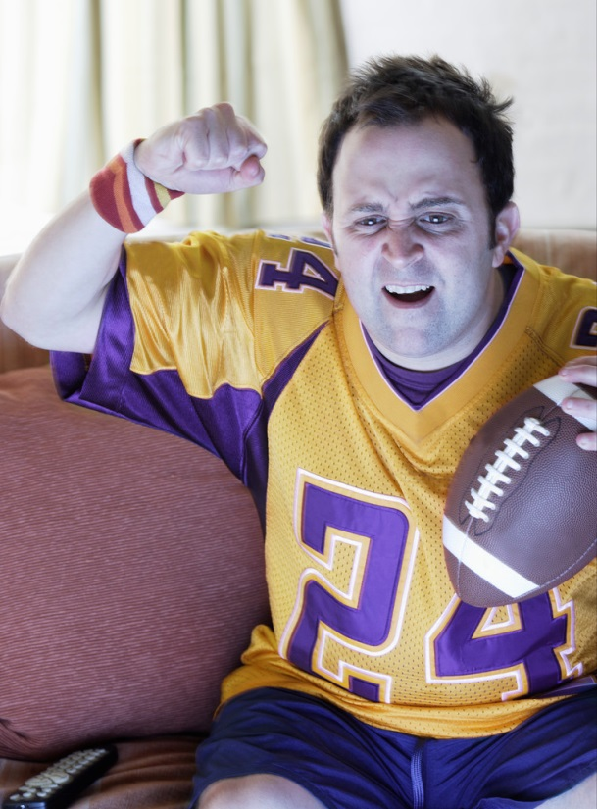
What is Missing?
Usability
Immersion
Notes:
appropriate or not for task or use
threshold
price / performance
sale
immersion
learn scene
1st to 2nd to 3rd viewing
question bias answer

Slide 4
Unique SRC x HRC Mapping
subject 1
hrc 1
hrc 2
hrc 3
subject 2
hrc 2
hrc 3
hrc 1
subject 3
hrc 3
hrc 1
hrc 2
Notes:
same SRC
same HRC
different map each subject

Slide 5
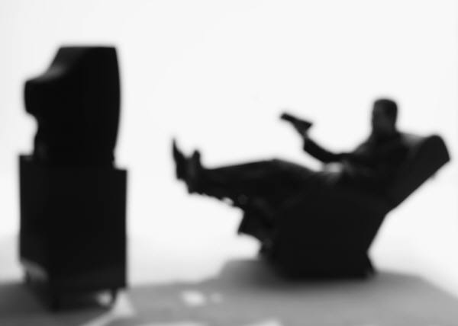
Immersion
Audiovisual
1 minute SRC
Distractor questions
35-40 subjects
Notes:
Audiovisual content
Real environment
Distractor questions
Same 5-6 questions each SRC
Increase subjects
≈ 30 SRC
5-6 HRC
4-5 SRC

Slide 6
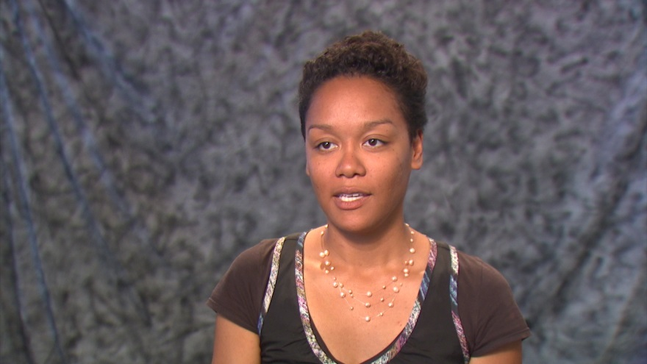
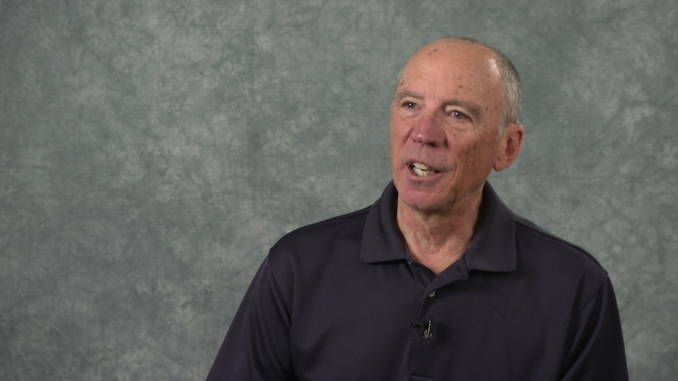
Speech Quality Test
A1 is AMR narrowband, mode 0 (4.75 kb/s)
A2 is AMR narrowband, mode 7 (12.2 kb/s)
A3 is AMR wideband, mode 1 (8.85 kb/s)
A4 is AMR wideband, mode 8 (24.0 kb/s)

Slide 7
Questions
What topic was this person discussing?
Occupation, traveling, family, self, memories, other
How interesting did you find this clip?
Intriguing, interesting, neutral, uninteresting, boring
What attracted your attention the most?
Message, clothing, face, gestures, manner of speaking
Would you enjoy having a conversation with this person?
Very likely, somewhat likely, neutral, unlikely, very unlikely
How would you rate the overall quality of the sound and picture?
Excellent, good, fair, poor, bad

Slide 8
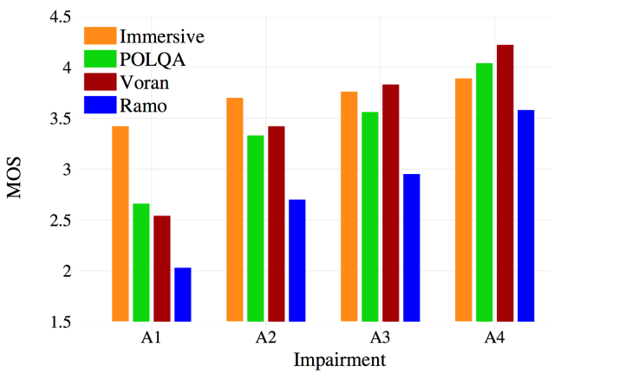
Compare to POLQA & P.800

Slide 9
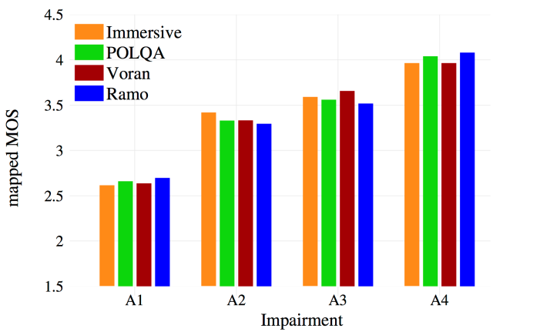
Mapped to POLQA

Slide 10
Pearson Correlation
 | Immersive | POLQA | Voran | Ramo
Immersive | 1.00 | 0.99 | 0.99 | 0.98
POLQA | 0.99 | 1.00 | 0.99 | 0.99
Voran | 0.99 | 0.99 | 1.00 | 0.98
Ramo | 0.98 | 0.99 | 0.98 | 1.00

Slide 11
Student’s t-test at 95% confidence
Immersive
(A1,A3) and (A1,A4) were statistically different
Voran
all HRCs were statistically different
Ramo
all HRCs are statistically different

Slide 12
Thoughts?
Sample Experiments
Collaboration
Notes:
My psychology student
Try sample test
Sample experiments
Try technique
Define
Publish
ITU Rec for credibility

