Slide 1
Discussion for JEG in Ghent
Marcus Barkowsky

Slide 3
Status SRC
SRC database
64 High Quality HDTV sequences
6 Rendered Movies
22 User generated contents
Gaming content
Gold dataset 2012 selected (10 sequences)
A first version of manual annotation regarding the sequence characteristics is available
Todo:
Some sequences need to be cut into shorter videos (notably the Rendered Movies)
It would be nice to have the sequences from the CDVL database available on ftp for easier download

Slide 4
Status PVS
The Goldset 2012 was encoded by AGH with
~600 different parameter settings in x264
~600 different parameter settings in JM
The 12000 sequences (108GB) can be downloaded from:
ftp://ftp.ivc.polytech.univ-nantes.fr/ VQEG/JEG/HYBRID/database/
Soon a mirror at AGH will be installed

Slide 5
Status PVS
Todo:
Create a Virtual Machine allowing for recreating these videos
Create the same PVS for more SRC
Transmit these videos over various lossy/lossless transmission channels
Remarks/Questions:
The HMIX2 files in compressed bz2 format take about 800GB. It would probably be more convenient to run this locally.
The PVS would be very large and can be created in the same process

Slide 6
H.264 database details
Presentation by Lucjan

Slide 7
Status objective indicators
Objective Algorithms are currently run on the database (SSIM, PSNR, VQM, …)
Isolated indicators are evaluated as well (blockiness, blurriness, jerkiness from AccepTV, various algorithms from AGH)
Todo
Run further objective measurement algorithms

Slide 8
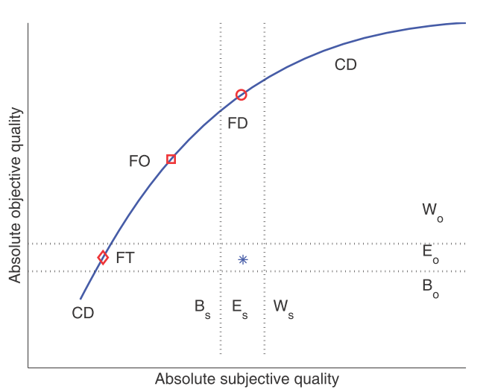
Status Estimating MOS
Todo
Develop statistical tools to
Select and align various objective algorithm results
Provide information which sequences have to go into a subjective experiment, i.e. based on order classification

Slide 9
Testplan discussion
New structures in the testplan in the Appendices (see there)

Slide 10
HEVC database
Glenn is going to present details

Slide 11
Addition of other types of media/degradations
Presentation by Anthony

Slide 12
Status for developing Hybrid measurement
Todo:
Student competition organisation?

Slide 13
Further work ideas
Further work on HEVC XML file creation
Further work on balanced SRC selection algorithm
Predicting manually voted SRC selection features including measuring of performance of existing algorithms

