Slide 1
Standardization Trends in Visual Quality Assessment:
VQEG & Standards Development Organizations (SDOs)
Arthur Webster
webster@its.bldrdoc.gov
Notes:
I am Arthur Webster from the Institute for Telecommunication Sciences, located in Boulder, Colorado, in the USA; and I’m going to talk to you today about standardization trends in visual quality assessment.

Slide 2
SDOs developing Visual Quality Assessment Standards
International Telecommunications Union (ITU)
  ITU-T
    Study Group 9: Television and sound transmission and integrated broadband cable networks
    Study Group 12: Performance, QoS and QoE
  ITU-R
    Working Party 6C: Programme production and quality assessment in Broadcasting service
Alliance for Telecommunications Solutions (ATIS)
  Performance Reliability Quality Committee (PRQC)
  IPTV Interoperability Forum (IIF)
Video Quality Experts Group (VQEG)
  Established in 1997

Slide 3
The INTERNATIONAL TELECOMMUNICATION UNION
ITU is the UN agency for telecommunication and information & communication technologies (ICTs)
World’s governments (192) and regulatory bodies work together with private sector (700) and academia (20) to bring the benefits of ICTs to the citizens of the world

Slide 4
ITU STRUCTURE (1/2)
3 Sectors:
Standardization (ITU-T): promotes enabling technical, policy and regulatory frameworks to boost ICT development
Radiocommunication (ITU-R): coordinates the shared global use of radio spectrum and geostationary satellite orbit
Development (ITU-D): works to improve telecommunication infrastructure in the developing world

Slide 5
ITU STRUCTURE (2/2)
Plenipotentiary Conference
General
Secretariat
ITU Council
ITU TELECOM
ITU-T
Standardization
ITU-R
Radiocommunication
ITU-D
Development
Notes:
General Secretariat: Coordinates and manages the administrative and financial aspects of the Union’s activities
ITU-R: Coordinates radio communications, radio-frequency spectrum management and wireless services
ITU-D: Technical assistance and deployment of telecom networks and services in developing and least developed countries to develop communication services
ITU-T: Mission is to ensure an efficient and on-time production of internationally applicable high quality standards covering all fields of telecommunications
TELECOM:Brings together the top names from across the ICT industry as well as ministers and regulators and many more for a major exhibition, a high-level forum and a host of other opportunities.

Slide 6
ITU-T STRATEGIC GOALS
To develop interoperable, non-discriminatory international standards (ITU-T Recommendations)
To assist in bridging the standardization gap between developed and developing countries
To extend and facilitate international cooperation among international, regional and national standardization bodies

Slide 7







ITU: 44 formal partnerships
World Standards Cooperation ISO – IEC - ITU
  Patent policy & Joint events
ITU-T and IEEE
  MoU & Joint events
Global Standards Collaboration
  Supports ITU as preeminent global ICT standards organization.
Management meetings with:
  ETSI
  IETF
  ICANN
  ISO/IEC JTC 1
MoU on E-Business:
IEC, ISO, ITU and UN/ECE
JTC 1

Slide 8
ITU-T Structure and organization
Study Group x
Study Group y
Study Groups …
Working Party 2/x
Working Party 1/x
Working Party 3/x
Working Parties …
Working Party 1/y
Question 1/1
Question 1/2
Question 1/3
Question 1/1
TSAG
WTSA

Slide 9
Study Group 9 Overview
Lead Study Group on integrated broadband cable and television networks
Responsible for studies relating to:
  use of telecommunication systems for contribution, primary distribution and secondary distribution of television, sound programmes and related data services including interactive services.
  use of cable and hybrid networks, primarily designed for television and sound programme delivery to the home, as integrated broadband networks to also carry voice or other time-critical services, video on demand, interactive services, etc.

Slide 10
Video Quality Questions in SG9
Q 1/9 Transmission of television and sound programme signal for contribution, primary distribution and secondary distribution
Q 2/9 Measurement and control of the Quality of Service (QoS) for television transmission on contribution and distribution networks
Q 3/9 Methods and practices for conditional access, protection against unauthorized copying and against unauthorized redistribution ("redistribution control" for digital cable television distribution to the home)
Q 4/9 Application programming interfaces (API) for advanced content distribution services within the scope of Study Group 9
Q 5/9 Functional requirements for a universal integrated receiver or set-top box for the reception of advanced content distribution services
Q 6/9 Digital programme delivery controls for multiplexing, switching and insertion in compressed bit streams, possibly encapsulated in TS or IP packets
Q 7/9 Cable television delivery of digital services and applications that use Internet Protocols (IP) and/or packet-based data
Q 8/9 Voice and video IP applications over cable television networks
Q 9/9 The extension of network-based content distribution services over broadband in Home Networks
Q 10/9 Requirements and methods to delivery sound and television programmes and other multimedia services over IP networks for advanced service platforms
Q 11/9 Transmission of multichannel analogue and/or digital television signals over optical access networks
Q 12/9 Objective and subjective methods for evaluating perceptual audiovisual quality in multimedia services within the terms of Study Group 9
Q 14/9 Work programme, coordination and planning

Slide 11
Some Recent Work in SG9
Visual Quality Assessment
Rec. # | Name | Qu | Title | Timing
J.249 | J.redref | Q2/9 | Perceptual video quality measurement techniques for digital cable television in the presence of a reduced reference | 2009
J.340 | J.ra-psnr | Q2/9 | Reference Algorithm for Computing Peak Signal to Noise Ratio (PSNR) of a Video Sequence with Constant Spatial Shifts and a Constant Delay | 2009
J.341 | J.vqhdtv-fr | Q2/9 | Objective perceptual multimedia video quality measurement of HDTV for digital cable television in the presence of a full reference | 2010
J.bitvqm | J.bitvqm | Q12/9 | Hybrid perceptual bitstream video quality assessment | 2013
J.av-dist | J.av-dist | Q12/9 | Methods for subjectively assessing audiovisual quality of internet video and distribution quality television, including separate assessment of video quality and audio quality | 2013
J.3D-disp-req | J.3D-disp-req | Q2/9 | Display requirements for 3D video quality assessment | 2013

Slide 12
Study Group 12 Overview
‘Performance, QoS and QoE’
Responsible for Recommendations on performance, quality of service (QoS) and quality of experience (QoE) for the full spectrum of terminals, networks and services ranging from speech over fixed circuit-based networks to multimedia applications over networks that are mobile and packet based. Included in this scope are the operational aspects of performance, QoS and QoE.
A special focus is given to interoperability to ensure end-to-end users' satisfaction.
SG 12 is the Lead SG on QoS and Performance

Slide 13
Video Quality Questions in SG12
1/12 Work programme, QoS/QoE coordination, tools & definitions, and “bridging the standards gap”
3/12 Speech transmission characteristics of speech terminals for fixed circuit-switched, mobile and packet-switched (IP) networks
4/12 Hands-free communication in vehicles
5/12 Telephonometric methodologies for handset and headset terminals
6/12 Analysis methods using complex measurement signals including their application for speech enhancement techniques and hands-free telephony
7/12 Methods, tools and test plans for the subjective assessment of speech, audio and audiovisual quality interactions
8/12 E-Model extension towards WB transmission and future telecom. and application scenarios
9/12 Perceptual-based objective methods for voice, audio and visual quality measurements in telecommunication services
11/12 Transmission planning, interworking and traffic management for networks supporting voice, data and multimedia services
12/12 Operational aspects of telecommunication network service quality
13/12 QoE, QoS and performance requirements and assessment methods for multimedia including IPTV
14/12 Development of parametric models and tools for audiovisual and multimedia quality measurement purposes
15/12 Objective assessment of speech and sound transmission performance quality in networks
16/12 Framework for diagnostic functions and their interaction with external objective models predicting media quality
17/12 Performance of packet-based networks and other networking technologies
18/12 Conferencing and telemeeting assessment

Slide 14
Some Recent Work in SG12
Visual Quality Assessment
Rec. # | Name | Qu | Title | Timing
P.1201 | P.NAMS | Q14/12 | Parametric non-intrusive assessment of audiovisual media streaming quality | 2012-09
P.1202 | P.NBAMS | Q14/12 | Parametric non-intrusive bitstream assessment of video media streaming quality | 2012-09
G.1080 | G.IPTV-QoE | Q13/12 | Quality of experience requirements for IPTV services | 2008
G.1050 |  | Q13/12 | Network model for evaluating multimedia transmission performance over the Internet Protocol | 2011
G.OMVAS | G.OMVAS | Q13/12 | Opinion model for video and audio streaming applications | 2014
P.1401 | P.STAT | Q9/12 | Methods, metrics and procedures for statistical evaluation, qualification and comparison of objective quality prediction models | 2012

Slide 15
ATIS Network Performance, Reliability and Quality of Service Committee (PRQC)
The PRQC develops standards on the performance, reliability, and security of communications networks/services, and the processing/integration of voice, audio, data, image, and video signals:
  Defines performance parameters/levels and measurement techniques for speed, accuracy, dependability, availability, and robustness of connection establishment and disengagement and data transfer;
  Defines methods for characterizing network and signal processing performance for customer applications; and
  Develops transmission planning guidance for the deployment of signal processing devices such as echo cancellers and VoIP elements.

Slide 16
ATIS PRQC has developed many video quality-related documents:
Title | ATIS Standard
Reduced Reference Video Calibration Estimation Method | ATIS-0100017.2008
System M-NTSC Television Signals - Network Interface Specifications and Performance Parameters | ATIS-0100502.2005 (R2010)
Quality of Service for Business Multimedia Conferencing | ATIS-0100522.2000 (R2009)
Digital Transport of Video Teleconferencing Video Telephony Signals – Video Test Scenes for Subjective & Objective Performance Assessment | ATIS-0100801.01.1995 (R2011)
Digital Transport of Video Teleconferencing Video Telephony Signals – Performance Terms, Definitions, and Examples | ATIS-0100801.02.1996 (R2011)
Digital Transport of One-Way Video Signals – Parameters for Objective Performance Assessment | ATIS-0100801.03.2003 (R2008)

Slide 17
ATIS PRQC has developed many video quality-related documents:
Title | ATIS Standard
Multimedia Communications Delay, Synchronization, and Frame Rate | ATIS-0100801.04.2005 (R2010)
Methodological Framework for Specifying Accuracy and Cross-Calibration of Video Quality Metrics | T1.TR.72-2003
Video Normalization Methods Applicable to Objective Video Quality Metrics Utilizing a Full Reference Technique | T1.TR.73-2001
Objective Video Quality Measurement Using a Peak-Signal-to-Noise-Ratio (PSNR) Full Reference Technique | T1.TR.74-2001
Objective Perceptual Video Quality Measurement Using a JND-Based Full Reference Technique | T1.TR.75-2001
Data and sample program code to be used with the method specified in T1.TR.72-2001 for the calculation of resolving power of the video quality metrics in T1.TR.74 and T1.TR.75 | T1.TR.77-2002

Slide 18
ATIS PRQC QoS
Under Development
Current Work
  ATIS-0100035, Telepresence Quality of Experience and Quality of Service, was published on 8/10/12

Slide 19
ATIS IPTV Interoperability Forum (IIF)
The ATIS IIF’s Quality of Service Metrics Committee develops standards that define metrics, models, and approaches for measurement and reporting of quality of service (QoS) and quality of experience (QoE) for IPTV services.

Slide 20
ATIS IIF has developed many video quality-related documents:
Title | ATIS Standard
Framework for QoS Metrics and Measurements Supporting IPTV Services | ATIS-0800004
QoS Metrics for Linear Broadcast IPTV | ATIS-0800008
QoS Metrics and Measurements for Public Services for IPTV | ATIS-0800011
Test Plan for Evaluation of Quality Models for IPTV Services | ATIS-0800025
Fault Codes for IPTV | ATIS-0800028
Technical Report on a Validation Process for IPTV Perceptual Quality Measurements | ATIS-0800035
IPTV MPEG Transport Stream Monitoring | ATIS-0800040
Implementer’s Guide to QoS Metrics | ATIS-0800041
Quality of Service Metrics for Content on Demand | ATIS-0800057

Slide 21
ATIS IIF: QoS Deliverables Under Development
  Technical Report on Mobile IPTV QoS.
  Implementer's Guide to Performance Management, i.e., Reporting and Aggregation of Quality Metrics.
  Implementer's Guide to Performance Metrics and Reporting of IPTV Services when using DASH (Dynamic Adaptive Streaming over HTTP).
  Standard on IPTV QoE Measurement Recommendations and Framework.
  Standard on QoS Metrics for Content on Demand (including metrics for adaptive streaming over HTTP).
  In collaboration with VSF to develop a Methodology for Subjective or Objective Video Quality Assessment in Multi Bit Rate Adaptive Streaming.

Slide 22
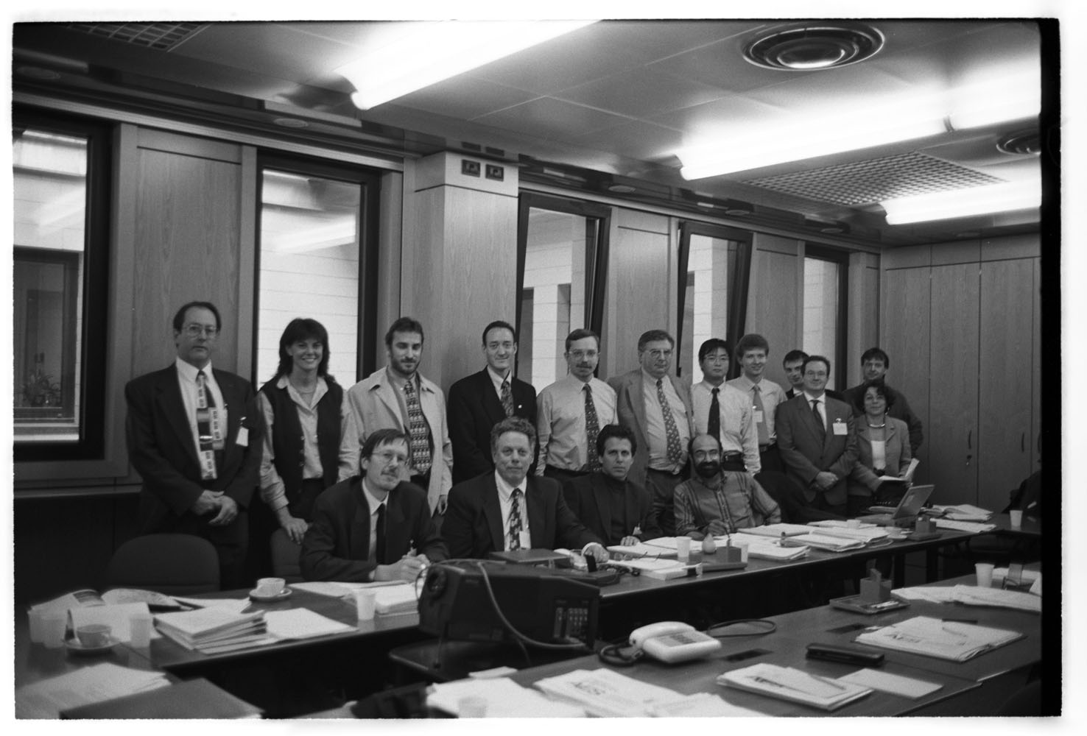
VQEG
Video Quality Experts Group
Founded 1997
  ITU-T SG 12, SG 9, and ITU-R 11E (now 6C) experts
  Web ( www.vqeg.org );
First VQEG meeting
(Turin, Italy 1997)
Notes:
VQEG was born from a need to bring together experts in subjective video quality assessment and
objective quality measurement from industry, government and academia. The first VQEG meeting, held in Turin in 1997, was attended by a small group of experts drawn from ITU-T and ITU-R Study Groups.

Slide 23
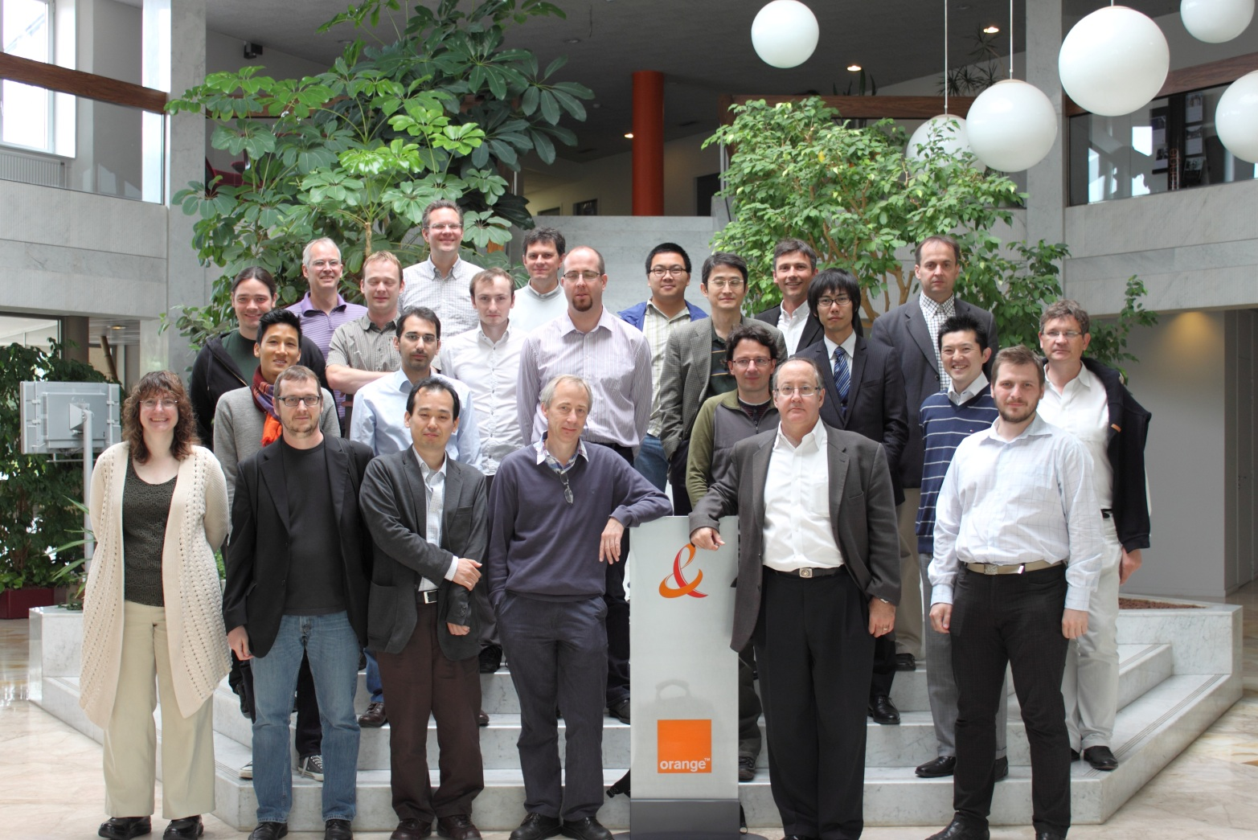
VQEG Rennes 2012
Most recent meeting in Rennes, France 2012

Slide 24
VQEG: Mission and Scope
Primary mission:
  Advance the field of video quality assessment by investigating new and advanced subjective and objective measurement techniques
VQEG does not develop or publish standards
  Conducts tests and reports results to ITU and other standards organizations
  Tests are conducted using specifically defined procedures (i.e., carefully developed test plans).
Notes:
The general motivation of VQEG is to advance the field of video quality assessment by investigating new and advanced subjective, i.e., subjective assessment methods, and objective, i.e., objective quality metrics and measurement techniques.
VQEG does not develop or publish standards, rather VQEG conducts tests and reports results to ITU and other standards organizations.
VQEG aims at providing a forum where algorithm developers and industry users can meet to
plan and execute validation tests of objective perceptual quality metrics as well as to develop new subjective methods. Prior to the formation of
VQEG, there was no recognized route for evaluating the predictive performance of objective
video quality metrics. Over the years, VQEG has developed a systematic approach to validation
testing which typically includes the collection of several subjective databases whose results are
to be predicted by the objective video quality models under examination. An important element
of the VQEG approach is the formulation of test plans that clearly and specifically define the
procedures for performing objective model validation. These test plans describe the format and
range of source content, the scope and nature of degradations that may be applied to the source
content, the subjective test methods to be used to collect the subjective data, the test laboratories
who perform the subjective assessment tests, the type of objective quality models that may be
submitted for the purpose of model validation, the submission procedures of the objective quality
models, and finally the statistical techniques and model evaluation metrics to be used.
Importantly, the test plans are approved by consensus among all VQEG participants - including
model proponents, subjective test labs, industry representatives, academia, and representatives of
several Standards Developing Organizations (SDOs).

Slide 25
VQEG: Characteristics
Unofficial, with links to several standards organizations
Technical group, open to all
No dues, no staff, all volunteer effort
600 email accounts on the main VQEG email list
Most documents and information open to all (but some restrictions on test materials)
Physical meetings have 25 to 45 participants

Slide 26
VQEG Projects
Completed
  FRTV I & II (5 ITU Recommendations)
  Multimedia I (7 ITU Recommendations)
  RRNR (3 ITU Recommendations)
  HDTV I (2 ITU Recommendations)
Active:
  3DTV (3 ITU Recommendations in progress)
  Joint Effort Group—JEG-Hybrid
  Hybrid Perceptual/Bitstream (3 ITU Recommendations in progress)
  Multimedia II—MM2 (1 ITU Recommendation in progress)
  Quality for Recognition Tasks—QART (Public Safety) (1 ITU Recommendation)
Ramping up
  High Dynamic Range Video—HDR
  HDTV Phase II—HDTV2
  Monitoring of Audio Visual Quality by Key Indicators—MOAVI
  Real-Time Interactive Communications Evaluation—RICE

Slide 27
VQEG/Standardization Process
Standards & Reports
ITU-T &
SG9, SG12, SG16
ITU-R
, WP6C
Other Standards Orgs
ATIS, IEEE, ETSI, MPEG
VQEG
Industry & Academia
Results

Slide 28
VQEG Timeline and Future Activities
3DTV
HYBRID
HDTV-I
HDTV2
Multimedia
MM2
HDR
RICE
RRNR-TV
MOAVI
FRTV-II
QART
FRTV-I
JEG-Hybrid
1996
1998
2000
2002
2004
2006
2008
2010
2012
Notes:
Completed
FRTV I & II (Full Reference Television)
Multimedia I
RRNR (Reduced Reference – No Reference Television)
HDTV I (High Definition Television Phase I)
Active:
3DTV (3D Television)
Joint Effort Group—JEG-Hybrid
Hybrid Perceptual/Bitstream
Multimedia II—MM2
Quality for Recognition Tasks—QART (Public Safety)
Ramping up
High Dynamic Range Video—HDR
HDTV Phase II—HDTV2
Monitoring of Audio Visual Quality by Key Indicators—MOAVI
Real-Time Interactive Communications Evaluation—RICE

Slide 29
VQEG and ITU Recommendations
VQEG Project | ITU-T SG9 Recommendation | ITU-R SG6 Recommendation
FRTV-I | J.143 (2000), J.144 (2001), J.149 (2004)
FRTV-II | J.144 revised (2004) | BT-1683 (2004)
Multimedia | J.148 (2003), P.910 revised (2008), J.246 (2008), J.247 (2008), J.340 (2010) | BT-1866 (2010), BT-1867 (2010)
RRNR-TV | J.244 (2008), J.249 (2010) | BT-1885 (2011)
HDTV-I | J.341 (2011), J.342 (2011)
QART | P.912 (2008)
Hybrid and JEG-Hybrid | J.bitvqm, J.mm-noref, J.noref
3DTV | J.3D-disp-req, J.3D-fatigue, P.3D-sam
MM2 | J.av-dist

Slide 30
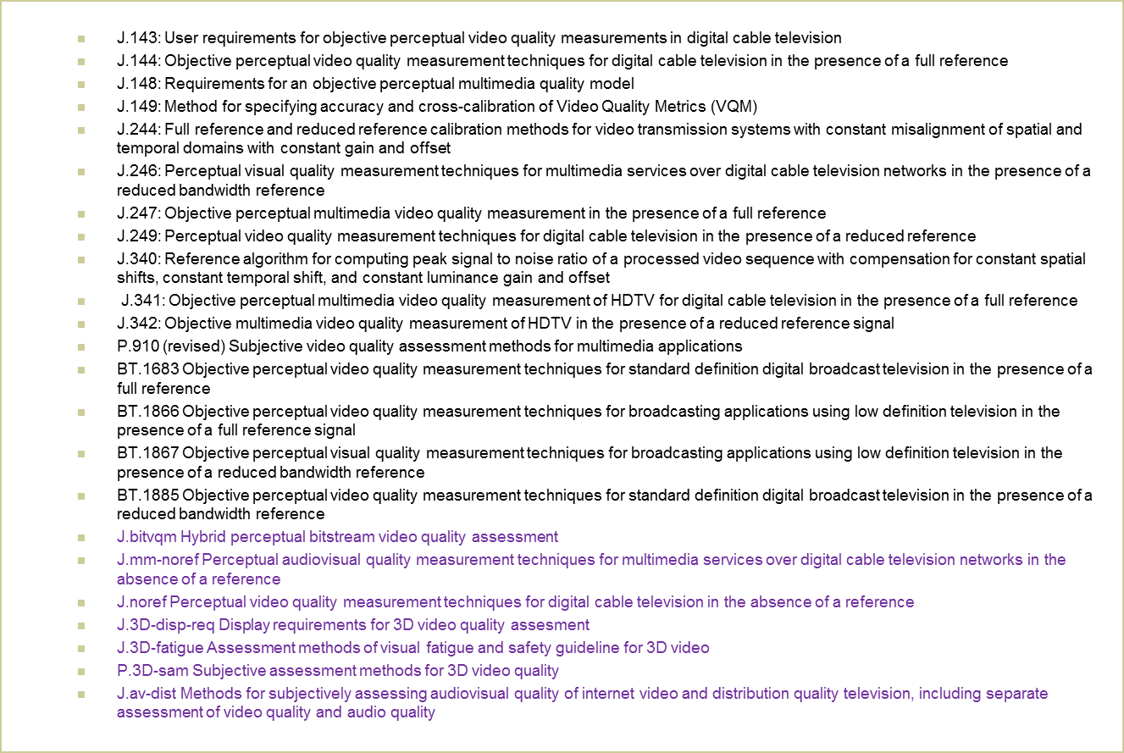
SG9 & WP6C Recommendations resulting from VQEG projects--List

Slide 31
Conclusions
Visual Quality Assessment Standards:
  Multi-stakeholder environment
    Standards Orgs, Industry, Forums, Academia
  Most standards developed in ITU and ATIS with VQEG providing technical support and guidance
  Need for additional Standards
    Academic research accelerating
    Video delivery channels increase Standards needs increase
    Even more Standards coordination needed
    Public Safety Video Quality growing in importance
VQEG is a good place to start

Slide 32
Some Additional Groups
SDOs, Fora, and Conferences
  ICIP, of course
  VQiPS (Public Safety Video Quality)
  VSF (Video Services Forum)
  IEEE P.3333 (3DTV)
  I3DS & 3D@Home
  MPEG (Codec Development)
  ITU-T SG16 (Codec Development)
  ETSI STQ
  IEC/TC100/TA11
  EU COST Project Qualinet
  QoMex (International Workshop on Quality of Multimedia Experience)
  VPQM (International Workshop on Video Processing and Quality Metrics for Consumer Electronics)
  SPIE
  IETF mbone and cdni

Slide 33
Useful Links
http://www.itu.int/ITU-T/index.html
http://www.itu.int/ITU-T/studygroups/com09/index.asp
http://www.itu.int/ITU-T/studygroups/com12/index.asp
http://www.itu.int/en/ITU-T/publications/Pages/recs.aspx
http://www.itu.int/ITU-R/index.asp?category=study-groups&rlink=rwp6c&lang=en
http://www.atis.org/
http://www.vqeg.org

Slide 34
Questions?
Arthur Webster
webster@its.bldrdoc.gov

