Slide 1
VQEG Rennes meeting june 2012
HDR imaging and video quality
P. Le Callet / M. Perreira Da Silva

Slide 2
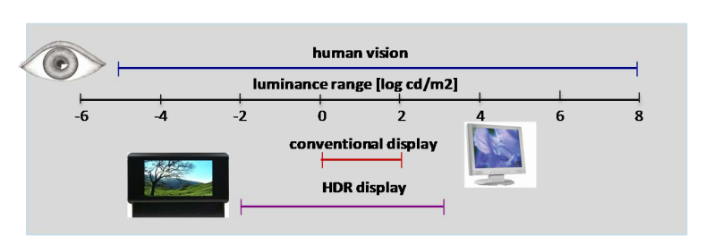
What is HDR ?
Dynamic range is a mix of contrasty and maximum luminance
Current LCD dynamic range
2⁸ levels but
max brightness of 500 cd/m² and 1:1000 max contrast ratio
this contrast ratio represents only 3 orders of magnitude
Human eyes can adapt from ~10⁻⁶ to 10⁶cd/m2 but only 5 orders of magnitude at a time
Aim of HDR imaging : capture and display these 5 orders of magnitude with high fidelity

Slide 3
HDR capture
Digital camera dynamic rang is 2⁵ to 2⁹
Recent DSLR up to 2¹⁴ (the limit of 14bits sampling)
For higher dynamic range, multiple images fusion is necessary
usually multiple exposures are fused
For video, multiple cameras / sensors a used
Special video rig
+
+
+

Slide 4
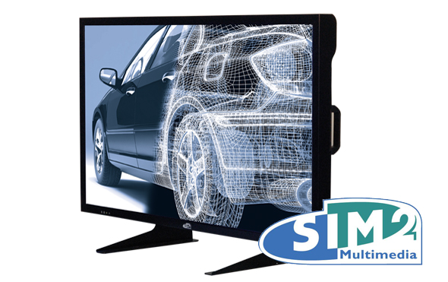
HDR display(s)
Dolby patent
Only one display : sim2 HDR47
max luminance : up to 4000cd/m²
max (ANSI) contrast : >20.000:1
36 bits per pixel
8 bits per color LCD panel control
Plus 12 bits leds panel control (2202 individual leds)

Slide 5
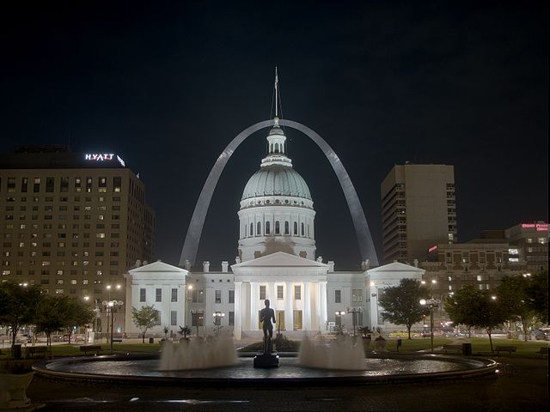
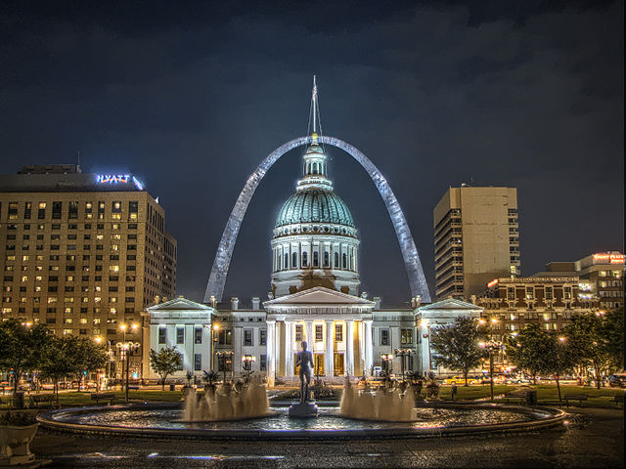
Tone mapping (HDR->LDR)
HDR images cannot be displayed on LDR screens
Simple contrast reduction is not efficient
A « tone mapping » operator must be applied
simple contrast reduction
with local tone mapper

Slide 6
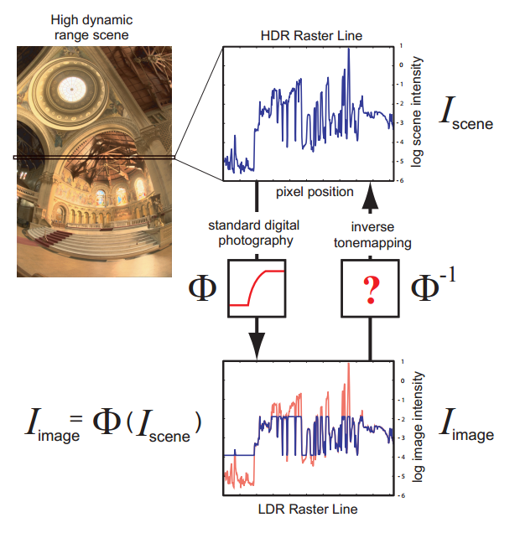
Inverse Tone-mapping (LDR->HDR)
How do we display LDR content on a HDR display ?
Simple lightness rescaling is not sufficient
Need for inverse tone-mapping operators

Slide 7
HDR and quality : new issues
Almost no native HDR capture device
Building HDR content from multiple LDR images causes some defects
Ghosting in over exposed area
Alignment / geometrics distortions (HDR rig)
Lens flares problems between cameras
Noise due to large difference between the different exposures

Slide 8
HDR and quality : new issues
Using a HDR display…
Much higher luminance than usually used in lab experiments
For LDR content, typical environmental illuminance is 200 lux (ITU-R BT.500)
How much light is necessary for HDR ?
Does it have to be dynamically adapted according to the mean luminance of the screen ?
Need for non normalized experiment rooms ?
HDR display not easy to feed (for better control LCD panel and backlight data should be addressed separately)
Almost no HDR video player available
HDR screen is not transparent : need to be studied
A « new » technology with its own defects (ex: LEDs bleeding)

Slide 9
HDR and quality : new issues
HDR displays are not widely available
Using a LDR display for HDR content implies new issues
Need to apply a tone mapping operator
Many operators with many parameters
Hard for find a good set of « universal » parameters
Tone mapping are not neutral
Effect on quality and artistic intention
Most tone mapping operator are built for still images. Big issues with videos because of max luminance changes…

Slide 10
HDR content transport and coding
How many bits for representing HDR data ?
What are the effects of quantization ?
Need high bit depth coder
H.264 is limited to 14 bits
HEVC ?
Which transport strategy ?
A single HDR channel ? Multiple LDR ones ?
LDR fallback possible ?
Influence on perceived quality

Slide 11
HDR and QoE
HDR content displayed on HDR display
Better immersion ?
More natural images ?
More emotions conveyed ?
Visual fatigue due to high luminance ?

Slide 12
The Nevex Project
French FUI projet
Partners : TF1, Binocle, Transvideo, IRISA, IRCCyN-IVC, Thomson Video Network, Technicolor, Telecom ParisTech, AccepTV, DxO, Polymorph Software
Started in october 2012 – will end in march 2015
Objective : Study and evaluation of a full HDR chain (from capture to display through encoding, transport and decoding)

