Slide 1
Guidelines for use of NICT 3D Contents (Draft Version)
Jun Okamoto (NTT)

Slide 2
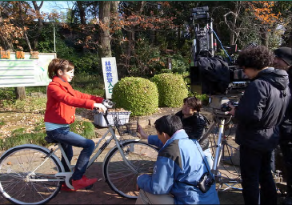
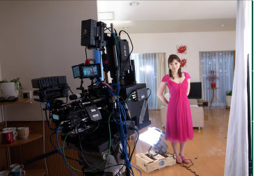
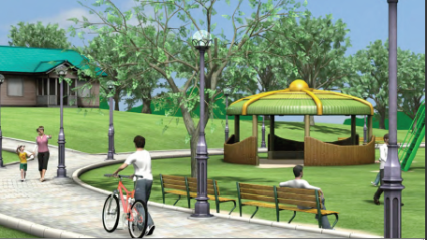
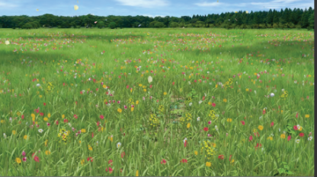
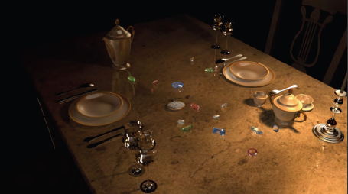
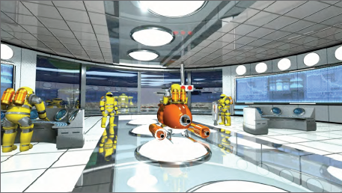
0. Contents overview (1/2)
Ultra-high resolution stereo 3D contents [3.5TB] (Indoor:1.5TB, Outdoor:1.5TB, Digest:1.0TB)
Ultra high quality 3D contents made using ultra-high resolution stereo camera (4K3D)
2) 3D CG contents [22GB(+43GB)]
High resolution CG model scenes and CG movies (6 scenes)
Outdoor
Indoor

Slide 3
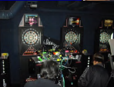
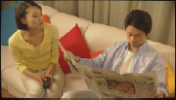
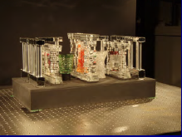
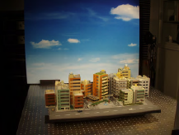
0. Contents overview (2/2)
3) 3D contents made using range cameras [370GB]
Flexibly convertible depth image contents
4) 3D contents made using scanning cameras [103GB]
Contents made using a dense array of cameras with full parallax
Captured using 3 cameras (left, right, renge),
And created the depth images
Living
Office
Dance
Darts
There are images as the following:
- Horizontal 150 view point,
- Vertical 100 view point
Crystal
Diorama
There are the detail information at http://3d-contents.nict.go.jp/ (only Japanese)

Slide 4
1. Scope and prohibitions
Scope of usage:
1) Assessment and management for research and development in related devices.
2) Industry standardization analysis and educational quality evaluation.
3) Assessment and management during production, editing and screening.
4) Display in trade fairs and exhibitions.
Prohibitions:
1) Redistribution and copying for users not included in the license agreement.
2) Display, broadcast and distribution for commercial purposes.
3) Re-editing (altering and plagiarising).

Slide 5
2. Report and period of usage
Submission of report of use：
1) For video screening in trade fairs and exhibition, a report of usage must be submitted every six months.
2) For presentation in academic meetings of research and development based on these contents or in industry standardization activities, a report of presentation activities must be submitted every six months.
Period of use：
Usage of contents is allowed only until the end of March 2011. If no notice of termination will be sent within three months from the date of expiration, license period will automatically be extended for one year.

Slide 6
3. Reminders/precautions
1) For public screening, the entire content must be shown, from the opening to the closing credits.
2) In writing reports for results of research activities, the enclosing frame numbers or time codes of the segments used must be specified, and the nickname “3D contents” must be written to indicate the source, in case only portions of the contents are used.
3) All contents were produced by the National Institute of Information and Communications Technology (NICT) during FY2009; prior permission from NICT must be obtained for usage and copyright issues not specified in this notice.

Slide 7
4. Additional information
- When the format is changed (e.g. from 4K to HD) or when compression or decompression is done, details of the changes must be indicated during exhibition.
Example: “4K 3D contents from NICT were converted to JPEG2K scalable video codec and displayed in VGA size…”
- The 3D contents are not for redistribution but if you wish to distribute to members of industry standards body and similar organizations, please request permission for it.
- Please contact NICT for inquiries about cases not covered in the scope and prohibitions indicated here.
- NICT does not offer support for conversion of distributed contents.

Slide 8
5. Other
- If you want to access NICT 3D contents, please send me (okamoto.jun@lab.ntt.co.jp) the following information.
1) The name of organization
2) Requested contents
3) Contact information (person, email, tel, address)
- The flow of copying process (TBD)
I plan one organization receives and copy it, one send next organization. Is there the better way?
Please prepare the 6TB USB3.0 HDD (If you use USB2.0 environment, you needs 1week for copying.)
- Proposal
Can we (VQEG) make these sequences (including orange Lab, intel) ITU standards as ITU-R BT.1210?

